Slide 1
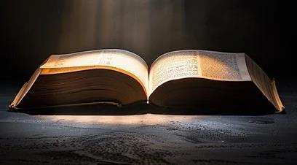
The Open Book
GENESIS 49:1
And Jacob called unto his sons, and said, Gather your-selves together, that I may tell you that which shall befall you in the last days.

Slide 2
Birthdays & Anniversaries in January
January 6th Mike Pritchard
January 12th Jessie Cockman
January 13th Lincoln Clayville
January 13th Nomsa Chikoro

Slide 3
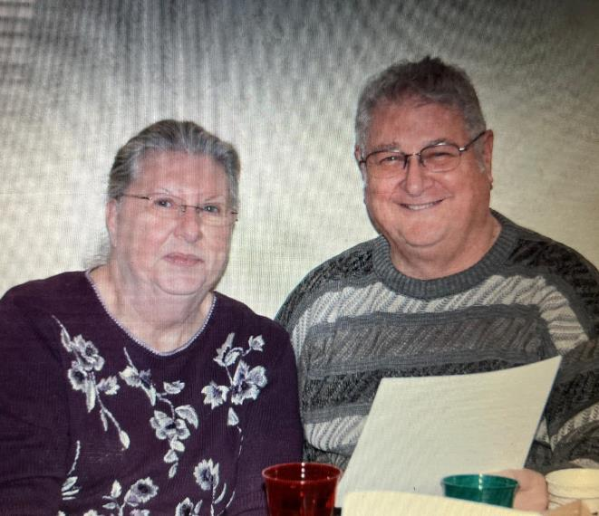
Bro. & Sis. Smith

Slide 4

Two Are Better Than One
Marriage Enrichment
Weekend
Feb. 14-16th
Hickory Bible Tabernacle
Topic one
Topic two
Topic three
Topic four
Topic five

Slide 5
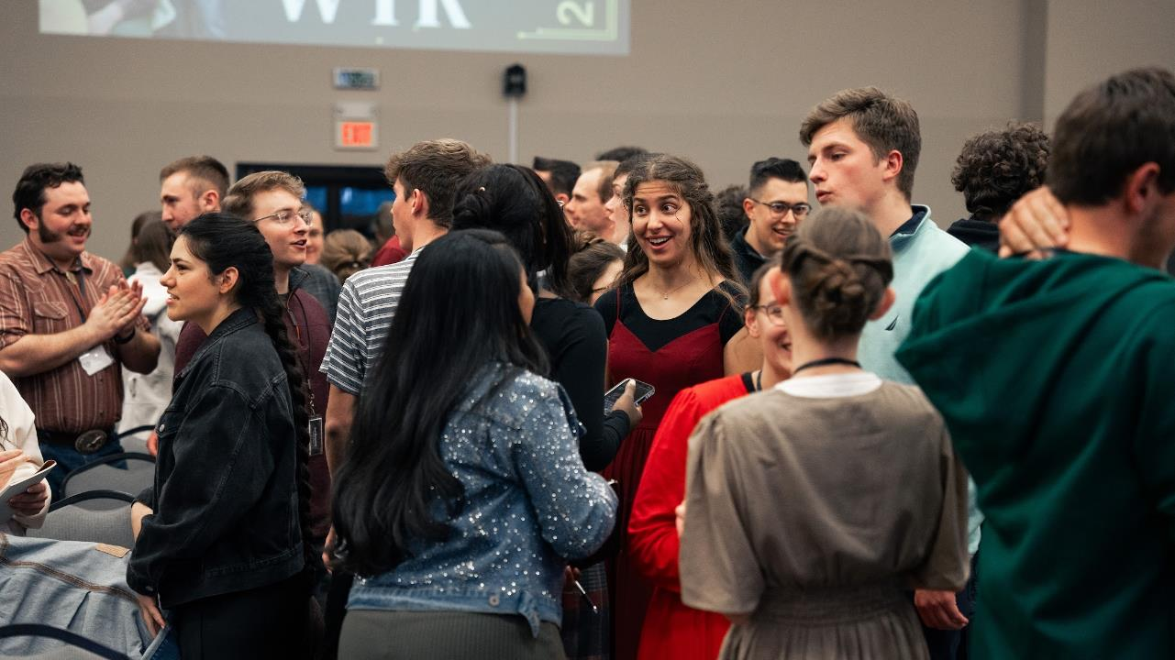
WYR 2024

Slide 6
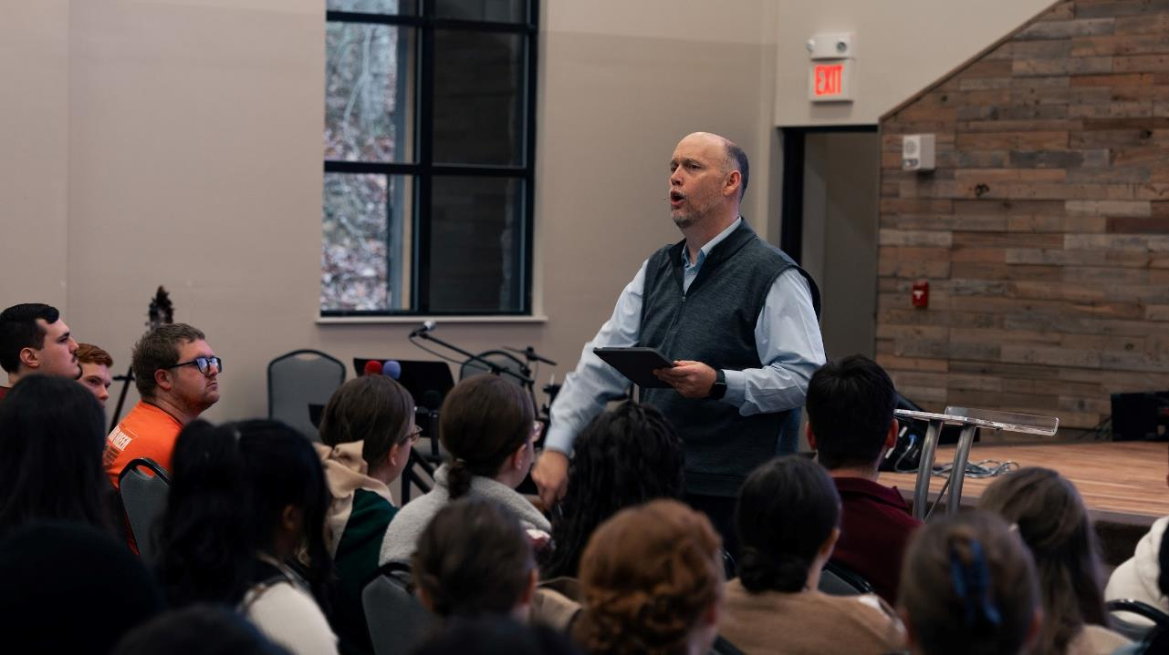

Slide 7
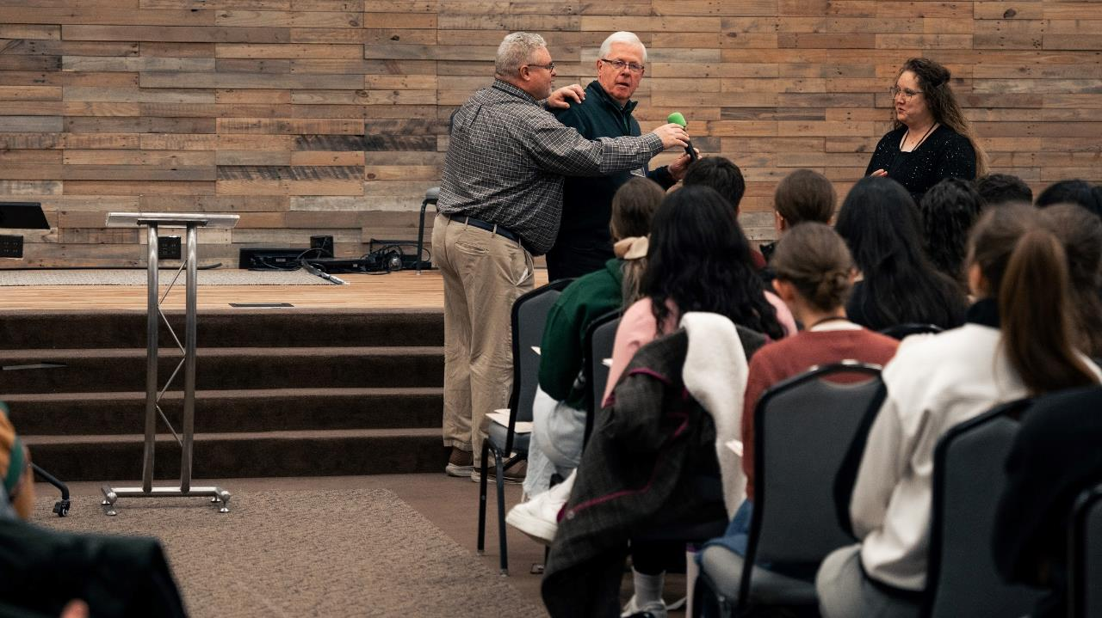

Slide 8
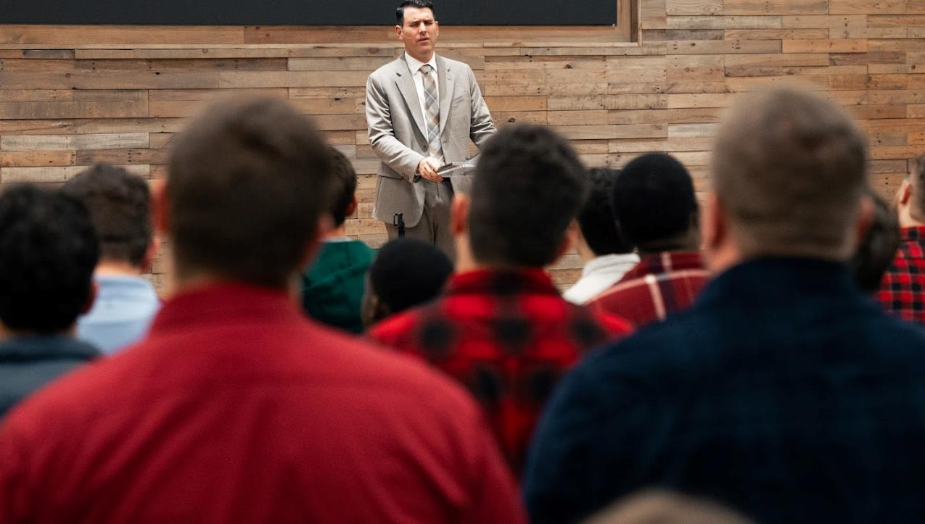

Slide 9
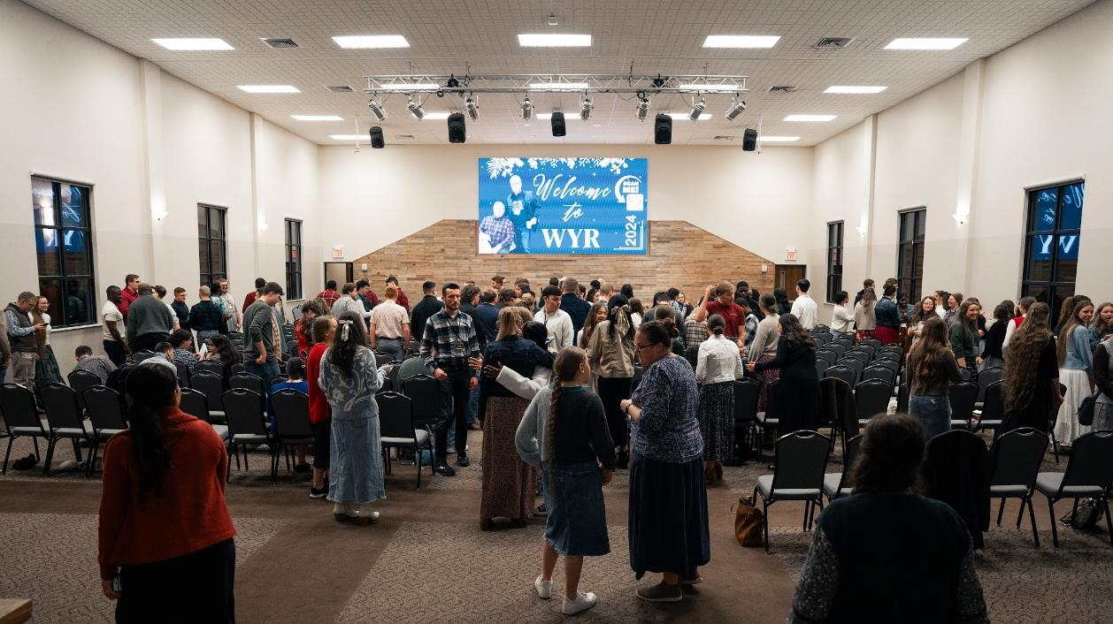

Slide 10
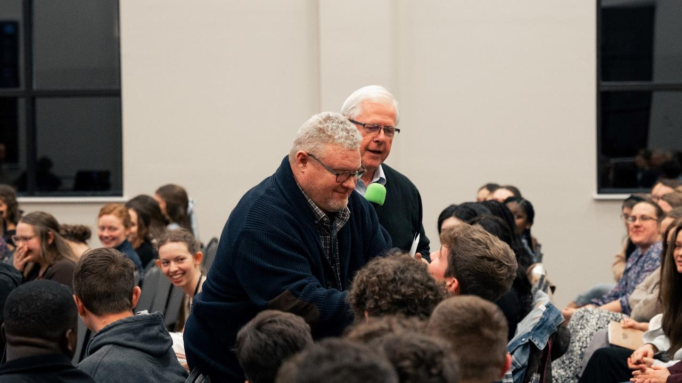

Slide 11
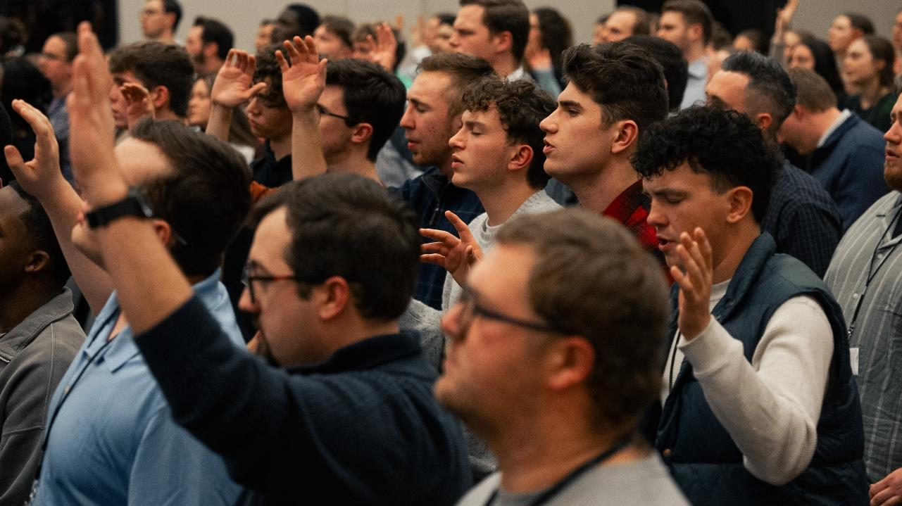

Slide 12
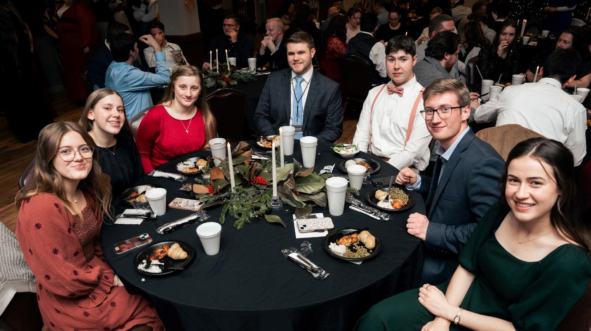

Slide 13
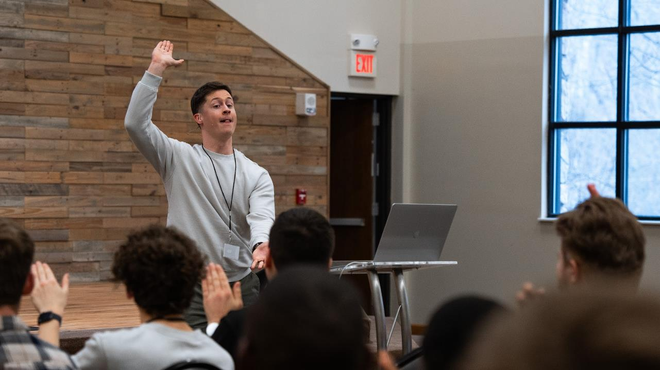

Slide 14
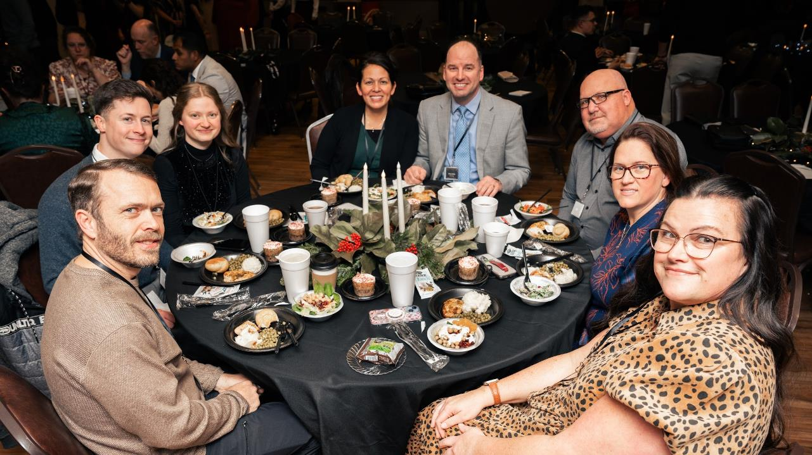

Slide 15
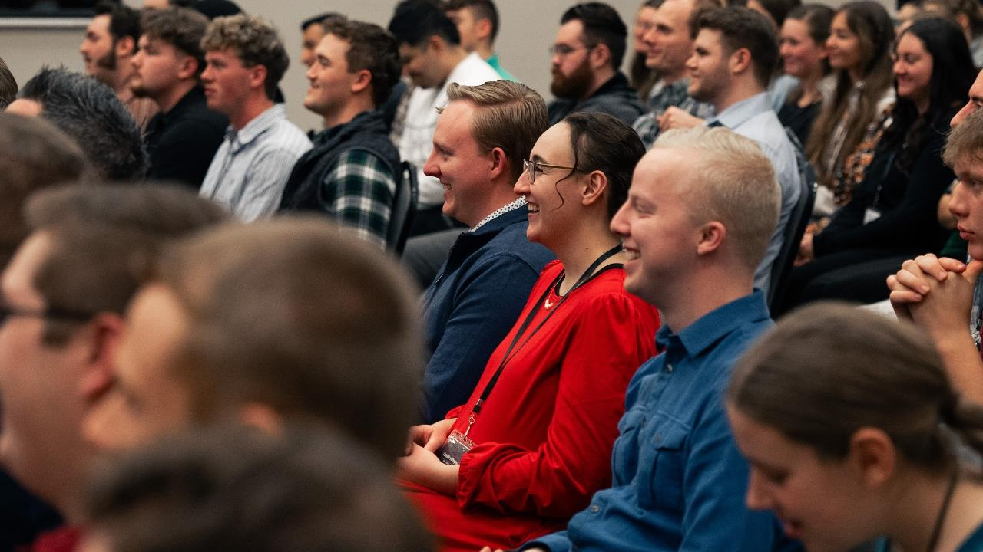

Slide 16
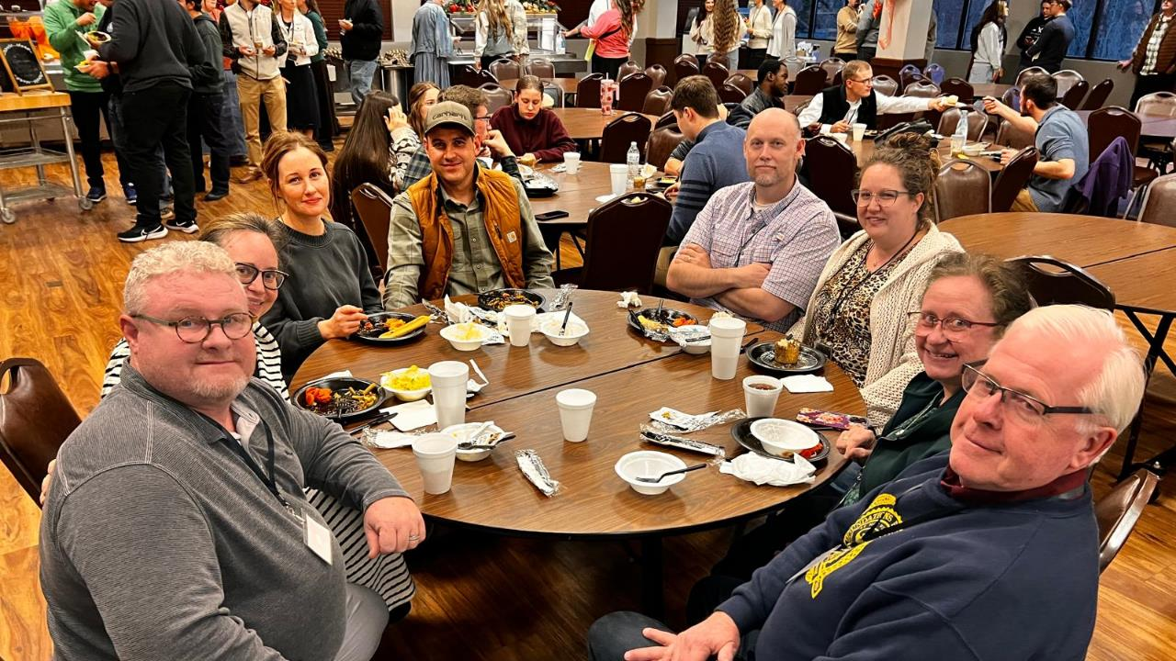

Slide 17
The Open Book Genesis 49:1
EPHESIANS 1:17-18
That the God of our Lord Jesus Christ, the Father of glory, may give unto you the spirit of wisdom and revelation in the knowledge of him: 18 The eyes of your understanding being enlightened; that ye may know what is the hope of his calling, and what the riches of the glory of his inheritance in the saints,

Slide 18
WHEN.DIVINE.LOVE.IS.PROJECTED
SOVEREIGN GRACE.TAKES.ITS.PLACE
7 And now, Father, may the Holy Spirit take the Word, open the Book, and loose the power of the Spirit in the Word, and may it find Its resting place in each heart. Amen. 57-0126

Slide 19
The First Seal
26 Now the Book is a revelation. So, a revelation is something that's made known of something that's been revealed. And now (notice, so you won't forget it!), it is closed up until the latter time. The whole mystery of it is closed up until the latter time.
63-0318

Slide 20
HEALING.AND.WHAT.SICKNESS.IS
11 Now, there may be things that God has added to the church, which stimulate faith. But when I'm gone, healing isn't gone. Healing ought to be more than it was 'fore we come here. That's the purpose, is to get the people in their mind in the spirit of the latter days...
We're in the latter day. We are. The world is in the spirit of the latter days. But the church is not in the latter day Spirit yet.

Slide 21
In other words, we may be in a portion... Look: eating, drinking, marrying, giving in marriage, and all the immorals there is in the world. The devil sent down his troops in the latter day spirit.
But we ministers haven't got the church yet in that Spirit. And we must be in that condition in order to be caught away in the rapture… 50-0808

Slide 22
The Righteous Branch
ISAIAH 11:1-3
And there shall come forth a rod out of the stem of Jesse, and a Branch shall grow out of his roots: 2 And the spirit of the LORD shall rest upon him, the spirit of wisdom and understanding, the spirit of counsel and might, the spirit of knowledge and of the fear of the LORD; 3 And shall make him of quick understanding in the fear of the LORD: and he shall not judge after the sight of his eyes, neither reprove after the hearing of his ears:

Slide 23
I CHRONICLES 22:11-13
Now, my son, the LORD be with thee; and prosper thou, and build the house of the LORD thy God, as he hath said of thee. 12 Only the LORD give thee wisdom and understanding, and give thee charge concerning Israel, that thou mayest keep the law of the LORD thy God. 13 Then shalt thou prosper, if thou takest heed to fulfil the statutes and judgments which the LORD charged Moses with concerning Israel: be strong, and of good courage; dread not, nor be dismayed.

Slide 24
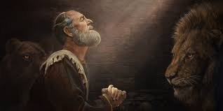
Daniel
DANIEL 1:19-20
And the king communed with them; and among them all was found none like Daniel, Hana-niah, Mishael, and Azariah: therefore stood they before the king. 20 And in all matters of wisdom and understanding, that the king enquired of them, he found them ten times better than all the magicians and astrologers that were in all his realm.

Slide 25
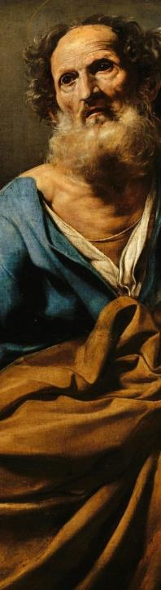
EPHESIANS 1:15-18
Wherefore I also, after I heard of your faith in the Lord Jesus, and love unto all the saints, 16 Cease not to give thanks for you, making mention of you in my prayers; 17 That the God of our Lord Jesus Christ, the Father of glory, may give unto you the spirit of wisdom and revelation in the knowledge of him: 18 The eyes of your understanding being enlightened…

Slide 26
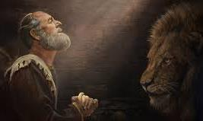
DANIEL 12:8-10
And I heard, but I understood not:
then said I, O my Lord, what shall
be the end of these things? 9 And
he said, Go thy way, Daniel: for the
words are closed up and sealed till
the time of the end. 10 Many shall be purified, and made white, and tried; but the wicked shall do wickedly: and none of the wicked shall understand; but the wise shall understand.
Sealed = Locked Up

Slide 27
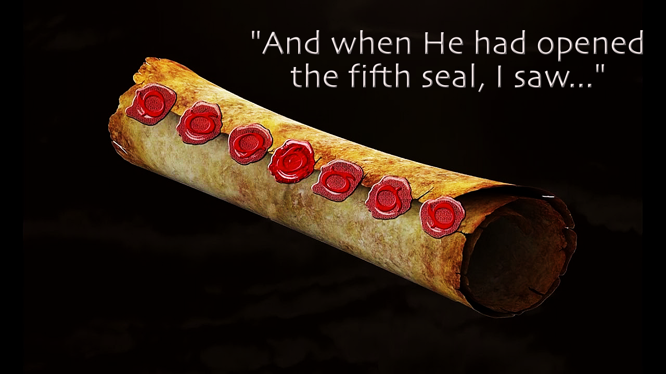
REVELATION 5:1
And I saw in the right hand of him that sat on the throne a book written within and on the backside, sealed with seven seals. 2 And I saw a strong angel proclaiming with a loud voice, Who is worthy to open the book, and to loose the seals thereof?

Slide 28
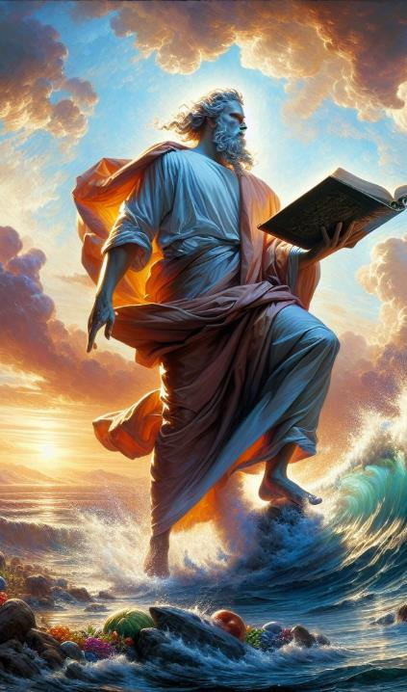
REVELATION 10:1-3
And I saw another mighty angel come down from heaven, clothed with a cloud: and a rainbow was upon his head, and his face was as it were the sun, and his feet as pillars of fire: 2 And he had in his hand a little book open: and he set his right foot upon the sea, and his left foot on the earth, 3 And cried with a loud voice, as when a lion roareth: and when he had cried, seven thunders uttered their voices.

Slide 29
WORKS.IS.FAITH.EXPRESSED
293 Abraham wasn't in Sodom, he was already called out. And there was One stayed and talked to him! Now, that brings to pass today, because we have faith. And I know this is of God, is because this and other Scriptures point to this hour. Revelation 10, said that "in the hour of the seventh angel's Message, when he begins to sound forth his Message," not in a healing service, but the Message that follows the healing service. 65-1126

Slide 30
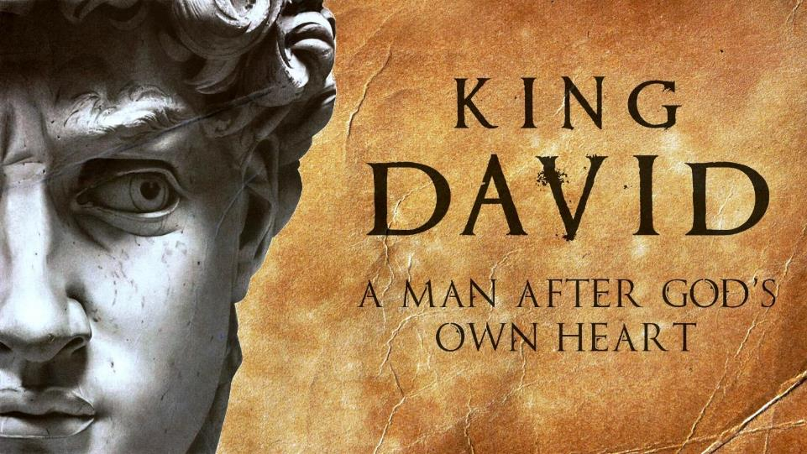

Slide 31
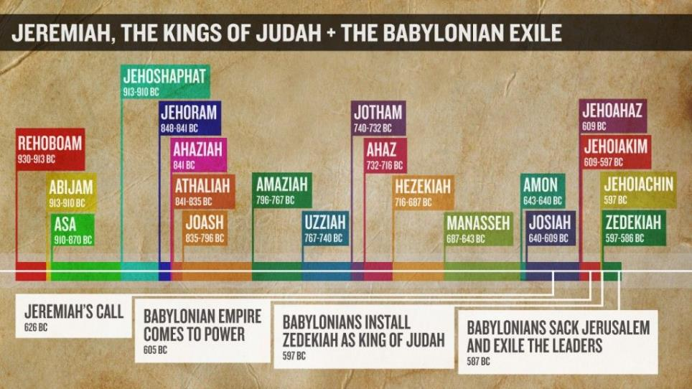

Slide 32
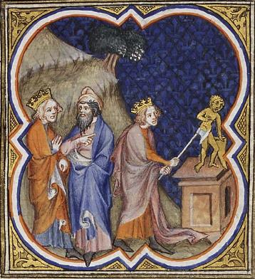
King Asa Destroying Idols
אָסָא Asa‎‎
His reign is dated between 913-910 BC to 873-869 BC
Great, Great Grandson of David
Great Grandson of Solomon
Grandson of Rehoboam
Father of Jehoshaphat

Slide 33
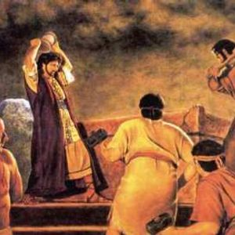
King Josiah Destroying Idols
אָסָא Josiah‎‎
Reign is dated 641-610 BCE
The Bible describes him as a righteous king, a king who "walked in all the way of David his father and turned not aside to the right hand or to the left" (2 Kings 22:2; 2 Chron. 34:2). Mentioned in the genealogy of Jesus, ( Matt. 1:10–11).

Slide 34
II KINGS 23:24-25
24 Moreover the workers with familiar spirits, and the wizards, and the images, and the idols, and all the abominations that were spied in the land of Judah and in Jerusalem, did Josiah put away, that he might perform the words of the law which were written in the book that Hilkiah the priest found in the house of the LORD. 25 And like unto him was there no king before him, that turned to the LORD with all his heart, and with all his soul, and with all his might, according to all the law of Moses; neither after him arose there any like him.

Slide 35
Character:
Your character is the sum of all the qualities that make you who you are: your values, thoughts, words, your actions.
How your habits, motives, thoughts relate to morality, particularly as it concerns integrity or “moral structure,” something you built through virtuous behavior.

Slide 36
Great people are usually judged by their character. ... Having good character means that you have such admirable traits as honesty, responsibility and courage.
It is beneficial for you to have good character. Being honorable and honest in the work you do and in your relations with others are essential in your life.

Slide 37
HEAR.YE.HIM
38 Now, when you're born again, that only puts you in the family. It's your character, your conduct that gives God confidence in you. The reason that we haven't got the great church marching on today, is because God can't find people to put His confidence in… Stay with God's Word. That's God's Truth; that's the Pattern; that's the Blueprint. 57-0519

Slide 38
THINGS.THAT.ARE.TO.BE
112 "I got the baptism, the Holy Spirit." That's just only a temporal gift for you. The real gift is your soul down in there, born of God, and that controls the whole thing to the Word of God and the will of God. And there you grow up, then you're a son and daughter of God…
"Well, I belong to church." That don't mean one thing. "I'm Methodist; my mother." That's good for your mother. 65-1205

Slide 39
II KINGS 22:1-2
1 Josiah was eight years old when he began to reign, and he reigned thirty and one years in Jerusalem. And his mother's name was Jedidah, the daughter of Adaiah of Boscath. 2 And he did that which was right in the sight of the LORD, and walked in all the way of David his father, and turned not aside to the right hand or to the left.

Slide 40
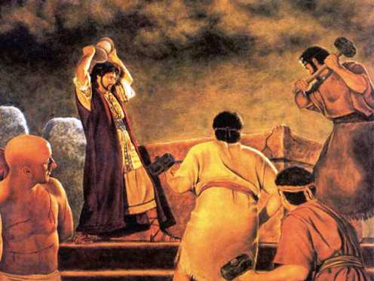
King Josiah
And he cried against the altar in the word of the LORD, and said, O altar, altar, thus saith the LORD; Behold, a child shall be born unto the house of David, Josiah by name; and upon thee shall he offer the priests of the high places that burn incense upon thee, and men's bones shall be burnt upon thee.
I KINGS 13:2

Slide 41
II KINGS 22:10
And Shaphan the scribe shewed the king, saying, Hilkiah the priest hath delivered me a book. And Shaphan read it before the king.
ספר התורה
“The book of the Torah of YHVH by the hand of Moses"

Slide 42
SPOKEN.WORD.ORIGINAL.SEED
When God creates a man, he’s of His kind. David said, “Thy Word have I hid in my heart that I sin not against You.” Only thing he needed was the rain. David would’ve been all right if he could just had that rain, but the Holy Ghost wasn’t yet given. He had the Word, the Word was in him, and he could know It; he said, “I’ve hid It in my heart, Lord. It won’t bloom out and act like It should, but I’ve hid It there Lord.” But when Jesus came, which was the Word made manifest took the germ life out of it… And if David’s cup run over, what ought ours to do? 62-0318

Slide 43
The Effect of the Open Book
LUKE 4:16-19

Slide 44
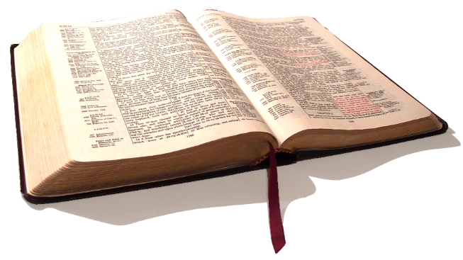
GOD'S.POWER.TO.TRANSFORM
…But since the opening of those Seven Seals, of them Angels just behind the mountain yonder, This has become a new Book. It's the things that's been hid, is being revealed as God promised in Revelation 10, He would do it.
And we are the privileged people that God has chosen, of the earth, that we might see and understand these things…
65-0911

Slide 45
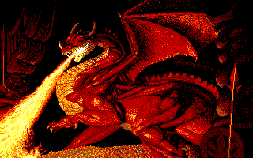
Triple Anointing of the Antichrist
Religious
Political
Demon powers
POSSESSING.THE.GATE.OF.THE.ENEMY.AFTER.TRIAL
153 The whole system has become polluted, the world system, church system, political system. Politics is so corrupted… everywhere are dictators, it's all corruption. The church has become the same way. Families have become the same way. It's just corruption, Sodom! 64-0322

Slide 46
FROM.THAT.TIME
47 …But there is something that, one time you can meet some a certain time and everything will be changed. That's when you meet God, and from that time you're a changed person. A man can meet God and say, "From that time..." You will never be the same after you meet Jesus Christ. Let me assure you that; you'll never, never be the same after you meet Jesus. Then you'd always refer back, "From that time...” 60-0716

Slide 47
MICAH 4:1-4
But in the last days it shall come to pass, that the mountain of the house of the LORD shall be established in the top of the mountains, and it shall be exalted above the hills; and people shall flow unto it. 2 And many nations shall come, and say, Come, and let us go up to the mountain of the LORD, and to the house of the God of Jacob; and he will teach us of his ways, and we will walk in his paths: for the law shall go forth of Zion, and the word of the LORD from Jerusalem.

Slide 48
3 And he shall judge among many people, and rebuke strong nations afar off; and they shall beat their swords into plowshares, and their spears into pruninghooks: nation shall not lift up a sword against nation, neither shall they learn war anymore. 4 But they shall sit every man under his vine and under his fig tree; and none shall make them afraid: for the mouth of the LORD of hosts hath spoken it.

