Slide 1

If I Was A Single In the Message Today 2
PSALM 139:15-16
Thine eyes did see my substance, yet being unperfect; and in thy book all my members were written, which in continuance were fashioned, when as yet there was none of them.

Slide 2
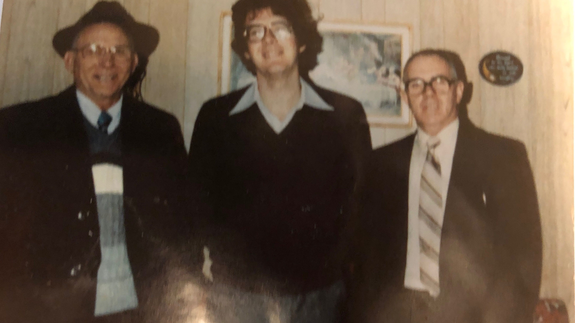

Slide 3

THY.HOUSE
67 These little studies in the Scriptures really could help us. It can strengthen you and make you strong, mighty men.
61-0808

Slide 4
Goals for Young Men
Spiritual Life
Establish Good Moral Boundaries
Stewardship & Mentorship
Pursuing Your Calling

Slide 5
If I Were a Girl…
Find a Man…
Find a Man of Purpose.
Find a Man Who Fears God.
Find a Man Who Prays.
Find a Man Who Can Lead.
Stay Under Headship.

Slide 6
HEAR.YE.HIM 57-0125
14 And, oh, how He loves to establish His Word... But really God doesn't do anything just to be, as we would call it, gadding around. God speaks considerably and every Word has a eternal meaning. Every word that proceedeth out of the mouth of God.

Slide 7
QUESTIONS.AND.ANSWERS.ON.GENESIS
48 Now, where did He get the spirit, woman? Genesis 1:26, "Let us make man in our own image..." He made the burly spirit for the man; He made the tender, little, delicate, feminish spirit for the woman.
And when you see a woman acting like a man, she's got out of her place in the beginning. I think it's a shame that women has lost their dainty, feminish place. It's a disgrace…That little ladylike, you don't see her much more; she's a hard person to find. 53-0729

Slide 8
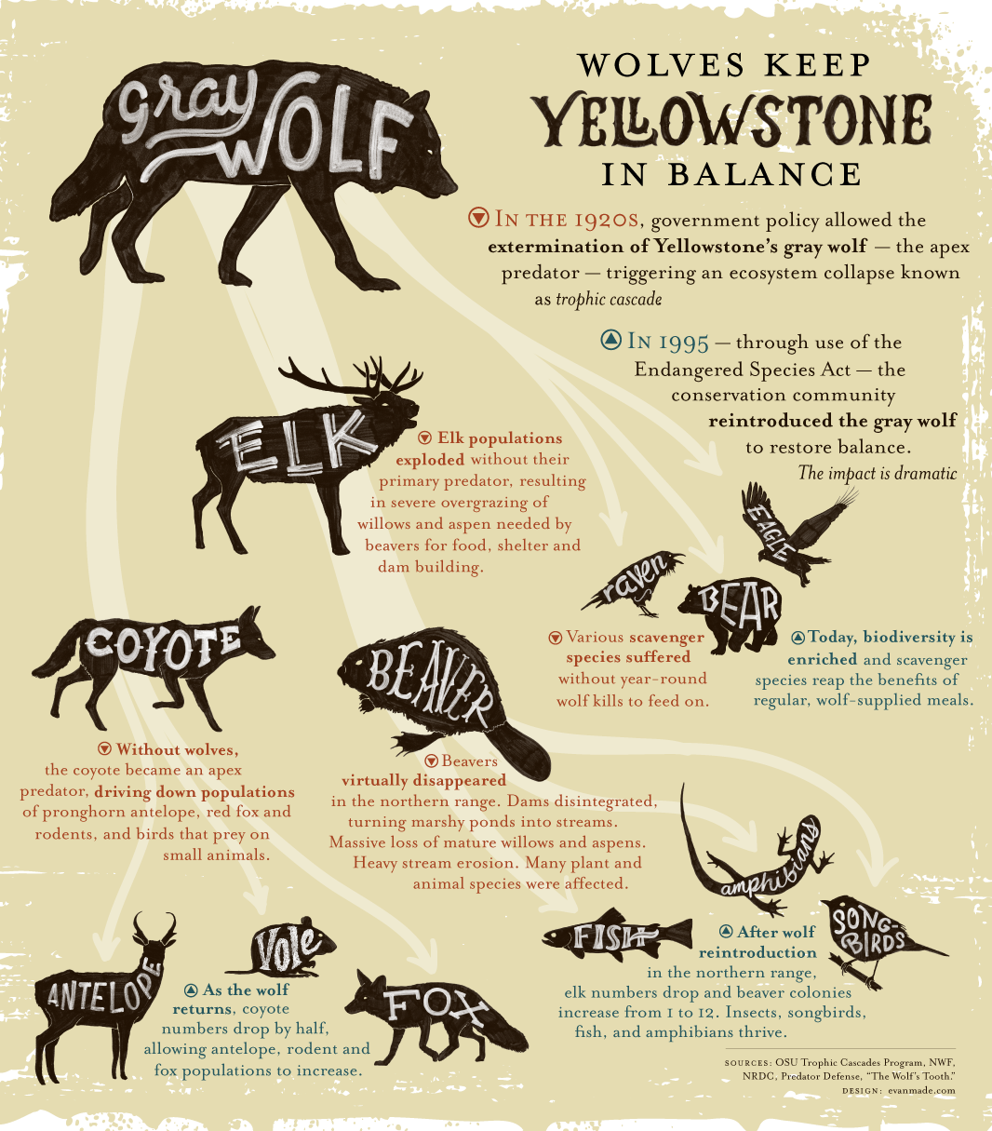
The Balance of
Nature
HE.THAT.IS.IN.YOU
He's the Creator that
speaks it into existence!
He is God! Nature obeys
His Word.
63-1110

Slide 9
Influence:
Once we were born in this earth, there were two things that shaped our early lives:
1. Genetics
2. Environment

Slide 10
PSALM 139:13
For thou hast possessed [created] my reins: thou hast covered [weaved] me in my mother's womb. 14 I will praise thee; for I am fearfully [reverently] and wonder-fully [distinctly] made: marvellous are thy works; and that my soul knoweth right well. 15 My substance was not hid from thee, when I was made in secret, and curiously wrought [skillfully woven] in the lowest parts of the earth.

Slide 11
I KINGS 8:7, 18
For the cherubims spread forth their two wings over the place of the ark, and the cherubims covered the ark and the staves thereof above.
18 And for the altar of incense refined gold by weight; and gold for the pattern of the chariot of the cherubims, that spread out their wings, and covered the ark of the covenant of the LORD.

Slide 12
Female Brains vs Male Brains
Female brains mature earlier and more quickly than male brains;
Girls acquire complex verbal skills earlier;
Corpus callosum is the bundle of nerves that connects the right and left hemispheres
Up to 20% larger in girls than boys;
Gives girls better cross talk between hemispheres.
Notes:
Myelination, a process of coating nerves around the brain shaft with myelin, allowing electrical impulses to travel down each nerve quickly and efficiently, is complete earlier in women than men
AG – 9 - 10

Slide 13
Female Brain has Learning Advantage
Resting female brain is as active as the activated male brain;
Female brain uses its resources quickly, often, and in more places;
Areas of Greater Functioning:
Females are memory and sensory oriented;
Males are spatial tasks and abstract reasoning.
Notes:
AG – 11-12

Slide 14
Use of Language
Females: Produce more words than males;
Prefer ideas conceptualized in normal language with concrete details;
Males:
Use fewer words and often work silently;
Find jargon and coded language more interesting.
Groups
Equal in word use in female groups;
1 or 2 dominating males speak more.
Notes:
AG - 17

Slide 15
Use of Symbolism
Both boys and girls like pictures, but boys often rely on them in their learning be-cause they stimulate the right hemisphere where many boys are more developed.
Boys like symbolic texts, diagrams, and graphs because of the coded quality;
Girls prefer written texts.
Notes:
AG - 20

Slide 16
Classroom Behavior
Boys are louder, more physically aggressive, more competitive, prone to attention-getting behavior;
Boys are less mature;
Girls are more quiet, passive and sendentary than boys;
Girls have longer attention spans than boys
Notes:
AG - 23-24

Slide 17
Reading & Writing Competence
Girls are approx. 1.5 years ahead of boys in reading and writing at all school levels;
Boys are dominant in certain aspects of math and science due to brain structure;
Improved instruction is necessary for boys in reading and writing, as well as for girls in math and science.
Notes:
AG 24

Slide 18
Tests
Boys score slightly higher on SATs;
Males are slightly better at storing single-sentence information than females;
Male brains have a visual advantage in working with and making quick deductive decisions on lists;
Female brains think more inductively and need substantial information to make a decision;
Females have the advantage on essay questions.
Notes:
AG 24-25

Slide 19
Girls are more likely to express and detail negative feelings and experiences;
Boys are reluctant to share feelings about any experience or details about a painful experience.
In girls, oxytocin is more constantly stimulated in females, making them capable of quick empathetic responses to others’ pain and need.
Notes:
AG - 28

Slide 20
2. (Environment) COME.FOLLOW.ME
39 No doubt that this kid was born in a good home, like you kids are. He was brought up with good parents. Cause, it proved it, when Jesus presented to him the commandments of God. He said, "I've kept these since a youth…" He had been brought up right.. Probably come up under a God-fearing mother and daddy, to teach him right, when he was a kid. Well, that's good.
63-0601

Slide 21
The Family is meant to be the primary place for
training for children and the “Shock Absorber”
from the harsh realities of life at an early age.
In 2023, there were 23,531,000 children living in
single-parent families in the United States, which is
about 34% of all children in the country.
This is a significant increase from 1960, when only
9% of children lived in single-parent families.

Slide 22
“What Happens When A Generation Never Grows Up?
As American 30-somethings increasingly bypass the traditional milestones of adulthood, economists are warning that what seemed like a lag may in fact be a permanent state of arrested development.
By Rachel Wolfe Dec 31, 2024
“It feels like the instructions for how to live a good life don’t apply anymore, And nobody has updated them.” Now, as a mix of social and economic factors holds back an entire generation, what researchers once called a lag is starting to look more like a permanent state of arrested development. “We’re moving from later to never,” (R. Reeves)

Slide 23

He notes that the longer people take to launch into a more conventional adulthood, the less likely they are to do it at all. A third of today’s young adults will never marry compared to less than a fifth of those born in previous decades. The share of child-less adults under 50 who say they are unlikely to ever have kids, mean-while, rose 10% between 2018-2023. (Pew Research.)

Slide 24
Principle: Disobedience causes Pain
PROVERBS 10:5
He that gathereth in summer is a wise son: but he that sleepeth in harvest is a son that causeth shame.
PROVERBS 13:18
Poverty and shame shall be to him that refuseth instruction: but he that regardeth reproof shall be honoured.

Slide 25
Example: THE.REACTION.TO.AN.ACTION
7 I [went] to the attorney's office, said, "I thought you were gone.“ I said, "I was only gone around behind the house while you were calling. Sir, I tell you what I did." And I explained it to him. I told everything I knew, over and over and over…" I told him I went to pray for a sick baby, and what happened.
Got up out of his seat and walked around behind his desk, looking me right in the eye, hand over on my shoulder, "Bro. Branham, I always had confidence in you, but I got more than ever now.“
59-0810

Slide 26
PROVERBS 29:21-22
He that delicately bringeth up his servant from a child shall have him become his son at the length. 22 An angry man stirreth up strife, and a furious man aboundeth in transgression.
That servant, who is treated like a son, (sensitively and tenderly), he receives affection, training compass-sion and favor. “Everything I have is yours.”

Slide 27
What turns a servant into a son: Tenderness!
What turns your child into your son?
Dealing with the child lovingly, tenderly, fairly with the goal of adoption.
COLOSSIANS 3:20-21
Children, obey your parents in all things: for this is well pleasing unto the Lord. 21 Fathers, provoke not your children to anger, lest they be discouraged.

Slide 28
I CORINTHIANS 9:27
But I keep under my body, and bring it into subjection: lest that by any means, when I have preached to others, I myself should be a castaway.

Slide 29
AS.I.WAS.WITH.MOSES
God don't hold you responsible for your mistakes. He holds you responsible for your willful sin. "He that sins willfully, after he has received the knowledge of the truth..." But a man that's going to do something is going to blunder; he's going to fall.
But if he's really Divinely called, and God in his heart, he'll rise again.
60-0911

Slide 30
3 Things Parents Must Always Do!
Be Gentle in the Struggle
Be as Consistent as you can for as long as you can.
Always Win in Struggles with your Children

