Slide 1

If I Had A Family In the Message Today
EXODUS 29:41-43
42 This shall be a continual burnt offering throughout your generations at the door of the tabernacle of the congregation before the LORD: where I will meet you, to speak there unto thee.

Slide 2
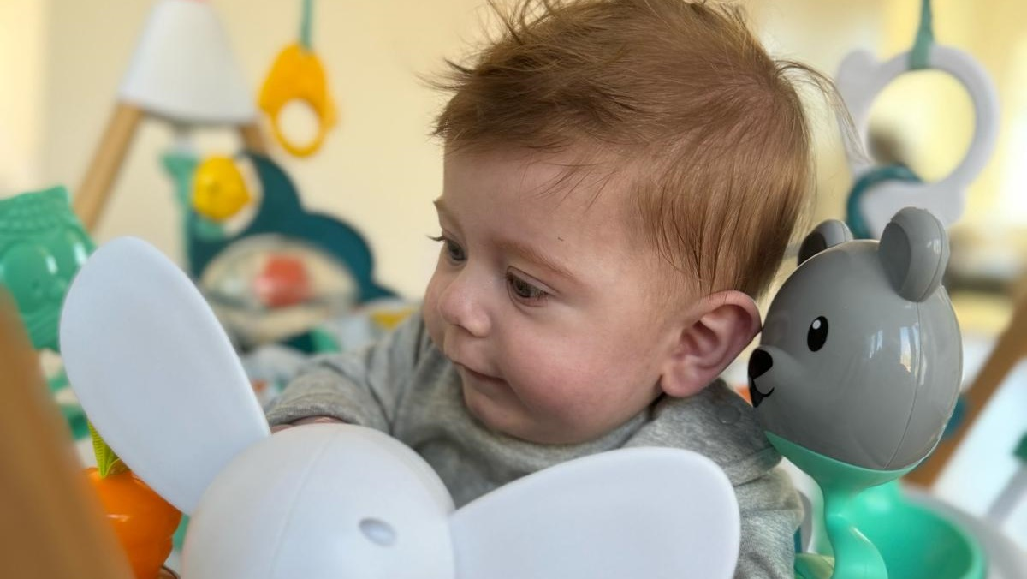

Slide 3
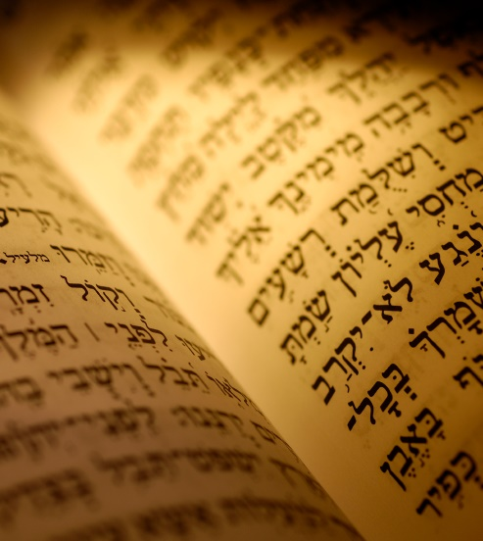
THY.HOUSE
67 These little studies in the Scriptures really could help us. It can strengthen you and make you strong, mighty men.
61-0808

Slide 4
SPIRITUAL.FOOD.IN.DUE.SEASON
1 The disciples said one time, after Jesus had done so many mighty works, they said, "Lord, now we believe.“ Jesus said, "Do you now believe?"
2 They said, "We believe that Thou knowest all things and need that no man teach Thee." So, Father, tonight we realize that You don't need our teaching, but we need Yours. So we pray that You'll teach us how to pray, how to live, and how to believe. Grant it, Lord, through this service tonight. If we lack anything, give it to us, Lord… 65-0718

Slide 5
The World is Falling Apart:
I have a question about planning for the future in light of the recent presidential election and potentially having a dictatorship in America. I’m a 33-year-old woman. In view of climate change, overpopulation and the election, I’ve started to wonder… There are so many wars, America turning isolationist, I fear for the world. It feels like everything is falling apart; there’s so much uncertainty, it doesn’t feel safe anymore. Knowing everything we know… is it right to be wanting/planning to start a family? Or should I plan to adopt instead? — Name Withheld

Slide 6
A hundred years ago, you would have brought a child into a country where a majority of people lived around or below the poverty line, where stepping on a tack could prove fatal, where environmental regulation hardly existed, where segregation was widely practiced. Stalin was consolidating his power in the U.S.S.R., Mussolini was eliminating forces of opposition in Italy and Hitler was rebuilding the Nazi Party in Germany. Still, people had kids, and so here you are, able to look back in horror at the way things used to be.

Slide 7
You cannot, of course, guarantee that any children of yours will have a brilliantly successful life. I’m not convinced that raising a happy child in this country is bound to be so hard that it would be unfair to bring a new person into the world. Many people will disagree with you about what the next 4, 40 or 400 years are likely to hold. (If you remain confident in your predictions, you could certainly join the estimated one to two million families waiting to adopt.) As the saying goes, the future hasn’t yet been written. If having a child is always a form of hope, not having one because you’re sure what lies ahead can, I fear, be a form of hubris.

Slide 8
4 Things Parents Must Always Do!
Be Gentle and Influential in the Home;
Be as Consistent as you can for as long as you can;
Work at the Your Marriage Relationship because Marriage and Parenting are Related;
Always Win in Struggles with your Children.

Slide 9
INFLUENCES
Today, our great problem, what we believe to be juvenile delinquency, is parent delinquent, a home delinquent. Our people got away from the things that they should have stayed with. The church got lukewarm or cold, and the children got out into the world. (Hollywood) …Satan got one jump ahead, by bringing it right in the house... And that's Satan's way of gradually entering in.

Slide 10
INFLUENCES [Modern Version!]
Today, our great problem, what we believe to be juvenile delinquency, is parent delinquent, a home delinquent. Our people got away from the things that they should have stayed with. The church got lukewarm or cold, and the children got out into the world. (Hollywood) …Satan got one jump ahead, by bringing it right in the house... And that's Satan's way of entering in.
64-0215

Slide 11
THE.INFLUENCE.OF.ANOTHER
60 The king [Uzziah]…Pride got in his heart. And that's what happens to us. If you'll pardon this expression, that's what's happened to our churches throughout the country… lifted up, self-centered, pride, you can't tell nothing. God can't find a way to get into their hearts. It's because they become so know-it-all… And when they do, they leave God in the back.
61 That's what happens to doctors. When they get so self-centered they don't need any help from God, that's when I don't want one fooling with me. You must always remember God first. He got lifted up...

Slide 12
62 Take a family of people that will start going to church, God will heal the little family. He will bless and give them the Holy Spirit in their life. The little children will pray, around the table. They'll pray before they go to bed. Mother and father will join hands and pray.
As long as they continue like that, they'll stay a family. First, they didn't have nothing; an old junk car, maybe, riding around in, or maybe walking. Finally they'll get a good car, a better home. And the first thing you know, then they want to get to what the

Slide 13
world, calls, "a better class," to associate with. They move into a different neighborhood, and in there, they find out they become influenced by the wrong influence.
You must always stay where the Kingdom of God is, and where the glory of God is pouring out. Stay where you can be spiritually fed, day and night. Then the first thing you know, separations comes in the home, and worldliness, and they get lifted up.

Slide 14
63 Uzziah did that. He got lifted up; much pride. Now, what really got him, when he got lifted up, in his heart, 2 Chronicles 26, he went into the temple, with a censor in his hand, to burn incense unto the Lord. And when he did, the minister of the temple, with 80 other ministers, followed him and told him, "Don't do that. You're wrong. You are not a minister. You are a king, not a minister."
64 He was wroth, his temper got away from him. And he lit the censor, and God smote leprosy on him right there while he was standing there in his anger. He died, a leper…

Slide 15
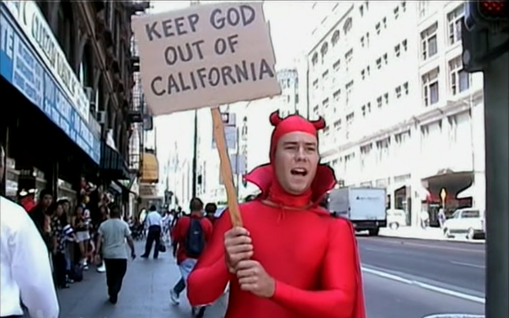
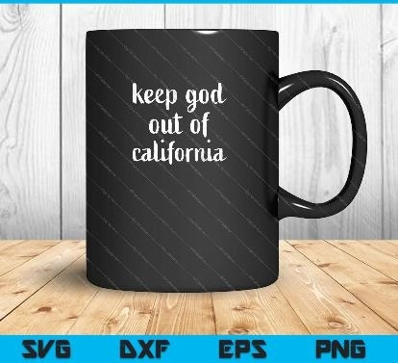
The picture on the left was posted 4 Days before the Fire broke out in California

Slide 16
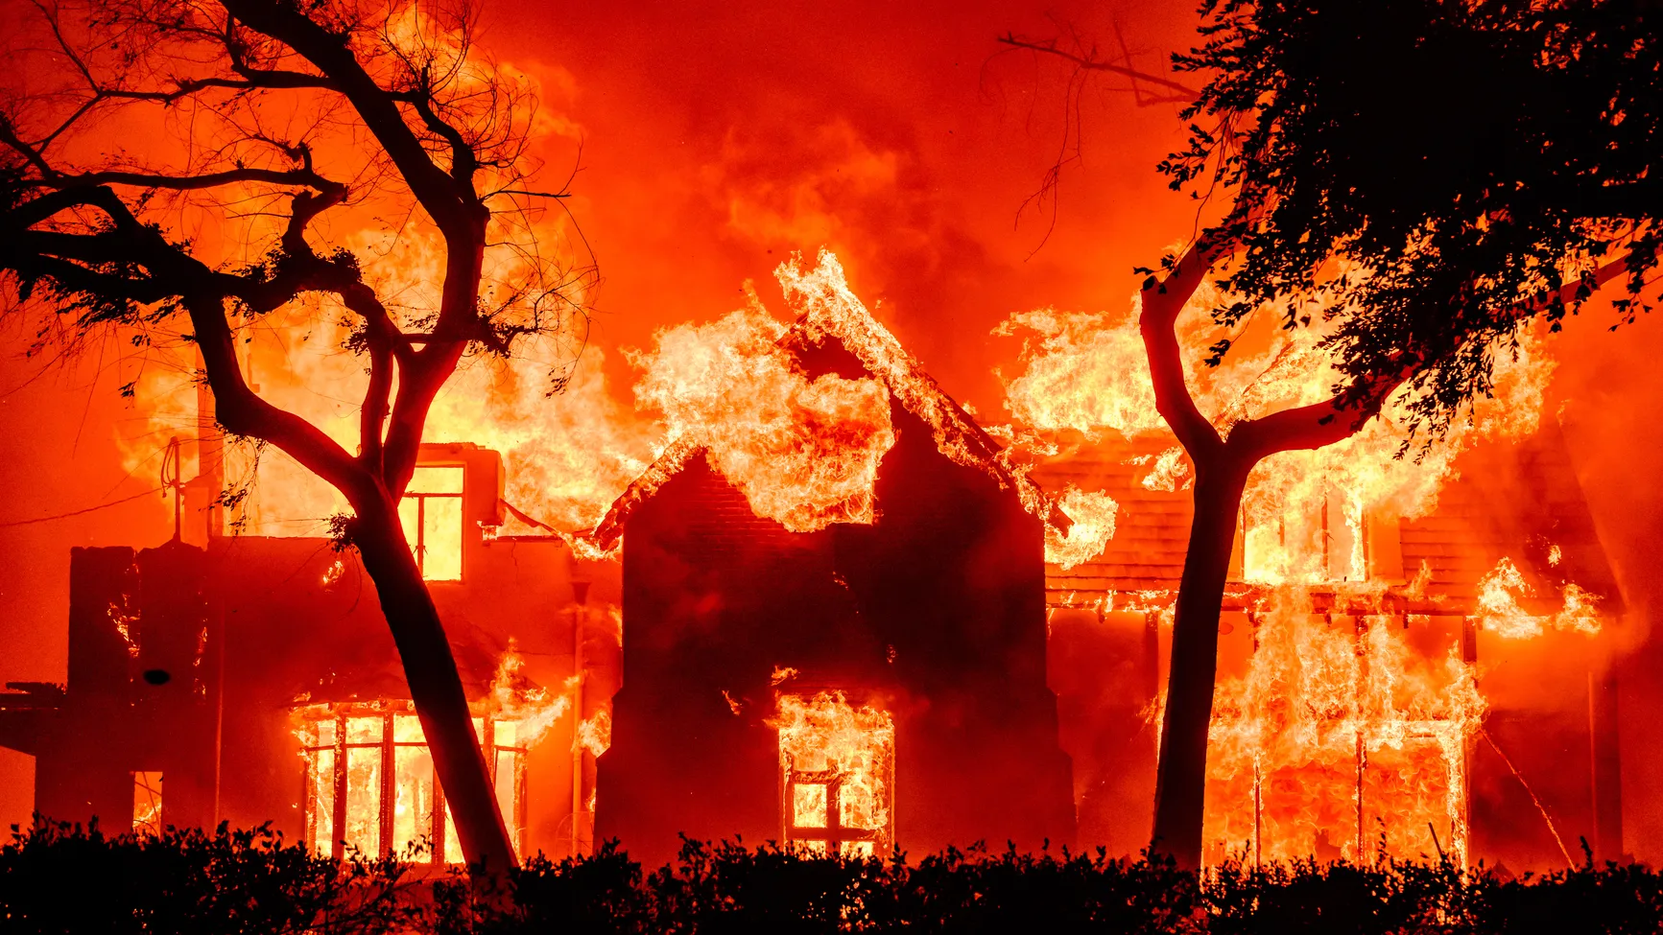

Slide 17
4 Fences of Protective Discipline
  Hedges Are Good;
  Who Captures Your Child’s Imagination?
  What Controls their Desires?
  Who Sets their Course?

Slide 18
INFLUENCE
15 Uzziah, the king, a shepherd boy, a king's son, and loved outdoors. He was a herdsman. And he also liked vineyards, see things grow. And this young fellow was brought up under real good influence.
Amaziah, his father, had been a great man, in his last days he let down a little, and picked up some gods from another country, and the Lord then taken him out of the earth. But this young fellow had had good influence, because his mother was a daughter of

Slide 19
Jerusalem, his father a Believer, and therefore the boy had been raised up with good influence.
16 And that's a good way to bring up a child, in the way it should go. And you know what? Your children is one of the main eyes that's watching you. They watch what you do. And whatever you do, they copy after you, because you're setting the example before them, to what you do.
63-0803

Slide 20
EXODUS 29:41-43
And the other lamb thou shalt offer at even, and shalt do thereto according to the meat offering of the morning, and according to the drink offering thereof, for a sweet savour, an offering made by fire unto the LORD. 42 This shall be a continual burnt offering throughout your generations at the door of the tabernacle of the congregation before the LORD: where I will meet you, to speak there unto thee. 43 And there I will meet with the children of Israel, and the tabernacle shall be sanctified by my glory.

Slide 21
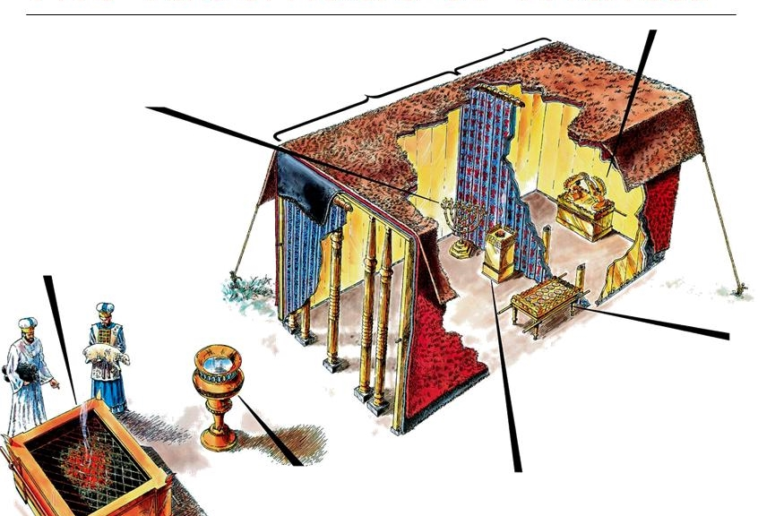
Table of
Shewbread

Slide 22
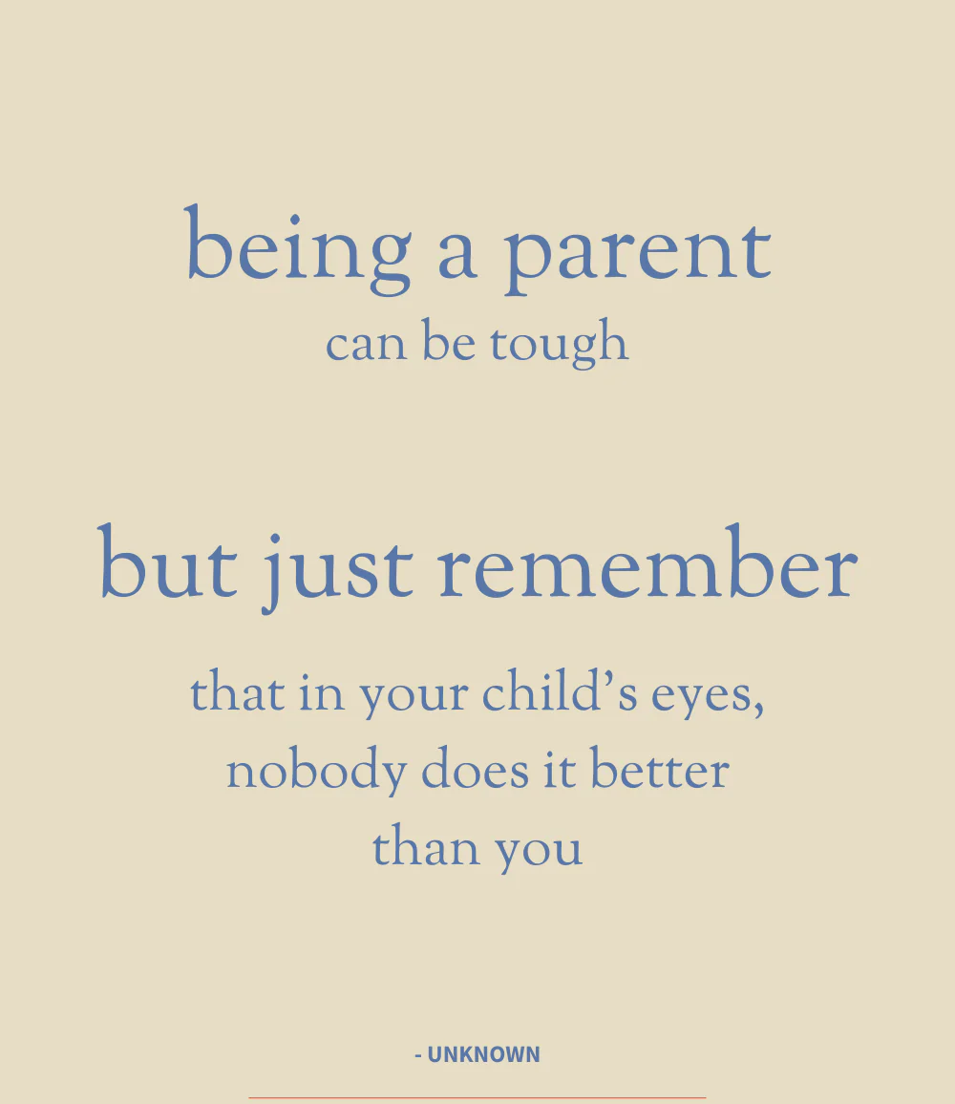
SHuLChaN = Table
(Heb.)
SHul = “The Place of”
CHaN = Grace
1) To Rest in One Place;
2) Economic Activity.

Slide 23
II SAMUEL 9:11, 13
Then said Ziba unto the king, According to all that my lord the king hath commanded his servant, so shall thy servant do. As for Mephibo-sheth, said the king, he shall eat at my table, as one of the king's sons.
13 So Mephibosheth dwelt in Jerusalem: for he did eat continually at the king's table; and was lame on both his feet.

Slide 24
PSALM 23:5-7
Thou preparest a table before me in the presence of mine enemies: thou anointest my head with oil; my cup runneth over.
REVELATION 19:9
And he saith unto me, Write, Blessed are they which are called unto the marriage supper of the Lamb. And he saith unto me, These are the true sayings of God.

Slide 25
LIFE
56 We're going to meet at a supper someday. That's a wedding supper, when that great table is stretched across the skies, reaching from sky to sky. We look across the table one to another, there's bound to be a little tear drop from our cheeks, as we think, as we shake each other's hand, say, "I remember the Salem meeting. Here's Bro. So-and-so, was the one that come in at that time, one down here.” Then the King in His beauty will walk out in His white robes
62-0719

Slide 26
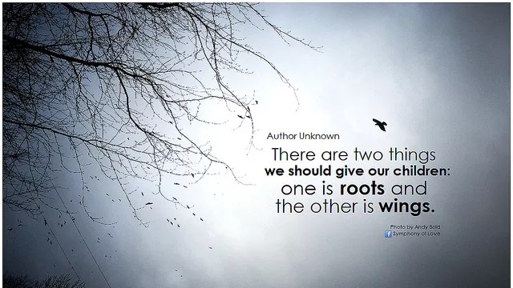
Parenting is a
Journey:
From Control to Influence

Slide 27
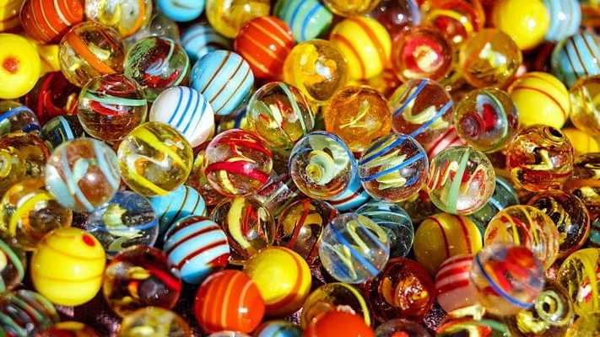
52 weeks x 22 years = 1,144

Slide 28
BE.CERTAIN.OF.GOD
2 I want to thank also the radio station, which is broadcasting this service… I sure would love to be close to where this radio station was. I believe that the influence that music puts upon children, it would pay every Christian throughout radio-land that this radio reaches, to keep their radios tuned to such a station as this tonight, because it brings the right kind of an influence through music and through preaching of the Word to our children. It sets them in a better environment.
59-0708

Slide 29
ZECHARIAH 8:15-19
So again have I thought in these days to do well unto Jerusalem and to the house of Judah: fear ye not. 16 These are the things that ye shall do; Speak ye every man the truth to his neighbour; execute [govern] the judgment of truth and peace in your gates: 17 And let none of you imagine evil in your hearts against his neighbour; and love no false oath: for all these are things that I hate, saith the LORD.

Slide 30


Slide 31
PROVERBS 29:14-15
The rod and reproof give wisdom: but a child left to himself bringeth his mother to shame.

Slide 33
A spiritual nature (2 Pet. 1:4; John 1:13);
The possession of a spirit becoming children of God (1 Pet. 1:14; 2 John 4; Rom. 8:15-21; Gal. 5:1; Heb. 2:15);
Present protection, consolation, supplies (Lk. 12:27-32; Jn. 14:18; 1 Cor. 3:21-23; 2 Cor. 1:4);
Fatherly chastisements (Heb. 12:5-11);
A future glorious inheritance (Rom. 8:17,23; James 2:5; Phil. 3:21).

Slide 34
Present Protection, Consolation & Supply
MATTHEW 6:25-34
25 Therefore I say unto you, Take no thought for your life, what ye shall eat, or what ye shall drink; nor yet for your body, what ye shall put on. Is not the life more than meat, and the body than raiment? 6 Behold the fowls of the air: for they sow not, neither do they reap, nor gather into barns; yet your heavenly Father feedeth them. Are ye not much better than they? 27 Which of you by taking thought can add one cubit unto his stature? 28 And why take ye thought for raiment? Consider the lilies of the field, how they grow; they toil not, neither do they spin: 29 And yet I say unto you, That even Solomon in all his glory was not arrayed like one of these.

Slide 35
30 Wherefore, if God so clothe the grass of the field, which to day is, and to morrow is cast into the oven, shall he not much more clothe you, O ye of little faith? 31 Therefore take no thought, saying, What shall we eat? or, What shall we drink? or, Wherewithal shall we be clothed? 32 (For after all these things do the Gentiles seek:) for your heavenly Father knoweth that ye have need of all these things. 33 But seek ye first the kingdom of God, and his righteousness; and all these things shall be added unto you. 34 Take therefore no thought for the morrow: for the morrow shall take thought for the things of itself. Sufficient unto the day is the evil thereof.

Slide 36
PROVERBS 29:21-22
He that delicately bringeth up his servant from a child shall have him become his son at the length. 22 An angry man stirreth up strife, and a furious man aboundeth in transgression.
That servant, who is treated like a son, (sensitively and tenderly), he receives affection, training compass-sion and favor. “Everything I have is yours.”

Slide 37
What turns a servant into a son: Tenderness!
What turns your child into your son?
Dealing with the child lovingly, tenderly, fairly with the goal of adoption.
COLOSSIANS 3:20-21
Children, obey your parents in all things: for this is well pleasing unto the Lord. 21 Fathers, provoke not your children to anger, lest they be discouraged.

Slide 38
5. You Share How Much You
Love Each Other.
Partners, and families, who are in the habit of telling one another what they appreciate about each other build on a solid foundation. If they see something positive, they point it out.
When we appreciate the positives we avoid the very spirit of contempt — one of the strongest predictors of divorce.

Slide 39
INFLUENCE
27 We have such a juvenile crime wave across the nation, but, really, I think it started in the home. I think the parents began to let go. And if the child had been raised up in a good, old-fashion, godly home; I don't say it would be all over, certainly not, but it would certainly give that child the right kind of influence.
I think, many times, that, homes that children has been brought up wrong... they don't love it and give it the affections, to take it up. It's young. You've got to teach it to love and respect, and to read the Bible. 63-1114

Slide 40
You Accept That The Person You Chose Is Not Perfect.
You’re not perfect and neither is your partner. If there a red flags at the outset — say, a partner who lies or treats you with disrespect — you’re wise to think twice.
But the ordinary challenging stuff isn’t going to disappear once you say ‘I do.’ The key is to appreciate the person and find peace with what’s less than ideal.

Slide 41
Communication is the number one problem for couples. None of us are perfect at it, but when we can talk about difficult topics like money, kids, religion or politics, and do so respectfully, we’ve got a good foundation for a better future together.

Slide 42
CHURCH.AND.ITS.CONDITION
35 God, wanting to make love, had to make something lovable, gentle like Himself. He had to make something that could be loved, something of His Own nature.
37 You couldn't love nothing that wasn't of your own nature. Loving has to unite with love. A husband and wife has to love one another, family has to love one another. You search everywhere, find a girl to be your wife that you love. She searches, finding a husband that she could love. And God searches, trying to find a soul that He can love. 56-0805

Slide 43
PROVERBS 4:5
Get wisdom, get understanding: forget it not; neither decline from the words of my mouth.
PROVERBS 4:7 Wisdom is the principal thing; therefore get wisdom: and with all thy getting get understanding.
PROVERBS 16:16
How much better is it to get wisdom than gold! and to get understanding rather to be chosen than silver!

Slide 44
INFLUENCE
35 Now, we find that Uzziah was called to be king at about 16 years old, after his father's death. And his father was a great believer. His mother also was a very fine woman. And this young king had been crowned at a young age, and quickly he taken the road that was right, because of the influence of a godly father and a godly mother.
36 And I think that's a very fine example for we parent today, is to set an example before our children. Now, you'll live your best and your worst at home.… Though the children might not just exactly act like

Slide 45
they're noticing it, but they are noticing it. Don't you never think that they are not, they're watching.
37 Not only the children are watching, the neighbors are watching… all that you are associated with, watch you. The people at your church watch you. The people that you do business with in the markets, are watching you, after your confession. And we should always try to reflect Christ in everything that we do.
63-0112

Slide 46
get to what they, the world, calls, "a better class," to associate with. They move into a different neighborhood, and they find out they become influenced by the wrong influence.
You must always stay where the Kingdom of God is, and where the glory of God is pouring out. Stay where you can be spiritually fed, day and night. Then the first thing you know, separations comes in the home, and worldliness, and they get lifted up.
62-1013

Slide 47
יָדִיד (yud, dalet, yud, dalet)
Friend, fellow, pal, beloved.
יד = Hand
1. Friends will move toward each other the things that are required for health, prosperity, and the others’ welfare.
2. One must graciously learn to accept an extended hand.

