Slide 1
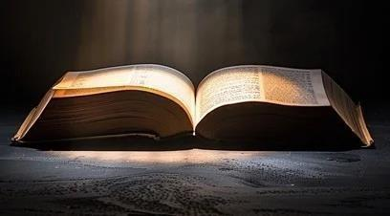
The Open Book
Part 3
II TIMOTHY 2:19
Nevertheless the foundation of God standeth sure, having this seal, The Lord knoweth them that are his. And, Let every one that nameth the name of Christ depart from iniquity.

Slide 2
Birthdays & Anniversaries in
January
Jan. 27th Chenelle Brown
Jace Botha
Jan. 29th Keith Buchanan
Jan. 30th Sabrina Stevens
Jan. 31st Brian McCall,
Katherine Pritchard
Feb. 1st Levin Guinn

Slide 3
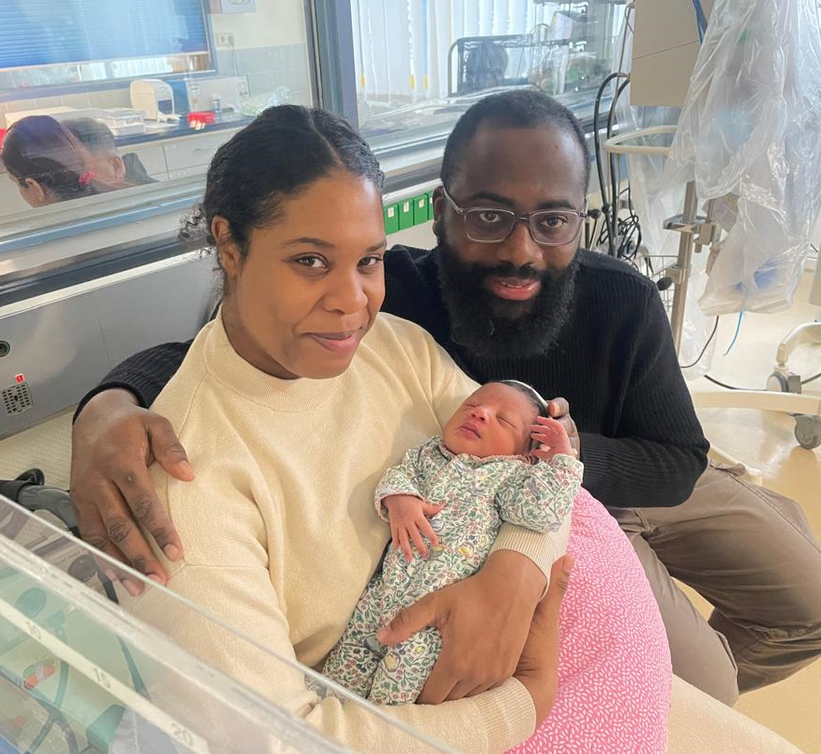
Mordecai & Naomi Ashong
Baby Eleanora-Joan

Slide 4

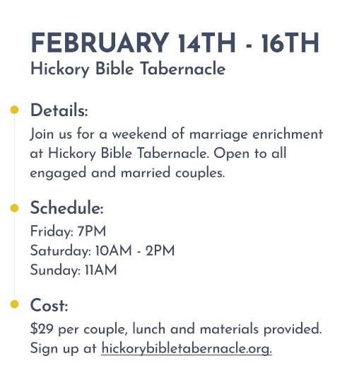

Slide 5


Slide 6

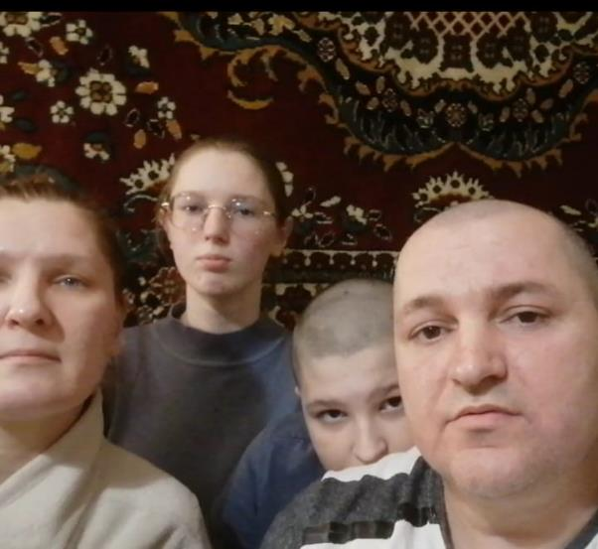
Greetings, we are the Kopchinskiy family. We thank you for the financial support during these hard times. We thank Bro. Coffeys church, all brothers and sisters, also Bro. Luzanov. We pray for you. I'd like to testify about how the Lord restored me: when I got into a car accident, the doctors said I wouldn't be able to walk, or at the very least with crutches, but now I am able to walk with no crutches or supports. Glory and praise to Jesus Christ!

Slide 7
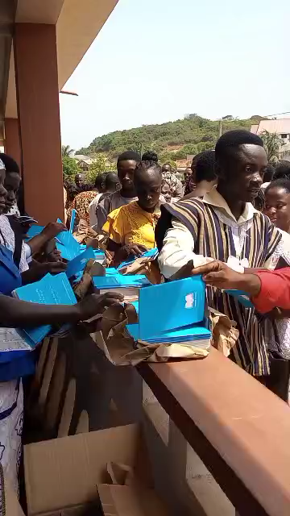
Ghana

Slide 8
The Open Book
Part 3
II TIMOTHY 2:19
Nevertheless the found-ation of God standeth sure, having this seal, The Lord knoweth them that are his. And, Let every one that nameth the name of Christ depart from iniquity.

Slide 9
PERSEVERANCE
And now we see nature, the very sign like the star that led the wise men to Bethlehem, on the move again. Jesus said [Lk. 21] there'd be perplexity of time, distress between the nations, signs in the heaven and earth, great storms and tidal waves and earthquakes in divers places. These things are buzzers that sets our hearts alarm, Lord, that we know to be ready. 62-0218

Slide 10
“The eyes of your understanding being enlight-ened; that ye may know what is the hope of his calling, and what the riches of the glory of his inher-itance in the saints, 19 And what is the exceeding greatness of his power to us-ward who believe, according to the working of his mighty power…
    Seeing
    Hope
    His Power Us-ward

Slide 11
CHRIST.IS.THE.MYSTERY
37-4 The new Birth is Christ, is a revelation. God has revealed to you this great mystery, and that's a new Birth. Now what are you going to do when you get all that group together, where the revelation is perfectly in harmony, and God expressing it through His Word by the same actions, the same things that He did, making the Word manifest! Oh, if the Church only knew its position. It will one day. Then, the rapture will go when it knows what it is.
63-0728

Slide 12
THE.UNCERTAIN.SOUND
64 [Lie detector] …you try to say that it's truth, but down on the inside of you, in the subconscious, lays …the soul. And this intellectual mind does not govern that vibration of the system. The mind is only a director, and it's very incapable of bringing you to God. You cannot know God by your mind, intellectual. It's one of the resources, or channels that would lead to it, but your soul is what governs you. You are what you are, by your soul. 55-0731

Slide 13
II TIMOTHY 2:19
Nevertheless the foundation of God standeth sure, having this seal, The Lord knoweth them that are his. And, Let every one that nameth the name of Christ depart from iniquity.
Knoweth: ginosko
1. Jewish idiom for intimacy between a man and woman
2. To the Greeks, this meant to know facts, but these facts may or may not affect one's conduct. To the Jew, true know-ledge always manifested itself in one's conduct. One did not “know” something until that fact had a practical outworking in his life.

Slide 14
Example: MATTHEW 1:23-25
Behold, a virgin shall be with child, and shall bring forth a son, and they shall call his name Emmanuel, which being interpreted is, God with us. 24 Then Joseph being raised from sleep did as the angel of the Lord had bidden him, and took unto him his wife: 25 And knew her not till she had brought forth her firstborn son: and he called his name JESUS.

Slide 15
Example: MATTHEW 7:21
Not every one that saith unto me, Lord, Lord, shall enter into the kingdom of heaven; but he that doeth the will of my Father which is in heaven. 22 Many will say to me in that day, Lord, Lord, have we not prophesied in thy name? and in thy name have cast out devils? and in thy name done many wonderful works? 23 And then will I profess unto them, I never knew you: depart from me, ye that work iniquity.

Slide 16
Example: EXODUS 3:7-9
And the LORD said, I have surely seen the affliction of my people which are in Egypt, and have heard their cry by reason of their taskmasters; for I know their sorrows; And I am come down to deliver them out of the hand of the Egyptians, and to bring them up out of that land unto a good land…
9 Now therefore, behold, the cry of the children of Israel is come unto me: and I have also seen the oppression wherewith the Egyptians oppress them. 10 Come now therefore, and I will send thee unto Pharaoh, that thou mayest bring forth my people the children of Israel out of Egypt.

Slide 17
CHRIST.IS.THE.MYSTERY
291 Same as in the days of Christ, God holds the key to this revelation of Christ, Himself. You believe that? [Congregation says, "Amen."] Schools of theology can never find It. Jesus said so. If you want to read it now, in Matt. 11:25 and 27.
63-0728

Slide 18
THE.FIRST.SEAL
122-2 And now, the Lamb is standing now tonight as we enter into this 6th chapter; He's got the Book in His hand and starting to reveal it.
And I hope that people are spiritual. I would've had a horrible mistake on that if it hadn't been about twelve o'clock today when the Holy Spirit came in the room and corrected me on something that I was writing down to say, taking it from an old context.
63-0318

Slide 19
TRYING.TO.DO.GOD.A.SERVICE
220 But now is the Bride-calling, when the Seven Seals has been opened, now when the complete things that the reformers left has to be opened; and only Malachi 4 can do that, because it takes the revelation straight from God to an individual to do so. It can't come to a group, never did.
One man! That's what God promised in the shadows of the coming for His Bride, an Eliezer.
65-1127

Slide 20
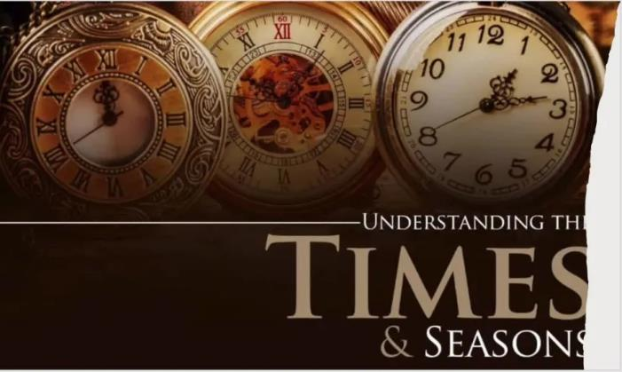
I THESSALONIANS 5:1-3
But of the times and the seasons, brethren, ye have no need that I write unto you. 2 For yourselves know perfectly that the day of the Lord so cometh as a thief in the night. 3 For when they shall say, Peace and safety; then sudden destruction cometh upon them, as travail upon a woman with child; and they shall not escape.

Slide 21
Uniting.Time.And.Sign
Never before, since the early church age, was the pillar of fire ever among the people. Never before, since the early church age, did they ever see the things that we are seeing today. And this was only made possible when God sent the Seven Seals…
63-0818

Slide 22
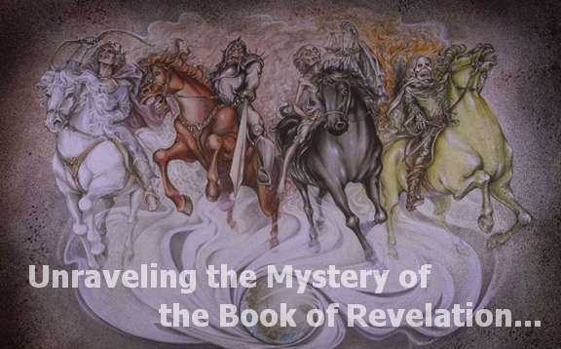

Slide 23
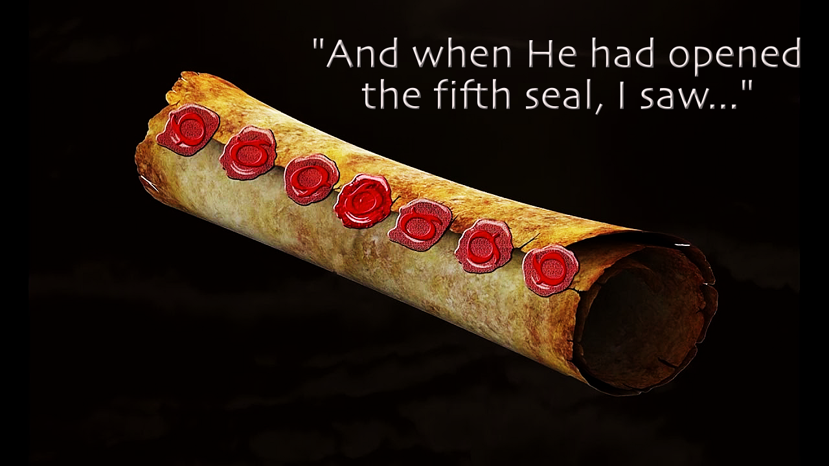
REVELATION 5:1
And I saw in the right hand of him that sat on the throne a book written within and on the backside, sealed with seven seals. 2 And I saw a strong angel proclaiming with a loud voice, Who is worthy to open the book, and to loose the seals thereof?

Slide 24
EXODUS 9:13
And the LORD said unto Moses, Rise up early in the morning, and stand before Pharaoh, and say unto him, Thus saith the LORD God of the Hebrews, Let my people go, that they may serve me.
HEBREWS.CHAPTER.SIX.2
419 The covenant God made with Israel: they lost their in-heritage, lost the promised land, went down into Egypt, but they hadn't lost their covenant. God said, "I remember My promise to Abraham. I remember, and I've come down to deliver My people. Go down there, Moses, and tell Pharaoh, I said, 'Let My people go.' I remember I made a promise to Abraham and to his seed.“
57-0908

Slide 25
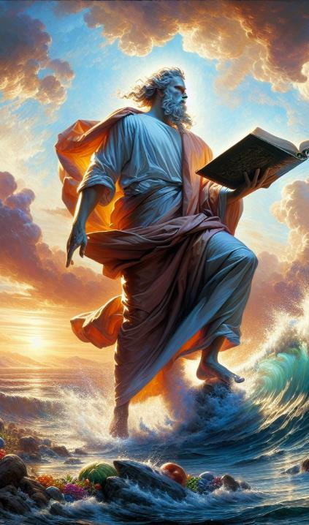
REVELATION 10:1-3
And I saw another mighty angel come down from heaven, clothed with a cloud: and a rainbow was upon his head, and his face was as it were the sun, and his feet as pillars of fire: 2 And he had in his hand a little book open: and he set his right foot upon the sea, and his left foot on the earth, 3 And cried with a loud voice, as when a lion roareth: and when he had cried, seven thunders uttered their voices.

Slide 26
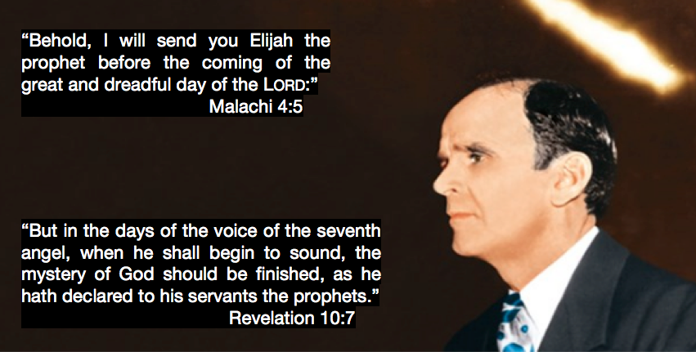

Slide 27
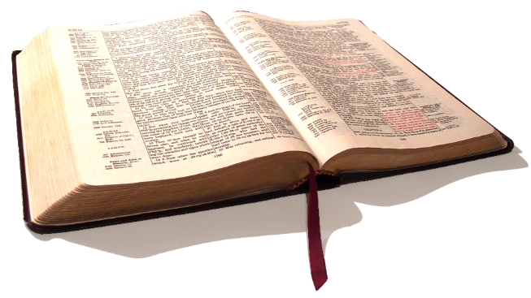
GOD'S.POWER.TO.TRANSFORM
…But since the opening of those Seven Seals, of them Angels just behind the mountain yonder, This has become a new Book. It's the things that's been hid, is being revealed as God promised in Revelation 10, He would do it.
And we are the privileged people that God has chosen, of the earth, that we might see and understand these things…
65-0911

Slide 28
REVELATION 18:4
And I heard another voice from heaven, saying, Come out of her, my people, that ye be not partakers of her sins, and that ye receive not of her plagues. 5 For her sins have reached unto heaven, and God hath remembered her iniquities.

Slide 29
DANIEL 12:4, 8 – 9
But thou, O Daniel, shut up the words, and seal the book, even to the time of the end: many shall run to and fro, and knowledge shall be increased.
And I heard, but I understood not: then said I, O my Lord, what shall be the end of these things? 9 And he said, Go thy way, Daniel: for the words are closed up and sealed till the time of the end..

Slide 30
MICAH 4:1-4
But in the last days it shall come to pass, that the mountain of the house of the LORD shall be established in the top of the mountains, and it shall be exalted above the hills; and people shall flow unto it. 2 And many nations shall come, and say, Come, and let us go up to the mountain of the LORD, and to the house of the God of Jacob; and he will teach us of his ways, and we will walk in his paths: for the law shall go forth of Zion, and the word of the LORD from Jerusalem.

Slide 31
3 And he shall judge among many people, and rebuke strong nations afar off; and they shall beat their swords into plowshares, and their spears into pruninghooks: nation shall not lift up a sword against nation, neither shall they learn war anymore. 4 But they shall sit every man under his vine and under his fig tree; and none shall make them afraid: for the mouth of the LORD of hosts hath spoken it.

Slide 32
THE.FEAST.OF.THE.TRUMPETS
113 He shall appear in the last days, is to bring the people back to the Word, so that the Bride will know Her Husband, know Her Mate, the revealed Word.
114 It wasn't in the reformers; wasn't in Luther, Wesley, Pentecostals, Scripture says it wasn't. But it will come. That is His promise for this age. We're living in the age that His Coming will be in. 64-0719

Slide 33
“You are entitled to your own opinion, But you are not entitled to your own facts.”
Sen. Daniel P. Moynihan
John 8:30-31
Then said Jesus to those Jews which believed on him, If ye continue in my word, then are ye my disciples indeed; 32 And ye shall know the truth, and the truth shall make you free.

Slide 35
CHURCH.AGE.BOOK
345-1 Compare this twentieth century church to the first century church. Where is the power? Where is the love? Where is the purified church that withstood sin and walked with faith toward Jesus? Where is the unity? You can't find it. If this church has all it needs, why were they crying out for more of God in the Book of Acts as though they didn't have it all, and yet they had far more than they have today?

Slide 36
Character:
Your character is the sum of all the qualities that make you who you are: your values, thoughts, words, your actions.
How your habits, motives, thoughts relate to morality, particularly as it concerns integrity or “moral structure,” something you built through virtuous behavior.

Slide 37
HEAR.YE.HIM
38 Now, when you're born again, that only puts you in the family. It's your character, your conduct that gives God confidence in you.
The reason that we haven't got the great church marching on today, is because God can't find people to put His confidence in… Stay with God's Word. That's God's Truth; that's the Pattern; that's the Blueprint. 57-0519

Slide 38
THINGS.THAT.ARE.TO.BE
112 "I got the baptism, the Holy Spirit." That's just only a temporal gift for you. The real gift is your soul down in there, born of God, and that controls the whole thing to the Word of God and the will of God. And there you grow up, then you're a son and daughter of God…
"Well, I belong to church." That don't mean one thing. "I'm Methodist; my mother." That's good for your mother. 65-1205

Slide 39
SPOKEN.WORD.ORIGINAL.SEED
When God creates a man, he’s of His kind. David said, “Thy Word have I hid in my heart that I sin not against You.” Only thing he needed was the rain. David would’ve been all right if he could just had that rain, but the Holy Ghost wasn’t yet given. He had the Word, the Word was in him, and he could know It; he said, “I’ve hid It in my heart, Lord. It won’t bloom out and act like It should, but I’ve hid It there Lord.…” And if David’s cup run over, what ought ours to do? 62-0318

Slide 40
JUDGES 10:13-14
Yet ye have forsaken me, and served other gods: wherefore I will deliver you no more. 14 Go and cry unto the gods which ye have chosen; let them deliver you in the time of your tribulation.
MODERN.EVENTS
Father, as we open this Word, speak to us directly out of this Word, that we might know the hour that we're living. If we know the hour we're living, then we can prepare for that hour; but if we go in blindly not knowing what or where, then we don't know how to prepare.
65-1206

Slide 41
Absolute
227 The red light settles the case, tells you who goes. No matter what anybody else says, it’s what the red light says. You can really have a traffic jam if you don’t mind the red light. There must be an absolute. Just like to the Church, there has got to be an absolute. To the people in the Church, you’ve got to have your absolute. But, today, each church has its own absolute. And don’t try to take, “We Baptist believe this. We Methodists believe this.” That’s all right, but why don’t you take the rest of It?
62-1230

Slide 42
COLOSSIANS 1:16-18
16 For by him were all things created, that are in heaven, and that are in earth, visible and invisible, whether they be thrones, or dominions, or principalities, or powers: all things were created by him, and for him: 17 And he is before all things, and by him all things consist.
18 And he is the head of the body, the church: who is the beginning, the firstborn from the dead; that in all things he might have the preeminence.

Slide 43
EPHESIAN.CHURCH.AGE
79-2 In that right hand of power are seven stars, who, according to Rev. 1:20, are the seven church messengers. This signifies that the very power and authority of God are behind His messengers to every age. They go forth in the fire and power of the Holy Ghost with the Word. They are stars because they reflect light. The light they reflect is His light. They have no light of their own.

Slide 44
Current View of the Temple Mount

Slide 45
THE.FIRST.SEAL 63-0318
122-2 And now, the Lamb is standing now tonight as we enter into this 6th chapter; He's got the Book in His hand and starting to reveal it.... And I hope that people are spiritual. I would've had a horrible mistake on that if it hadn't been about twelve o'clock today when the Holy Spirit came in the room and corrected me on something that I was writing down to say.
I was taking it from an old context. I had nothing on it. I don't know what the Second Seal is no more than nothing... And Dr. Smith, many great outstanding teachers and all of them believed that, so I'd wrote it down. And I was fixing to say, "Well, now I'll study it from that standpoint." And there about twelve o'clock in the day the Holy Spirit just swept right down into the room, and the whole thing just opened up to me, and there it was, this First Seal being opened.

Slide 46
FIRST.SEAL.THE
128-2 And then there's coming forth seven mysterious thunders that's not even written at all. That's right. And I believe that through those seven thunders will be revealed in the last days in order to get the Bride together for rapturing faith; because what we got right now, we wouldn't be able to do it.
63-0318

Slide 47
LEADERSHIP
144 We've turned a corner. We're looking towards heaven, watching for the coming of the cap on the pyramid, as we would say, His coming back… And the only way you can, is not say, "Why, I belong to the Assemblies, Oneness…” that don't mean a thing. "Our fathers shouted and danced." That's just perfectly all right; that was their day.
But today you're confronted, not with the organization that they made, but with the Life that's going on, which is Jesus Christ.
65-1207

Slide 48
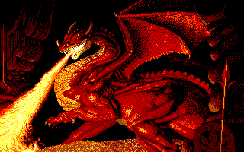
Triple Anointing of the Antichrist
Religious
Political
Demon powers
POSSESSING.THE.GATE.OF.THE.ENEMY.AFTER.TRIAL
153 The whole system has become polluted, the world system, church system, political system. Politics is so corrupted… everywhere are dictators, it's all corruption. The church has become the same way. Families have become the same way. It's just corruption, Sodom! 64-0322

