Slide 1


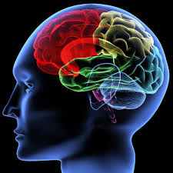
If I Had A Family The Intellect
MATTHEW 21:22-27
The baptism of John, whence was it? from heaven, or of men? And they reasoned with themselves, saying, If we shall say, From heaven; he will say unto us, Why did ye not then believe him?

Slide 2
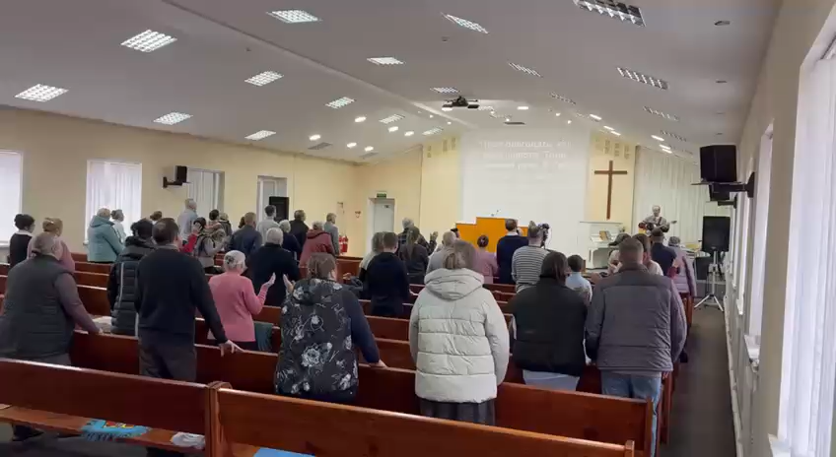
Donetsk, Ulraine

Slide 3
THE.LAMB'S.BOOK.OF.LIFE
51 …And then it's not what I've done; it's what God has done for me in Christ. And we are perfected with our Sacrifice. He makes no mistakes. He wouldn't bring you in, if you wasn't worthy. He knows your heart. He knows what you are. There's traps all along the road. Sure.
The devil will cause you to stumble, "I didn't mean to do that. God, You know it." You're still perfect, because there's a perfect Blood offered for you every day, and a bleeding Sacrifice hanging before the throne of Almighty God.
56-0603

Slide 4
Thinking Man’s Filter
Man
I I Cor.
11:14
Hair
Woman
14 Doth not even nature itself teach you, that, if a man have long hair, it is a shame unto him? 15 But if a woman have long hair, it is a glory to her: for her hair is given her for a covering.

Slide 5
Thinking Man’s Filter
Marriage/
Remarriage
Rom.7:2
For the woman which hath an husband is bound by the law to her husband so long as he liveth; but if the husband be dead, she is loosed from the law of her husband.

Slide 6
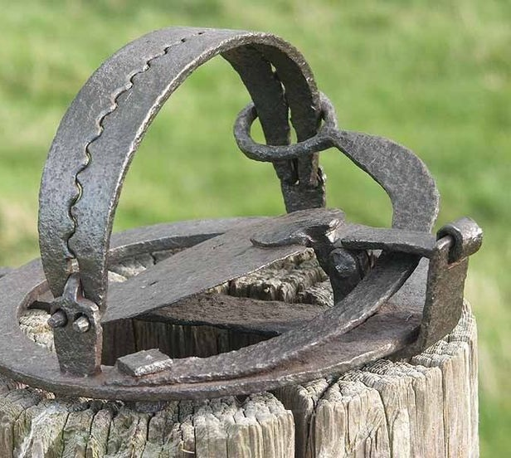
Trap: (w) A mechanical device or enclosed place in which something, esp. an animal, is caught or penned. Any device or plan for tricking a person or thing into being caught unawares.

Slide 7
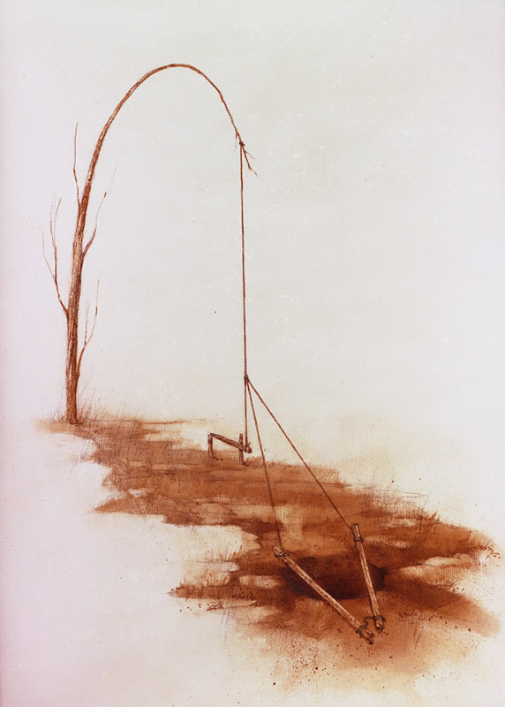
Traps
Deceive

Slide 8
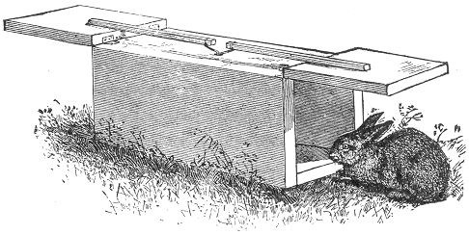
2. A Trap Always Promises
Something Good

Slide 9
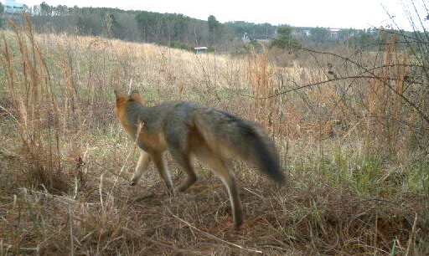
3. Traps Never look like Traps!

Slide 10
“When we see a brother or sister in sin, there are two things we do not know: First, we do not know how hard he or she tried not to sin. And second, we do not know the power of the forces that assailed him or her. We also do not know what we would have done in the same circumstances.”
F.B. Meyer

Slide 11
Example: MY.LIFE.STORY
19 Here's three things I've noticed in reading of other ministers. If this ever gets a hold of a minister, it's got him. There's a weak spot: money, women, popularity. Dodge the very appearance of it.
For money, I care not for it. I've got a little old fat wife here, sweetest woman in the world…the only one I've ever cared for, some little children. When I was a sinner I lived clean, and when I'm a Christian. Popularity, who am I? 6’ of dirt, that's all: sinner saved by grace. 50-0820

Slide 12
Example: THE.MANIAC.OF.GADARA
19 I get physically wore out. I have difficults, things that an ordinary person doesn't have. You can imagine how Satan fights at me all the time. Cast those demons out, they haunt at you. And I have never let my ministry get to a big place, to where it would look like it would be big.
It might go to my head. My ministry's been kept little. I deal with a few people and about time the crowd gets built up, I move off somewhere else and go somewhere else. Because my whole motive is: to please my heavenly Father.
54-0720

Slide 13

REVELATION 3:17
Because thou sayest, I am rich, and increased with goods, and have need of nothing; and knowest not that thou art wretched, and miserable, and poor, and blind, and naked:

Slide 14
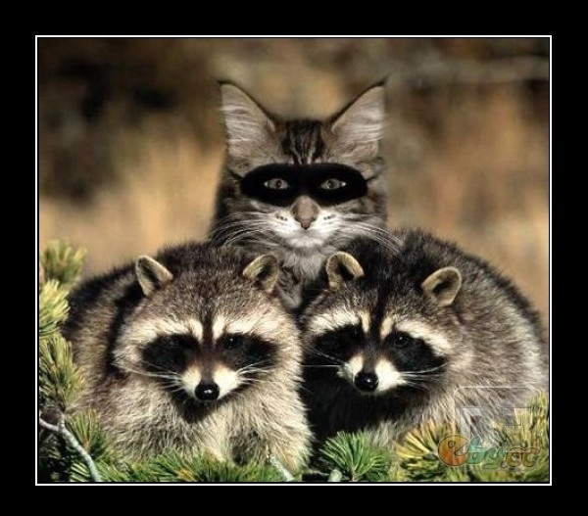
Self-deception is a process of denying or rationalizing away a truth, significance, or importance of opposing evidence and logical argument.
Self-deception involves convincing oneself of a truth (or lack of truth) that has no basis in reality.

Slide 15
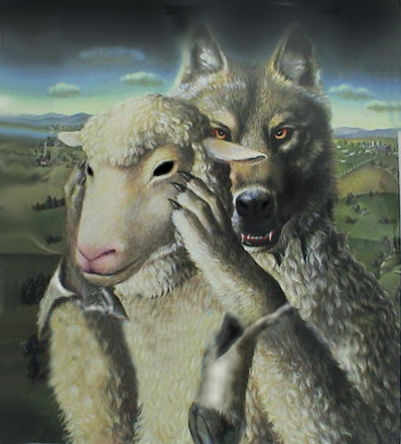
MATT. 7:15-17
Beware of false prophets, which come to you in sheep's clothing, but inwardly they are ravening wolves. 16 Ye shall know them by their fruits. Do men gather grapes of thorns, or figs of thistles? 17 Even so every good tree bringeth forth good fruit; but a corrupt tree bringeth forth evil fruit.

Slide 16
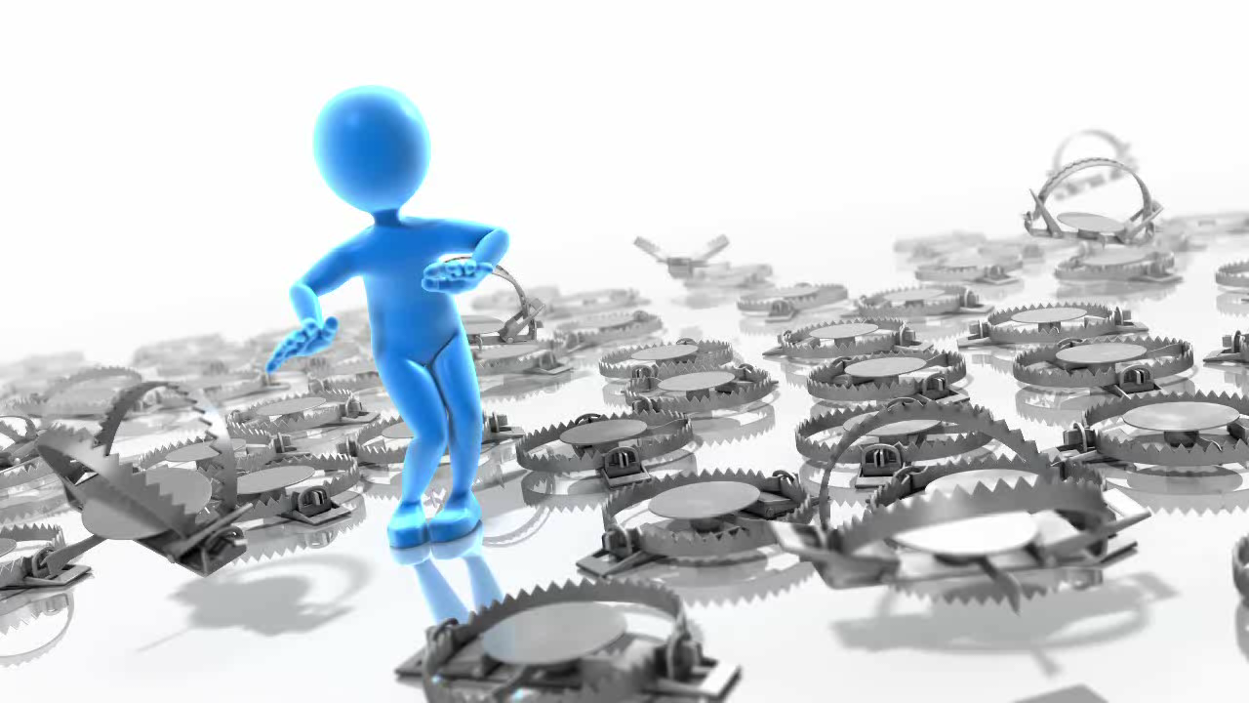
It Can Sometimes Feel Like
There Are Traps All Around Us!

Slide 17
If I Had a Family: I Would Warn them about Traps The Intellect
MATTHEW 21:22-27
The baptism of John, whence was it? from heaven, or of men? And they reasoned with themselves, saying, If we shall say, From heaven; he will say unto us, Why did ye not then believe him?

Slide 18
THE.UNCERTAIN.SOUND
But let's put down reasoning. God never made us to live by our intellect. We live by the Holy Spirit that's in our soul, that says "no" to any reasonings that's contrary to God's Word.
When God's Word says it's so, there's nothing in the world stands in Its way. 55-0731
But God hath chosen the foolish things of the world to confound the wise; and God hath chosen the weak things of the world to confound the things which are mighty;
I CORINTHIANS 1:27

Slide 19
MATTHEW 21:23-27
23 And when he was come into the temple, the chief priests and the elders of the people came unto him as he was teaching, and said, By what authority doest thou these things? and who gave thee this authority? 24 And Jesus answered and said unto them, I also will ask you one thing, which if ye tell me, I in like wise will tell you by what authority I do these things. 25 The baptism of John, whence was it? from heaven, or of men? And they reasoned with themselves, saying, If we shall say, From heaven; he will say unto us, Why did ye not then believe him? 26 But if we shall say, Of men; we fear the people; for all hold John as a prophet. 27 And they answered Jesus, and said, We cannot tell. And he said unto them, Neither tell I you by what authority I do these things.

Slide 20
THE.PHILADELPHIAN.CHURCH.AGE
38 Many books... was wrote about him [Wesley] in his day, slandering him, making fun. But they've long been forgotten now, so has their authors. You can't do nothing against a child of God and get by with it, you just fighting the air. God is going to take them right on through, anyhow.
60-1210
PSALM 31:13-14
For I have heard the slander of many: fear was on every side: while they took counsel together against me, they devised to take away my life. 14 But I trusted in thee, O LORD: I said, Thou art my God.

Slide 21

ISAIAH 1:18
Come now, and let us reason together,
saith the LORD: though your sins be as scarlet,
they shall be as white as snow; though they be
red like crimson, they shall be as wool.
Reason:
The capacity for rational/intelligent thought. The ability of the mind to make correct conclusions about what is true or real, about how to solve problems.

Slide 22
Example:
EARNESTLY.CONTENDING.FOR.THE.FAITH
I want you to watch the trickery of the devil. Balak said to Balaam, "Come back up here on this side now, and I'll show you." He showed him the worst part, just their hinder parts, of Israel. He didn't show him the overall picture; he just showed him the back part of it: the worst part, the little camp, the stragglings that was come along, the poorer sheep and the goats.
54-0404M

Slide 23
I.WILL.RESTORE.UNTO.YOU.SAITH.THE.LORD
43 Same thing fundamentals try to poke onto the holy-rollers today. But the thing that Balaam failed to see is the same thing those teachers fail to see today. They failed to see that smitten Rock; that Pillar of Fire making atonement for them, vindicating them with signs, wonders, miracles. Hallelujah.
Today they fail to see that power of the resurrection of the Lord Jesus Christ. They're always pointing on this Pentecostal preacher run away with somebody's wife. Only they're political enough to keep it covered up.

Slide 24
But brother, right amongst these holy-rollers, they may have their ups-and-downs. But let me tell, you fundamentalist here this afternoon, they got the shout of the King among them. There's a living God among them, resurrected, showing signs and wonders, God's Church moving on from glory unto glory. Amen.
54-0809

Slide 25
UNITY.OF.ONE.GOD.IN.THE.ONE.CHURCH
53 Satan uses a man's head. He chose that in the garden of Eden, to take a man's head, his thinking. And he has brought that down even to the church. See, the devil takes a man's head, so he can use his eyes. And notice, if the man isn't genuinely borned again, spiritual, he'll take what he can see with his eyes, the pride of life…
58-1221

Slide 26
II CORINTHIANS 10:4-6
(For the weapons of our warfare are not carnal, but mighty through God to the pulling down of strong holds;) 5 Casting down imaginations, and every high thing that exalteth itself against the knowledge of God, and bringing into captivity every thought to the obedience of Christ; 6 And having in a readiness to revenge all disobedience, when your obedience is fulfilled.
Casting Down: (Gr.) kathaireo
To take down; with use of force; demolish; the subtle reasonings (of opponents) likened to a fortress.

Slide 27
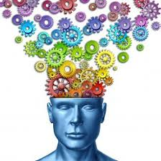
Imaginations: (Gr.) logismos (Rom. 2:15)
Computations: such as is hostile to the Christian faith. A judgment, decision: such as conscience passes.
Revenge: (Gr.) ekdikeo
To vindicate one's right, do one justice, to protect, defend, o.ne person from another. To avenge a thing

Slide 28
2 Corinthians 10:4-7 (NIV)
The weapons we fight with are not the weapons of the world. On the contrary, [we] have divine power to demolish strongholds. ⁵ We demolish arguments and every pretension that sets itself up against the knowledge of God, and we take captive every thought to make it obedient to Christ. ⁶ And we will be ready to punish every act of disobedience, once your obedience is complete.
⁷ You are judging by appearances. If anyone is confident that they belong to Christ, they should consider again that we belong to Christ just as much as they do.

Slide 29
DOOR.TO.THE.HEART
36 …I've seen people who laughed at the Holy Spirit. I've held them when they died. Don't laugh at Christ. Respect Him; honor Him. Get away from all your own theologies and senses. You was given five senses. But them five senses, your intellectuals, was never given to you to lead you. The six sense, which is faith, was given to you to lead you. That's the six sense; that is the super sense. It leads you.
60-0312

Slide 30
PAINTED.FACE.JEZEBEL
71 Lady setting, standing here, a stranger to me… I don't know you. But Jesus does know you… Now, if God will reveal to me what you're here for, will you accept it?
First thing I see blood dripping before me. It's got sugar in it, which is diabetes. Insulin's a wonderful thing, but the Blood of Jesus is better. I see you're upset about something in your heart you're praying about. It's your husband. And he's a patient in a state hospital. It's his soul that you don't believe is saved, and you want prayer for him.

Slide 31
I'm not reading your mind, but that's true, isn't it? Now, there's not a shadow of doubt in your mind now, is there?
O heavenly Father, in the Name of Jesus the Son of God, I pray that You'll grant this and give her her deliverance and her husband, in Christ's Name. Amen.
Looking down at the hospital at the chart, Mrs. Hill you can go ahead then. Amen. That strengthened you, didn't it? I seen the chart with the name; that's the reason I said that.
56-1005

Slide 32
WORD.BECAME.FLESH.INDIA.TRIP.REPORT
170 Now, before there was a man. Before. "In the beginning was the Word..." Now, just about as far as the human mind can go, that's as far as we can go back now to "the beginning.” "In the beginning was the Word." But now, that's as far as we can go by theology. That's as far as we can go by our mind. But revelation carries us beyond that.
54-1003

Slide 33
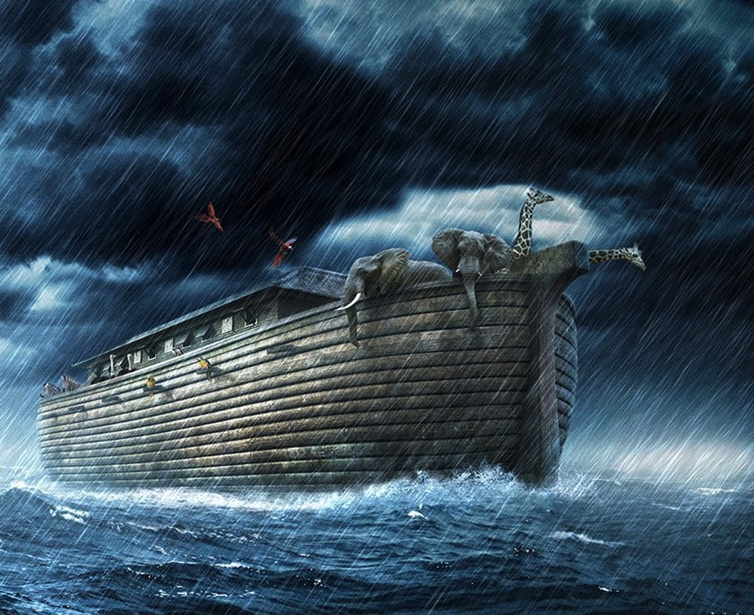
PERSEVERANT
28 And Noah was persistent, very perseverant. I can imagine them taking the doctors and bringing him before psychiatrists to find out what's the matter with the old man's mind. But it wasn't his mind; it was in his heart. And he had the Word of the Lord, and he knew that it was God.
62-0623

Slide 34
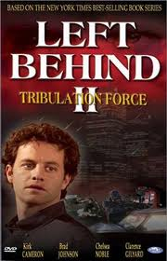
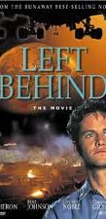

Slide 35
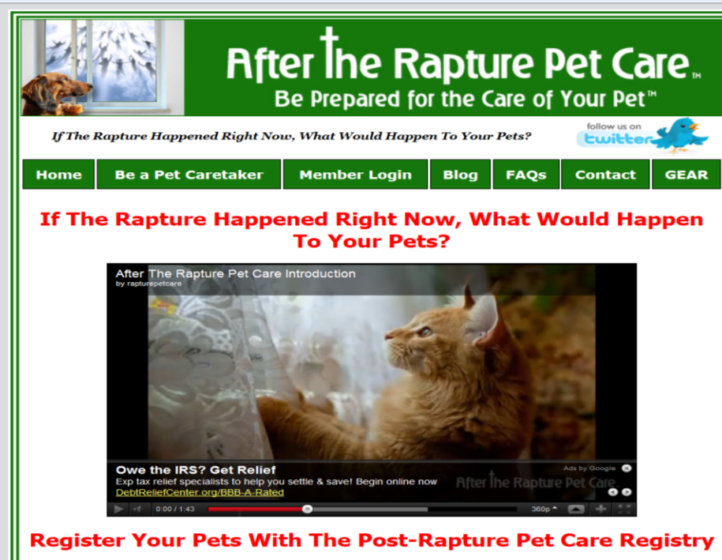

Slide 36
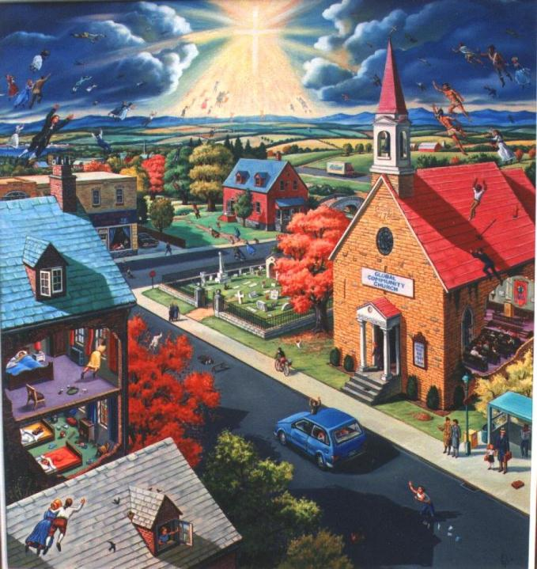
COD
362. Please explain the mystery of the translation of the Bride.
Just a change (See?), our bodies now... Let's say our. You know what I mean when I say that? I don't mean to say ours; I don't mean to say this church; I mean to say every believer.
64-0830

