Slide 1
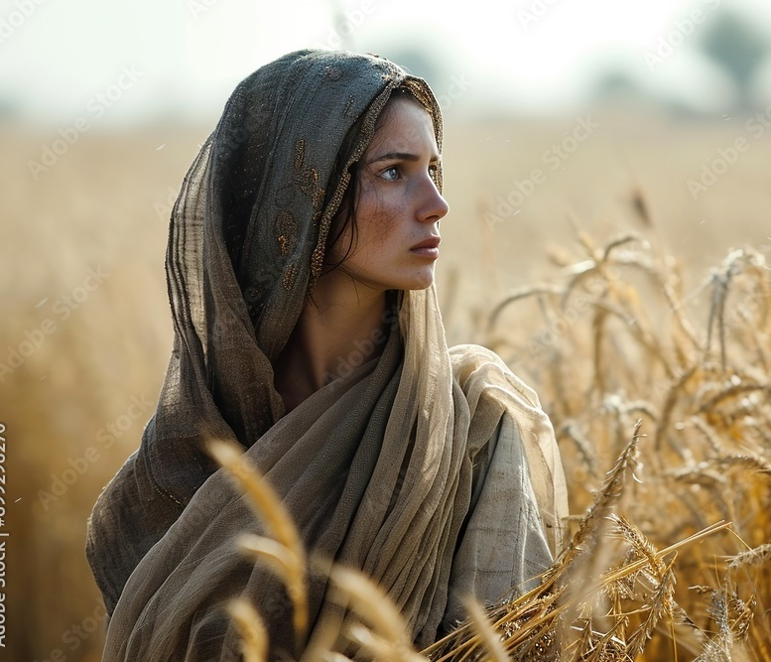
Deciding
RUTH 1:16
And Ruth said, Intreat me not to leave thee, or to return from following after thee: for whither thou goest, I will go; and where thou lodgest, I will lodge: thy people shall be my people, and thy God my God: 17 Where thou diest, will I die, and there will I be buried: the LORD do so to me, and more also, if ought but death part thee and me.

Slide 2
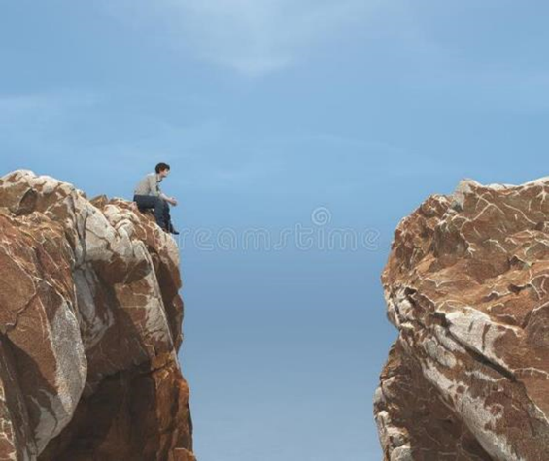
Lost
MATTHEW 14:30
But when he saw the wind boisterous, he was afraid; and beginning to sink, he cried, saying, Lord, save me.

Slide 3
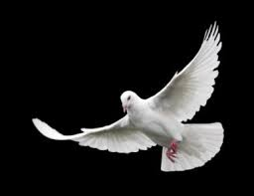
Saved…
II CORINTHIANS 5:17
Therefore if any man be in Christ, he is a new creature: old things are passed away; behold, all things are become new.

Slide 4
Deciding
RUTH 1:16
And Ruth said, Intreat me not to leave thee, or to return from following after thee: for whither thou goest, I will go; and where thou lodgest, I will lodge: thy people shall be my people, and thy God my God: 17 Where thou diest, will I die, and there will I be buried: the LORD do so to me, and more also, if ought but death part thee and me.

Slide 5
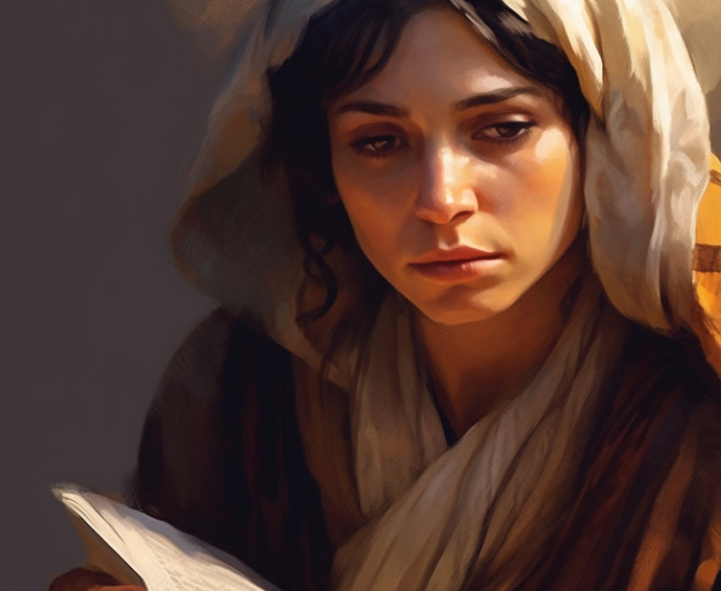
Rev. Chap. Five
254 Ruth, deciding, she had to make a decision - whether she was going to decide to go over there or not. She had to make a decision. Now, that's the way every believer has to do. You've got to leave your old haunts, you've got to leave your old life, you've got to leave the old things of the world. 61-0618

Slide 6
GOD.MAKING.HIS.PROMISE
12 God is the sole Judge of who is Christian and who's not. We can only judge ourselves as we weigh ourself in God’s Word and see how our life compares with His requirements… our attitude towards what He has required us to do. But I've noticed how He always keeps His Word to the person. If truly you’ve received Christ, there's nothing can take that away from you.
But the only way that we'll know we're saved is when we've met God's conditions. You're never saved by your feelings; you're saved by your faith. 56-1209

Slide 7
What Can I Do To Earn “Acceptance” In His Sight?
EPHESIANS 2:4-9
But God, who is rich in mercy, for his great love wherewith he loved us, 5 Even when we were dead in sins, hath quickened us together with Christ, (by grace ye are saved;) 6 And hath raised us up together, and made us sit together in heavenly places in Christ Jesus… 8 For by grace are ye saved through faith; and that not of yourselves: it is the gift of God: 9 Not of works, lest any man should boast.

Slide 8
LAW.HAVING.A.SHADOW
30 In the Old Testament the believer, maybe committed adultery, told a lie, he came with a lamb… The first thing, the lamb must be perfect… without a blemish for the sin offering. A lot of people think, "Well, I could be a Christian if I'd just could quit this. If I could just be a better man… a better woman."
You'll never be better in that estate. You can never get better until something comes in you to make you better, and then you're borned again. You can't do it.
54-1203

Slide 9
As it is written, There is none righteous, no, not one:
Romans 3:10
God’s Righteous Requirement
Sinner

Slide 10
HEBREWS 9:12
Neither by the blood of goats and calves, but by his own blood he entered in once into the holy place, having obtained eternal redemption for us.
Redeemed
Blood of Christ
Sinner

Slide 11
PROVING.HIS.WORD
264 When I'm praying, God don't see me, He just hears my voice through the Blood of Jesus. He don't see me, He hears my voice, He sees only the Blood. See, He don't see me, so I can't be dirty when I'm under the Blood. The Blood cleanses. He's the bumper between me and God… Do you believe that to be true?
64-0816

Slide 12
ADOPTION.2
108 Sins," s-i-n-s, we have forgiveness of our sins through His what? Blood, precious Blood.... (How do we get it? (Because we're worthy? we did something to have our sins forgiven?)... grace; Oh, my.
Nothing in my arms I bring, Lord. There isn't a thing I could do. He predestinated me; He called me; He chose me. I never chose Him. He chose me; He chose you; He chose all of us. We didn't choose Him. 60-0518

Slide 13
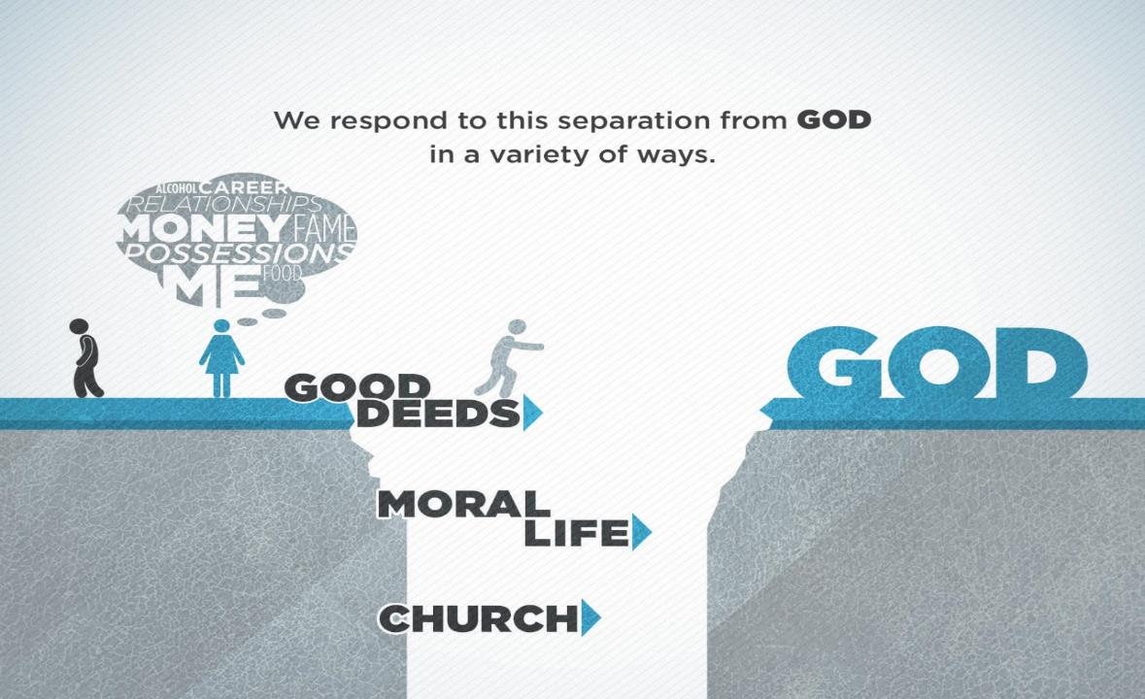

Slide 14
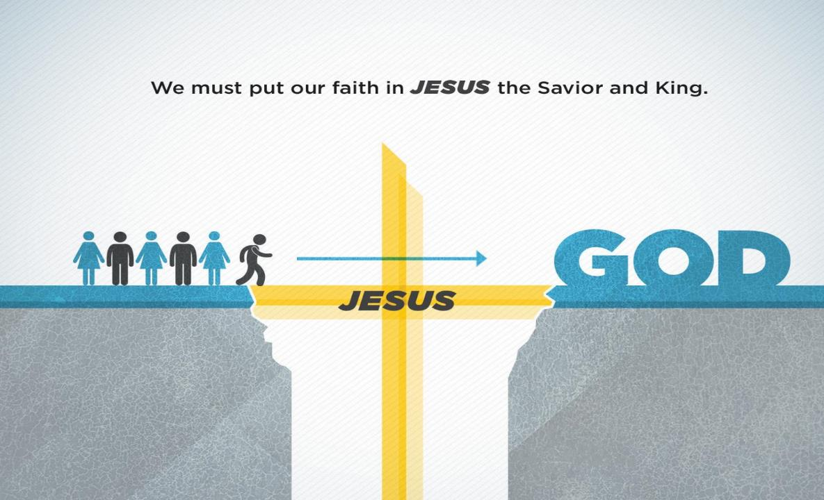

Slide 15
JOHN 15:15-16
15 Henceforth I call you not servants; for the servant knoweth not what his lord doeth: but I have called you friends; for all things that I have heard of my Father I have made known unto you.
16 Ye have not chosen me, but I have chosen you, and ordained you, that ye should go and bring forth fruit, and that your fruit should remain: that whatsoever ye shall ask of the Father in my name, he may give it you.

Slide 16
Ephesians 1:3-5
Blessed be the God and Father of our Lord Jesus Christ, who hath blessed us with all spiritual blessings in heavenly places in Christ:
According as he hath chosen us in him before the foundation of the world, that we should be holy and without blame before him in love: Having predestinated us unto the adoption of children by Jesus Christ to himself, according to the good pleasure of his will…

Slide 17
Grace Defined: GOD'S.WRAPPED.GIFT
27 Rahab the harlot, being a young girl turned on the street by a heathen father and mother, because she was beautiful, was to bring an income to them on prostitution... And yet, down in this immoral girl, she had heard that there was a God Who answered prayer. And the first opportunity that she got to accept that God… she did it. And God spared her life, and saved her father and mother, and her family. 60-1225

Slide 18
PSALM 86:15
But thou, O Lord, art a God full of compassion, and gracious, longsuffering, and plenteous in mercy and truth.
Grace: (Heb.) chen Favor, acceptance.
ESTHER 2:17
And the king loved Esther above all the women, and she obtained grace and favour in his sight more than all the virgins; so that he set the royal crown upon her head, and made her queen instead of Vashti.

Slide 19
Mercy
To have compassion on; to help one afflicted or seeking aid, bring help to the wretched. Compassion is for the miserable. By the atoning sacrifice of Christ a way is open for the exercise of mercy towards men.
MATTHEW 9:27
And when Jesus departed thence, two blind men followed him, crying, and saying, Thou Son of David, have mercy on us.

Slide 20
ROMANS 4:3-7 Abraham
For what saith the scripture? Abraham believed God, and it was counted unto him for righteousness. 4 Now to him that worketh is the reward not reckoned of grace, but of debt. 5 But to him that worketh not, but believeth on him that justifieth the ungodly, his faith is counted for righteousness. 6 Even as David also describeth the blessedness of the man, unto whom God imputeth righteousness without works, 7 Saying, Blessed are they whose iniquities are forgiven, and whose sins are covered. 8 Blessed is the man to whom the Lord will not impute sin.

Slide 21
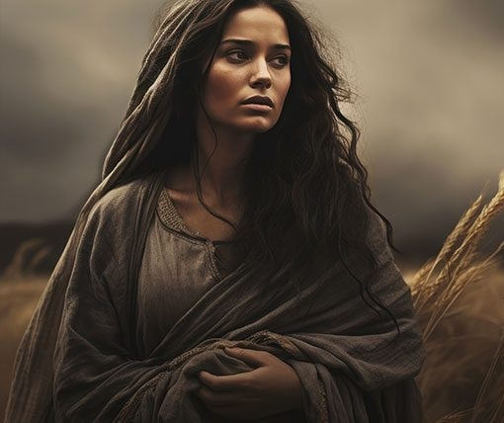
Ruth Deciding
PSALM 103:10-14
He hath not dealt with us after our sins; nor rewarded us according to our iniquities. 11 For as the heaven is high above the earth, so great is his mercy toward them that fear him. 12 As far as the east is from the west, so far hath he removed our transgressions from us.

Slide 22
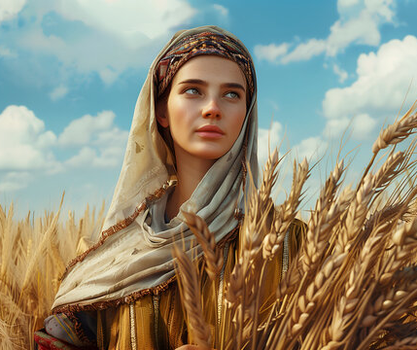
Grace
RUTH 2:10-11
Then she fell on her face, and bowed herself to the ground, and said unto him, Why have I found grace in thine eyes, that thou shouldest take knowledge of me, seeing I am a stranger? 11 And Boaz answered and said unto her, It hath fully been shewed me, all that thou hast done unto thy mother in law since the death of thine husband: and how thou hast left thy father and thy mother, and the land of thy nativity, and art come unto a people which thou knewest not heretofore.

Slide 23
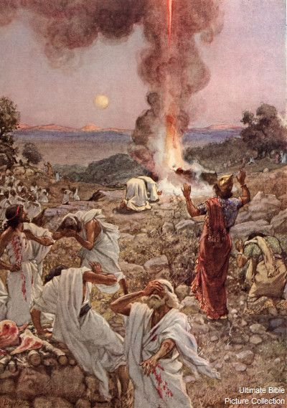
I KINGS 18:20-21
So Ahab sent unto all the children of Israel, and gathered the prophets together unto mount Carmel. 21 And Elijah came unto all the people, and said, How long halt ye between two opinions? if the LORD be God, follow him: but if Baal, then follow him. And the people answered him not a word.

Slide 24
The Kinsman Redeemer
30 I want to liken Naomi, the elder lady, to the Jewish Orthodox church. Ruth, the Moabite, a Gentile, being the Christian church, the new church. I want to approach it from four different phases: Ruth deciding, making her decision; Ruth serving; Ruth resting; Ruth rewarded.
... as her being a type of the Christian; as each individual represents the entire Christian nation. Did you know that? You, in your behavior, in the way you act and what you do, you represent the entire body of Christ.

Slide 25
You say, "But I'm just a lay member." That doesn't matter. When you take on that name of "Christian" you represent Christ in His church. You should live like gentlemen, like ladies. Don't never do things of the world, the whole eyes of heaven and earth is cast on you, to represent that one thing. No matter how weak you are, how little, hold your head right, because you are a Christian.
32 Now, Ruth was a pagan (served idols), so was Orpah. And they was on the road, coming back with mother-in-law, because she heard that down in Bethlehem, God had lifted the plague, and the people was having bread. 60-1002

Slide 26
AT.KADESH.BARNEA 56-0527
At the hour of decision, you've got to make up your mind. This church has got to make up its mind. Every man comes to a crucial hour… a judgment seat. You had to say, "I am guilty or I am not guilty." When you're standing before the judge, you've got to make up your mind. Tonight the Branham Tabernacle's got to make up its mind. You're going back to garlic, leeks stuff of Egypt, or you're going on with Angel's food to the promised land, where God made a promise. You're going to an old fashion Holy Ghost revival, or you'll be wishy-washy, pecking like a robin pecking on a

Slide 27
apple until the day you die. You've got to make your decision; you can't go on.
59 "Why halt ye between two opinions?" If the real experience of God is what takes the sin out of a man's heart... Education won't bring it… We thought the Big Four would settle all the wars. We thought educational program would save the whole world… Education and society will not save the world. There's only one Saviour for the world, the Blood of Jesus Christ, Who was freely poured out at Calvary for the remission of every sin…"He was wounded for our transgression..."

Slide 28
ROMANS 9:15-18
15 For he saith to Moses, I will have mercy on whom I will have mercy, and I will have compassion on whom I will have compassion. 16 So then it is not of him that willeth, nor of him that runneth, but of God that sheweth mercy. 17 For the scripture saith unto Pharaoh, Even for this same purpose have I raised thee up, that I might shew my power in thee, and that my name might be declared throughout all the earth. 18 Therefore hath he mercy on whom he will have mercy, and whom he will he hardeneth.

Slide 29
Examples of Grace:
ABRAHAM'S.SEED 59-0423
17 Jesus said, and we wouldn't argue with Him, "No man can come to Me except My Father draws him first." Then, it was God knocking at your heart, not you seeking God; it was God seeking you. So, the covenant is to you also, a grace covenant, because it's God's grace calling you.
You never chose Him; He chose you. Out of the millions in the world today, He reached down and chose you...

Slide 30
FELLOWSHIP 60-0611
40 …In the garden of Eden, when God saw that His children had sinned and had gone from Him, God Himself, Who is the supreme Judge, made a reconciliation so He could restore that fellowship to His creatures by the shed blood of an animal. And that shed blood lasted for a many years--speaking of the coming of Christ.

Slide 31
But one day, 1900 years ago… Jesus, purchased an eternal fellowship for us.... once for all, one time He has perfected forever those that have come into that fellowship, with an eternal blessing, eternal fellowship, with a eternal Presence of God, with the power of the Holy Ghost, not in a symbol, or some word, or some theology, but the Holy Ghost in you!
The power of God that raised Christ from the grave is made alive in you, and you are a new creature. Oh, it takes the Blood of Jesus Christ…

Slide 32
Abraham
ROMANS 5:1-5
Therefore being justified by faith, we have peace with God through our Lord Jesus Christ: 2 By whom also we have access by faith into this grace wherein we stand, and rejoice in hope of the glory of God. 3 And not only so, but we glory in tribulations also: knowing that tribulation worketh patience; 4 And patience, experience; and experience, hope: 5 And hope maketh not ashamed; because the love of God is shed abroad in our hearts by the Holy Ghost which is given unto us.

Slide 33
EVENTS.MADE.CLEAR.BY.PROPHECY
126 He's the same yesterday, today, and forever. It was then that He opened their eyes to know that Heb. 13:8.
At the evening time, events are made clear by the prophecy. What's taking place in the modern hour can be easily identified if you'll just believe the prophecy of the hour.
65-0801

Slide 34
II PETER 3:9-12
The Lord is not slack concerning his promise, as some men count slackness; but is longsuffering to us-ward, not willing that any should perish, but that all should come to repentance.
12 Looking for and hasting unto the coming of the day of God, wherein the heavens being on fire shall be dissolved, and the elements shall melt with fervent heat?

Slide 35
REVELATION 7:1
And after these things I saw four angels standing on the four corners of the earth, holding the four winds of the earth, that the wind should not blow on the earth, nor on the sea, nor on any tree.
WATER.FROM.THE.ROCK
18 "Not willing that any should perish, long-suffering.“ The bomb that would probably burst every atom in the earth is hanging yonder in Russia tonight. It ought to have been fired a long time ago, but God's long-suffering, not willing that any should perish, past due.
55-0224

Slide 36
GREATEST.BATTLE.EVER.FOUGHT
403 What you fussing and hollering about Russia? They ain't going to win no wars. They ain't going to conquer no world. Communism isn't going to conquer no world.
404 To the world, I speak, or wherever these tapes may go. Russia, communism, isn't conquering nothing. God's Word can't fail. Romanism is going to conquer the world.
62-0311

Slide 37
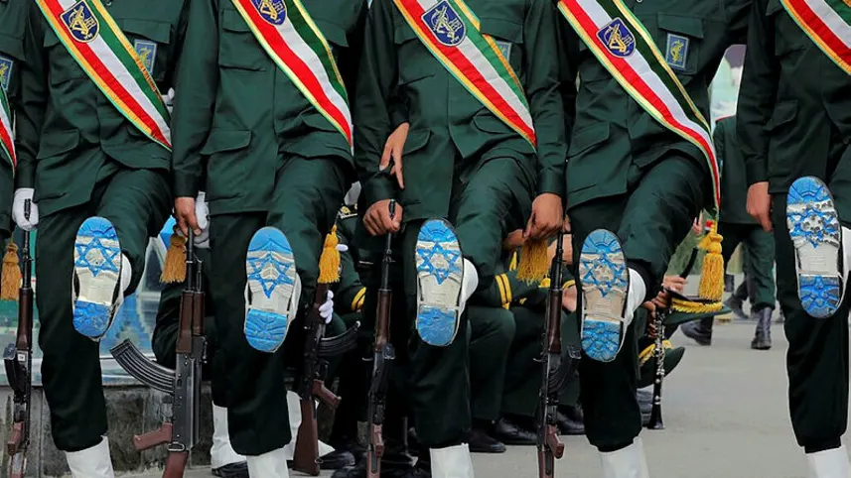
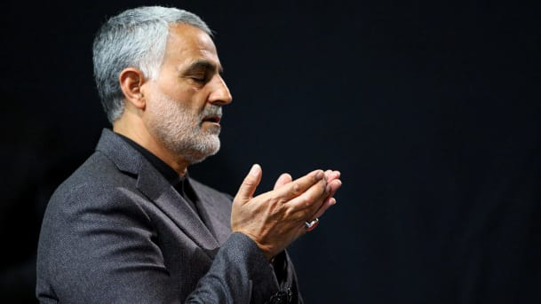
Commander of the Iranian Revolutionary Guard's Quds Force, Gen. Qasem Soleimani

Slide 38
LUKE 21:5-9
And as some spake of the temple, how it was adorned with goodly stones and gifts, he said, 6 As for these things which ye behold, the days will come, in the which there shall not be left one stone upon another, that shall not be thrown down. 7 And they asked him, saying, Master, but when shall these things be? and what sign will there be when these things shall come to pass?

Slide 39
8 And he said, Take heed that ye be not deceived: for many shall come in my name, saying, I am Christ; and the time draweth near: go ye not therefore after them. 9 But when ye shall hear of wars and commotions, [instability, state of disorder, disturbance, confusion] be not terrified: for these things must first come to pass; but the end is not by and by.

Slide 40
A.SECONDHANDED.ROBE
8 …we're coming down to the gathering time, the harvest time. Genesis was a planting of the seed, these six thousand years has been the maturing of the harvest; and now the seed has become a seed itself. It's the gathering time now, harvest time, all the great things that started.
The true Church that started in Genesis has come down to the fruit time... And the antichrist that started in Genesis is come down to its fruit.

Slide 41
And we're just in the closing time of this world's entire dispensation... It's the greatest time that anyone ever lived, is this time. It's a shaking time. It's a trouble-some time for sinners.
But a marvelous time for Christians, because we know that we are gathering the last little efforts together to go home and meet the Lord.
56-1125

Slide 42
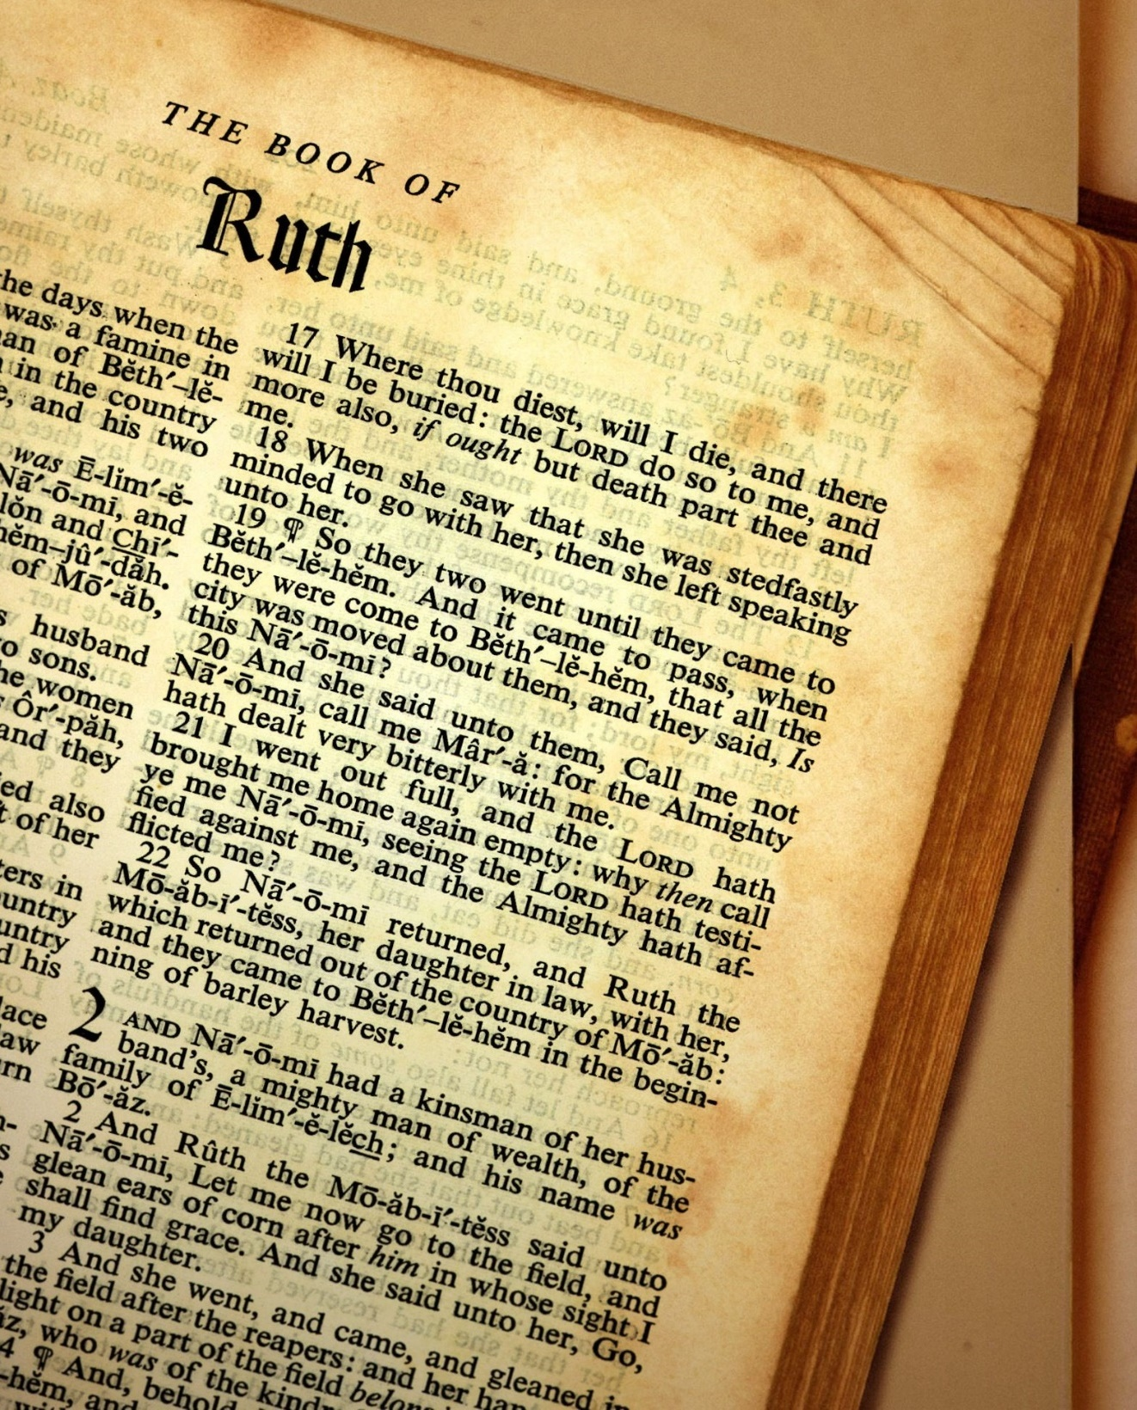
RUTH 3:16
And when she came to her mother in law, she said, Who art thou, my daughter? And she told her all that the man had done to her.

Slide 43
PERFECT.STRENGTH.BY.PERFECT.WEAKNESS
379 While you're making your decisions... "Why halt ye between two opinions?" You heard what He said. If God be God, serve Him; if the world be god, just continue on. If the denominational way is right, go on with it; but if the Bible is right, then come to It. Choose you this hour whom ye shall serve.
61-1119

