Slide 1
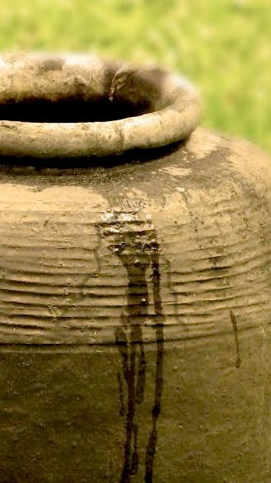
Springs Of Living Water 3
“As I See It”
ISAIAH 5:20-21
Woe unto them that call evil good, and good evil; that put darkness for light, and light for darkness; that put bitter for sweet, and sweet for bitter! 21 Woe unto them that are wise in their own eyes, and prudent in their own sight!

Slide 2

April 4th Tendai Esau
April 6th Becky Coffey
Joe & Frieda Drum
April 7th Anna Jackson,
Sarah Buchanan
April 8th Rachel Pritchard
April 11th Crystal Johnson,
Theo Cross

Slide 3
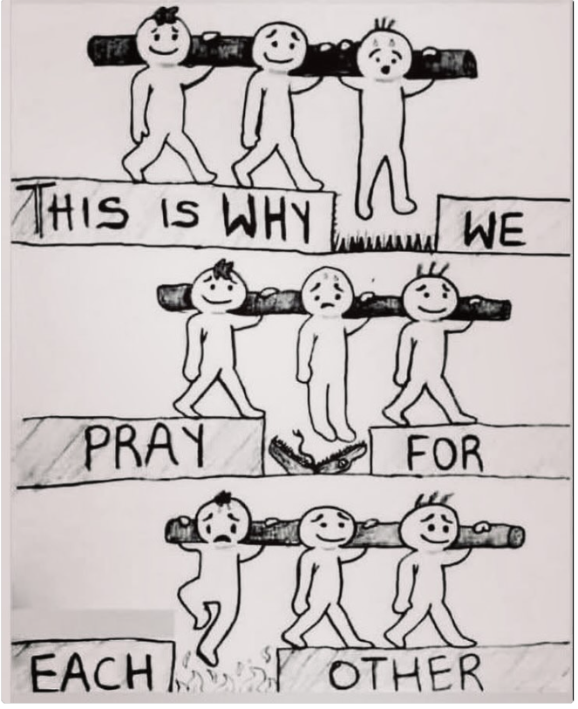
Bear ye one another's burdens, and so fulfil the law of Christ. Gal. 6:2

Slide 4
Springs Of Living Water 3
“As I See It”
ISAIAH 5:20-21
Woe unto them that call evil good, and good evil; that put darkness for light, and light for darkness; that put bitter for sweet, and sweet for bitter! 21 Woe unto them that are wise in their own eyes, and prudent in their own sight!

Slide 5
NUMBERS 13:32-33
And they brought up an evil report of the land which they had searched unto the children of Israel, saying, The land, through which we have gone to search it, is a land that eateth up the inhabitants thereof; and all the people that we saw in it are men of a great stature. 33 And there we saw the giants, the sons of Anak, which come of the giants: and we were in our own sight as grasshoppers, and so we were in their sight.
JUDGES 17:6 In those days there was no king in Israel, but every man did that which was right in his own eyes.
PROVERBS 16:2All the ways [moral] of a man are clean in his own eyes; but the LORD weigheth the spirits.

Slide 6
WORKS.IS.FAITH.EXPRESSED
10 I was thinking about, tonight, preaching on a subject of the Rapture to the church. How the conditions, as I see it in the Scripture, what conditions the Church will have to be in for the Rapture, and what will take place just before the Rapture takes place, and how it will take place.
65-1126

Slide 7
DIVINE.HEALING
210 And...?... the great storm of formality, the great storm of indifference, a great storm of denial of God, "O God, don't let me try to beat the Light out. Let me use It to walk in. I believe it, Lord." There you are. Walk in the Light. "As I see it in the Scripture, that's Light. It's God's Word, and let me walk in it. Lord, Lord, let me walk in it; never, never try to deny It.“
54-1219

Slide 8
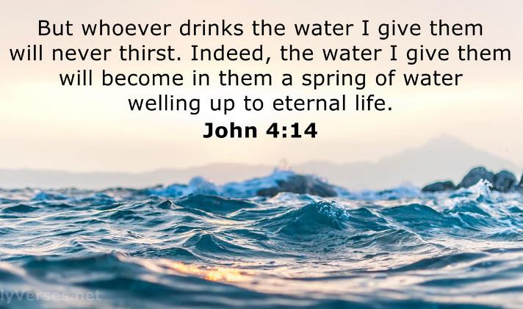
JOHN 7:37-39
In the last day, that great day
of the feast, Jesus stood and
cried, saying, If any man thirst,
let him come unto me, and
drink. 38 He that believeth on
me, as the scripture hath said,
out of his belly shall flow rivers
of living water. 39 (But this
spake he of the Spirit, which they that believe on him should receive: for the Holy Ghost was not yet given; because that Jesus was not yet glorified.)

Slide 9
BROKEN.CISTERNS*
121 That's the way it is with a born-again experience. You cannot contain it. It's a well of water within you, bubbling up into everlasting Life, there is something about it, you have nothing to do with… No, you don't have to wait on local rains and local revivals. You are full of It. "I'll give unto him a fountain of Life, in him..." There's something in It, fresh every day, pure and clean. I don't care what kind of weather, you’re still happy because the Holy Spirit is in there bubbling up. It's the hidden Power, it's secret is within it. 65-0123

Slide 10
GOD'S.PROVIDED.WAY
10 Now, a righteous man is not a sinless man. Notice, "Elijah was a man subject to like passions as we are." And the Scripture of his life proves he had his ups-and-downs like we do. He had his times of wondering, times that his temper got away from him, a lot of things that went wrong. But he was still a righteous man, because he confessed his unworthiness, believed in God. That's what made him righteous.
We're not righteous within ourselves; we're righteous through Jesus Christ. I cannot be sanctified within myself; I am sanctified through Jesus Christ Who stands in the Presence of God in my place.

Slide 11
REVELATION 3:15
I know thy works, that thou art neither cold nor hot: I would thou wert cold or hot. 16 So then because thou art lukewarm, and neither cold nor hot, I will spue thee out of my mouth. 17 Because thou sayest, I am rich, and increased with goods, and have need of nothing; and knowest not that thou art wretched, and miserable, and poor, and blind, and naked:

Slide 12
ISAIAH 5:20
Woe unto them that call evil good, and good evil; that put darkness for light, and light for darkness; that put bitter for sweet, and sweet for bitter! 21 Woe unto them that are wise in their own eyes, and prudent in their own sight!

Slide 13
JEREMIAH 7:2-4
Stand in the gate of the LORD'S house, and proclaim there this word, and say, Hear the word of the LORD, all ye of Judah, that enter in at these gates to worship the LORD. 3 Thus saith the LORD of hosts, the God of Israel, Amend your ways and your doings, and I will cause you to dwell in this place. 4 Trust ye not in lying words, saying, The temple of the LORD, The temple of the LORD, The temple of the LORD, are these.

Slide 14
JEREMIAH 29:6-7
Take ye wives, and beget sons and daughters; and take wives for your sons, and give your daughters to husbands, that they may bear sons and daughters; that ye may be increased there, and not diminished. 7 And seek the peace of the city whither I have caused you to be carried away captives, and pray unto the LORD for it: for in the peace thereof shall ye have peace.
I TIMOTHY 2:1-4
I exhort therefore, that, first of all, supplications, prayers, intercessions, and giving of thanks, be made for all men; 2 For kings, and for all that are in authority; that we may lead a quiet and peaceable life in all godliness and honesty. 3 For this is good and acceptable in the sight of God our Saviour; 4 Who will have all men to be saved, and to come unto the knowledge of the truth.

Slide 15
Dual Role: BLIND.BARTIMAEUS
11 And God, to serve Him, is like a dual personality, I guess, or something. You go out here and you like to work, to help build a house, go fishing or hunting, or whatever, you're just on your own then.
But when that Spirit of God strikes you, it's something different then. It's the anointing of God using that individual vessel. 54-0402

Slide 16
THE.HANDWRITING.ON.THE.WALL
33 Talking to a man in Idaho, "Well, Mr. Branham, I raised hogs. My grandfather had this herd. He educated us children. And the same herd, I've educated my children. And my children will come up and educate theirs by the same herd."
I said, "That's very nice, sir, that's a legitimate job. But did you know God put you here for some other purpose besides raise hogs to educate your children? God put you here to be sons and daughters of God, and if you fail to get that, you fail to receive the very purpose God put you on earth to be.“ No matter how honest, decent, how moral, how good you might be: you fail to answer the purpose that God put you on the earth to be. 56-0902

Slide 17
THE.UNCERTAIN.SOUND
43 Israel was a perfect type of this nation… a God-fearing people in bondage to the Egyptians. They left that land of bondage… (Don't you fail to get this!) come to their promised land, drove back the occupants, and inhabited the land. We did the same thing. And we wanted to be a God-fearing people that loved God, had freedom of religion...
When Israel started out, they had God-fearing leaders: David, Solomon. Israel was known all over the world, all nations, and they all respected them. That showed what God could do with a bunch of men and women that feared Him and lived godly before Him. 61-0415

Slide 18
JAMES 4:6-7
But he giveth more grace. Wherefore he saith, God resisteth the proud, but giveth grace unto the humble. 7 Submit yourselves therefore to God. Resist the devil, and he will flee from you.
I PETER 5:5-6
Likewise, ye younger, submit yourselves unto the elder. Yea, all of you be subject one to another, and be clothed with humility: for God resisteth the proud, and giveth grace to the humble. 6 Humble yourselves therefore under the mighty hand of God, that he may exalt you in due time:

Slide 19
Humble: (Gr.) tapeinoo
Metaph. To assign a lower rank or place to; to abase; to be ranked below others who are honoured or rewarded; to humble or abase myself by humble living.
To have a modest opinion of one's self, to behave in an unassuming manner, devoid of all arrogance.

Slide 20
II TIMOTHY 3:1-5
This know also, that in the last days perilous times shall come. 2 For men shall be lovers of their own selves, covetous, boasters, proud, blasphemers, disobedient to parents, unthankful, unholy, 3 Without natural affection, truce-breakers, false accusers, incontinent, fierce, despisers of those that are good, 4 Traitors, heady (reckless), highminded,[puffed u[ with conceit] lovers of pleasures more than lovers of God; 5 Having a form of godliness, but denying the power thereof: from such turn away.

Slide 21
JEREMIAH 9:23-26
Thus saith the LORD, Let not the wise man glory in his wisdom, neither let the mighty man glory in his might, let not the rich man glory in his riches:24 But let him that glorieth glory in this, that he understandeth and knoweth me, that I am the LORD which exercise lovingkindness, judgment, and righteousness, in the earth: for in these things I delight, saith the LORD. 25 Behold, the days come, saith the LORD, that I will punish all them which are circumcised with the uncircumcised; 26 Egypt, and Judah, and Edom, and the children of Ammon, and Moab, and all that are in the utmost corners, that dwell in the wilderness: for all these nations are uncircumcised, and all the house of Israel are uncircumcised in the heart.

Slide 22
Why Pray?
“Prayer is not overcoming God's reluctance.
It is laying hold of His willingness.”
Martin Luther

Slide 23
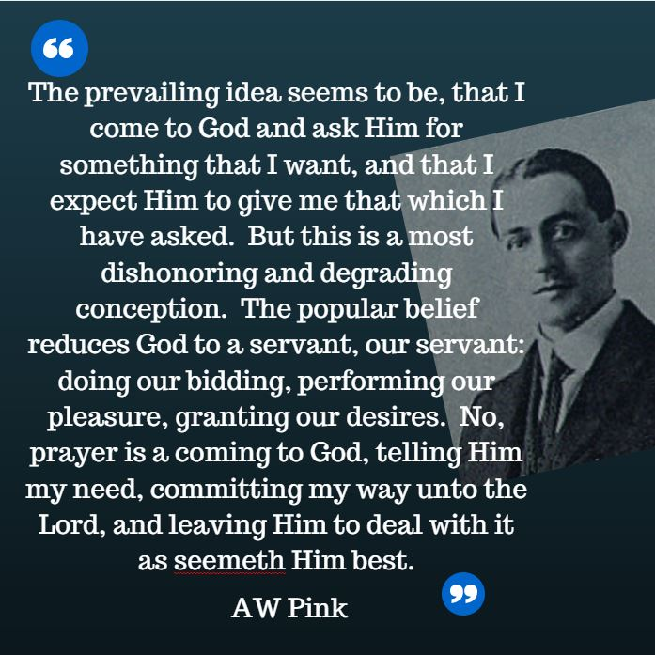

Slide 24
Example: ACTS 12:20-24
20 And Herod was highly displeased with them of Tyre and Sidon: but they came with one accord to him, and, having made Blastus the king's chamberlain their friend, desired peace; because their country was nourished by the king's country. 21 And upon a set day Herod, arrayed in royal apparel, sat upon his throne, and made an oration unto them. 22 And the people gave a shout, saying, It is the voice of a god, and not of a man. 23 And immediately the angel of the Lord smote him, because he gave not God the glory: and he was eaten of worms, and gave up the ghost. 24 But the word of God grew and multiplied.

Slide 25
Example: DANIEL 4:30-33
The king spake, and said, Is not this great Babylon, that I have built for the house of the kingdom by the might of my power, and for the honour of my majesty? 31 While the word was in the king's mouth, there fell a voice from heaven, saying, O king Nebuchadnezzar, to thee it is spoken; The kingdom is departed from thee. 32 And they shall drive thee from men, and thy dwelling shall be with the beasts of the field: they shall make thee to eat grass as oxen, and seven times shall pass over thee, until thou know that the most High ruleth in the kingdom of men, and giveth it to whomsoever he will. 33 The same hour was the thing fulfilled upon Nebuchadnezzar: and he was driven from men, and did eat grass as oxen, and his body was wet with the dew of heaven, till his hairs were grown like eagles' feathers, and his nails like birds' claws.

Slide 26
34 And at the end of the days I Nebuchadnezzar lifted up mine eyes unto heaven, and mine understanding returned unto me, and I blessed the most High, and I praised and honoured him that liveth for ever, whose dominion is an everlasting dominion, and his kingdom is from generation to generation: 35 And all the inhabitants of the earth are reputed as nothing: and he doeth according to his will in the army of heaven, and among the inhabitants of the earth: and none can stay his hand, or say unto him, What doest thou…? 37 Now I Nebuchadnezzar praise and extol and honour the King of heaven, all whose works are truth, and his ways judgment: and those that walk in pride he is able to abase.

Slide 27
INFLUENCE
37 Uzziah held this standard. He was a great influence to Isaiah the prophet. Then Uzziah made that fatal mistake, like many people does. When he felt secured, felt he had the whole thing in his hand, he got lifted up in his spirit, lifted up to pride. Now, there's a real example for us all.
You know, that's been the trouble. I'm speaking to Christians and ministers… And that's where many ministers even make a mistake. We've heard so many times about the ministers, the acts that they do, and the things, some of them maybe to doing things they should not do. 63-1114

Slide 28
I think sometimes, them are good men, wonderful Christians that's been used of the Lord. Then they get a little kingdom built around them, or a lot of influence, many people attending their meetings, until they get careless, and they get kinda lifted up. The people applaud them and stand up, we shouldn't really do that. We, remember there's no big people among us. Why, we're all just God's children.
If God made some of us one thing and some another, He made me with a finger and an eye, so forth. Well, we got to appreciate each other, and then not try to feel big. Because we're all connected together to one God and we all come off of one tree.

Slide 29
LIFE
39 That's the way it is with some of this "shake-hands" religion. I believe in being born again: go back to the beginning, and die out, and be re-molded. If you don't, there's going to be a blowup somewhere down along the road.
It'll blow up on you when the pressure comes. So let's hold the pressure.
62-0719

Slide 30
THE.MARRIAGE.OF.THE.LAMB
54 "If the Lord will take this evil spirit from me, from drinking, or gambling, lying, or stealing, I'll serve Him."
55 But that's up to you. You got to do something, too. "They that overcome shall inherit all things." You have power to do it, but you must be willing to lay it down. "She has made Herself ready."
56 See, God could not push us through a little pipe, pull us out on the other end, then say, "Blessed is he that over-cometh." You had nothing to overcome; He just pushed you through. But you've got to make decisions for yourself. In doing that, we show our faith and respects to God. 62-0121

Slide 31
WHAT.DOES.IT.TAKE.TO.MAKE.A.CHRISTIAN.LIFE
34 When you receive the Holy Spirit It goes right in the middle of that new disposition of yours. "Oh, I quit drinking; smoking. I just feel like a different person." He makes every motion, every intellectual, everything agree right into this middle of the wheel… And when you have these little temper fits and you fly off, tell lies and so narrow minded you couldn't hear another minister, remember, the Holy Spirit isn't ticking in the inside of you.
35 The Holy Spirit will make every movement like Christ. It'll make you Christ-like. The fruits of the Spirit is love, joy, peace, longsuffering, goodness, etc.

Slide 32
Those things the Holy Spirit controls, our emotions.
The Holy Spirit brings you [under] control of God, walk in peace, love, joy, long-suffering, goodness, meekness, gentleness, patience. It isn't something that you do. It's something the Holy Spirit does in you. It's no longer an intellectual thought of yours; it's a subconscious moving of the Holy Spirit. Church of the living God, there's where our Pentecostal move failed. We have some man-made musical, clap hands, jump up-and-down emotion. 57-0113

Slide 33
GO.TELL.MY.DISCIPLES
146 And, brother, sister, as long as down in my heart, through the black clouds of torment, and trials, and troubles, if I can feel the Holy Spirit press through once in a while and give me a blessing, I know the power of God still lives and reigns somewhere.
53-0405S

Slide 34
LIFE
39 That's the way it is with some of this "shake-hands" religion. I believe in being born again: go back to the beginning, and die out, and be re-molded. If you don't, there's going to be a blowup somewhere down along the road.
It'll blow up on you when the pressure comes. So let's hold the pressure.
62-0719

Slide 35
It was Pride that changed angels into devils; it is humility that makes men as angels.
Augustine

Slide 37
Default (w)
The thing that exists or happens if you do not change it intentionally. A selection made, usually automatically, or without active consideration.
Absolute:
A value or principle which is regarded as universally valid or which may be viewed without relation to other things.

Slide 38
Absolute Truth is something that is true at all times and in all places. It is something that is always true no matter what the circumstances.
The Greenland Shark has an average lifespan of 272 years.
Honey never spoils.
Every planet of the whole solar system can fit between the earth and the moon.
The biggest tire manufacturer in the world is Lego. The company makes more than 50% more tires than other tire manufacturers such as Bridgestone or Goodyear.

Slide 39
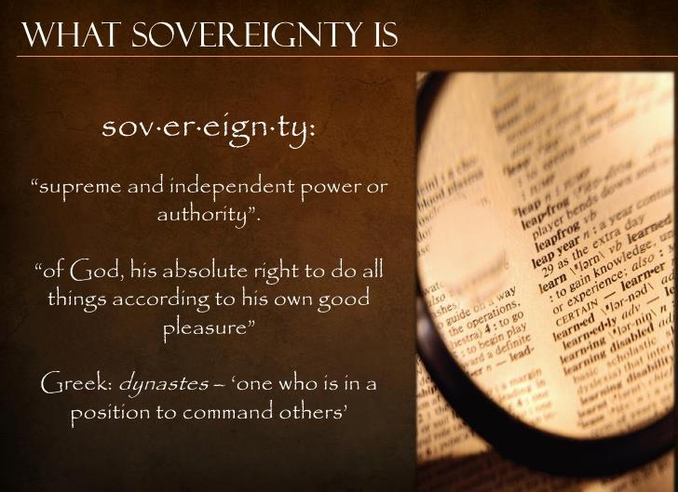
Sovereignty (God) is the supreme authority, and all things are under His control. His Sovereignty
is His "absolute right to do all things according to his own good pleasure."

