Slide 1

How Will I Know?
A Short Study on the Subject of Exercising Spiritual Discernment
I Cor. 2:14-16
If I Was A Young Person
in the Message Today

Slide 2
MATTHEW 23:37-38 (Pastor)
O Jerusalem, Jerusalem, thou that killest the prophets, and stonest them which are sent unto thee, how often would I have gathered thy children together, even as a hen gathereth her chickens under her wings, and ye would not! 38 Behold, your house is left unto you desolate.

Slide 3
DISCERNING.BODY.OF.LORD
5-2 We should have a discernment on everything that we do. It ought to be measured by the Word of God. All that Christians do and say should be measured by the Word of God.
59-0812

Slide 4
PROVERBS 24:16
For a just man falleth seven times, and riseth up again: but the wicked shall fall into mischief.
“Paralysis of Analysis”

Slide 5
COL. 3:15 And let the peace of God rule in your hearts, to the which also ye are called in one body; and be ye thankful.
If you lose the peace of God, don’t do it.
If it lacks the blessings of God, don’t do it.
If it is done in haste, don’t feel pressured to do it.
If it is not line upon line (progressively) don’t do it.
If it is without faith, don’t do it.
If it aims to please the flesh, don’t do it.
God doesn’t speak to the prayerless.
JOB 33:26 He shall pray unto God, and he will be favourable unto him: and he shall see his face with joy: for he will render unto man his righteousness.

Slide 6
Discernment is a richer and deeper concept than “deciding”. The goal of discernment is to see beyond the mere external attributes of something, and to probe to its deeper significance.
Discern: (Latin) dis- “off, or away” + cernere which means to distinguish, separate, sift, set apart, divide.
To discern is to distinguish or sort out what is of God, and what is of the flesh, the world or the devil. As such, discernment, in its root meaning is something that ought to precede decision and aid it.

Slide 7
HEBREWS 5:14
But strong meat belongeth to them that are of full age, even those who by reason of use have their senses exercised to discern both good and evil.

Slide 8
I CORINTHIANS 2:14-16
14 But the natural man receiveth not the things of the Spirit of God: for they are foolishness unto him: neither can he know them, because they are spiritually discerned. 15 But he that is spiritual judgeth all things, yet he himself is judged of no man. 16 For who hath known the mind of the Lord, that he may instruct him? But we have the mind of Christ.

Slide 9
The Carnal Man: Unregenerate, wild, insensitive to Spiritual things;
The Natural Man: Eloquent, Intelligent, Respectful, but the Spiritual content of Scripture is hidden;
The Spirit Man: Led by the Spirit, renewed and walking in harmony with the Spirit of God.

Slide 10
Judgeth: (Gr.) anakrino
Investigate, sift, examine, scrutinize, question.
In a forensic sense of a judge to hold an investigation; determine excellence or defect of a person or thing. Fundamentally, discernment is the ability to judge well. Whether it’s choices we make or people we interact with, discernment is the gift of recognizing the moral and practical consequences of our decisions.

Slide 11
Solomon’s Prayer:
I Kings 3: 9-10
Give therefore thy servant an understanding heart to judge thy people, that I may discern between good and bad: for who is able to judge this thy so great a people? 10 And the speech pleased the Lord, that Solomon had asked this thing.

Slide 12
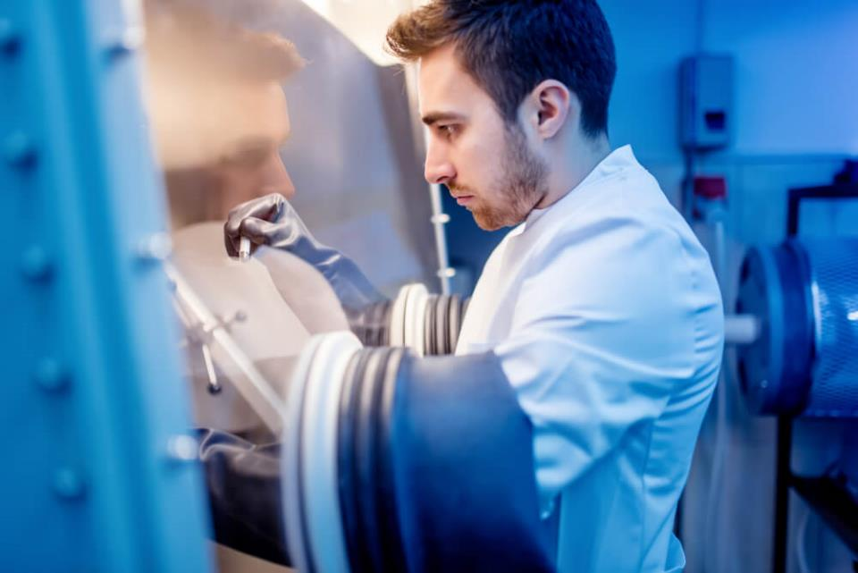
Forensic
Science

Slide 13
ACTS 17:10-11
10 And the brethren immediately sent away Paul and Silas by night unto Berea: who coming thither went into the synagogue of the Jews.
11 These were more noble than those in Thessalonica, in that they received the word with all readiness of mind, and searched the scriptures daily, whether those things were so.

Slide 14
[CJB] 7 And Jason has let them stay in his home! All of them are defying the decrees of the Emperor; because they assert that there is another king, Yeshua!” 8 Their words threw the crowd and the authorities into a turmoil, 9 so that only after Jason and the others had posted bond did they let them go. 10 But as soon as night fell, the brothers sent Sha’ul and Sila off to Berea.
As soon as they arrived, they went to the synagogue. 11 Now the people here were of nobler character than the ones in Thessalonica; they eagerly welcomed the message, checking the Tanakh every day to see if the things Sha’ul was saying were true. 12 Many of them came to trust…

Slide 15
GETTING.IN.THE.SPIRIT 61-0428
98 If I'd bring this woman up here, say, "The Lord sent me to pray for the sick. Let me lay hands on you, anoint you with oil. Glory to God. You're going to be healed." She's got a right to believe that. But she could doubt it whether I'm telling her the truth or not… But when the Holy Spirit comes and speaks through my lips and tell her something she has been. That takes the kink out of it right there. 'Cause she knows I don't know her.
You say "Bro. Branham, you're the Messiah?" If you think that, it shows you haven't got spiritual discernment.

Slide 16
WHAT.HOLY.GHOST.
WAS.GIVEN.FOR
3 And all that God promised to His church lays within the Holy Spirit.
59-1217
MATTHEW 24:24
For there shall arise false Christs, and false prophets, and shall shew great signs and wonders; insomuch that, if it were possible, they shall deceive the very elect.

Slide 17
How do you Exercise Discernment?
1. Identifying the Issue.
2. Taking time to pray about the choice.
3. Making a wholehearted decision.
4. Discussing the choice with a mentor.
5. Finally, trusting the decision made.

Slide 18
THE.ANOINTED.ONES
46 Same Holy Spirit that anoints the Church, gives them desire to save souls, gives them power to perform miracles, It falls on the unjust the same as the just. The very same Spirit!
Now, you can't make it another way and understand Matt 24:24, "There shall rise false Christs," false, anointed ones. Anointed with the genuine Thing, but be false prophets of It, false teachers of It.
65-0725

Slide 19
TIME.OF.DECISION
21 Before you get married, you have to decide on what girl you're going to make your wife. And you women have to decide on what man's going to be your husband.
59-0418

Slide 20
DISCERNING.BODY.OF.LORD
11-2 ...God can start moving, and spiritual things happening, people getting saved and filled with the Holy Spirit; many thousands who call themselves Christians will pull back from it and say, "Oh, that's holy-rollers." You haven't got spiritual discernment, for everything the Holy Ghost does is written in the Bible. Judge all things by the Scripture. That's how we discern to see if our discernment is right.
59-0812

Slide 21
Dear Bro. Barry
I have a friend (girl) and I am amazed at what God is doing in her life, yet she has such different standards to those we are encouraged to have. Can you explain what is going on? I struggle to understand.
She started going to a church, was not in the ‘in crowd’ there, but for her discovering God was more important than making friends with people at church. Six years later she is someone on fire for God. She loves reading the Bible, God gave her this desire.
Recently she read the Bible through in 42 days! She loves to go to church, hear sermons, read Christian books, evangelize, find out more about God. She experiences the supernatural, has the gift of tongues and experiences the leadership of the spirit of God in her life. She has been blessed too with a major love for God.

Slide 22
She has been involved in youth work in her church and the way she prays is genuine. However, wearing trousers is not an issue, nor cutting her hair. She is happy to go swimming. She uses the Bible as her absolute, has also led services in her church (just for the youth.) Also, before becoming a Christian, she was involved in gangs and hip-hop music. When she became a Christian, she found Christian Hip-Hop to be a very helpful medium to be encouraged in her faith and continues to find it a blessing. I find this hard to understand.
When you look at some of the fruits you’d say that this is the life I would want – a supernatural life, with God at the centre, a real love for Jesus. Can you explain at all?

Slide 23
Marriage Question
THE.CHOOSING.OF.A.BRIDE
125 God's first Adam didn't have any choice, for his wife… So we find out that she led him astray from God's Word. He didn't get to pray over the matter. Her motives and objectives were simply wrong... And how many women today, and men, could pull a good woman away from God, or pull a good man away from God, by trying to tell him, "That's old-fashion..." You better pray hard before you marry that girl. I don't care how pretty she is.

Slide 24
128 She persuaded him out of the will of God... That's why the Bible forbids her to teach, or preach, or to handle God's Word, in any manner. I know, sister, many of you say, "The Lord called me to preach.” I'm not going to argue with you.
But I'm going to tell you, the Word says you not to do it.

Slide 25
II CORINTHIANS 6:14-17
Be ye not unequally yoked together with unbelievers: for what fellowship hath righteousness with unrighteousness? and what communion hath light with darkness? 15 And what concord hath Christ with Belial? or what part hath he that believeth with an infidel? 16 And what agreement hath the temple of God with idols? for ye are the temple of the living God; as God hath said, I will dwell in them, and walk in them; and I will be their God, and they shall be my people. 17 Where-fore come out from among them, and be ye separate, saith the Lord, and touch not the unclean thing…

Slide 26
CHOOSING.OF.A.BRIDE
8-6 And if we would study what we were doing when we get married, when we choose our wife or husband... A man should pray earnestly... Remember the vow is "Until death do we part." And he could ruin his life by making the wrong choice... If the woman [or man] takes a husband and knows that he's not fit to be a husband to you, then that's your own fault after you know what's right and wrong. So you shouldn't do it until you thoroughly pray through. 65-0429

Slide 27
TIME.OF.DECISION
13 …Time came, Abraham was determined that he did not want his son to marry an unbeliever. That would be good decision for a Christians today, who are sons and daughters of Abraham, to make the same decision about their children. Now, it didn't make any difference how pretty those unbelieving girls were, and how nice a women they were, but Abraham did not want his son connected with that kind of stuff.
59-0611

Slide 28
ABSOLUTE
9 When a young man is going to get married to a young woman, he must know the character of this young woman… [young man] something that she can hold to.
Will this man be a just man? Will he make me the right type of husband? Will this woman give to me in life what I expect out of her, of loyalty and so forth?
63-0304

Slide 29
INVASION.OF.THE.USA
213 I can take my boy, let him be out for a day with somebody; let me come in, I can almost tell you who he's been with. Watch, that environment, that spirit catches him. (Churches) You take a man that's a good moral man, and let him marry a little old woman that ain't worth a dime; it isn't long till he ain't worth a dime either. That's what happened to Ahab.

Slide 30
How could I go, this morning, and point my hands on little broken up homes and things like that… What is it? It's the devil. It's the devil, the invasion. He swept into this nation like a roaring lion. He set hisself down here in the best place they had, in Hollywood. He said, "I can get the movies here until the television comes on, then I'll get them.“ I ain't got nothing against the movie. I ain't got nothing against television. It's the rotten stuff that's on it.
54-0509

Slide 31
BE.CERTAIN.OF.GOD
5 And then in his wedding, instead of marrying among his own people, he went over and married a sinner, an idolater, worship of idols. He married Jezebel. And she was not a believer.
And no believer should ever marry an unbeliever, under no circumstances: should always marry believers.
59-0125

Slide 32
MAN.RUNNING.FROM.PRESENCE 65-0217
48 We got so many things we have to do, responsibility to face. When you get married, you've got to take responsibility.... Maybe you build a home... And as a married woman you got to think of the responsibility of raising children… the responsibility of educating your children… clothing and feeding. So easy when responsibilities face us to shirk from them.

Slide 33
COD 59-1219
431-98 A lying spirit come up from underneath, said, "If you'll just permit me. I'm a lying spirit. I'll go down and get in all them preachers, 'cause they haven't got the Holy Ghost; (They're just school-trained boys.) and I'll go down, and get in every one of them, and deceive them, and make them prophesy a lie…” A lying spirit working to the will of God.
... And watch how those evil spirits, how they'll move. Paul speaking: It is reported commonly that there's fornications among you... named among the Gentiles,... (What do you think about that amongst the church?)

Slide 34
I CORINTHIANS 5:1
It is reported commonly that there is fornication among you, and such fornication as is not so much as named among the Gentiles, that one should have his father's wife.
EPHESIANS 5:1-3
Be ye therefore followers of God, as dear children; 2 And walk in love, as Christ also hath loved us, and hath given himself for us an offering and a sacrifice to God for a sweetsmelling savour. 3 But fornication, and all uncleanness, or covetousness, let it not be once named among you, as becometh saints;

Slide 35
MAKING.THE.VALLEY.FULL.OF.DITCHES
5 Drink, gamble... A lot of places allow the kids to smoke in the school, just before semester to quieten their nerves. They ought to had a prayer meeting. That's the best thing I know to quieten your nerves. But you know, hungry people has got to fill that longing with something. If they won't drink from the Fountain of the waters of Life, the devil will give them a stagnated cistern with wiggletails in it.

Slide 36
So they'll drink from somewhere. I feel sorry for them because of the let-down and pollution of our modern churches. That's one of the things that I lay it to, the social gospel that people preach.
Why, in our own city of Jeffersonville a certain pastor every Saturday night has a square dance in the bottom of the church. Teaches square dancing: famous denominational church, a square dance...
56-0728

Slide 37
CHURCH.AGE.BOOK
15-3 Revelation shows how that the antichrist spirit would come into the church and defile it, making it lukewarm, formal, powerless. It exposes Satan, revealing his works (attempted destruction of God's people and the discrediting of God's word) right down to the time he is cast into the lake of fire. He fights that. He cannot stand it.
He knows that if the people get the TRUE REVELATION of the TRUE CHURCH and what she is, what she stands for and that SHE CAN DO THE GREATER WORKS, she will be an invincible army.

Slide 38
If they get a true revelation of the two spirits within the framework of the Christian church, and by God's Spirit discern and withstand the antichrist spirit, Satan will be powerless before her…
Satan hates revelation. But we love it. With true revelation in our lives, the gates of hell cannot prevail against us, but we will prevail over them.

Slide 39
MATTHEW 5:44-45
But I say unto you, Love your enemies, bless them that curse you, do good to them that hate you, and pray for them which despitefully use you, and persecute you; 45 That ye may be the children of your Father which is in heaven: for he maketh his sun to rise on the evil and on the good, and sendeth rain on the just and on the unjust.

Slide 40
LIFE.STORY
22 …My little girl, when she gets to be any age, she finds a good Christian boy she wants to marry, I'd rather she marry him and settle down, be a lady, than be out in some of these roadhouses... Bible said, "Let your daughters marry young." Some's already turned aside after Satan.
And I ain't meaning for little bitty kids to get married now. Let your father and mother, they know. They're Christians; they can instruct you. 51-0415

Slide 41
CHILDREN.IN.THE.WILDERNESS
48 He told Balaam to go on down there. On the road, the Angel of the Lord met him. He was so blind, money crazy till he couldn't even see the Angel standing before him. And the mule he was riding on, turned aside out into the field.
The mule had more spiritual discernment than the man did when he got his mind off of God. 47-1123

Slide 42
COLOSSIANS 3:22
Servants, obey in all things your masters according to the flesh; not with eyeservice, as menpleasers; but in singleness of heart, fearing God: 23 And whatsoever ye do, do it heartily, as to the Lord, and not unto men; 24 Knowing that of the Lord ye shall receive the reward of the inheritance: for ye serve the Lord Christ.

Slide 43
HEAR.YE.HIM
73 God, will in me Thy will to do. Create in me, Lord, a greater hunger. Create in me, and this church Your body, create in us the Spirit of Your sons and daughters.
Make us real, Lord. Make us real. We love You, Father. Give us Your Spirit.
60-0806

