Slide 1
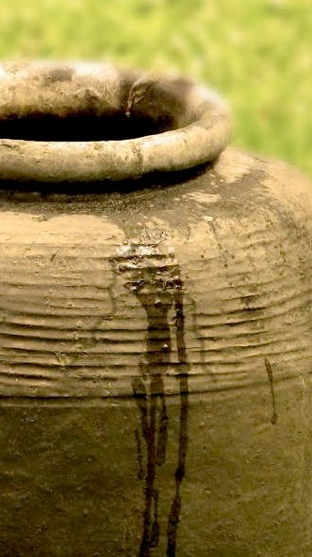
Springs Of Living Water 4
EZEKIEL 22:26
Her priests have violated my law, and have profaned mine holy things: they have put no difference between the holy and profane, neither have they shewed difference between the unclean and the clean, and have hid their eyes from my sabbaths, and I am profaned among them.

Slide 2

April 13th Lukas Coffey
April 16th Samuel Brittain,
John & Ashley James
April 17th Sawyer Pugh,
Shirley Buchanan

Slide 3
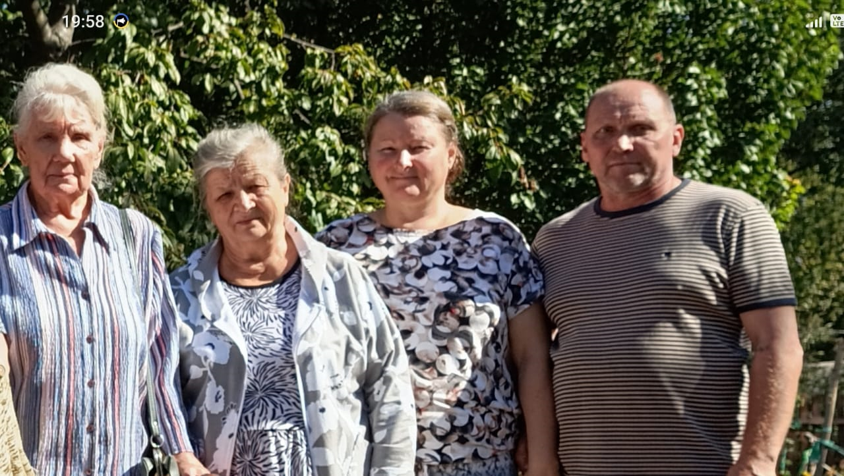
We thank the saints in America, the church of brother Barry Coffey for the support in this time of trials for us, may the Lord bless you.
From Ukraine, the city of Zaporizhia

Slide 4
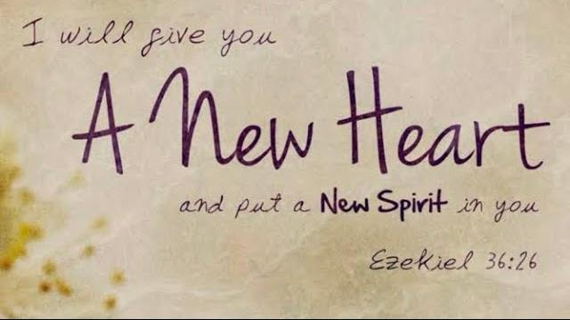
A New Heart
EZEKIEL 18:30-32
Therefore I will judge you, O house of Israel, every one according to his ways, saith the Lord GOD. Repent, and turn yourselves from all your transgressions; so iniquity shall not be your ruin. 31 Cast away from you all your transgressions, whereby ye have transgressed; and make you a new heart and a new spirit: for why will ye die, O house of Israel? 32 For I have no pleasure in the death of him that dieth, saith the Lord GOD: wherefore turn yourselves, and live ye.

Slide 5
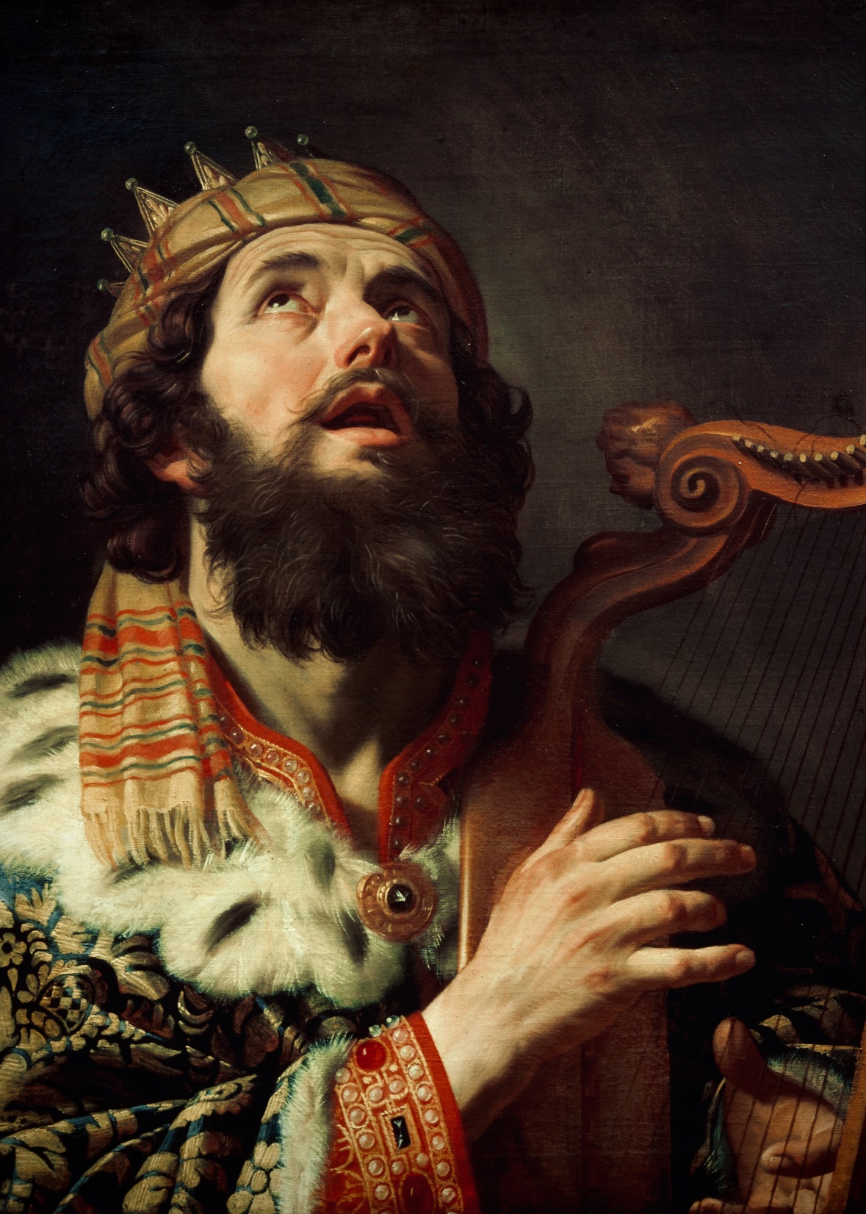
PSALMS 141:4
Incline not my heart to any evil thing, to practise wicked works with men that work iniquity…

Slide 6
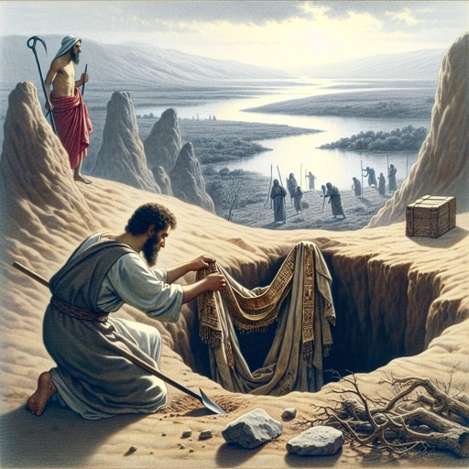
JEREMIAH 13:1
Thus saith the LORD unto me, Go and get thee a linen girdle, and put it upon thy loins, and put it not in water. 2 So I got a girdle according to the word of the LORD, and put it on my loins. 3 And the word of the LORD came unto me the second time, saying, 4 Take the girdle that thou hast got, which is upon thy loins, and arise, go to Euphrates, and hide it there in a hole of the rock.

Slide 7
JEREMIAH 13:8-11
Then the word of the LORD came unto me, saying, 9 Thus saith the LORD, After this manner will I mar the pride of Judah, and the great pride of Jerusalem. 10 This evil people, which refuse to hear my words, which walk in the imagination of their heart, and walk after other gods, to serve them, and to worship them, shall even be as this girdle, which is good for nothing. 11 For as the girdle cleaveth to the loins of a man, so have I caused to cleave unto me the whole house of Israel and the whole house of Judah, saith the LORD; that they might be unto me for a people, and for a name, and for a praise, and for a glory: but they would not hear.

Slide 8
JEREMIAH 11:7-10
For I earnestly protested unto your fathers in the day that I brought them up out of the land of Egypt, even unto this day, rising early and protesting, saying, Obey my voice. 8 Yet they obeyed not, nor inclined their ear, but walked every one in the imagination of their evil heart: therefore I will bring upon them all the words of this covenant, which I commanded them to do; but they did them not. 9 And the LORD said unto me, A conspiracy is found among the men of Judah, and among the inhabitants of Jerusalem. 10 They are turned back to the iniquities of their forefathers, which refused to hear my words; and they went after other gods to serve them: the house of Israel and the house of Judah have broken my covenant which I made with their fathers.

Slide 9
EXODUS 20:3
Thou shalt have no other gods before me.
EXODUS 23:13
…And make no mention of the name of other gods, neither let it be heard out of thy mouth.
DEUTERONOMY 6:14
Ye shall not go after other gods, of the gods of the people which are round about you;

Slide 10
JESUS.CHRIST.THE.SAME
John 12:20, “And there were certain Greeks among them that came up to worship at the feast: The same came therefore to Philip, which was of Bethsaida of Galilee, and desired him, saying, Sirs, we would see Jesus.”
And now, on this Word I would like to talk to you just a few moments. It's a most unusual thing to think that someone or the world would question the words of the Creator, but it's because it's dominated by unbelief and spirits of enemy which make them to disbelieve.
58-0207

Slide 11
JEHOVAH.JIREH 57-0326
36 Abraham had to separate hisself from his kindred, his people. Another thing he was asked to sojourn in a strange land, strange people, speaking a strange language.
Well, it's just the same today. Men are to separate yourself and to walk with a different people. You young men that come to Christ, used to go down to the pool room, you stay away from that territory, and go with those boys who's goes to church and to prayer meeting.

Slide 12
Objective: How to live the life that is pleasing to the Holy Spirit.
HEBREWS 12:13 And make straight [upright] paths for your feet, lest that which is lame be turned out of the way; but let it rather be healed.[free of sin, error] 14 Follow peace with all men, and holiness, [sanctification of heart and life] without which no man shall see the Lord: 15 Looking diligently lest any man fail of the grace of God; lest any root of bitterness springing up trouble you, and thereby many be defiled; 16 Lest there be any fornicator, or profane [godless] person, as Esau, who for one morsel of meat sold his birthright.

Slide 13
COLOSSIANS 1:9-11
For this cause we also, since the day we heard it, do not cease to pray for you, and to desire that ye might be filled with the knowledge of his will in all wisdom and spiritual understanding; 10 That ye might walk worthy of the Lord unto all pleasing, being fruitful in every good work, and increasing in the knowledge of God; 11 Strengthened with all might, according to his glorious power, unto all patience and longsuffering with joyfulness;

Slide 14
Fundamental Truths
II THESSALONIANS 2:13-15
But we are bound to give thanks alway to God for you, brethren beloved of the Lord, because God hath from the beginning chosen you to salvation through sanctification of the Spirit and belief of the truth: 14 Whereunto he called you by our gospel, to the obtaining of the glory of our Lord Jesus Christ. 15 Therefore, brethren, stand fast, and hold the traditions which ye have been taught, whether by word, or our epistle.

Slide 15
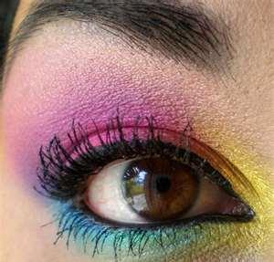
The Spirit of Holiness
PSALMS 96:9
O worship the LORD in the beauty of holiness: fear before him, all the earth.

Slide 16
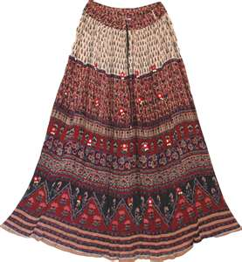
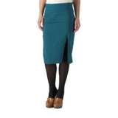
Allowed
Not Allowed

Slide 17
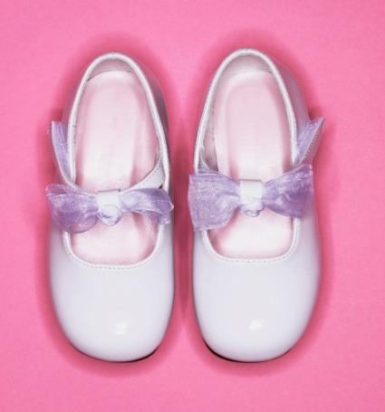

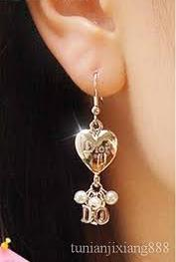
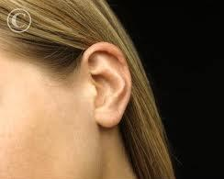
Allowed
Not Allowed

Slide 18
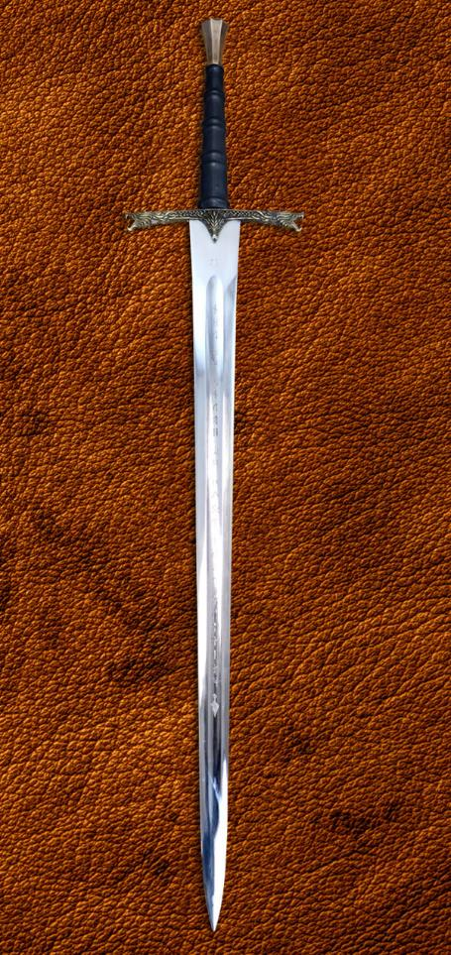
INVASION.OF.THE.UNITED.STATES
165 (A rose) it's pretty; it's there to be looked at. Like the church; it's there to be looked at. Like a pretty little woman, there to be looked at.... to her husband, she is all right. But if she hasn't got the moral sword sticking out there to protect her, she becomes trouble to society and human beings… And people don't realize that these devils are invading your homes. 54-0509

Slide 19
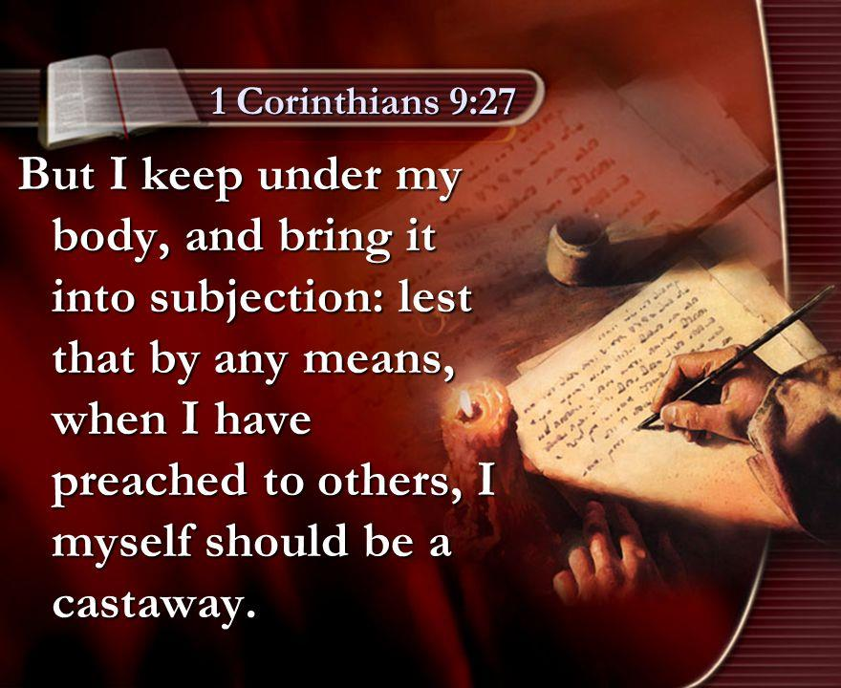
“Under”
I CORINTHIANS 9:27 To beat black and blue, to smite so as to cause bruises: like a boxer one buffets his body, handle it roughly, discipline by hardships;

Slide 20
WITHOUT.MONEY.OR.PRICE 59-0802
29 ...There's so much to entice people to what we call pleasures, it's for all peoples and all ages. There are the enticements for the young people: dances, the music that they have that goes with it.
I don't care how good a home a child has been brought up in, and how it's been taught to do right; if that child hasn't accepted the experience of the new birth, rock-and-roll music catches his attention just as quick as he hears it. Because in him is born in him by nature, a carnal spirit. And the power of the devil is so great today, till it catches that spirit of that little one.

Slide 21
HEAR.YE.HIM
23 Lady, you might be as virtue and clean as you can be, but if you dress these little old Hollywood dresses, get on the street, and a man looks at you, you're guilty of adultery. Jesus said, "Whosoever looketh upon a woman to lust after her hath committed adultery with her already in his heart." You may never go through the act, but at the Day of Judgment, you presented yourself to him like that, you're going to be counted for adultery. That's God's Word. That's old fashion, but it's God's Truth. 57-0725

Slide 22
CHURCH.AGE.BOOK
292-1 …As the Jews took refuge in the synagogue form of worship, so in the Philadelphian Age they were taking refuge in the church. It is not joining a church that counts. The life is not in the church. The life is in Christ.
"This is the record that God hath given us eternal life and this life is in His Son. He that hath the Son hath life, and he that hath not the Son hath not life." Man is made holy by the Spirit. It is the Spirit of Holiness that raised Jesus from the dead that in-dwells us and makes us holy with His holiness.

Slide 23
Fundamental Truths
ROMANS 12:21
Be not overcome of evil, but overcome evil with good.
EPHESIANS 4:27
Neither give place to the devil.
James 1:5-8
If any of you lack wisdom, let him ask of God, that giveth to all men liberally, and upbraideth not; and it shall be given him.

Slide 24
II CORINTHIANS 2:5-11
Wherefore I beseech you that ye would confirm your love toward him. 9 For to this end also did I write, that I might know the proof of you, whether ye be obedient in all things. 10 To whom ye forgive any thing, I forgive also: for if I forgave any thing, to whom I forgave it, for your sakes forgave I it in the person of Christ; 11 Lest Satan should get an advantage of us: for we are not ignorant of his devices.

Slide 25
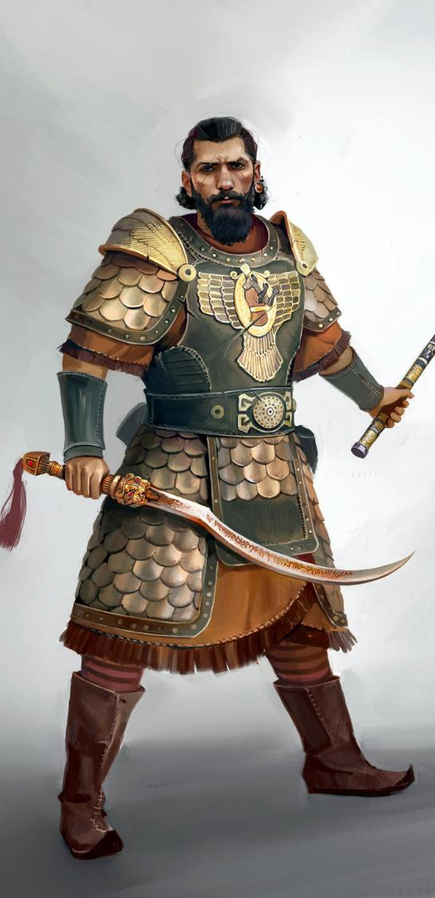
WHY.LITTLE.BETHLEHEM
97 David setting there, his throat burning, and it was in the middle of summer. The Philistines was taking advantage of that split between David
and Saul. And Saul looking for David everywhere, the Philistines also, and the Philistines looking for the Israelites. Talk about a time of confusion; just about like it is now. 58-1228

Slide 26
RAISING.JAIRUS.DAUGHTER
24 Now, out here on this little old sea, tossed about, ten thousand devils swore they'd drown Him, while He was laying back there tired. You know the devil takes advantage of you when you get tired or wore out. You just get a little tired and and discouraged. He caught Jesus right that weak spot, tried and weary.
LED.BY.THE.HOLY.SPIRIT
4 I'm a temperamental person, melancholy… I can't let myself get away. Satan takes advantage of that on me. One of those types that could break down… 52-0727

Slide 27
THE.SEAL.OF.THE.ANTICHRIST
66 And that poor little old girl out there, she got mixed up with some of her associates. Why did she get that way? Because she got into that kind of a group. Listen, there's a spirit of everything... What is this nation spirited with? Entertainment. They have “I Love Lucy…” People will stay home to watch TV instead of going to church, and say that they got the Holy Ghost… That's what you're getting out of will of God. That's where you've moved back. No wonder you can hate your neighbor, everything else… Can't have the love of God in your heart and do that. 55-0311

Slide 28
THE.INVASION.OF.THE.UNITED.STATES
181 In our great Baptist churches recently... I'm hitting the Baptists. I got a right to that; they lean on the side that I come from. But when they had to give intermission between the Sunday school service and the preaching service so that the pastor and all could go out and have a smoke, and the street was lined with men and women smoking cigarettes. The devil has done that. Here in our own city, one of our most outstanding ministers in New Albany, is directing a square-dance program to bring men and women on the platform. 54-0509

Slide 29
MAKING.THE.VALLEY.FULL.OF.DITCHES
5 A lot of places allow the kids to smoke in the school, to quieten their nerves. They ought to had a prayer meeting. That's the best thing I know to quieten your nerves.
But you know, hungry people has got to fill that longing with something. If they won't drink from the Fountain of the waters of Life, the devil will give them a stagnated cistern with wiggletails in it. You'll spend that longing either on the devil or on God. I feel sorry for them because of the let-down and pollution of our modern churches.

Slide 30
That's one of the things that I lay it to, the social gospel that people preach.
Why, in our own city of Jeffersonville a certain pastor every Saturday night has a square dance in the bottom of the church. Teaches square dancing: of a famous denominational church, a square dance... That was the same pastor that asked me that time, coming down the telephone pole, how I got so many people out to the tabernacle.
56-0728

Slide 31
JEREMIAH 3:15
And I will give you pastors according to mine heart, which shall feed you with knowledge and understanding.

Slide 32
GOD'S.PROVIDED.WAY
10 Now, a righteous man is not a sinless man. Notice, "Elijah was a man subject to like passions as we are." And the Scripture of his life proves he had his ups-and-downs like we do. He had his times of wondering, times that his temper got away from him, a lot of things that went wrong. But he was still a righteous man, because he confessed his unworthiness, believed in God. That's what made him righteous.
We're not righteous within ourselves; we're righteous through Jesus Christ. I cannot be sanctified within myself; I am sanctified through Jesus Christ Who stands in the Presence of God in my place.

Slide 33
DIVINE.HEALING
210 And...?... the great storm of formality, the great storm of indifference, a great storm of denial of God, "O God, don't let me try to beat the Light out. Let me use It to walk in. I believe it, Lord." There you are. Walk in the Light. "As I see it in the Scripture, that's Light. It's God's Word, and let me walk in it. Lord, Lord, let me walk in it; never, never try to deny It.“
54-1219

Slide 34
INFLUENCE
37 Uzziah held this standard. He was a great influence to Isaiah the prophet. Then Uzziah made that fatal mistake, like many people does. When he felt secured, felt he had the whole thing in his hand, he got lifted up in his spirit, lifted up to pride. Now, there's a real example for us all.
You know, that's been the trouble. I'm speaking to Christians and ministers… And that's where many ministers even make a mistake. We've heard so many times about the ministers, the acts that they do, and the things, some of them maybe to doing things they should not do. 63-1114

Slide 35
I think sometimes, them are good men, wonderful Christians that's been used of the Lord. Then they get a little kingdom built around them, or a lot of influence, many people attending their meetings, until they get careless, and they get kinda lifted up. The people applaud them and stand up, we shouldn't really do that. We, remember there's no big people among us. Why, we're all just God's children.
If God made some of us one thing and some another, He made me with a finger and an eye, so forth. Well, we got to appreciate each other, and then not try to feel big. Because we're all connected together to one God and we all come off of one tree.

Slide 36
LIFE
39 That's the way it is with some of this "shake-hands" religion. I believe in being born again: go back to the beginning, and die out, and be re-molded. If you don't, there's going to be a blowup somewhere down along the road.
It'll blow up on you when the pressure comes. So let's hold the pressure.
62-0719

