Slide 1

The Glorious Spirit-Made Church 2
MATTHEW 16:17
And Jesus answered and said unto him, Blessed art thou, Simon Barjona: for flesh and blood hath not revealed it unto thee, but my Father which is in heaven. 18 And I say also unto thee, That thou art Peter, and upon this rock I will build my church; and the gates of hell shall not prevail against it.

Slide 2

Birthdays
Anniversaries & Events
May 6th Billy Ivy
May 8th Carrie Whitlock, Jackie Sylvester
May 9th Mitch Buchanan
Dates to Remember:
May 16th Ladies Tea & May 17th Nathaniel Sias
May 24th Matthew Watkins
May 27th Samuel Taylor
May 31st Tim Dodd June 3rd Brian Naidoo
June 14th Communion Service
Family Day (Possibly Aug. 15th)

Slide 3
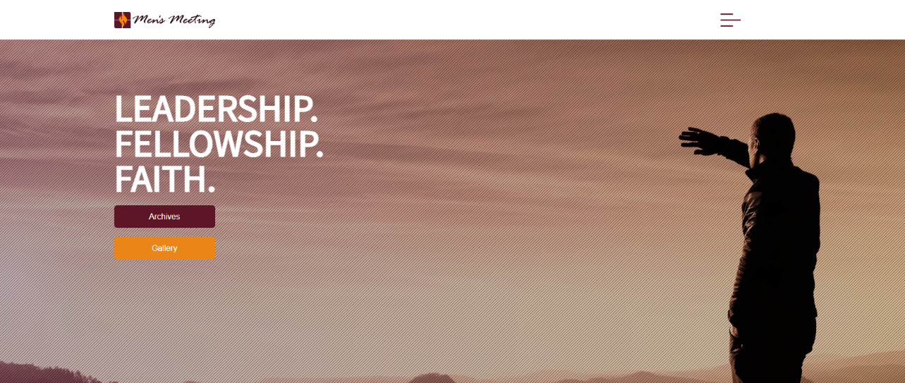
Men’s Meeting HBT
Oct. 9-11, 2026
Carson Springs Conference Center
Jason Watkins
Matthew Watkins
Donnie Reagan
Paul LaFontaine
Tim Dodd
Jan Hansen, Norway

Slide 4
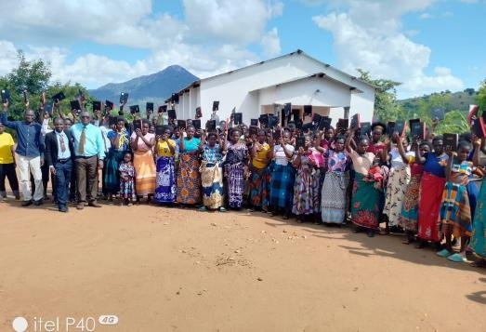
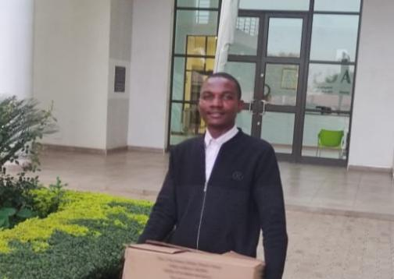
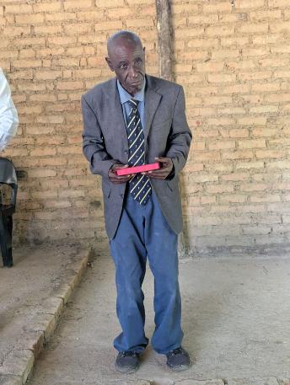
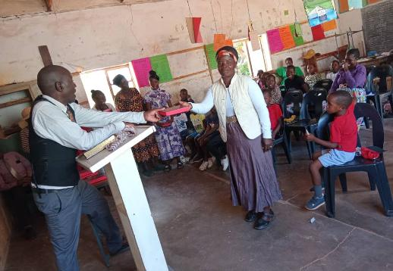
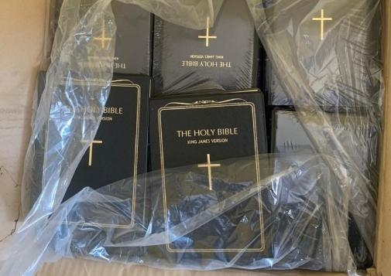
Malawi
Bible Distribution
2026 Africa
Uganda
Zimbabwe
Sierra Leone

Slide 5
A.SUPER.SIGN
8 Now, we're hoping someday soon, the Lord willing, to have a nice, big tabernacle, where we'll have all kinds of Sunday school rooms for the classes…
There'll be no interfering in the services, at all, walking or tromping around. These little fellows are restless, and they don't understand. We have to understand them; they can't understand us. 59-1227

Slide 6
GOD.HIDING.HIMSELF.IN.SIMPLICITY
32 Now, there's little children, little babies, they don't know no different. The only way they can get what they want is cry for it. Sometimes it's a drink of water [or] they need attention. And so we have by the grace of God dedicated room; it was called on the list a "cry room," where the mothers can take their baby.
(Now, maybe I won't even notice it, being anointed) but other people setting near, it bothers them. And they come to hear the service. So the mothers, if your little baby starts whimpering, you can't help that. You should, you ought to bring it. A real mother wants to take her baby to church, that's the thing you should do. 63-0317

Slide 7
CHURCH.ORDER
69 There should be a little bitty baby class, there should be from about five years old.
And all the others under that should be kept with the mother, and taken to the nursery if it's necessary during the time of the preaching, if they go to carrying on. That's what the nursery's out there for. 63-1226

Slide 8
The Glorious Spirit-Made Church 2
MATTHEW 16:17
And Jesus answered and said unto him, Blessed art thou, Simon Barjona: for flesh and blood hath not revealed it unto thee, but my Father which is in heaven. 18 And I say also unto thee, That thou art Peter, and upon this rock I will build my church; and the gates of hell shall not prevail against it.

Slide 9
WHO.IS.THIS.MELCHISEDEC
42 The Bible has been a work of God that's been covered up. [He] promised in this day He would take the mask off, and we could see It.
43 God, en morphe, masked in the Pillar of Fire. God, en morphe, in a Man called Jesus. God, en morphe, in His Church. God above us, God with us, God in us; the condescending of God.
65-0221

Slide 10
THE.REVELATION.OF.JESUS.CHRIST
100 The Book of Revelation has more symbols in it than all the rest of the Books in the Bible… because it is a Book of prophecy. It's a prophetic Book. Therefore it has to be understood by a prophetic class. This Book is not meant for everybody.
There's nobody can understand it, hardly. This Book is made for a certain class of people. Deut., "The hidden things belong to the Lord." And He reveals to us, His children, the hidden things.
60-1204M

Slide 11
I.PERCEIVE.THAT.THOU.ART.A.PROPHET
30 He [Rabbi] said, "No doubt a notable deed has been done to John [Ryan] here, but it couldn't have been Jesus Christ because Jesus wasn't the Christ. You Gentiles can't chop God in three pieces and hand Him to a Jew."
I said, "Some of them might chop Him in three pieces, but I don't." No, sir. "There's one God. And that God Jehovah was manifested in flesh here in His Son, Christ Jesus." 53-0614

Slide 12
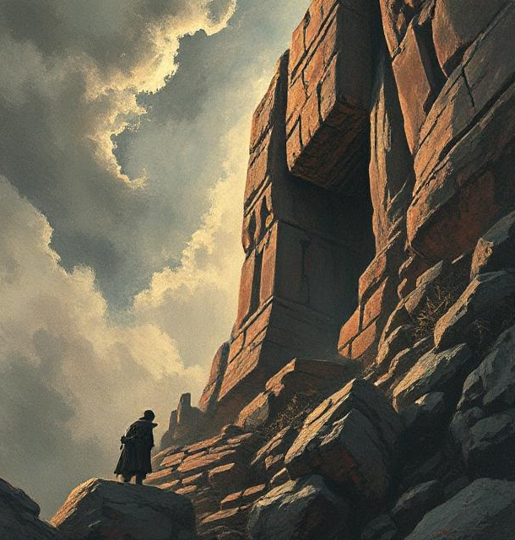
Condescend
To behave as one descending from a superior position, or rank.
To put aside one’s dignity or superiority voluntarily and assume equality with one regarded as inferior.

Slide 13
PHILIPPIANS 2:5-8
Let this mind be in you, which was also in Christ Jesus: 6 Who, being in the form of God, thought it not robbery to be equal with God: 7 But made himself of no reputation, and took upon him the form of a servant, and was made in the likeness of men: 8 And being found in fashion as a man, he humbled himself, and became obedient unto death, even the death of the cross.

Slide 14
LEAN.NOT.UNTO.THY.OWN.UNDERSTANDING
49 And when the Word is made manifest, revealed, they won't accept It, because they lean to their own understanding. "This church was built here, a beautiful place. It's a great organization... Why shouldn't we belong to that? I'll trust in it."
Trust not in your own understanding, but trust in the Word of the Lord! 65-0120

Slide 15
MATTHEW 16:13
When Jesus came into the coasts of Caesarea Philippi, he asked his disciples, saying, Whom do men say that I the Son of man am?
MATTHEW 16:15
He saith unto them,
But whom say ye that I am?

Slide 16
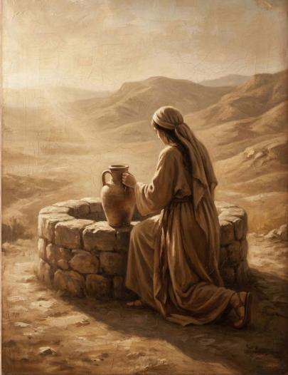
JOHN 4:18
For thou hast had five husbands; and he whom thou now hast is not thy husband: in that saidst thou truly. 19 The woman saith unto him, Sir, I perceive that thou art a prophet.

Slide 17
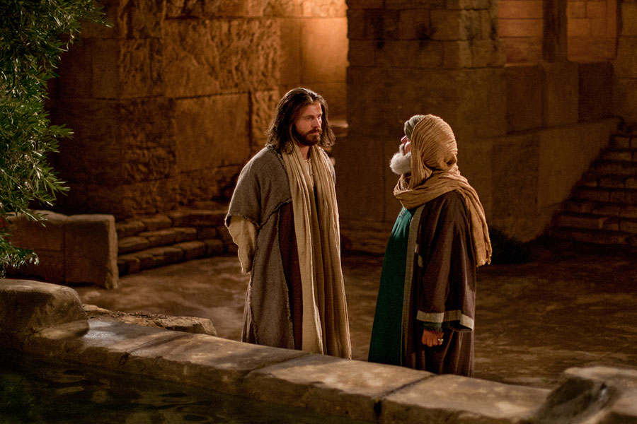
JOHN 3:2
The same came to Jesus by night, and said unto him, Rabbi, we know that thou art a teacher come from God: for no man can do these miracles that thou doest, except God be with him.

Slide 18
MATTHEW 16:13
When Jesus came into the coasts of Caesarea Philippi, he asked his disciples, saying, Whom do men say that I the Son of man am?
MATTHEW 16:15
He saith unto them,
But whom say ye that I am?

Slide 19
THE.PROPHET.ELISHA
52 What is the Word "Christ?" Means "the Anointed one." And God was in Christ, reconciling the world to Himself.
54-0723
JOHN 17:2
As thou hast given him power over all flesh, that he should give [give back, return] eternal life to as many as thou hast given him. 3 And this is life eternal, that they might know thee the only true God, and Jesus Christ, whom thou hast sent.

Slide 20
A.SUPER.SENSE
55 I would not say because we receive the 6th sense that the 5 senses are no good no more. Yes, they are. Those 5 senses were given to you by God, and they are to be used… The super Sense is the Holy Spirit, the faith of God that dwells in you…For it's so far above the natural sense, as the spiritual man is above the natural... It makes you believe things that you cannot see. It makes you act where you do not think the five senses would ever think about it. The devil can get into these five senses and lie to you, but he cannot touch that super sense. 59-1227

Slide 21
A.HIDDEN.LIFE 55-1006
38 Now only believers, the elect comes into that, that God has chosen you. Rev. 2, "He that overcometh." You said, "I overcome smoking." That ain't what He's talking about. There's a whole lot more goes to Christianity besides not smoking cigarettes or drinking whiskey. "He that overcometh shall inherit all things, and he will be My son; I will be his God, and I will give him of the hidden manna.” (Amen.) I will hide him away, give him the hidden things the world on the outside don't know nothing about it.“ Though they eat manna, but they don't know about this: entering into the adoption or the hidden place with God.

Slide 22
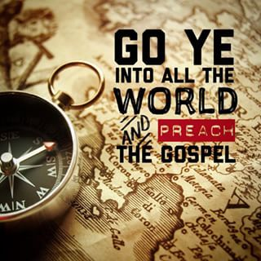
MARK 16:15-16
And he said unto them,
Go ye into all the world, and preach the gospel to every creature. 16 He that believeth and is baptized shall be saved; but he that believeth not shall be damned.

Slide 23
HEBREWS.CHAP. 5-6
138 When the new Birth is come, you are changed. You don't have to do anything to prove it. Your life proves it, as you walk: love, peace, long-suffering, gentleness, meekness, patience. That's what you are, the whole world sees the reflection of Jesus Christ in you.
57-0908M

Slide 24
JESUS.CHRIST.THE.SAME
21 But you should be born again. "Well, if I get that kind of experience, I won't be able to do this or that…“ Well, the devil will tell you that you're going to lose some good time…
But he's a lying to you, especially you young people. You don't have to drink, smoke…. Why, the Holy Spirit is a million times better than all the devil could offer you. You don't have to get drunk on strong drink to have a big time.

Slide 25
THE.RAPTURE
70 Cain and Abel didn't have a Bible to read, but it was revealed to Abel, by faith, a revelation... Matt. 16:17-18, "Who does man say I the Son of man am?" "One of them said You're 'Moses, Elias, or so forth.'" He said, "But Who do you say I am?“ He said, "Thou art the Christ, the Son of the living God." He said, "Blessed art thou, Simon… Upon this rock," the spiritual revelation of Who God is, Who Jesus is. And He is the revelation of God, God made in flesh and revealed to the world.

Slide 26
"He was in the world,” God was in Christ, reconciling the world to Himself, revealing what God was, in a body of flesh. “…Upon this rock I'll build My Church, the revelation of the Word in Its season…”
74 The Book of the Revelations…It's sealed to unbelievers. It was altogether given for believers. And It opens the Book and reveals Who the Author of this entire Book is... reveals His complete mystery of Himself, His plans for His church ages that's to come, and was sealed in there by Seven Seals. 65-1204

Slide 27
THINGS.THAT.ARE.TO.BE
101 There's three people of you. The outside is the body. You got five senses, that you contact your earthly home with that. The inside is a spirit. There's five senses there, love and conscience, and so forth, you contact. But the inside of that is the soul.
102 Remember, "The rain falls on the just and the unjust." The same rain that'll make a grain of wheat grow makes a cocklebur grow too. At the inside of that seed is a nature, and that nature display, displays itself. 65-1205

Slide 28
THE.IDENTIFIED.CHRIST.OF.ALL.AGES
Watch when He done His Messiahic sign. The Pharisees had a little bit of light. They was good people lived a good religious life, had a little light about them. They had organized, and a priesthood, had a little light. But down in the bottom of their heart, they had no Eternal representation in Glory. So when they seen that supernatural done, said, "This man is Beelzebub, a devil." What happened? That put what light they had out.
64-0401

Slide 29
(Example) JEHOVAH.JIREH
35 We find Abraham was just an ordinary man. And God called him, and said that through him He was going to make him a father of nations. That's the way... Now, many of the brethren laying hands on the sick. That's all right but that's a Jewish tradition. That was never meant for the Gentiles. The Jew said, "Come, lay your hand on my daughter and she'll be well.“
But the Gentile said, "Just speak the word; my servant will live." That's the difference. Just say the word. 61-0209

Slide 30
“If all the sleeping folks will wake up, and all the lukewarm folks will fire up, and all the disgruntled folks will sweeten up, and all the discouraged folks will cheer up, and all the depressed folks will look up, and all the estranged folks will make up, and all the gossiping folks will shut up, and all the dry bones will shake up, and all the true soldiers will stand up, and all the church members will pray up, and if the Savior of all will be lifted up . . . then we can have the greatest renewal this world has ever known.”

Slide 31
WHAT.DOES.IT.TAKE.TO.MAKE.A.CHRISTIAN.LIFE
11 God intended this Church to be a powerful Church, a glorious Church, a Church that the whole world could look upon as a Bride of Christ well expected and espoused, and to live in such an atmosphere and conduct itself in such a way that God would be proud of this Church to present it to Christ at the coming of the Lord. It should be living that way. But we find out that many times that with good intentions that people are trying to make themselves act like Christians.

Slide 32
Sinners do that, but you don't have to do that… The Lord is here. If things are going good, things are going good in my soul and bad in my body, it makes any difference, God is always there, and I'm always stimulated with a pleasure that's, "Joy unspeakable and full of glory." That's what He does for the believer.
55-0806

Slide 33
Now, if the church could only not look at it in that way. God never intended Christianity to be governed by denominations, by creeds. If God only allowed or intended for the church to be governed by creeds, denominations and intellectuals, then we do not need the Holy Spirit in the church, Its success would be largely placed upon the intellectuals of the best of us. The better intellectuals we would have in our church, the more progressive our church would be.

Slide 34
12 In the Word I find God did not intend for the church to be governed by intellectual, but the Holy Spirit was given to the Church to govern and control the body of Christ. And in God's program, we will never be successful, no matter how good our intentions are, until we get back into the center of God's program... And yet we put our intellectuals mixed with it, then we can get a conglomeration of both Holy Spirit and intellectuals. And when the Holy Spirit desires to do a thing and degrades something, or lifts something up, it causes petty jealousy amongst the people, which proves that they haven't got the Holy Spirit. Every man would want to be in his place.

Slide 35
Now, in this the people has a reason because they have seen so much denominationals, so many different spiritual dictators in the church. But the Holy Spirit has placed each one into the body of Christ, and we're helpless to maneuver without every member of our body. We have to have my hands, my arms, my mouth, my eyes...
Everything that's in me has to operate to make my body function perfectly. And then if God wanted His body, the Church, to be governed by His Spirit, there has got to be some way or some program that we've got to enter into other than what we have already had. 57-0113

Slide 36
A.TOTAL.DELIVERANCE
78 What would He do if we were one heart and one accord? And the only way we can do that is unify our hearts together with brotherly love, obey the offices of the church, the pastor, and the pastor obey God; then God works through the pastor, through the board, down into the church, all together one unit to the Kingdom of God.
Then God will hear when we have a unified group. Let nothing bother you. Don't be dismayed in anything. That's the kind of a person that God ordained to take the land.
59-0712

Slide 37
THE.RESULTS.OF.DECISION
75 JOSH. 3:3 And they commanded the people, saying, When ye see the ark of the covenant of the LORD your God, and the priests the Levites bearing it, then ye shall remove from your place, and go after it. 4 Yet there shall be a space between you and it, about two thousand cubits by measure: come not near unto it, that ye may know the way by which ye must go: for ye have not passed this way heretofore.
I believe there's an experience for the Church “…you've never passed this way before.”

Slide 38
76 Let's move out towards Jordan. God's here leading you. The Angel of God took Jordan first. The Angel of God will lead you every step of the way. Sometimes you think that the trials are hard. God ain't in no hurry. You're the only one that's in a hurry.
God let the Hebrew children go right in the fiery furnace…Daniel get right in the lion's den, before He ever come. Just rise up and start walking by faith. "God, I believe you. I'm bound for the promised land. God, You promised it to me, and here I come…

Slide 40
The Tates In Your Church
Do you know how many members of the Tate family belong to your church? There is old man Dic Tate who wants to run everything, while Uncle Ro Tate tries to change everything. Their sister Agi Tate stirs up plenty of trouble, with help from her husband, Irri Tate.
Whenever new projects are suggested, Hesi Tate and his wife, Vege Tate, want to wait until next year. Then there is Aunt Imi Tate, who wants our church to be like all the others. Devas Tate provides the voice of doom, while Poten Tate wants to be a big shot. But not all members of the family are bad. Bro. Facili Tate is helpful in church matters. And a , happy member of the family is Miss Felici Tate. Medi Tate always thinks things over and of course there is the black sheep of the family, Ampu Tate, who has completely cut himself off from the church.

Slide 41
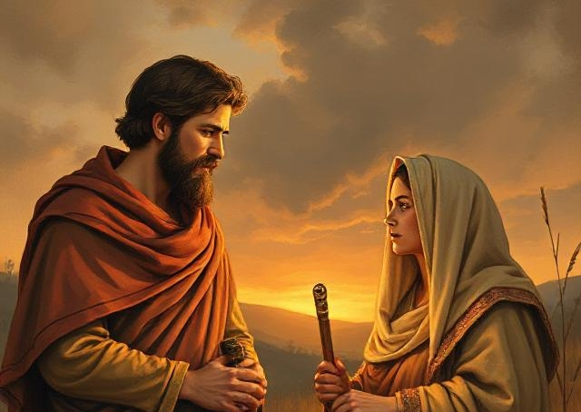
RUTH 2:11-12
And Boaz answered and said unto her, It hath fully been shewed me, all that thou hast done unto thy mother in law since the death of thine husband: and how thou hast left thy father and thy mother, and the land of thy nativity, and art come unto a people which thou knewest not heretofore.
12 The LORD recompense thy work, and a full reward be given thee of the LORD God of Israel, under whose wings thou art come to trust.

Slide 42
Faith in God’s Existence; and,
Faith in God’s Trustworthiness
EXODUS 4:1-3
And Moses answered and said, But, behold, they will not believe me, nor hearken unto my voice: for they will say, The LORD hath not appeared unto thee. 2 And the LORD said unto him, What is that in thine hand? And he said, A rod. 3 And he said, Cast it on the ground. And he cast it on the ground, and it became a serpent; and Moses fled from before it.

Slide 43
A.GUIDE
57 Don't travel your denominational routes now, stay right behind the Word, 'cause you haven't passed this way before... The Word will lead you across, because the Word is Christ...
58 Stay behind the Word! Yes, sir! Stay with that Guide. Don't get in front of It, stay behind It. Let It lead you, don't you lead It. Joshua said, "Now, you've never passed this way before, you know nothing about the road.“ 62-1014

Slide 44
Matt. 19:26
But Jesus beheld them, and said unto them, With men this is impossible; but with God all things are possible.

