Slide 1

Go Ye Up Your Mountain
EZRA 6:14 And the elders of the Jews builded, and they prospered through the prophesying of Haggai the prophet and Zechariah the son of Iddo. And they builded, and finished it, according to the commandment of the God of Israel, and according to the commandment of Cyrus, and Darius, and Artaxerxes king of Persia.
HAGGAI 1:8 Go up to the mountain, and bring wood, and build the house; and I will take pleasure in it, and I will be glorified, saith the LORD.

Slide 2
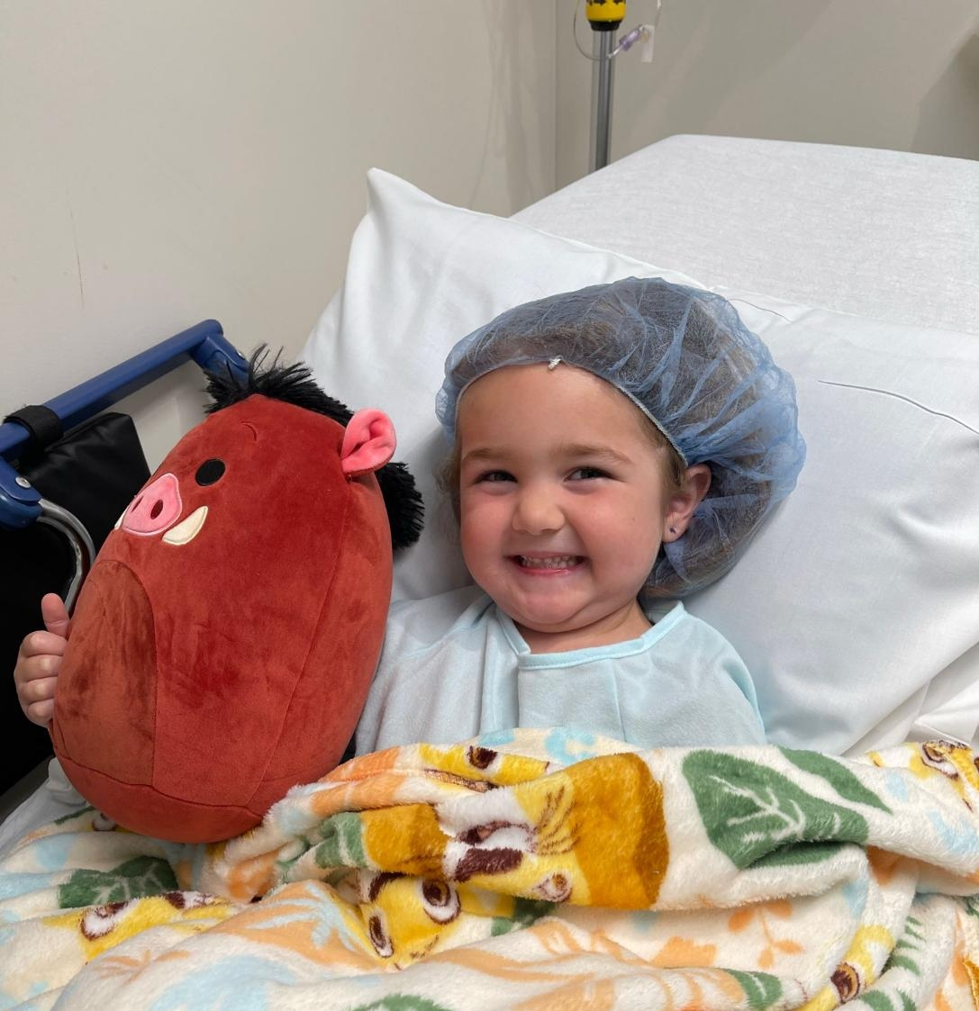
Lily

Slide 3
THINGS.THAT.ARE.TO.BE
103 Christians, I may never see you again. See, it's been years since I been here. May never see you again. Line up with God's Word. Look in the mirror.
65-1205

Slide 4
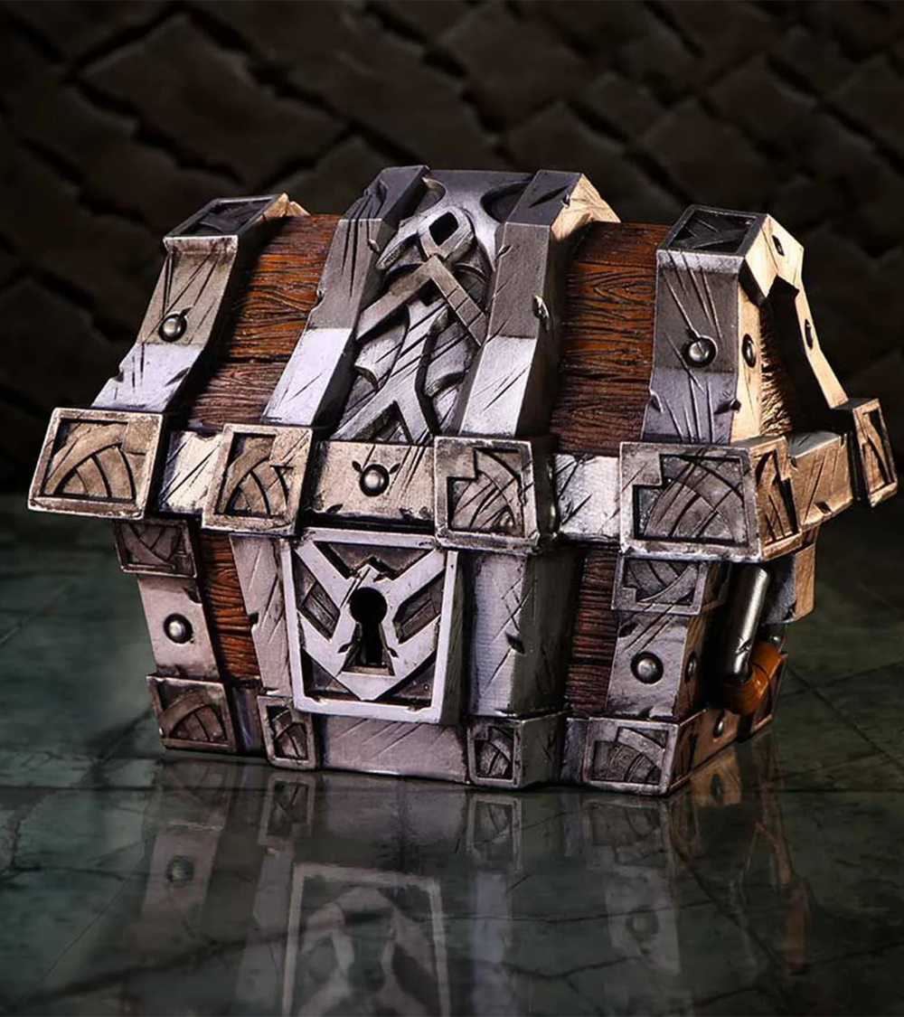
Examples:
MATTHEW 6:19
Lay not up for yourselves treasures upon earth, where moth and rust doth corrupt, and where thieves break through and steal: 20 But lay up for yourselves treasures in heaven, where neither moth nor rust doth corrupt, and where thieves do not break through nor steal: 21 For where your treasure is, there will your heart be also.

Slide 5
GOD.USING.HIS.GIFT
18 He [Bartimaeus] was a provider for his family; he thought of his family first before himself. Any real true dad will do that and husband.
Any Christian will think of others before himself. Every Christian tries to put God first, his family second; he's number three. I've tried to make that a practice in my own life.
56-0311

Slide 6
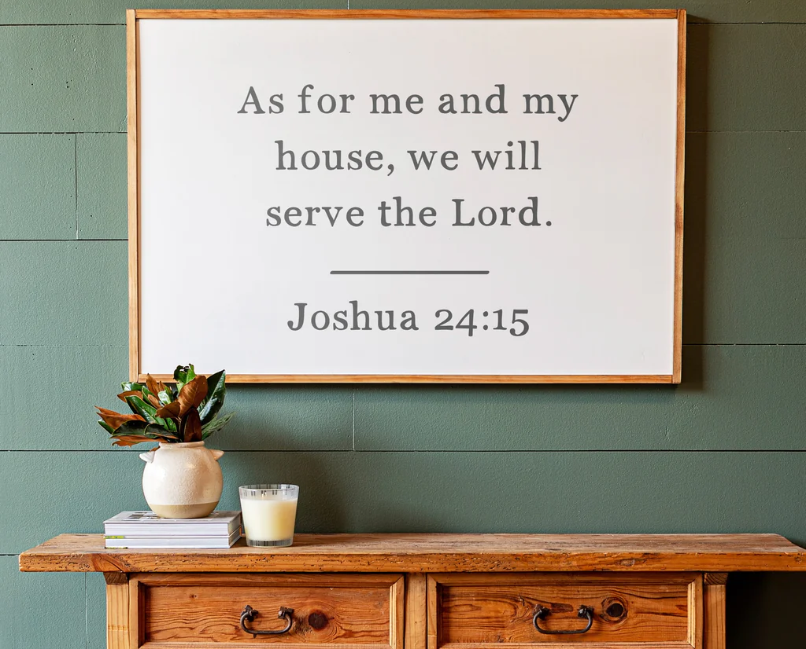

Slide 7
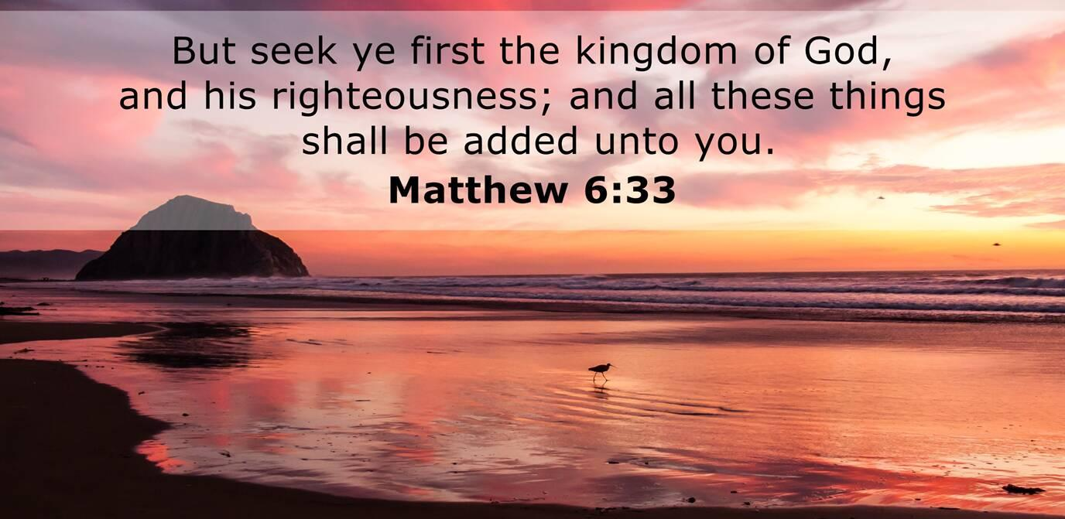
MATTHEW 6:33
But seek ye first the kingdom of God, and his righteousness; and all these things shall be added unto you.

Slide 8
FELLOWSHIP.BY.REDEMPTION
118 The reason we can't see the television pictures our bodies are not set as instruments to pick up mechanical sent things. But when our body becomes in tune with God, becoming a part of Him, then our soul can pick up the power of the Holy Spirit to vindicate the Presence of the Lord Jesus Christ…
He lives among us today. And He wants fellowship… He's desiring to fellowship again with His people like He did in the garden of Eden. 55-0403

Slide 9
THE.ARROW.OF.GOD'S.DELIVERANCE
18 Why, brother, if we'd ever come in the Presence of God like Moses did, it was revolutionary to him. In the Light of that Angel of God standing on that mountain that day, everything he once thought never would happen, come to be a reality.
And I think if men and women today would ever step into the Light of the Holy Spirit, under the unction of God's Spirit and the Light of God's Word, everything that God has promised will illuminate to you and be real again.
56-0801

Slide 10
EXODUS 14:13-16
And Moses said unto the people, Fear ye not, stand still, and see the salvation of the LORD, which he will shew to you to day: for the Egyptians whom ye have seen to day, ye shall see them again no more for ever. 14 The LORD shall fight for you, and ye shall hold your peace. 15 And the LORD said unto Moses, Wherefore criest thou unto me? speak unto the children of Israel, that they go forward: 16 But lift thou up thy rod, and stretch out thine hand over the sea, and divide it: and the children of Israel shall go on dry ground through the midst of the sea.

Slide 11
ISAIAH 51:11-13
Therefore the redeemed of the LORD shall return, and come with singing unto Zion; and everlasting joy shall be upon their head: they shall obtain gladness and joy; and sorrow and mourning shall flee away. 12 I, even I, am he that comforteth you: who art thou, that thou shouldest be afraid of a man that shall die, and of the son of man which shall be made as grass; 13 And forgettest the LORD thy maker, that hath stretched forth the heavens, and laid the foundations of the earth; and hast feared continually every day because of the fury of the oppressor, as if he were ready to destroy? and where is the fury of the oppressor?

Slide 12
EZRA 6:14
And the elders of the Jews builded, and they prospered through the prophesying of Haggai the prophet and Zechariah the son of Iddo.
And they builded, and finished it, according to the commandment of the God of Israel, and according to the commandment of Cyrus, and Darius, and Artaxerxes king of Persia.

Slide 13
GOD'S.COVENANT.WITH.ABRAHAM (CHARLOTTE.NC)
While we got our heads bowed... Sinner friend of mine, I know something great for you, my lost brother, my wayward sister, you ain't supposed to be in the condition you're in. God made you to serve Him. Sin's what's wrecked you like this.“ 56-0428

Slide 14

THE.SECOND.SEAL
135 The only thing, don't try to line Scriptures up to your thought, but line yourself up with the Scriptures. Then you're running with God. No matter how much you have to cut away or lay aside, line up with that.
63-0319

Slide 15
DOOR.TO.THE.HEART
42 You want Him to be your Saviour, but He wants to be your Lord. Lord is rulership. He wants to be your Ruler, not just your Saviour only.
You want Him as a Saviour, but what about being your Lord, that'll control you, your emotions, your thinking, control your every fiber of you, that you could say…"For me to live is Christ and to die is gain." Let Him in in that way to be Ruler and Lord over you.
58-0316

Slide 16
CHRIST.IS.THE.MYSTERY.OF.GOD.REVEALED
503 But all this mystery is revealed only to His Bride. Hell is against this Truth, of the revelation of this mystery. But the Bride is standing on it. Why do you hunger, Church, why do you thirst?
It's the Father trying to reveal this hidden secret to you. But you let so many things get it out of you. You let your job, your wife, you let your husband, your children, the cares of the world, you let some pastor, somebody else get that out of you, when you know that way down in your heart you're thirsting, hungry.
63-0728

Slide 17
ROMANS 6:12-23
Let not sin therefore reign in your mortal body, that ye should obey it in the lusts thereof….
Bondage: (Gr.) douloo
To make a slave of, reduce to bondage.
Metaphorically, give myself wholly to one's needs and service, make myself a bondman to him.

Slide 18
WHY.SO.MANY.CHRISTIANS.FIND.IT.SO
HARD.TO.LIVE.THE.CHRISTIAN.LIFE
55 Oh, brother, intellectual will never do it. Mental conception will never do it. It's the work of the Holy Spirit that brings the human being to his place. Make your choice. Oh, happy day!
I fixed my choice on Thee my Saviour and my God. No matter what the rest of the world does it's sinking sand, my choice is on Thee. 57-0303

Slide 19
WHY.CRY.SPEAK
307 "Why are you crying to Me, when I've proved to be with you? Haven't I healed your sick, told you things that happened exactly? Your pastor can't do that. Me! He's a man. I'm the One that did this, tells him these things to say. It's My Voice. I'm the One that raises up your dead when they drop down, that heals the sick. I'm the One that does the saving. I'm the One that give the promise."
308 God, give me courage to take that Sword of the Word that He put in my hand and march forward to the Third Pull, is my prayer. 63-0714

Slide 20
THE.INVISIBLE.UNION
34 And we know that history is closing out. The world's history will soon be over, then we're going to step into a new day, to the great Millennium. That, as one believer, I believe in a Millennium reign with Christ, a thousand years upon the earth; the physical return of the Lord Jesus, to take a physical people, glorified, by His cleansing Blood.
65-1125

