Slide 1
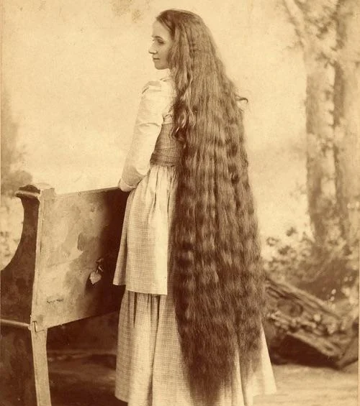
A Hair Short of Glory
A Word Study on the Woman’s Uncut Hair and the Old Testament Roots of the Covering
1 Corinthians 11:13–15

Slide 2


Slide 3
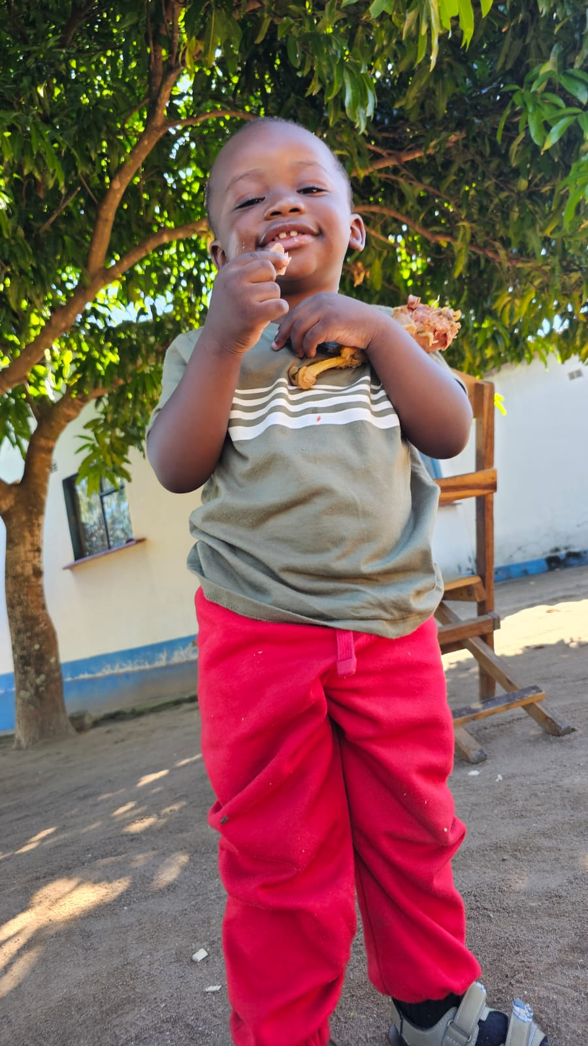


Slide 4
A PRIDE
57 God be merciful. Oh, My, my Lord, and that cold-hearted bunch of Pharisees setting there, indifferent. Oh, my, wiping His blessed feet with the hairs of her head... Some of you women to do that, would have to stand on your head. You cut your hair, that's right. I don't say it for a joke. The Bible said, "The glory of a woman is in her hair." And you've cut yours off. 55-0807

Slide 5
AZUSA.JUBILEE
15 The devil's took many of us captive. Years ago it was a sin for you women to cut your hair. But today Pentecostal women look just like the women of the street; you can't tell the difference. It used to be it was a sin, back in the old days, for women to wear make-up. And today you can't tell the sinner from the saint. What's the matter? Back to the old hewing line again... And then some of you preachers that let down the bars, and you men, I'm ashamed of you. 56-0916

Slide 6
Comely πρέπον Fitting, suitable, becoming — what is appropriate to one’s station and nature. It belongs to the same family of words used in Heb. 2:10, where it “became” Christ to be made perfect through suffering. Paul is not asking what is “permitted” but what is fitting.
Nature φύσις The natural order of created things. Paul is not appealing here to Mosaic law, apostolic command, nor to Corinthian custom, he is appealing to creation itself. Even the unbeliever, who has neither covenant nor scripture, can read this lesson off the human body.

Slide 7
Long Hair v.14–15 komaō. Not the ordinary word for hair (thrix), but a word meaning to let the hair grow long, uncut, to wear it long deliberately. It denotes a chosen, sustained practice, not a momentary state. Paul is speaking of how a person keeps their hair, not how it happens to be on a given day.
Shame v.14 atimia. Literally the absence of honor. Disgrace, dishonor, a loss of standing. For a man to wear his hair as a woman wears hers brings shame upon him; he visibly forsakes his place under God’s order.

Slide 8
Glory (v.15) doxa.
This is the great word — the same word used of the glory of God, the glory of Christ, the glory of the resurrection body.
Of all the words Paul could have chosen, he chose doxa. Her hair is not merely her ornament; it is her glory.

Slide 9
Numbers 5:18 & The Trial of Jealousy
“And the priest shall set the woman before the LORD, and uncover the woman’s head, and put the offering of memorial in her hands, which is the jealousy offering: and the priest shall have in his hand the bitter water that causeth the curse.”

Slide 10
The Nazirite Counterpoint — Numbers 6
The same book that uncovers the suspected woman’s head commands the consecrated Nazirite to let his hair grow long.
“All the days of the vow of his separation there shall no razor come upon his head: until the days be fulfilled, in the which he separateth himself unto the LORD, he shall be holy, and shall let the locks of the hair of his head grow.”

Slide 11
The Shaved Head: Mark of Judgment & Captivity
The Old Testament is unanimous: a shorn or shaved woman is a woman under judgment.
Isaiah 3:17, 24
“Therefore the Lord will smite with a scab the crown of the head of the daughters of Zion, and the LORD will discover their secret parts … and instead of well set hair baldness.”

Slide 12
Jeremiah 7:29 Cut off thine hair, O Jerusalem, and cast it away, and take up a lamentation on high places; for the LORD hath rejected and forsaken the generation of his wrath.”
Deuteronomy 21:10–13
When thou goest forth to war against thine enemies … and seest among the captives a beautiful woman … then thou shalt bring her home to thine house; and she shall shave her head, and pare her nails … and bewail her father and her mother a full month.”

Slide 13
The Suspected Adulteress
The Captive
The Mourner
The Daughters of Zion under Judgment
I CORINTHIANS 11:13-16
Judge in yourselves: is it comely that a woman pray unto God uncovered? 14 Doth not even nature itself teach you, that, if a man have long hair, it is a shame unto him? 15 But if a woman have long hair, it is a glory to her: for her hair is given her for a covering. 16 But if any man seem to be contentious, we have no such custom, neither the churches of God.

Slide 14
Paul appeals to the judgment of the believer: “Judge in yourselves.” The Spirit-taught conscience is invited to decide. He does not bully; he reasons.
Paul appeals to nature. What creation teaches, the church confirms. A daughter of God who lets her hair grow long bears upon her head a natural sign — a wrap of glory — that says, I stand under the order God has set. A son of God who keeps his hair short bears the visible mark of his place as the head, uncovered before the Lord.
Paul calls the woman’s hair her “glory.” He places upon her uncut hair the same dignity-word he uses for the glory of Christ Himself. To cut it away is to cut away a glory God Himself bestowed.

