Slide 1
Motherhood The Advantages of Growing Up in a Christian home
DEUTERONOMY 6:4-9; 6-7
And these words, which I command thee this day, shall be in thine heart: 7 And thou shalt teach them diligently unto thy children, and shalt talk of them when thou sittest in thine house, and when thou walkest by the way, and when thou liest down, and when thou risest up.

Slide 2
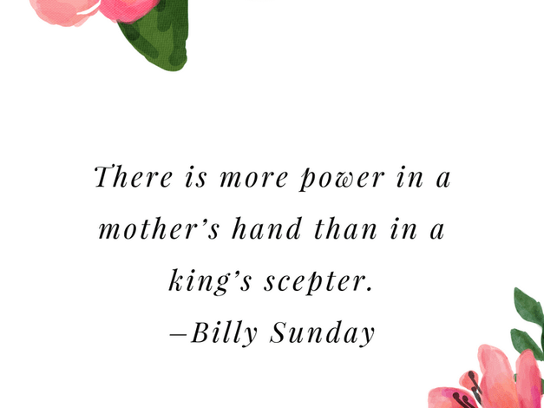

Slide 3


Slide 4
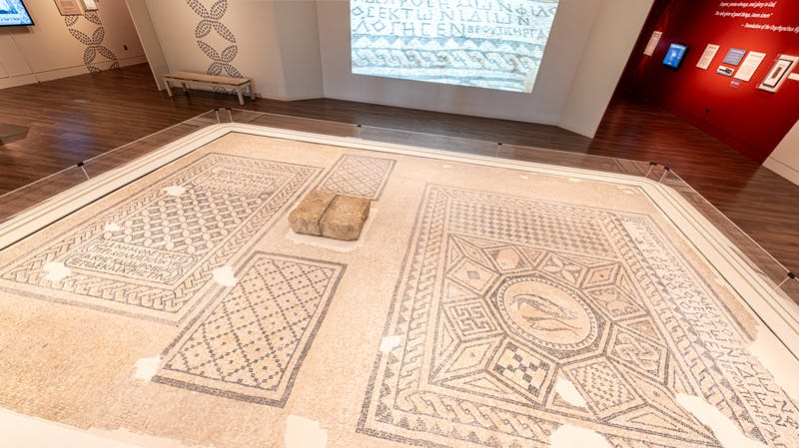

Slide 5
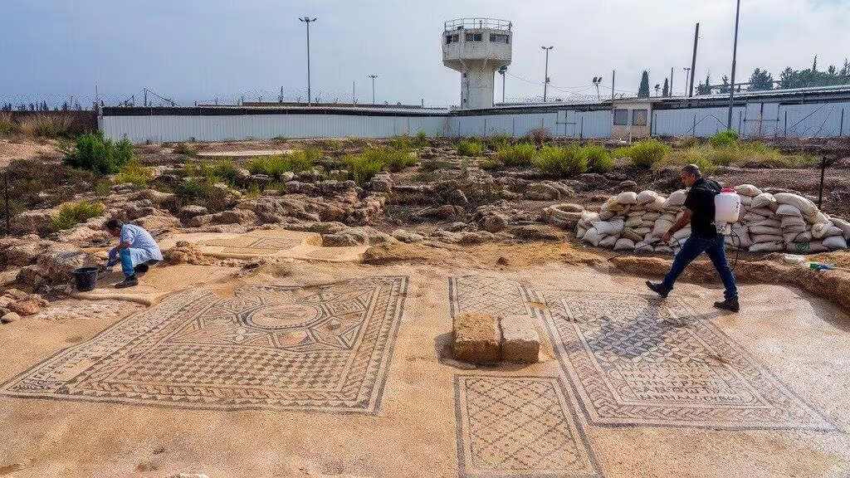

Slide 6
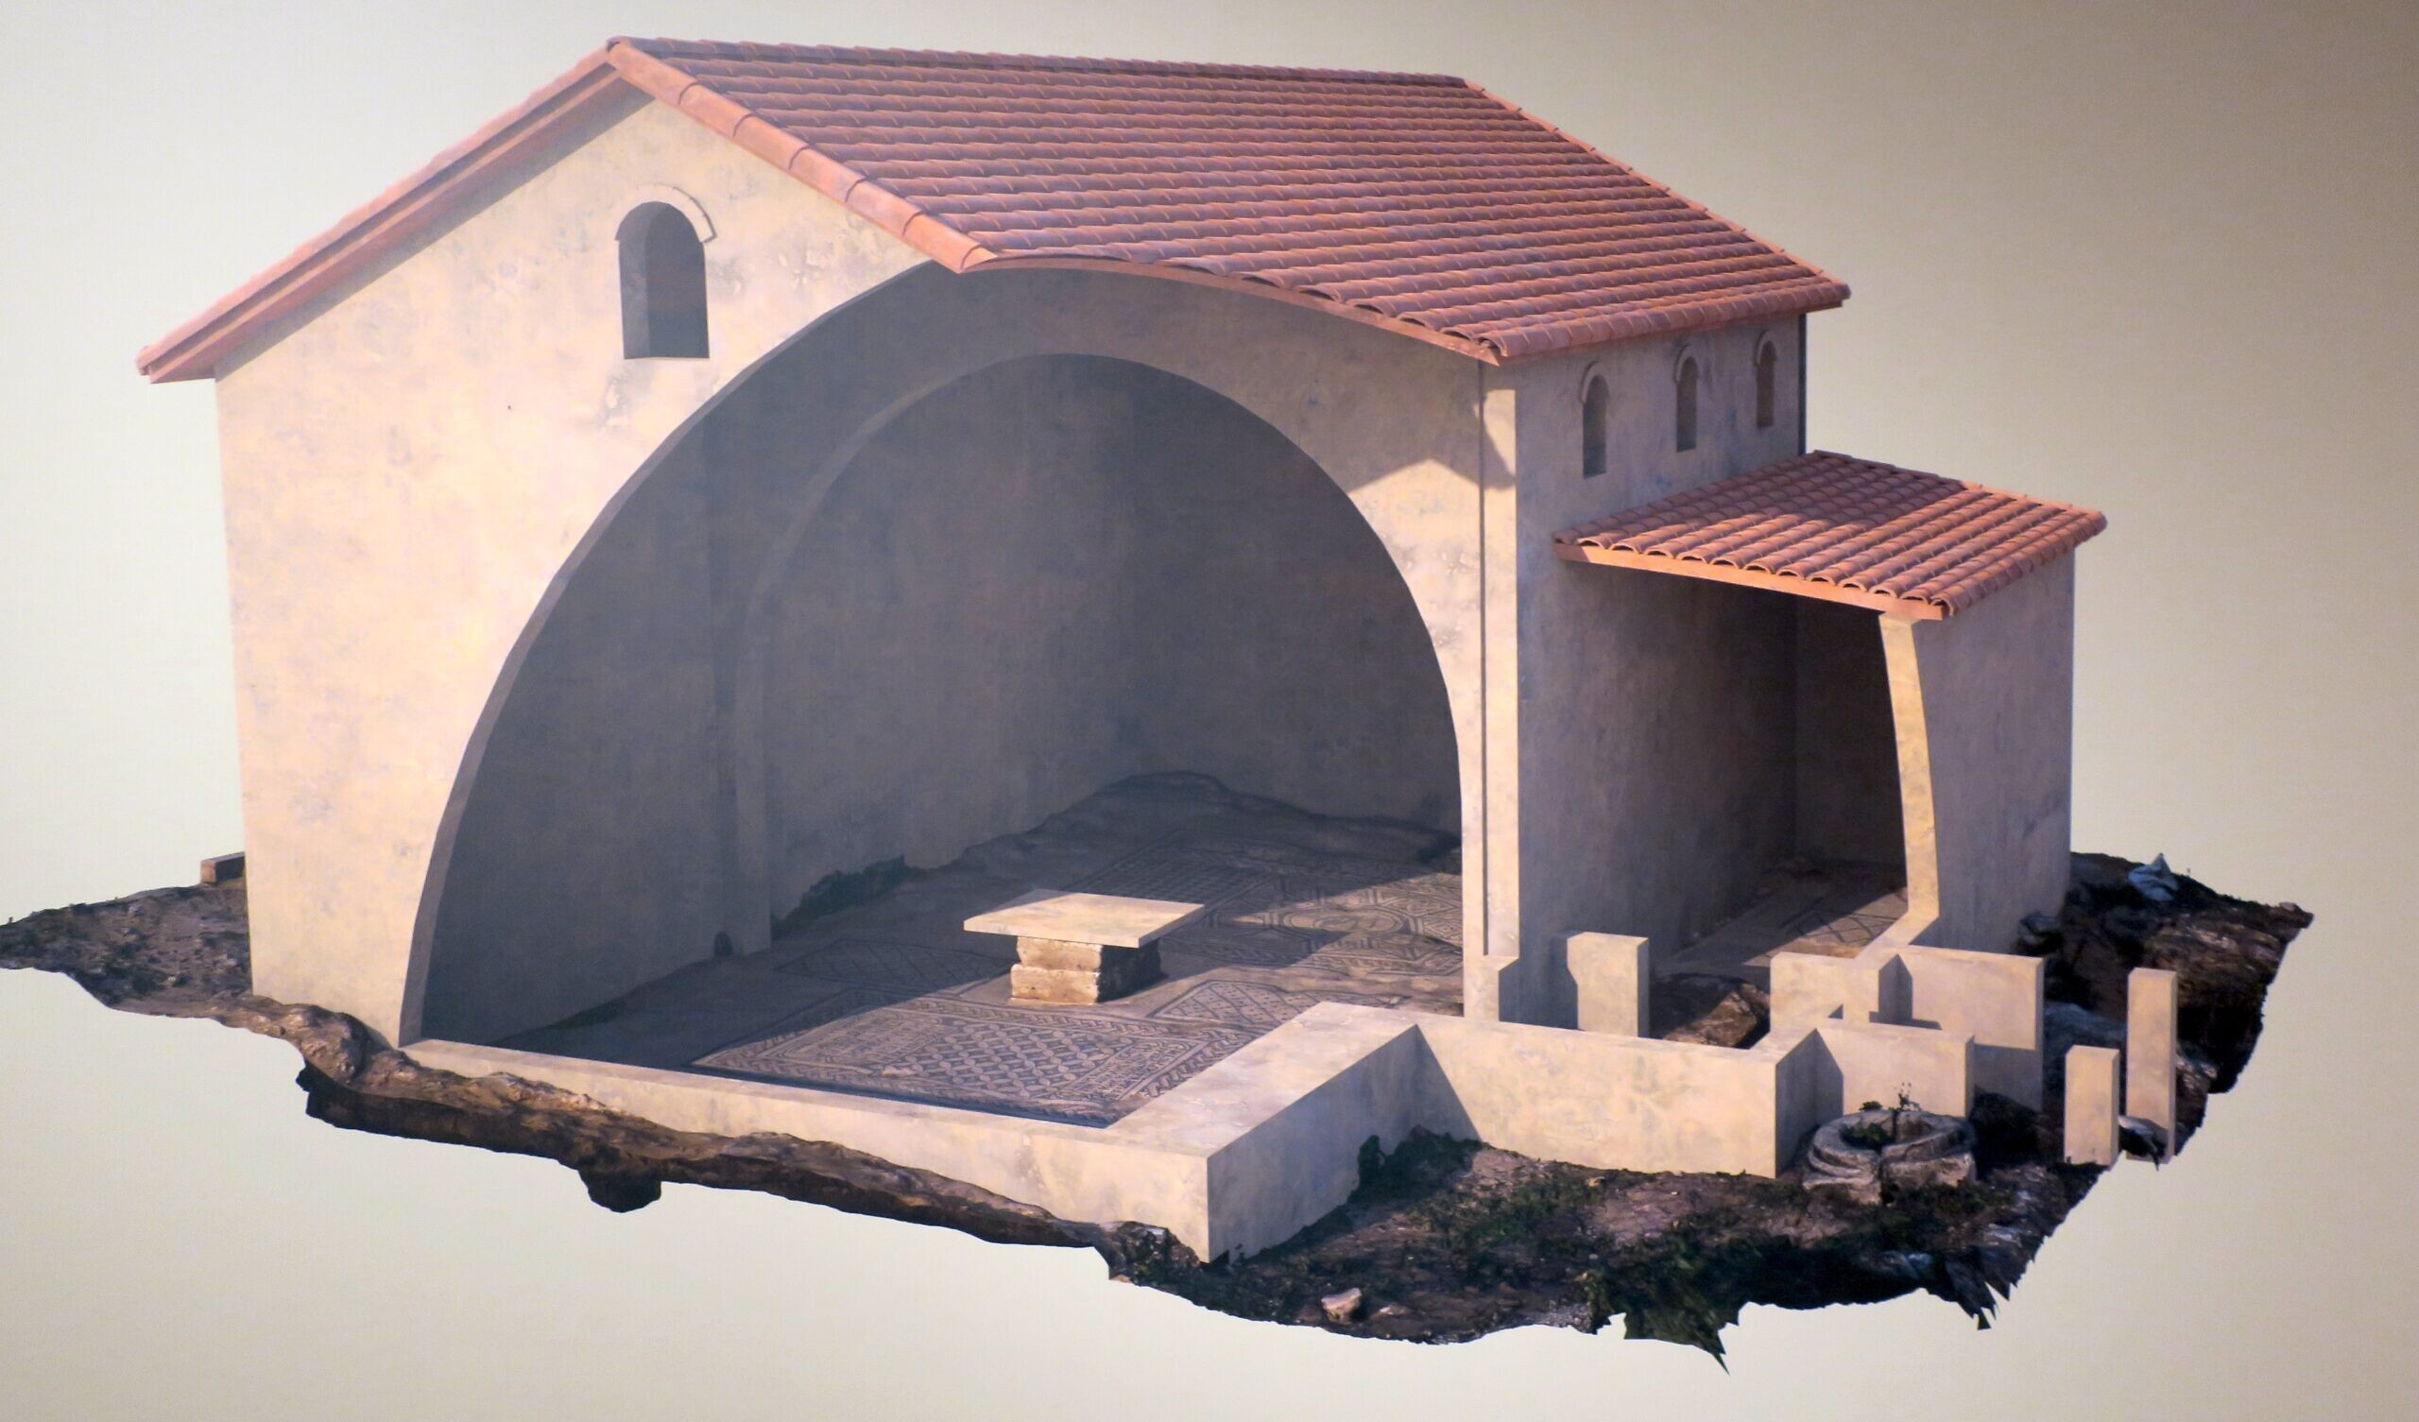

Slide 7
QUESTIONS.AND.ANSWERS.1
134 And the backbone of any nation is womanhood, when it comes to morals. And you break motherhood, you've broke your nation.
54-0103
Biology is the least of what makes
someone a mother.
Oprah Winfrey

Slide 8
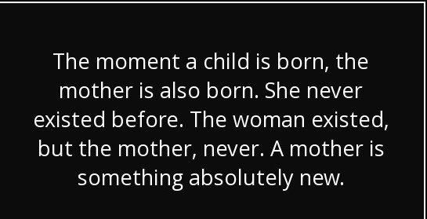

Slide 9
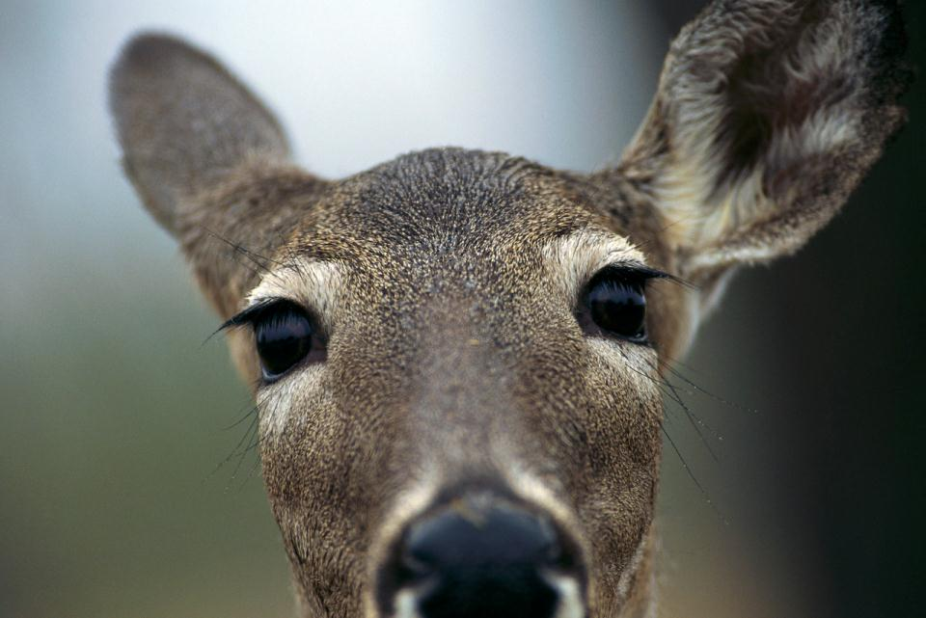

Slide 10
HE.WAS.TO.PASS.THIS.WAY
149 That genuine loyal mother standing there. She wasn't a hypocrite. She wasn't just putting that on... She was a mother. Death didn't mean nothing to her… She thought more of her baby than she did of her own life. Let the hunters shoot; her loyal heart was beating, her motherhood in her was calling. Her baby was crying. There was something inside of her, pulsating, was real.
64-0321
There is an instinct in a woman to love most her own child - and an instinct to make any child who needs her love, her own.
~Robert Brault

Slide 11

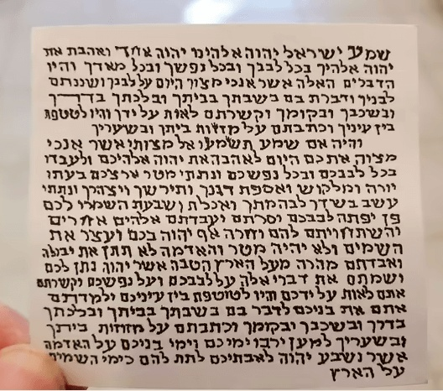
Deut. 6; Deut. 11
Exodus 13

Slide 12
DEUTERONOMY 11:(13-21) 18-21
Therefore shall ye lay up these my words in your heart and in your soul, and bind them for a sign upon your hand, that they may be as frontlets between your eyes. 19 And ye shall teach them your children, speaking of them when thou sittest in thine house, and when thou walkest by the way, when thou liest down, and when thou risest up. 20 And thou shalt write them upon the door posts of thine house, and upon thy gates: 21 That your days may be multiplied, and the days of your children, in the land which the LORD sware unto your fathers to give them, as the days of heaven upon the earth.

Slide 13
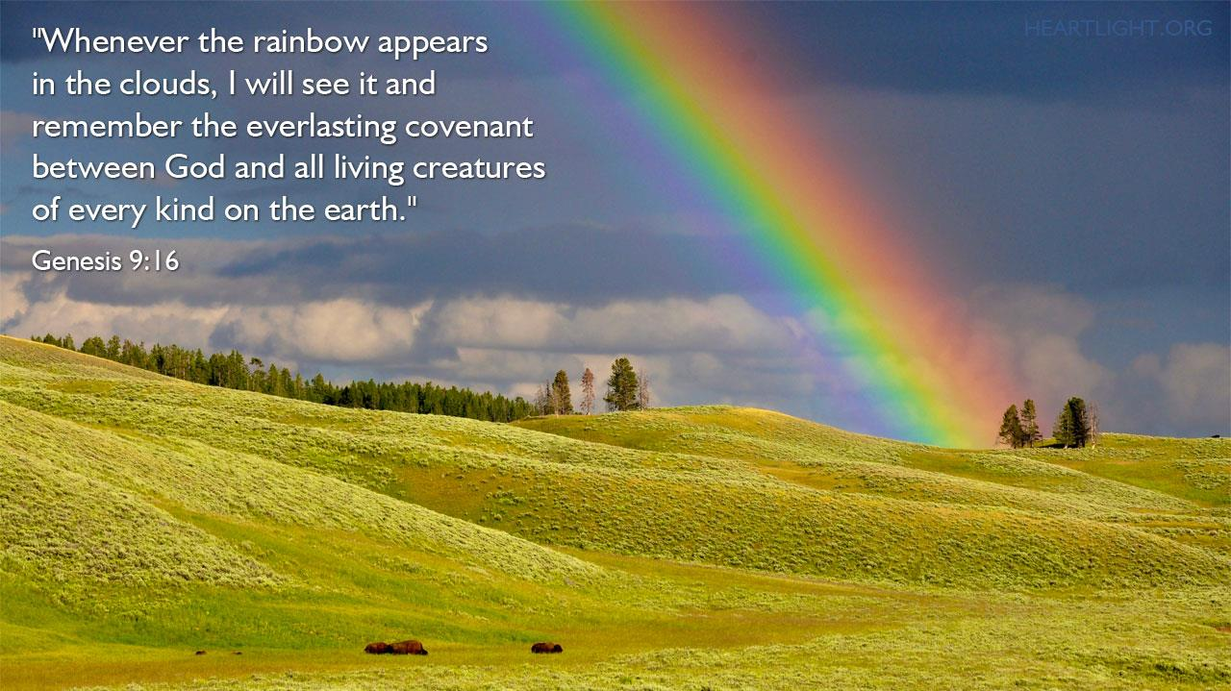

Slide 14
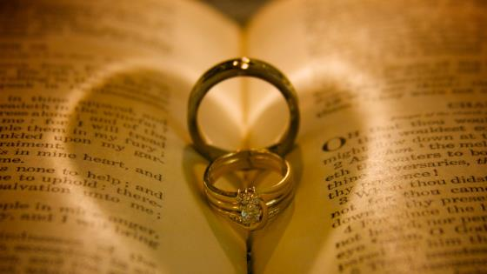

Slide 15
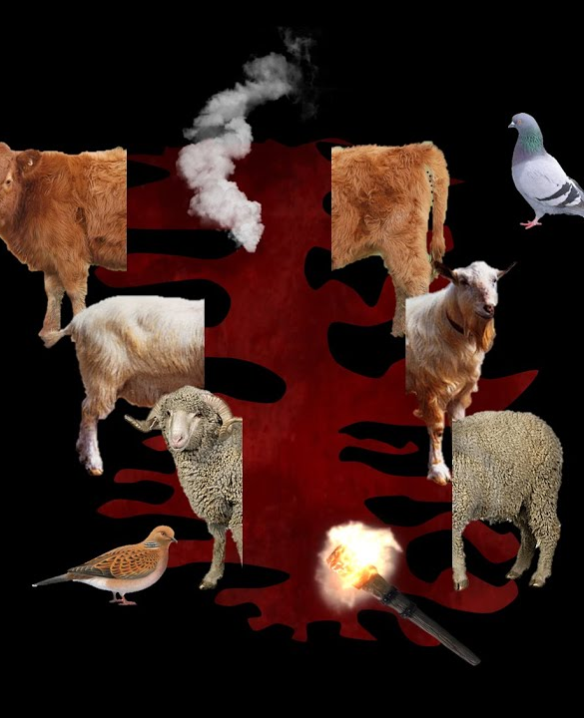
GENESIS 15:17-18
And it came to pass, that, when the sun went down, and it was dark, behold a smoking furnace, and a burning lamp that passed between those pieces. 18 In the same day the LORD made a covenant with Abram, saying, Unto thy seed have I given this land, from the river of Egypt unto the great river, the river Euphrates…

Slide 16

JEREMIAH 11:1-3
The word that came to Jeremiah from the LORD, saying, 2 Hear ye the words of this covenant, and speak unto the men of Judah, and to the inhabitants of Jerusalem; 3 And say thou unto them, Thus saith the LORD God of Israel; Cursed be the man that obeyeth not the words of this covenant…

Slide 17
JEREMIAH 29:10
For thus saith the LORD, That after seventy years be accomplished at Babylon I will visit you, and perform my good word toward you, in causing you to return to this place. 11 For I know the thoughts that I think toward you, saith the LORD, thoughts of peace, and not of evil, to give you an expected end.
perform (HEB.) quwm
To arise, to fulfil, confirm, establish.

Slide 18
JOB 11:13-18
If thou prepare [establish] thine heart, and stretch out thine hands toward him; 14 If iniquity be in thine hand, put it far away, and let not wickedness dwell in thy tabernacles. 15 For then shalt thou lift up thy face without spot; yea, thou shalt be stedfast, and shalt not fear: 16 Because thou shalt forget thy misery, and remember it as waters that pass away: 17 And thine age shall be clearer than the noonday; thou shalt shine forth, thou shalt be as the morning. 18 And thou shalt be secure [confident], because there is hope; yea, thou shalt dig about thee, and thou shalt take thy rest in safety.

Slide 19
JEREMIAH 31:31-34*
Behold, the days come, saith the LORD, that I will make a new covenant with the house of Israel, and with the house of Judah: 32 Not according to the covenant that I made with their fathers in the day that I took them by the hand to bring them out of the land of Egypt; which my covenant they brake, although I was an husband unto them, saith the LORD: 33 But this shall be the covenant that I will make with the house of Israel;

Slide 20
After those days, saith the LORD, I will put my law in their inward parts, and write it in their hearts; and will be their God, and they shall be my people. 34 And they shall teach no more every man his neighbour, and every man his brother, saying, Know the LORD: for they shall all know me, from the least of them unto the greatest of them, saith the LORD: for I will forgive their iniquity, and I will remember their sin no more.

Slide 21
FAITH (CHARLOTTE.NC)*
23 Abraham called by election, and God giving him the covenant of grace unconditionally. When God makes a covenant with man, man breaks his covenant. When God made a covenant with man in the garden of Eden, "This you do, and if you do this," there's an "if" in it.
Man turned right back around it and broke his covenant with God. God was determined to save man. So instead of saying "if," He was no "if" to Abraham: "I have." You see the assurance?

Slide 22
24 Oh, you say, "I'd like to be Abraham. Oh, Bro. Branham, if I had that assurance, then I would certainly rest perfectly quiet." Why, you've got the same assurance and the same covenant.
The covenant was not only to Abraham only, but to his seed after him. If you begin to see that, then Divine healing becomes easy. Any the other promise that God has given becomes easy when you see that it's not you; it's God. God has give the promise, so then you don't get restless.
56-0427

Slide 23
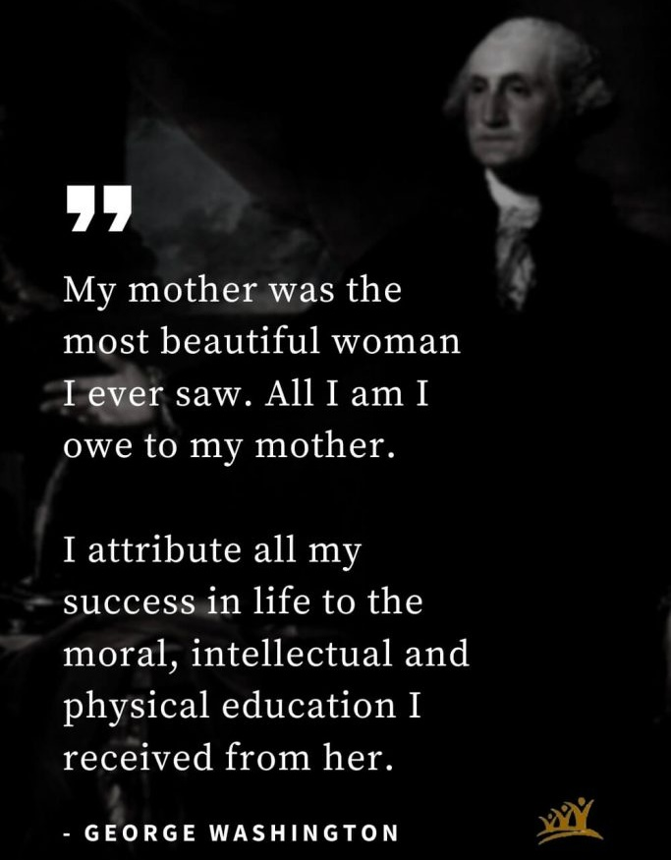

Slide 24
EXPRESSIONS
59 (Sis. Bell) And her never-failing plea for her children! I don't believe I ever left her, without her asking a request for those children. That showed real motherhood, knowing that life is merely a preparation place for her children. She wanted to meet them in a Land beyond, where there would be no more hard times… She would say, "Bro. Billy, pray for my children, none of them will be lost." If that isn't expressing real motherhood; a mother who is interested in her children, her neighbors, her husband, her loved one! It's God in the woman, expressing Eternal things.
62-0313

Slide 25
The phrase "working mother" is redundant.
~Jane Sellman
A mother is a person who seeing there are only four pieces of pie for five people, promptly announces she never did care for pie. ~Tenneva Jordan
The mother of boys work son-up to son-down.
~Author Unknown

Slide 26
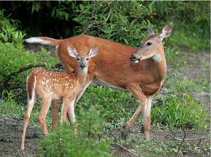
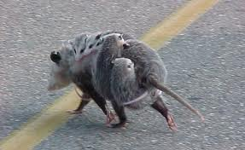
Mother is a verb, not a noun.
~Proverb

Slide 27
THE.UNCERTAIN.SOUND
209 I couldn't get that poor old opossum off my mind. I thought, "God, I ought to go in, and get a gun, and kill that opossum, but I can't do it…" I walked up-and-down the floor. Daylight come, old opossum laying there. "O God, there she is, that hot sun, laying right at my step." The blessed Holy Spirit stopped me, "You called her a lady. You took up for her, for being a real mother. And I sent her to your house to be prayed for, and you're letting her lay there like a woman at your doorstep.“ I said, "God, forgive Your stupid servant…“ 55-0731

Slide 28
HEBREWS (7) 57-0915
161 Your attitude towards Christ will make a great impression on what your children will be. Your life that you live before your family will make an impression on what your children will be. Cause, the Bible said, that, "He would visit the iniquity of the parents upon the children to the third and fourth generations."

Slide 29
JUST.ONE.MORE.TIME.LORD
133 You fathers, you mothers, are you ready to establish an altar in your house, and take that television out? Are you ready to take that deck of cards off the table? Them comic books that your children's reading, preparing their little mind for a blast that the Devil's going to give them. Are you ready to establish the old family altar again? Or do you just want to continue on the way you are?
63-0120

Slide 30



Top Selling Comic Books
Of 1963

Slide 31
AND.KNOWETH.IT.NOT
165 Now watch the Spirit, following it. There'll come a time, in the Name of the Lord, that people will go completely insane. The Bible says so. They'll scream and holler; great hideous things in their imaginary mind. The radios and things, our television programs, are producing it… But it'll be the Plagues.
65-0815

Slide 32
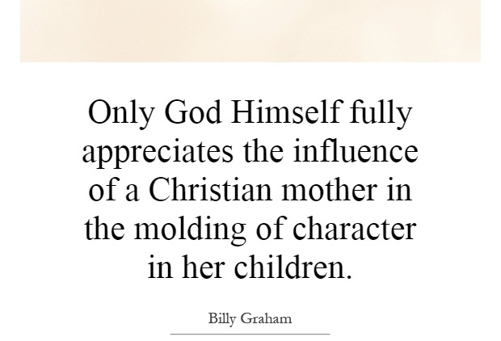

Slide 33
LAMB.AND.DOVE 60-0805
62 …May that still small voice attract the people tonight to a real sanctified life, a life that'll stand by their God, stand by their church, stand by their pastor, stand by the cause of Christ, hold up a banner, live, act, dress… that'll be so salty, that'll cause others to thirst to be like them.
Grant it, Lord. May our church never get so polluted till it looks like the rest of the world, where you can't tell sinner from saint. God, grant that it'll be real. Make it real, Father, I pray…
A mom's hug lasts long after she lets go. ~Author Unknown

Slide 34
TAKING.SIDES.WITH.JESUS
755-52 So we've got to think of the others that's coming on behind us, these young people and so forth, and a place for our children. Our daughters, we don't want them out in the world in these things like that, we want them girls raised like their mothers. And we've got to make arrangements for that.
62-0601

Slide 35


