Slide 1
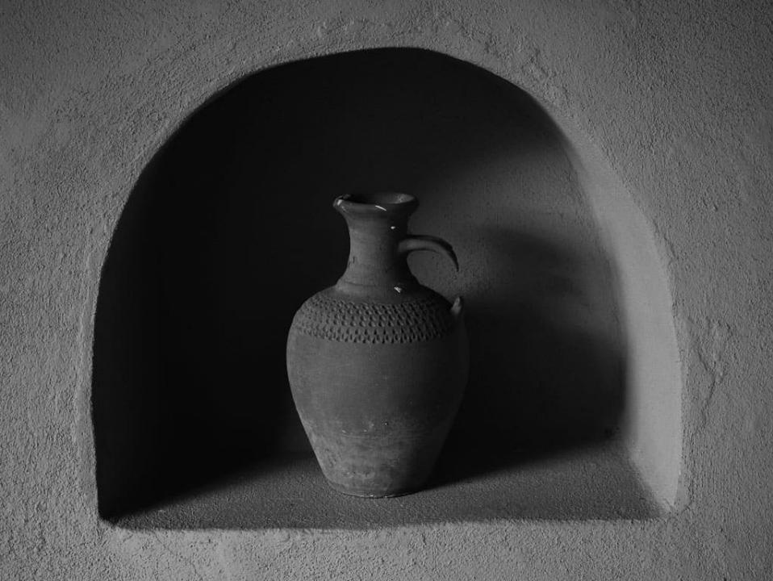
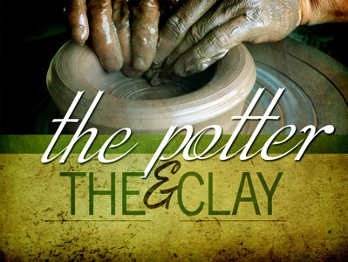
The Potter’s House
JEREMIAH 18:1
The word which came to Jeremiah from the LORD, saying, 2 Arise, and go down to the potter's house, and there I will cause thee to hear my words.

Slide 2
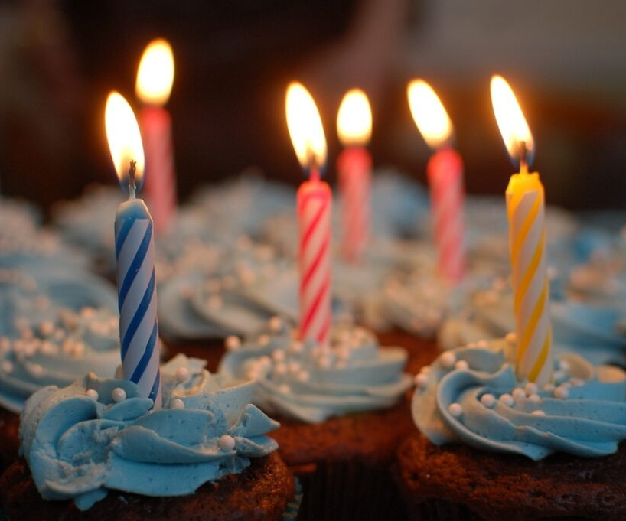
Birthdays Anniversaries Events
June 1st Ben & Sharon McCafferty
June 4th John & Hanna Harwell
Jeremy Clayville, Lillian Godwin
June 5th John & Laura Harwell
June 7th John James
Mark & Jackie Sylvester
Men’s Meeting: September 25-27th
Winter Youth Retreat: Dec. 29 to Jan. 1, 2026

Slide 3
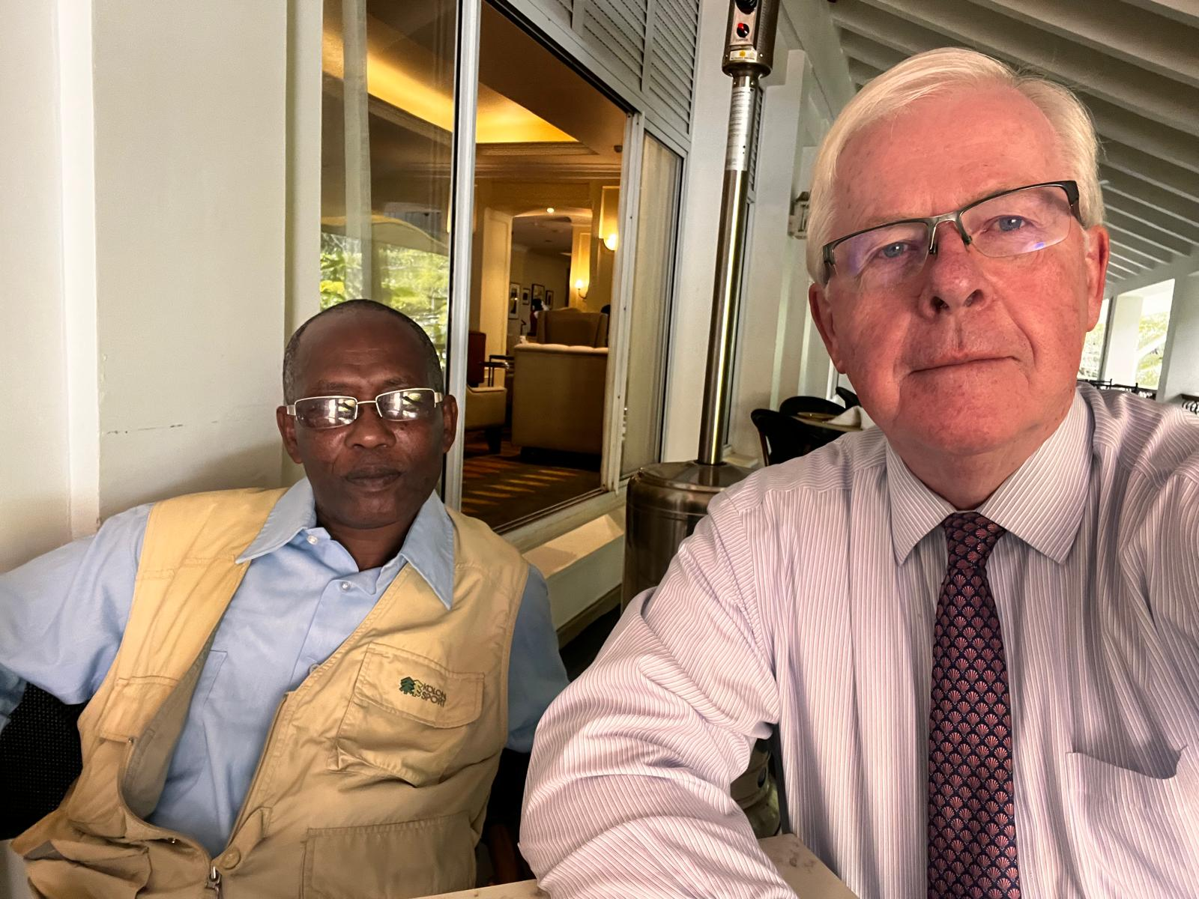
Pastor
Exhaud Moleill
Tanzania

Slide 4
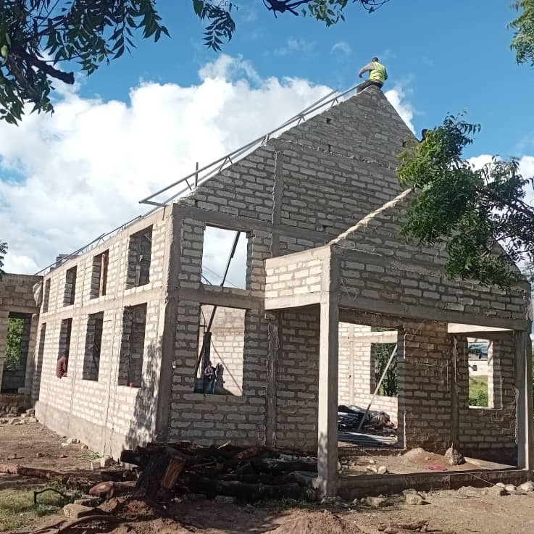
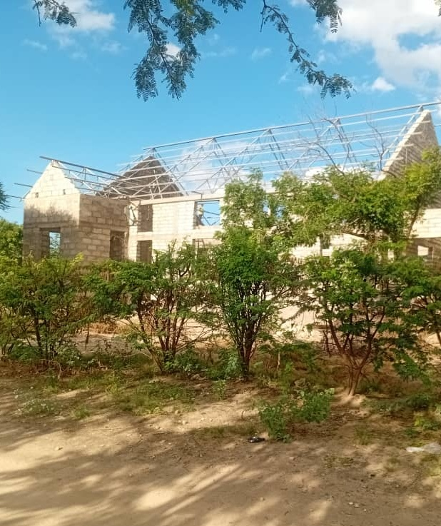

Slide 5
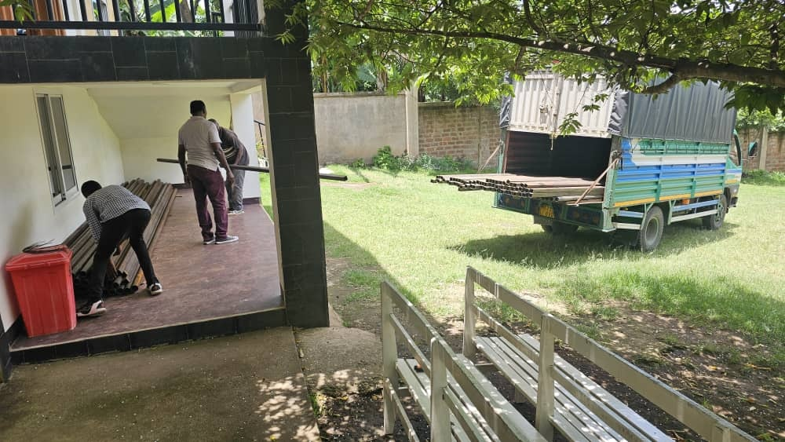

Slide 6
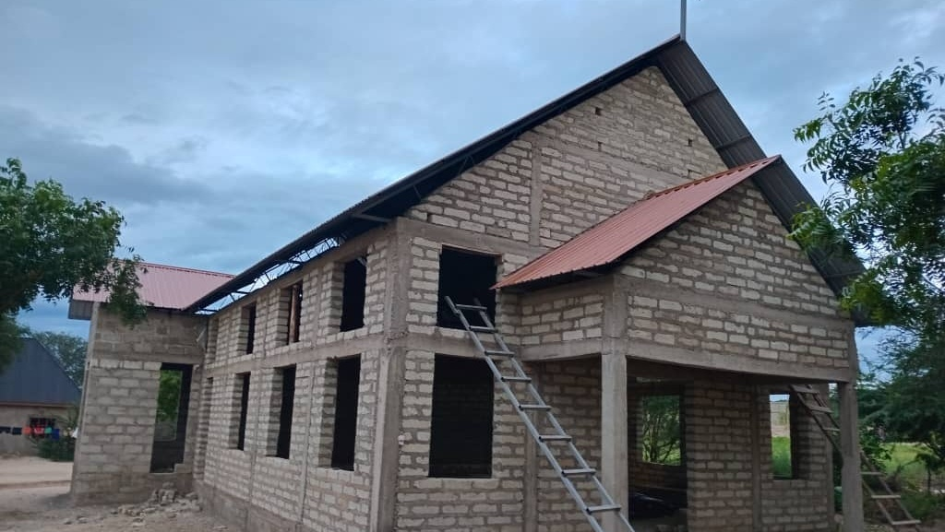

Slide 7
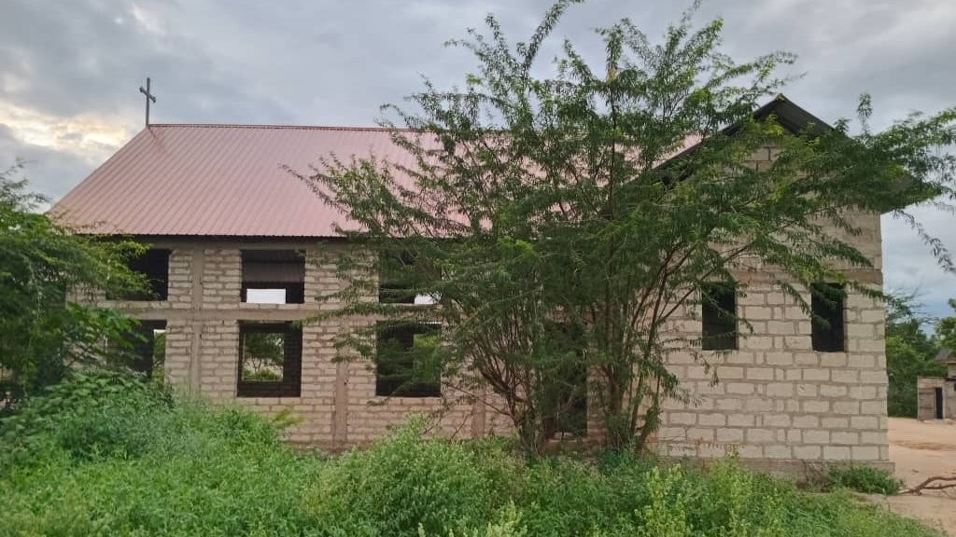

Slide 8
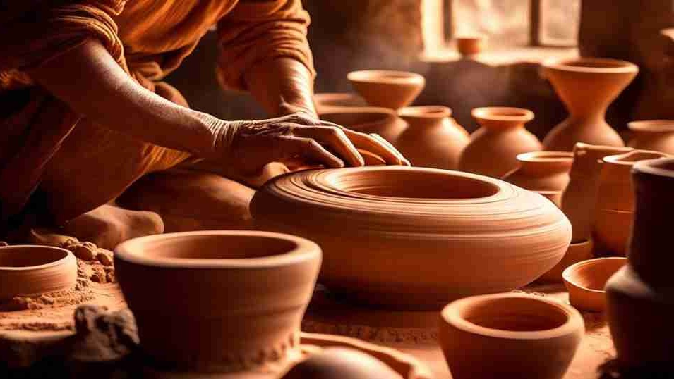
JEREMIAH 18:1
The word which came to Jeremiah from the LORD, saying, 2 Arise, and go down to the potter's house, and there I will cause thee to hear my words.
The Potter’s
House

Slide 9
I.KNOW
41 Satan could not drown Noah in the flood, until the purpose of God had been finished. He could not burn up the Hebrew children… He could not kill Job with boils and troubles…Neither could death and old age take Abraham until the purpose of God had been finished. And neither can it take you, or can it take me until the purpose of God of our life is finished. And why does God let troubles come? God harnesses trouble, puts bits in its mouth, and makes it obey Him, and those troubles bring us into a closer fellowship with God. 60-0417

Slide 10
HAGGAI 2:3
Who is left among you that saw this house in her first glory? and how do ye see it now? is it not in your eyes in comparison of it as nothing?
9 The glory of this latter house shall be greater than of the former, saith the LORD of hosts: and in this place will I give peace, saith the LORD of hosts.

Slide 11
JOB 2:11
Now when Job's three friends heard of all this evil that was come upon him, they came every one from his own place; Eliphaz the Temanite, and Bildad the Shuhite, and Zophar the Naamathite: for they had made an appointment together to come to mourn with him and to comfort him.
JOB 42:10 And the LORD turned the captivity of Job, when he prayed for his friends: also the LORD gave Job twice as much as he had before.

Slide 12
GENESIS 50:19-20
And Joseph said unto them, Fear not: for am I in the place of God? 20 But as for you, ye thought evil against me; but God meant it unto good, to bring to pass, as it is this day, to save much people alive.

Slide 13
I JOHN 3:1-3
Behold, what manner of love the Father hath bestowed upon us, that we should be called the sons of God: therefore the world knoweth us not, because it knew him not. Beloved, now are we the sons of God, and it doth not yet appear what we shall be: but we know that, when he shall appear, we shall be like him; for we shall see him as he is. 3 And every man that hath this hope in him purifieth himself, even as he is pure.

Slide 14
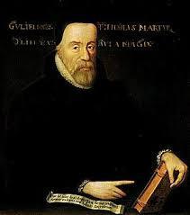
“He was a wealthy merchant who had made a fortune in the cloth business and he played as significant a part in the Reformation as any of the more famous theologians and preachers. Everybody knows of Luther and Calvin.
His invaluable contribution arose out of his relationship with William Tyndale, the father of the English Bible. Tyndale was martyred for his efforts in 1536. But his work still lives on: ninety percent of his words passed on into the later King James Version of the Bible.”
Humphry Monmouth
Died 23 November 1537

Slide 15
I.AM.THE.RESURRECTION.AND.THE.LIFE And here they are living into today, and Pentecost getting right into it. You holiness people going right into it, just headlong. That's true. Oh, my. What a sad sight it is.
What we need today, brother, is a revival, a stirring, a breaking down, breaking up, down to the Potter's house again.
52-0810

Slide 16
TRYING.TO.DO.GOD.A.SERVICE
171 I wonder, today, if all of our great crusades and revivals, we haven't been filling up the Methodist ark, Baptist ark! But what about the Ark of Christ, the Word? And if the Bride is to be the Word, then She's got to be of Christ, part of the Bridegroom. She's got to be the Word; the Word not for His day; the Word of this day, that He promised would be this day, that He sent His Word forth to mold His Bride and make Her. Don't get some idea of your own now, and don't take somebody else's idea. 65-0718

Slide 17
LAW.HAVING.A.SHADOW
1 The prophet, one time, went down to the potter's house, to be broke up, melded over. If there's something wrong, God don't just put a patch in anything. He said you put a new piece in an old garment, it'll make it worse than ever. The thing to do is put the whole thing new. So, if you've done something wrong, don't just get around with a little, say, "Well, I'm sorry I did it. I won't, try not, do it again." Just break up and get molded over again. Make that piece another piece. 54-0516

Slide 18
MATTHEW 9:16
No man putteth a piece of new cloth [unprocessed] unto an old garment, for that which is put in to fill it up taketh from the garment, and the rent is made worse. 17 Neither do men put new wine into old bottles: else the bottles break, and the wine runneth out, and the bottles perish: but they put new wine into new bottles, and both are preserved.
New: (Gr.) recently made, fresh, unused, unworn; which as recently made is superior to what it succeeds.

Slide 19
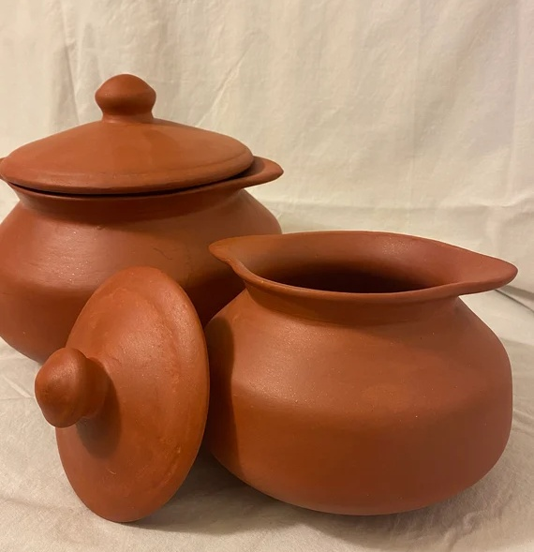
New: kainos
As respects form, recently made, fresh, recent, unused, unworn; new, which as recently made is superior to what it succeeds.

Slide 20
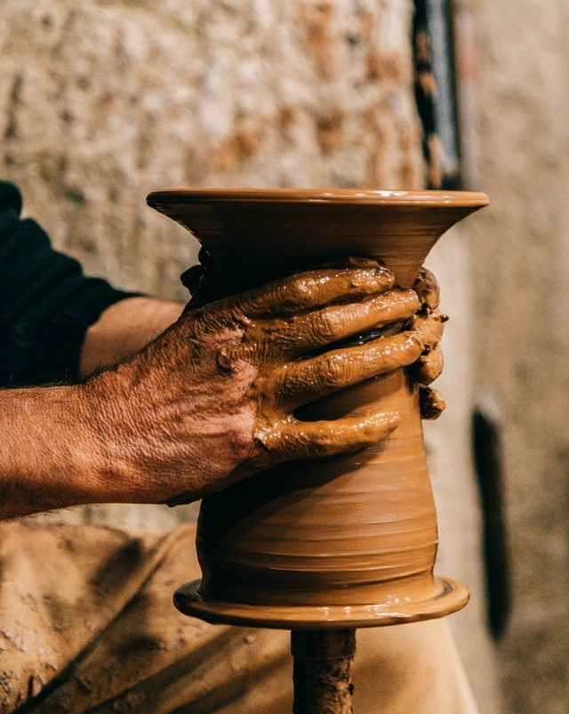
65-1205 THINGS.THAT.ARE.TO.BE
124 I had some scars when I was a kid. I know things that happened that's kind of turned me that way. But it was all God, making, molding me for this hour.

Slide 21
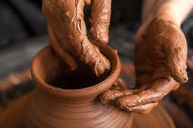
JEREMIAH 18:4
And the vessel that he made of clay was marred in the hand of the potter: so he made it again another vessel, as seemed good to the potter to make it.
Marred: (Heb.) shachath
1. Decayed, spoiled, rotted.
2. To pervert, corrupt morally.
3. To pervert.

Slide 22
GENESIS 6:10
And Noah begat three sons, Shem, Ham, and Japheth. 11 The earth also was corrupt before God, and the earth was filled with violence. 12 And God looked upon the earth, and, behold, it was corrupt; for all flesh had corrupted his way upon the earth.

Slide 23
GENESIS 13:10
And Lot lifted up his eyes, and beheld all the plain of Jordan, that it was well watered every where, before the LORD destroyed Sodom and Gomorrah, even as the garden of the LORD, like the land of Egypt, as thou comest unto Zoar.
EXODUS 32:7
And the LORD said unto Moses, Go, get thee down; for thy people, which thou broughtest out of the land of Egypt, have corrupted themselves:

Slide 24
PROVERBS 6:32 But whoso committeth adultery with a woman lacketh understanding: he that doeth it destroyeth his own soul.
PROVERBS 11:9 An hypocrite with his mouth destroyeth his neighbour: but through knowledge shall the just be delivered.
PROVERBS 18:9 He also that is slothful in his work is brother to him that is a great waster.

Slide 25
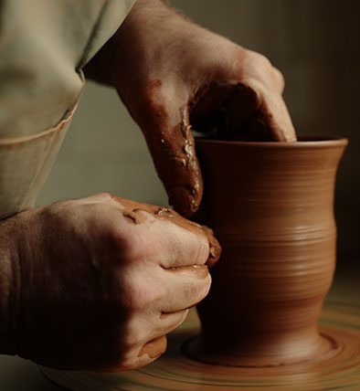
Jer. 19: 1-4 Adonai then said, “Go; buy a clay jar from the potter; take some of the people’s leaders and some of the leading cohanim; ² and go out into the Ben-Hinnom Valley, by the entry to the Potsherd Gate. There you are to proclaim the words I am about to tell you. (CJB)

Slide 26
IT.IS.THE.RISING.OF.THE.SUN
141 He's got a predestinated, foreordained Church! Sons and daughters, a Bride; when the Holy Spirit begins to fly over it, that wave Sheaf. No matter how many tried to tell him, "a eagle," he didn't know what a eagle was. Yet, he was a eagle. And when we see, not a denomination, not a good neighbor; but a son of God molded in the image of God, with the dynamic Power of God to answer the request of this day, that He's the same yesterday, today, and forever, there ain't no hen going to hold you. 65-0418

Slide 27
THE.CHOOSING.OF.A.BRIDE
185 He's looking for her character… He chooses a Bride to reflect His character, which the modern churches of today certainly misses His program here, a million miles, 'cause they deny This to be the Truth. He's looking for the day for that Bride to be formed, Heb. 13:8, exactly like He was. His same flesh, same Spirit… just exactly built up, and them two become one. Until the church becomes that, they're not one. The character of Him, the Word, for this age, must be molded. She must be molded like He is. 65-0429

Slide 28
