Slide 1

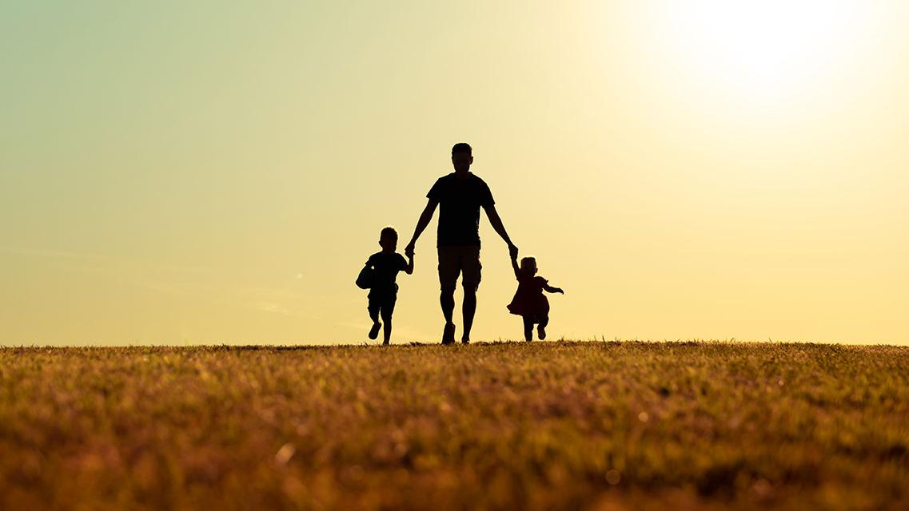
FATHERHOOD
HEBREWS 12:9-10
PROVERBS 20:7
The just man walketh in his integrity: his children are blessed after him.

Slide 2

June
15th Bro. Richard Smith
16th Kristie Williams
22nd Simona Walters
22nd Bro. Trevor Emond

Slide 3
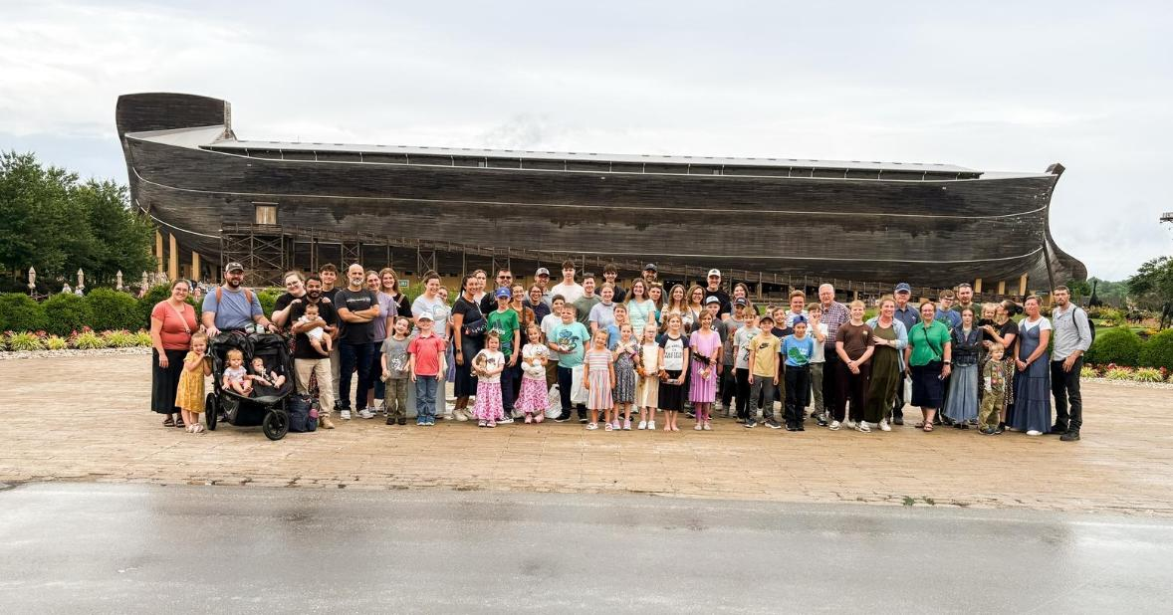
The Ark 2025

Slide 4

Israel 2025
PSALM 122:6
Pray for the peace of Jerusalem: they shall prosper that love thee.

Slide 5
AND.THEN.JESUS.CAME
35 In this hour we're living, this great chaos that we're in now. Where is the hope? Sputnik’s [1957] in the skies, atomic bombs, controlled missiles, war. Any little nation can destroy the world... If we had a President like we got now, Eisenhower, a wonderful man, if we had one in every county, we could not be secured. If we had bomb shelters under these places, we're still not secured. There's only one safe place; that's in Christ. He is the bomb Shelter. Under His wings we will abide. 57-1213

Slide 6
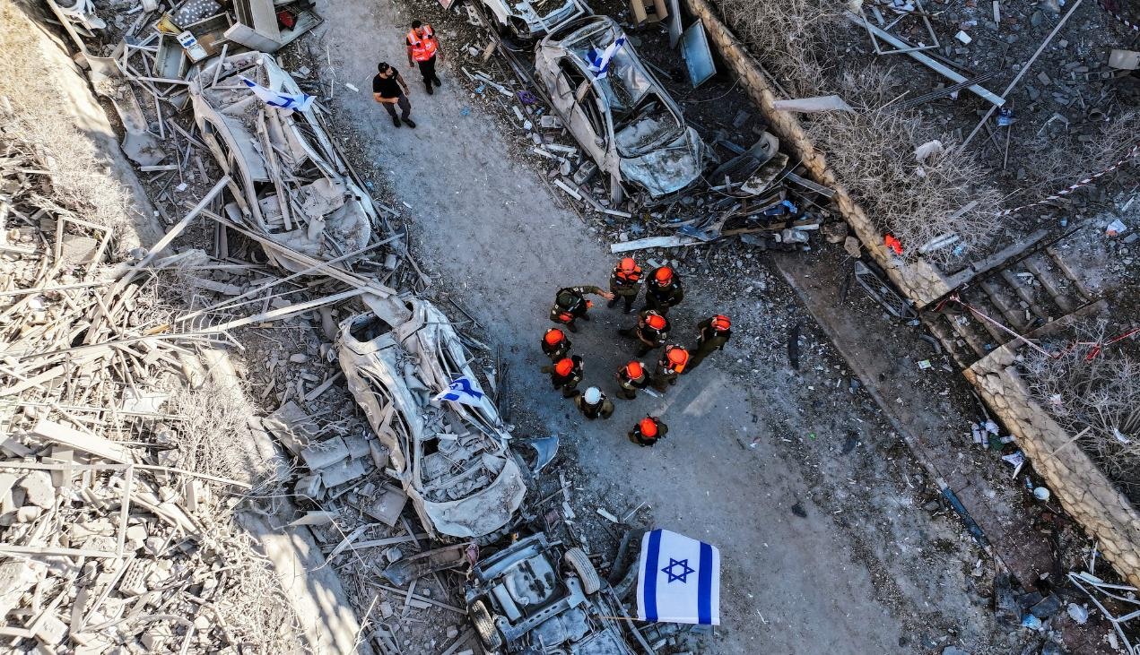

Slide 7
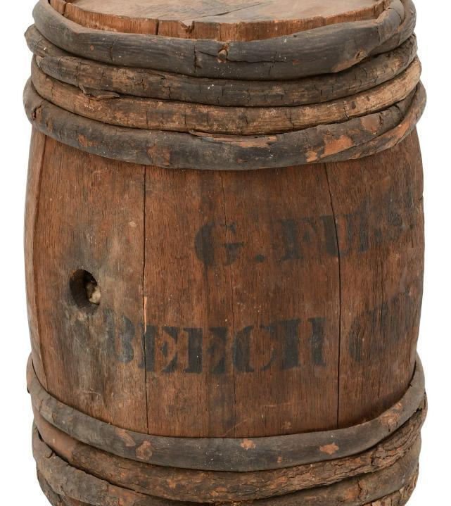
BUT.IT.WASN'T.SO.FROM.THEBEGINNING
113 Think of it, friends. In the days when nations don't know what to do... Our nation and this world is on a powder keg. You know that. Not a powder keg, but on an atomic bomb...
61-0411

Slide 8
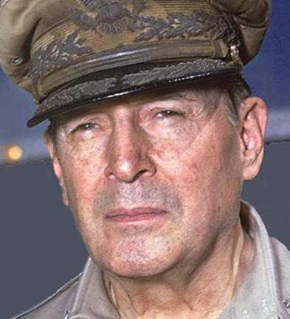
Gen. Douglas McCarthur
“By profession, I am a soldier, and take pride in that fact, but I am prouder, infinitely prouder, to be a father. A soldier destroys in order to build; a father only builds, never destroys. The one has the potentialities of death; the other embodies creation of life…
It is my hope that my son, when I am gone, will remember me, not from the battle, but in the home repeating with him our simple, daily prayer, our Father Who art in Heaven.”

Slide 9
FATHERHOOD
HEBREWS 12:9-10
PROVERBS 20:7
The just man walketh in his integrity: his children are blessed after him.

Slide 10

THE.TIME.OF.DECISION
6 So the Church is not in its right state yet. We have to remember that. It's not matured. So we just have to linger and do the best we can. And there's no one can bring it to maturity, only the Holy Spirit, as we listen to It. I don't believe it'll ever come by man, it'll have to come by God.59-0611

Slide 11
PSALM 34:9-11
O fear the LORD, ye his saints: for there is no want to them that fear him. 10 The young lions do lack, and suffer hunger: but they that seek the LORD shall not want any good thing. 1
1 Come, ye children, hearken unto me: I will teach you the fear of the LORD.

Slide 12
TITUS 2:6
Young men likewise exhort to be sober minded. 7 In all things shewing thyself a pattern of good works: in doctrine shewing uncorruptness, gravity, sincerity, 8 Sound speech, that cannot be condemned (no need to be censored); that he that is of the contrary part may be ashamed, having no evil thing to say of you.
Gravity: (Gr.) the characteristic of a thing or person which entitles to reverence and respect, dignity, majesty, honour.

Slide 13
The UN Office on Drugs and Crime reports that countries with more permissive cultures toward juvenile discipline tend to have higher juvenile homicide and assault rates. For example, in permissive countries, juvenile homicide rates can be up to 60% higher than in countries with stricter disciplinary norms.
A study published in Developmental Psychology (2010) found that inconsistent discipline was associated with a 45% increase in the likelihood of juvenile delinquency
(Odds Ratio [OR] = 1.45).

Slide 14
^{CJB} Similarly, urge the young men to be self-controlled, ⁷ and in everything set them an example yourself by doing what is good. When you are teaching, have integrity and be serious;
⁸ let everything you say be so wholesome that an opponent will be put to shame because he will have nothing bad to say about us.

Slide 15
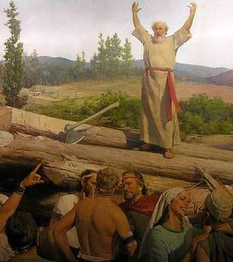
GENESIS 6:5
And GOD saw that the wickedness of man was great in the earth, and that every imagination of the thoughts of his heart was only evil continually…

Slide 16

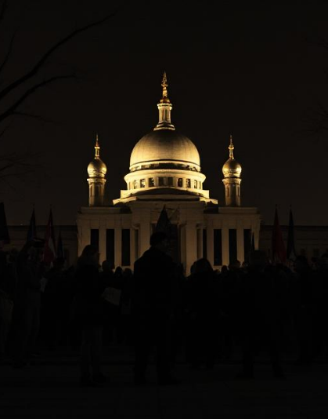
Secularism: A system of political or social philosophy that rejects all forms of religious faith and worship.
The view that public education and other matters of civil policy should be conducted without the introduction of a religious element.

Slide 17
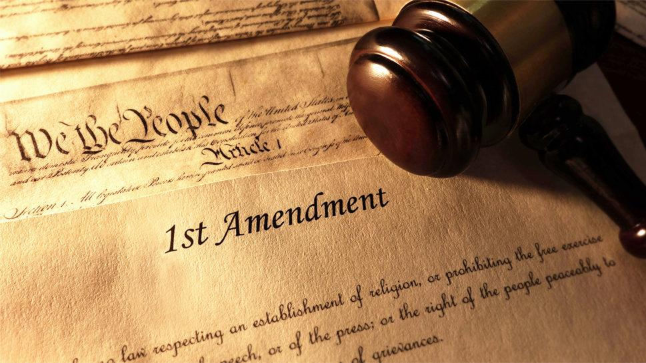
First Amendment
Congress shall make no law respecting an establishment of religion, or prohibiting the free exercise thereof; or abridging the freedom of speech, or of the press; or the right of the people peaceably to assemble, and to petition the Government for a redress of grievances.

Slide 18
Parent
YoReH
מורה
Yoreh
Rain is so special in Israel. This word refers to the annual debut of gentle rain on young seedlings, something noteworthy.

Slide 19
Present
Future
Husband
Instruct
Protector
Discipline
Provider
Counsel

Slide 20
PSALM 27:5
For in the time of trouble he shall hide me in his pavilion: in the secret of his tabernacle shall he hide me; he shall set me up upon a rock.
Trouble: (Heb.) injury, evil, misery, distress, wrong,
Calamity, sadness, worry, fear, things that are bad, malignant.

Slide 21
Ps. 27:3-6
³ If an army encamps against me, my heart will not fear; if war breaks out against me, even then I will keep trusting. ⁴ Just one thing have I asked of Adonai; only this will I seek: to live in the house of Adonai all the days of my life, to see the beauty of Adonai and visit in his temple.
⁵ For he will conceal me in his shelter on the day of trouble, he will hide me in the folds of his tent, he will set me high on a rock. ⁶ Then my head will be lifted up above my surrounding foes, and I will offer in his tent sacrifices with shouts of joy; I will sing, sing praises to Adonai.

Slide 22
LUKE 11:9-13
And I say unto you, Ask, and it shall be given you; seek, and ye shall find; knock, and it shall be opened unto you. 10 For every one that asketh receiveth; and he that seeketh findeth; and to him that knocketh it shall be opened. 11 If a son shall ask bread of any of you that is a father, will he give him a stone? or if he ask a fish, will he for a fish give him a serpent? 12 Or if he shall ask an egg, will he offer him a scorpion? 13 If ye then, being evil, know how to give good gifts unto your children: how much more shall your heavenly Father give the Holy Spirit to them that ask him?

Slide 23
I TIMOTHY 5:8
But if any provide not for his own, and specially for those of his own house, he hath denied the faith, and is worse than an infidel.
Provide: (Gr.) pronoeo
To perceive before, foresee, to take thought for.
Denied the Faith:(Gr.) arneomai
Refuse, abnegate; not to accept, to reject, to refuse something offered.

Slide 24
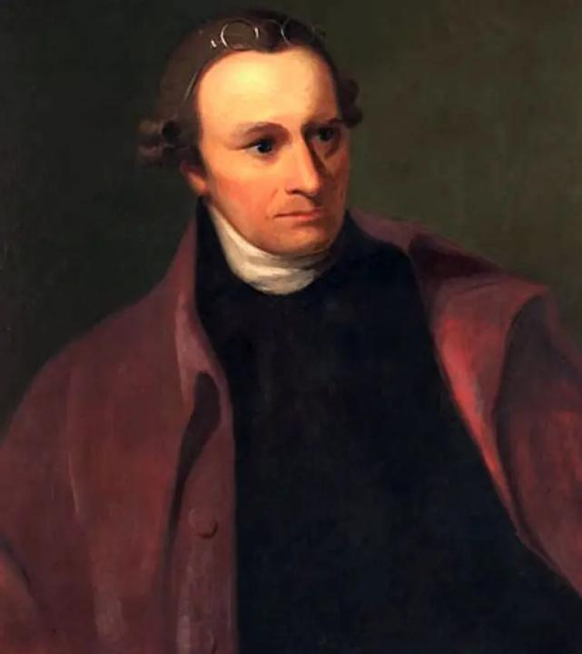
“This is all the inheritance I can give to my dear family. The religion of Christ can give them One which will make them rich Indeed.
Whoever you are, remember this And in thy sphere, practice Virtue thyself and encourage it
In others.”
Patrick Henry
1736-1799

Slide 25
QUESTIONS.AND.ANSWERS.
292 Oh, how this world is contaminated. They have crossed the dividing line between reason and common sense, let alone between salvation.
Man can't even judge. We don't have men no more like we used to have. Where is Patrick Henry? Where is Abraham Lincoln? men that can stand for solid convictions.
What's common sense? If she puts herself out there, let her go like a dog. If she’s [got] no more common decency than that... Where's the laws that could stop it? 64-0823

Slide 26
LEAN.NOT… UNDERATANDING
19 I got that little story about that eagle, walking with the hens and chickens because he was hatched out and born there, but he never did feel just like them chickens…
That's the way every believer is. You wasn't born for this world. You was created in the image of God, to be a son of God. And you don't belong in this chicken yard out here. You're a eagle.
65-0120

Slide 27
GOD.KEEPS.HIS.WORD.1
62 God, the woman's got cancer… It's death. Now, heavenly Father, I cannot control that, but I can ask You… And may it leave, as this church prays, not only me, but the rest of us, that shadow will be gone from the woman.
She knows something’s by her, and has told her by the Bible, it's the truth. May the demon leave, because it's said in the Bible, "In My Name they shall cast out devils.“
57-0306

Slide 28
MAKE.THE.VALLEY.FULL.OF.DITCHES
3 A lady in my church... Mrs. Weber, dying with TB, in the sanatorium at the last stages. They sent her home to die: said there's nothing could be done for her. She lived just beyond the Tabernacle, and she had a got five or six little children. So the Angel of the Lord come to me that night and said, "Go, tell Mr. Webber to get things ready; for he's going to be left with those children on his hands; for his wife's going." Well, I went and told Mr. Webber.

Slide 29
4 And two days after that, some ladies from the government depot there, where she worked, come in. Mrs. Webber said, "If I could only have Bro. Bill to pray for me once more, I seen when my cousin Opal was healed with that cancer, and the doctor just give her 'till morning to live.”
The girls from out at the government said, "There ain't nothing to that guy. He isn't nothing but a hypocrite."

Slide 30
And Miss Webber said, "Look, I'm a dying. And I know that, but I just won't stand still for that. I know better than that. I lived right here around this city, around that man all the time.
I seen him from a child, growed up. You can call it fake if you want to, but I've seen it and seen God heal the people. I know the man's life and I know it's the truth.“
And it happened to be the Angel of the Lord heard that.

Slide 31
5 And that very night, setting on the side of my chair, I seen Him walking through the door. "Tomorrow (Sunday), they're going to pick Miss Webber up, bring her down. She'll be setting on the right hand side in the Tabernacle. I heard her, and tell her I heard her, what she said. And tell her, THUS SAITH THE LORD, she'll live and not die."
His Presence was there when she was taking up for what was right. His Presence was there, and He found her.

Slide 32
So, He come and told me what she had said to these women, and He had respect to her because she had respect unto what was representing God. So God will do the same thing for you. Not to respect to me, but to respect to Him, to Christ, the One Who died for your healing. If you'll just give respects to Him and His Word, God will do the work for you. Amen.
53-0609E

Slide 33
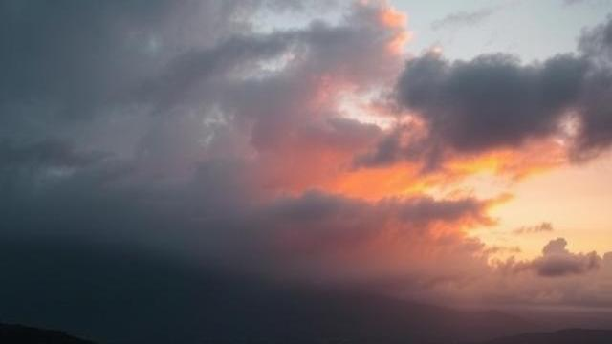
FROM.THAT.TIME
29 …Now, there is things that happen that changes the whole course of our life. We're all aware.
Certain things take place along life's journey that changes the whole course of life for us.
62-0713

