Slide 1
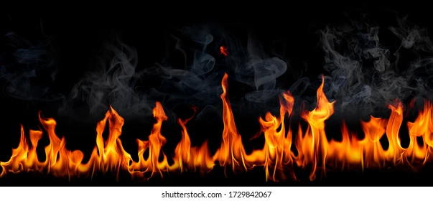
Marks, Seals & Cults
REVELATION 13:15-18
And that no man might buy or sell, save he that had the mark, or the name of the beast, or the number of his name. 18 Here is wisdom. Let him that hath understanding count the number of the beast: for it is the number of a man; and his number is Six hundred threescore and six.

Slide 2
July
July 6th Isaac Clayville
July 7th Haven Pritchard
July 8th Barry & Becky Coffey
Wells Pritchard
July 10th Cody Harwell
Waqas Javed

Slide 3

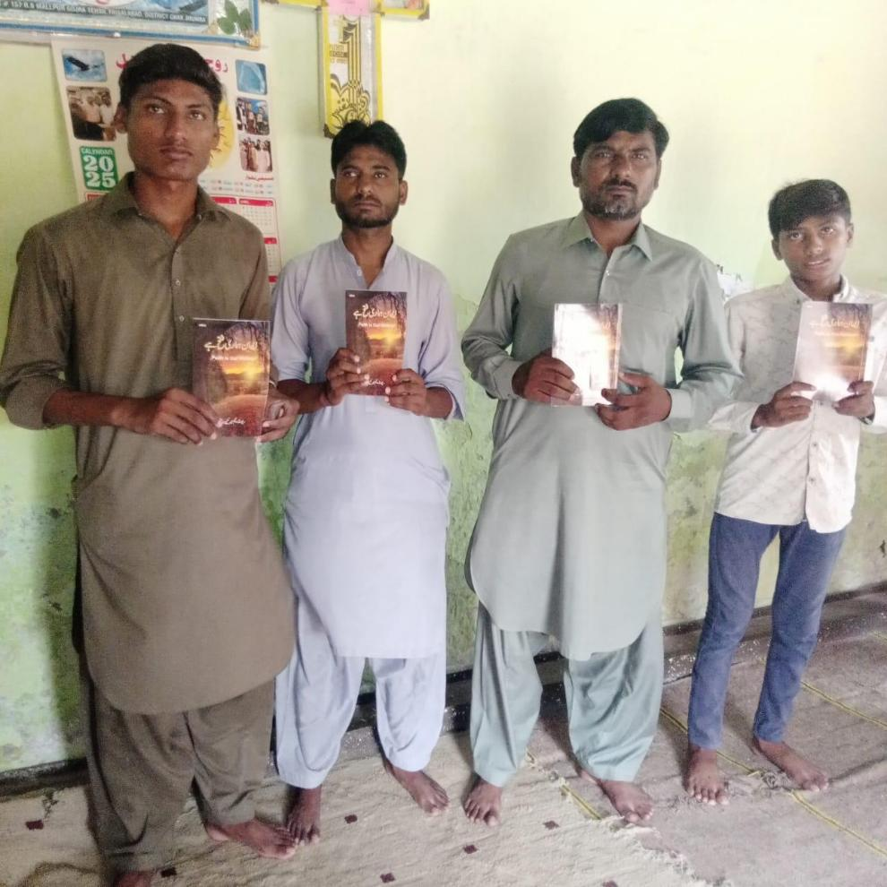
Pakistan

Slide 4
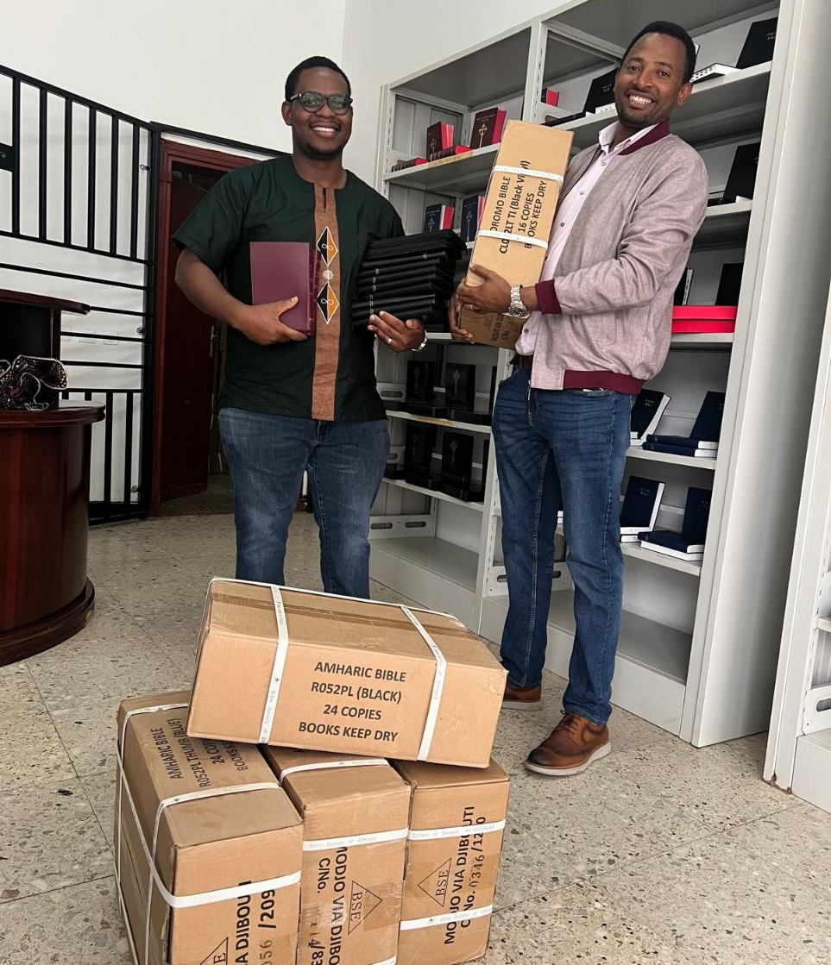
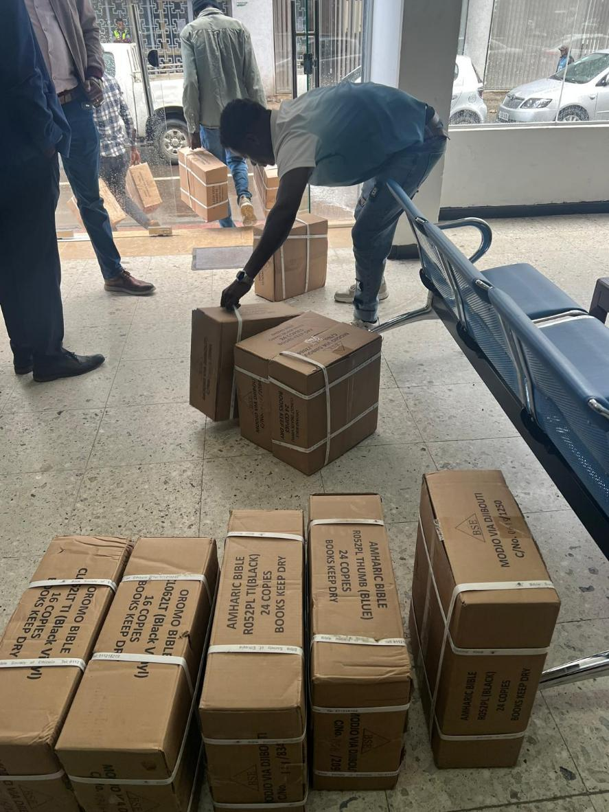
Ethiopia

Slide 5
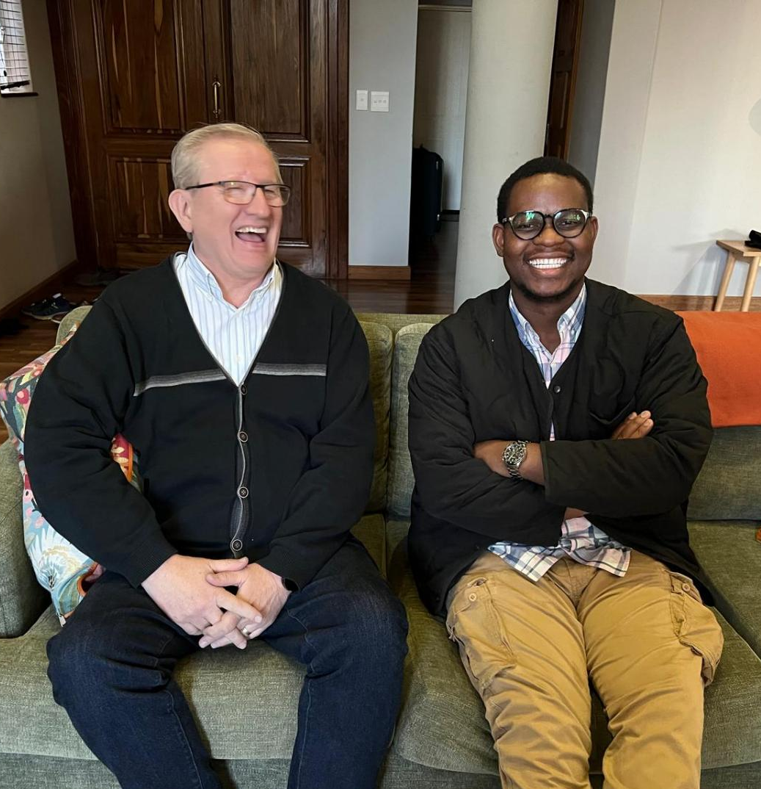

South Africa

Slide 6
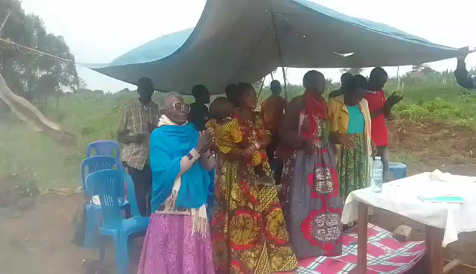
Uganda

Slide 7
Marks, Seals & Cults
REVELATION 13:15-18
And that no man might buy or sell, save he that had the mark, or the name of the beast, or the number of his name. 18 Here is wisdom. Let him that hath understanding count the number of the beast: for it is the number of a man; and his number is Six hundred threescore and six.

Slide 8
REVELATION.OF.JESUS.CHRIST
96 This is the only Book that Christ put His seal upon… And if Satan hates any Book in the Bible, it's the Revelation. He hates all Scripture… But, if anything, he despises mostly, is Revelation and Genesis. Because Genesis tells the beginning. Revelation reveals what's going to happen to him in the last day. Going to be bound a thousand years; then him, and the false prophet, and the beast, is going to be throwed, alive, into the Lake of Fire.
60-1204

Slide 9
THE.REVELATION.OF.JESUS.CHRIST
100 The Book of Revelation has more symbols than all the rest of the Books in the Bible… because it is a Book of prophecy. Therefore, it has to be under-stood by a prophetic class. This Book is not meant for everybody.
There's nobody can understand it, hardly. This Book is made for a certain class of people. Deut., "The hidden things belong to the Lord." And He reveals to us, His children, the hidden things. 60-1204

Slide 10
THE.FOURTH.SEAL
121 We've had Elijah's garments; Elijah's robes; John Alexander Dowie is buried up there wrapped in a robe; said he was Elijah. What is it anyhow? It's only to take away a Truth that is going to be presented.
They had false christs before Jesus' time. They always do that. It's Satan running out a counterfeit to upset the minds and the faith of the people before the thing actually happens. That's all. 63-0321

Slide 11
THE.SEAL.OF.GOD
64 In this day, Bible predicted there’d be a time men would receive a mark, and a mark of the beast. Every time a little something flies up in the country, "That's the mark of the beast.” I'd got ordained in the Baptist church, I heard about the N.R.A. Everybody said, "That's the mark of the beast." (1878)
They say, "Here comes Russia down, communism; it's the mark of the beast." But it's a lie. The Bible tells what the mark of the beast is. 54-0514

Slide 12
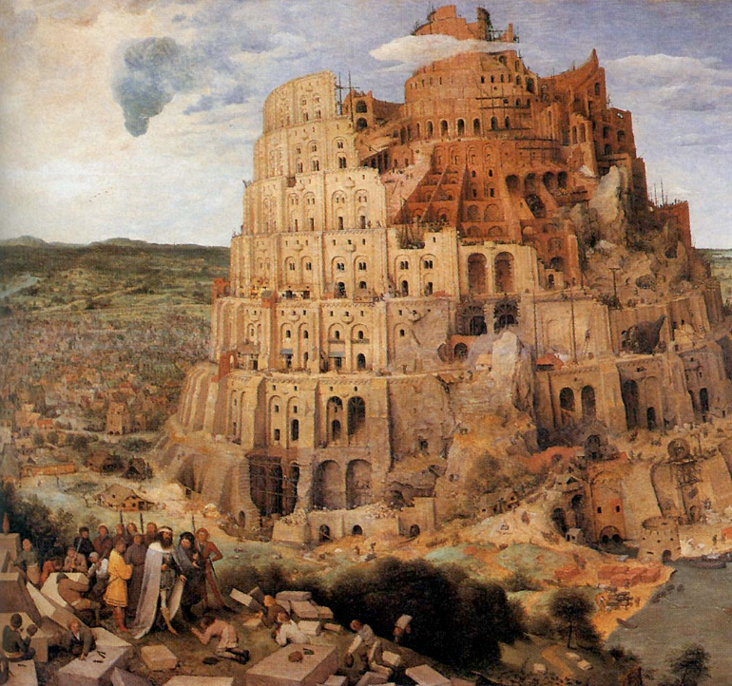
CHURCH.AGES
This spirit of antichrist is not new. This is not something that just came in the church ages. It has been here all along.
Pg. 121-4

Slide 13
JOHN 6:37-40
All that the Father giveth me shall come to me; and him that cometh to me I will in no wise cast out. 38 For I came down from heaven, not to do mine own will, but the will of him that sent me. 39 And this is the Father's will which hath sent me, that of all which he hath given me I should lose nothing, but should raise it up again at the last day. 40 And this is the will of him that sent me, that every one which seeth the Son, and believeth on him, may have everlasting life: and I will raise him up at the last day.

Slide 14
MATTHEW 6:22-24
The light of the body is the eye: if therefore thine eye be single, [haplos] thy whole body shall be full of light. 23 But if thine eye be evil, [duplos] thy whole body shall be full of darkness. If therefore the light that is in thee be darkness, how great is that darkness! 24 No man can serve two masters: for either he will hate the one, and love the other; or else he will hold to the one, and despise the other. Ye cannot serve God and mammon.

Slide 15
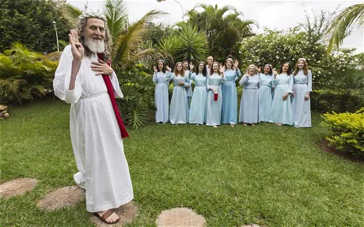
What Is The Mark Of The Beast? (AI)
Recent breakthroughs in medical RFID
technologies have increased interest in the
mark of the beast spoken of in Rev. 13. It is
important to realize having a medical or
financial microchip inserted into your right
hand or forehead is not the mark of the
beast. The mark of the beast will be something given only
to those who worship the Antichrist.
The mark of the beast will be an end-times identification required by the Antichrist in order to buy or sell, and it will be given only to those who worship the Antichrist.

Slide 16
The Overlap of Cults and Culture
Cult, which shares an origin with culture and cultivate, comes from the Latin cultus, meaning: training, education, adoration. The earliest known uses of the word, recorded in the 17th century, broadly denoted "worship."
From here cult came to refer to a specific branch of a religion or the rites and practices of that branch. By the early 18th century, cult could refer to a non-religious admiration or devotion, such as to a person, idea, or fad. Finally, by the 19th century, the word came to be used of "a religion regarded as unorthodox or spurious."

Slide 17
ACTS 24:14 But this I confess unto thee, that after the way which they call heresy, so worship I the God of my fathers, believing all things which are written in the law and in the prophets:
GOD'S.PREPARATION
60 Oh, argue with Paul when he was getting ready to be beheaded, "In the way that's called heresy...“ I join with him tonight, "Amen, Paul. The way that's called heresy, crazy, that's the way I worship God, with the people called crazy people." Act up, cuts up, screams, hollers, believes in Divine healing, the power of the resurrection, things. That's the kind of people I worship God with. 54-0401

Slide 18
ISRAEL.AND.THE.CHURCH.1
32 All these cults, uprises, isms today, everyone written in Genesis, where it had its beginning, it's just got another name. But watch the working of the spirit in that day, and watch how it's working today, and you'll see it's the very same thing.
…That spirit rose up back there in Cain, down through Ham, Nimrod, into Babylon; out of Babylon, into the days of the coming of Jesus.

Slide 19
34 Teachers, Bible students, and they failed to recognize the Lord Jesus Christ… Polished scholars, holy men, righteous, knowing the Word… It's moving right out today in a terrible force all around...
It behooves you, brother, sister, to consider what you're listening at, and don't you never underestimate Satan's power for deceiving. Don't you never under-estimate him. He's smooth as he can be. And the antichrist spirit isn't communism…[it] is so close like the real thing till it'll deceive the very elect if possible. 53-0325

Slide 20

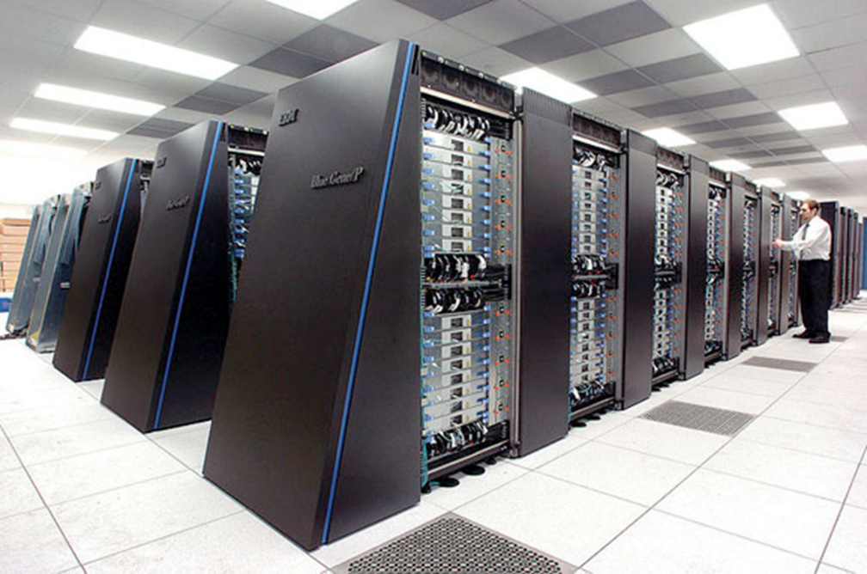
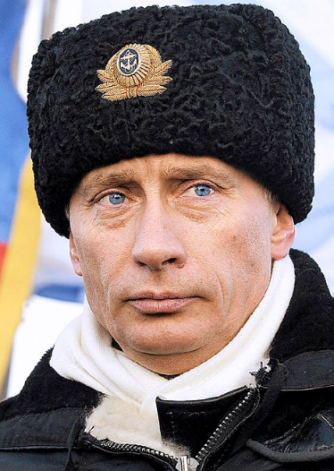
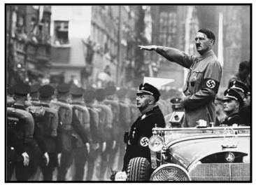
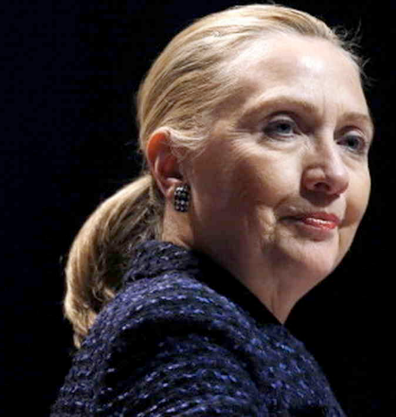
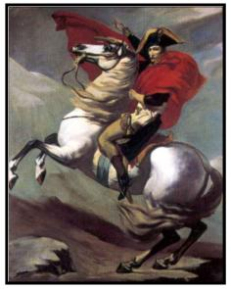

Slide 21
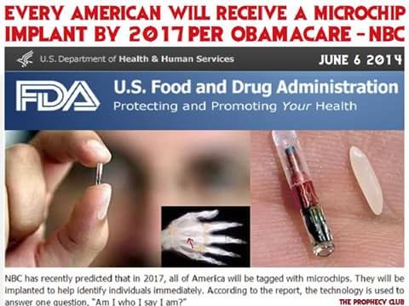

Slide 22
GOD'S.POWER.TO.TRANSFORM
179 Religion, that is Satan's business; not to kill the whole thing, just contaminate it. He ain't going to kill the whole thing. Oh, not communists; no, the antichrist is not communism. The Bible said, "It would deceive the Elected if it was possible." Don't notice the iron curtain, but the purple one.
65-0911

Slide 23
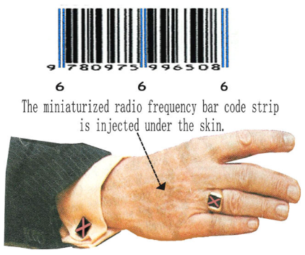
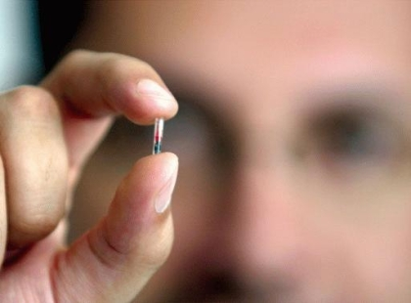

Wal-Mart Begins “Mark Of
The Beast” Age For World

Slide 24
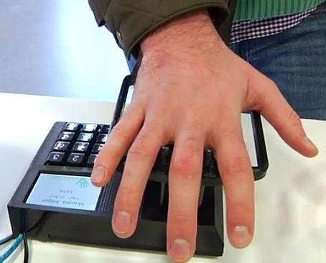
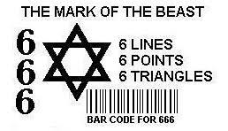
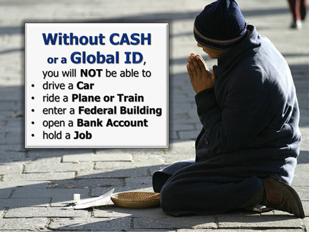

Slide 25


Slide 26
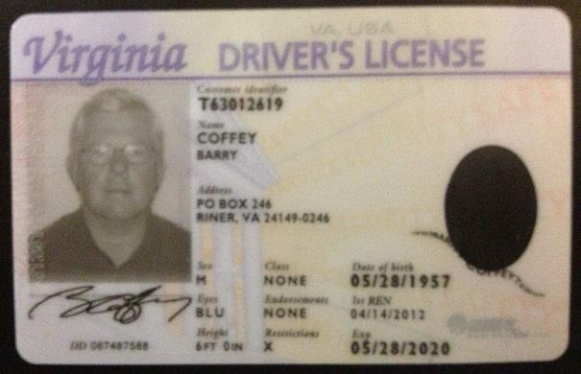
Is Real ID a step toward ‘mark of the beast’?
By Mannix Porterfield Register-Herald Reporter
Is the Real ID a precursor to the end-time world dictator known as the Antichrist? A Randolph County school teacher …wants WV lawmakers to grant anyone with a religious conviction an exemption from the license.
“If we as Christians comply with the Real ID act, we would be enrolled into a global system of identification that directly links our body through biometrics to our ability to buy or sell,” Philip Hudok told the Senate Transportation & Infrastructure Committee.

Slide 27
THE.MARK.OF.THE.BEAST
8 This great subject that we are approaching has certainly caused some great controversy... I believe it's such a great, vital part of the Scripture: We should not leave any of it out.
God spoke through the Scriptures about the mark of the beast and how it was to appear in the last days… There has been many thoughts projected to the peoples concerning this vital, God sent message, warning to the church…

Slide 28
REVELATION 14:9-11
And the third angel followed them, saying with a loud voice, If any man worship the beast and his image, and receive his mark in his forehead, or in his hand, 10 The same shall drink of the wine of the wrath of God, which is poured out without mixture into the cup of his indignation; and he shall be tormented with fire and brimstone in the presence of the holy angels, and in the presence of the Lamb: 11 And the smoke of their torment ascendeth up for ever and ever: and they have no rest day nor night, who worship the beast and his image, and whosoever receiveth the mark of his name.

Slide 29
MARK.OF.THE.BEAST & THE.SEAL.OF.GOD.1
14 Now, I'm going to tell you what I think the mark of the beast is and what I think the Scripture supports the mark of the beast to be. Then I'm going to tell you what I think the Scripture supports the Seal of God. Now, we know that the world is gripped by these two things right now: the mark of the beast or the seal of God. Some of them places it way over in the future; some says its already been in the past.

Slide 30
But I believe that there's just two answers to it. And that is that the seal of God is the baptism of the Holy Ghost; the mark of the beast is rejecting it. Now, that's the only two things.
Now, all the peoples on earth in the last days is either going to be sealed by the seal of God or marked by the mark of the beast.
61-0216

Slide 31
The Seal of God: THE.FOURTH.SEAL
78 I believe in speaking in tongues, all these other things are all right, but just that in itself won't work, you know it won't work. "Though I speak with tongue of men and angels…" So those things doesn't mean that you have the Holy Spirit.
But when He, the Person, the immortal Spirit of Christ becomes your personal Saviour, changes you, and throws your views right straight into Calvary, to this Word, something's happened. No one will have to tell you about it; you'll know it when it happens. 63-0321

Slide 32
THE.MARK.OF.THE.BEAST
233 Now see what the mark of the beast is? It's the mark of apostasy. It's a person who is just thinks, "Well, I belong to church, I'm just as good as the next fellow." And you realize where your church organization that you're depending on, where it come from?
The Bible said, "He that worships the beast, receives his mark, or the letter of his name in forehead or hand." That's knowledge or deed. That don't mean you got a big tattoo on your face. It don't have to be that. It's not talking of the outward. It's talking of spiritual. 54-0513

Slide 33
QUESTIONS.AND.ANSWERS
27. Brother Branham, speaking on the mark of the beast, don't you believe they'll tattoo a number in your head, or tattoo something on your hand?
No, sir. Don't never look for that. It'll be a boycott, certainly. No man could buy or sell 'less he belongs to the confederation of churches. That's true. That'll come like a union, unionizing the thing, bringing it down, unionized religion. Mark my word; it ain't far off. And you'll see it, she's just around the corner.
*54-0515 (71)

Slide 34
THE.LAMB'S.BOOK.OF.LIFE
46 "And he caused all both great…" He deceived all, the whole earth: the religious cults, the pretended Christian; the church member; he deceived the moral man; the good man; so-called preacher; so-called Christian. He deceived all with propaganda, saying, "We're all one big church, and we ought to all unite together, have the church and state uniting… We'll settle all wars forever.“ Millions of mothers would say, "That's the thing we want." Watch where it comes from, sister. Watch where the backgrounds of it is.
56-0603

Slide 35
THE.SEAL.OF.GOD
107 Both marks are spiritual marks. A lot of people thought, "They're going to go around and tattoo something in your forehead, and tattoo something in your hand."
We found out, last night, that was a lie. That's wrong. It's a spiritual mark. It’s just so hid. I know this may be ruffling a lot of feathers, and it seems hard… I don't mean to be rude, I'm just trying to state facts with all my heart.
54-0514

Slide 36
THE.SEAL.OF.THE.ANTICHRIST
16 I was listening to a radio broadcast, “Won't be long until the people's going to get a great tattooing machine. And they're going to tattoo it across the forehead, picture of the beast. And going to mark it in his hand. And all that receives that mark, will be doomed forever. Ever who joins the N.R.A. is sure to receive the mark of the beast." Found out, that wasn't so. It's got to come from, THUS SAITH THE LORD. Many people has placed it way over to a day that's yet to come. Some place it in this day. But for myself, I believe that it begin at the same time the Holy Spirit fell.
55-0311

Slide 37

IS.YOUR.LIFE.WORTHY?
62 Somebody said, “Going to be a mark of the beast, going to come someday." It's already come. As soon as the Holy Ghost begin to fall, the mark of the beast begin to take place.
When the trumpet sounded, and all wanted to go free could go. Them that didn't, was marked.
63-0630

Slide 38
TEN VIRGINS & 144,000 JEWS
250 The seal of God is the "Holy Spirit.” Rev. 9:1-4, you'll find they all had the seal in their forehead. (I Cor. 1:22, Eph. 4:30), that Angel that come forth sealing upon their forehead.
Now, that doesn’t mean He takes and puts a spot there; your forehead is your revelation, your hand is the thing you do about it. It's a spiritual mark. He don't take a big stamp and stamp you like that.... 60-1211

Slide 39
What is the Mark of the Beast? [markbeast.com]
The mark of the beast will be coming soon.The mark of the beast is a combination of letters and symbols that will be physically and permanently placed on your forehead or right hand. Most people will consider it an honor to receive the mark. It will be like a key for them that will open doors of acceptance, prosperity and peace. There will be 666 different ways to get the mark.
There will be severe penalties for refusing the mark and great rewards for getting it. The mark of the beast is an outward, physical symbol, showing that the wearer has chosen to worship the beast and receive him as God. http://www.markbeast.com/mark/what-is-mark-beast.htm

Slide 40
REVELATION 13:15-18
And he had power to give life unto the image of the beast, that the image of the beast should both speak, and cause that as many as would not worship the image of the beast should be killed. 16 And he causeth all, both small and great, rich and poor, free and bond, to receive a mark in their right hand, or in their foreheads: 17 And that no man might buy or sell, save he that had the mark, or the name of the beast, or the number of his name. 18 Here is wisdom. Let him that hath understanding count the number of the beast: for it is the number of a man; and his number is Six hundred threescore and six.

Slide 41
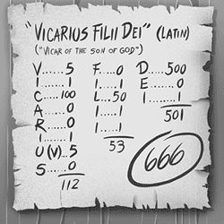
REV. 13:18
Here is wisdom. Let him that hath understanding count the number of the beast: for it is the number of a man; and his number is Six hundred threescore and six.

Slide 42
THE.SECOND.SEAL
265 In other words, up over the Vatican it's wrote Vicarius Filii Dei, in Roman numerals. Now, you just draw a line at the bottom of those Roman numerals, and it means "Instead of Son of God." In other words, he's a vicar. (A vicar takes the place of something.) He is the vicar instead of the Son of God. "Let him that has wisdom count the numbers of the beast, for it's the number of a man, and his number is 666."
63-0319

Slide 43
SATAN'S.EDEN
33 Communists has nothing to do with this. It's the church, you have to watch. It's not communists that would deceive the very Elected. It's the church that'll deceive the very Elected. We know they deny God, antichrist, sure they are, in principle, but they are not the antichrist. The antichrist is religious, very religious, and can quote the Scripture, and make It look so plain. 65-0829

Slide 44
THE.TRUE.EASTER.SEAL
198 And we know that the mark of the beast is disbelief. "Where'd you say the mark of the beast begin?" In the garden of Eden. Mark of the beast and the Seal of God was performed in the garden of Eden. Cain was the son of the beast which beguiled Eve. You can call it whatever you want to. He was the son of Satan. And what did he do? God put a mark on him and sent him out from the Presence of God.
61-0402

Slide 45
MARK.OF.THE.BEAST & THE.SEAL.OF.GOD.2
85 The Seal of God is the baptism of the Holy Ghost. The mark of the beast is to reject It. Receive ye the Holy Ghost.
61-0217

Slide 46
CHURCH.AGE.BOOK
I believe according to Revelation 13:16 that the bride will have to stop preaching for the beast is demanding the mark in the hand or forehead if permission to preach be granted. Denominations will take the mark or be forced to quit preaching. Then the Lamb will come for His bride and judge the great harlot.
Pg. 175-2

Slide 47
REVELATION 13:15-17
15 And he had power to give life unto the image of the beast, that the image of the beast should both speak, and cause that as many as would not worship the image of the beast should be killed. 16 And he causeth all, both small and great, rich and poor, free and bond, to receive a mark in their right hand, or in their foreheads: 17 And that no man might buy or sell, save he that had the mark, or the name of the beast, or the number of his name.
REVELATION 14:9 And the third angel followed them, saying with a loud voice, If any man worship the beast and his image, and receive his mark in his forehead, or in his hand…

Slide 48
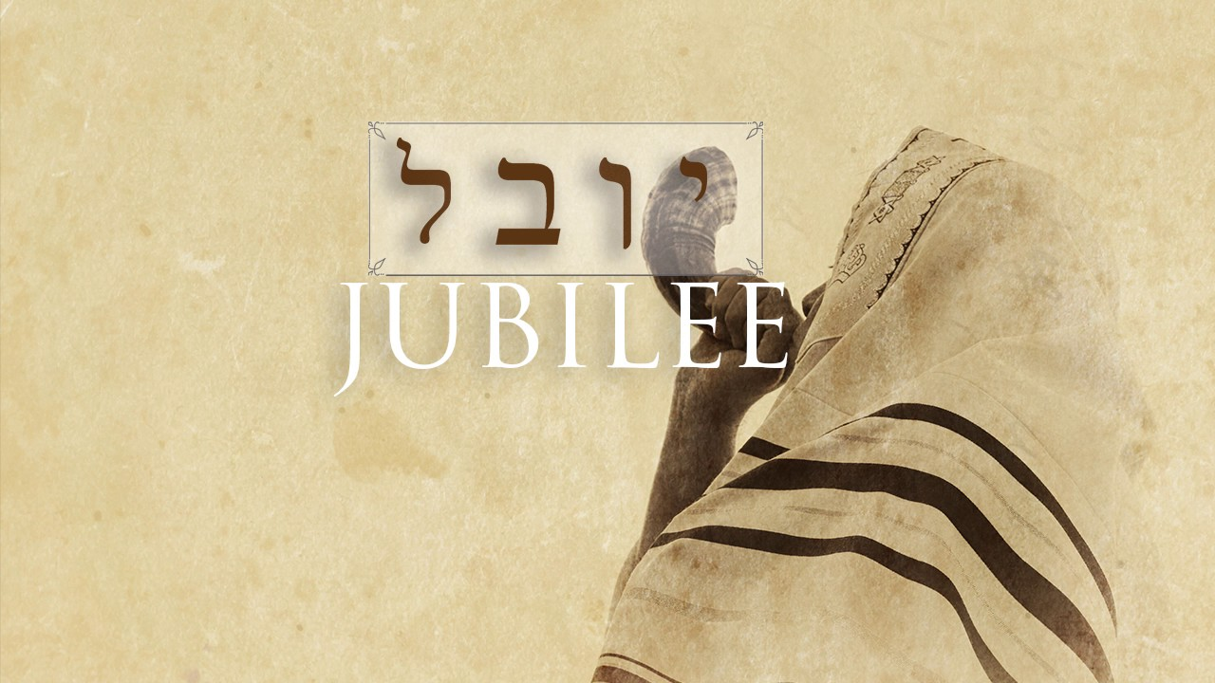
LEVITICUS 25:10-13
And ye shall hallow the fiftieth year, and pro-claim liberty throughout all the land unto all the inhabitants thereof: it shall be a jubile unto you; and ye shall return every man unto his possession, and ye shall return every man unto his family.

Slide 49
THE.MARK.OF.THE.BEAST
17 I've heard it predicted many different ways, the tattoo sign in your hand, sign on your head. I do not believe that that's correct with Scripture. And there's going to be a group of people that's going to be marked for destiny in hell. And there's going to be people marked for their eternal destiny in heaven. These two marks run side by side.
And it's going to get so great, so pinching, just before the coming of the Lord, you'll have to have one mark or the other, or there'll be a boycott: you can't buy nor sell. 56-0715

Slide 50
THE.MARK.OF.THE.BEAST
The good news is the Gospel. To reject to hear the Gospel, your ears are sealed up that you'll always call it fanaticism, and there's nothing to it. And you'll be serving sin in forms of godliness as long as you live. No matter how religious you are, you're sealed off from the Presence of God.

Slide 51
THE.RAPTURE
205 People, no one wants to die. No one wants to be lost. You should go to church. Keep on going to church.
But, whatever, just throw away your traditions, and move right on up into Christ. Cause, it's going to sound one of these days, and you're going to be caught with the mark of the beast on you, and not know what it is until it's too late.
65-1204

Slide 53
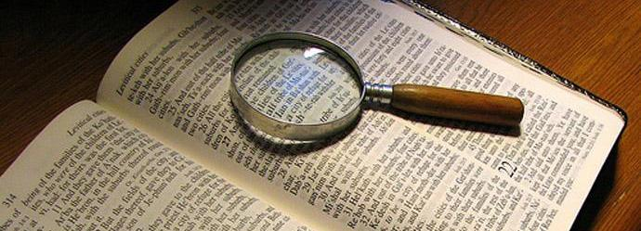
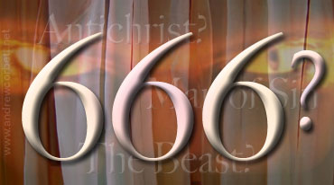

Slide 54
