Slide 1

Again
I Peter 5:6

Slide 2
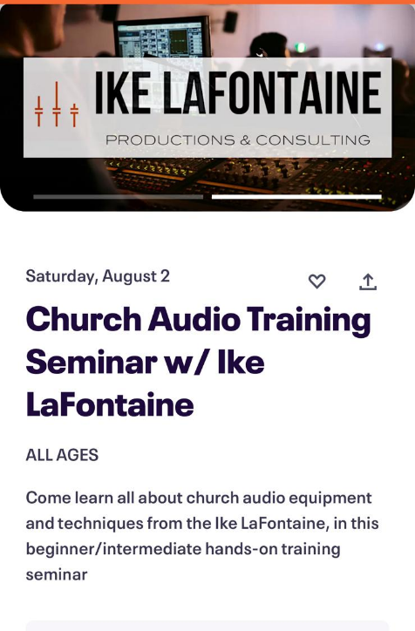
No Church July 30th
Men’s Meeting Sept. 26-28th
Fall Festival Oct. 25th

Slide 3
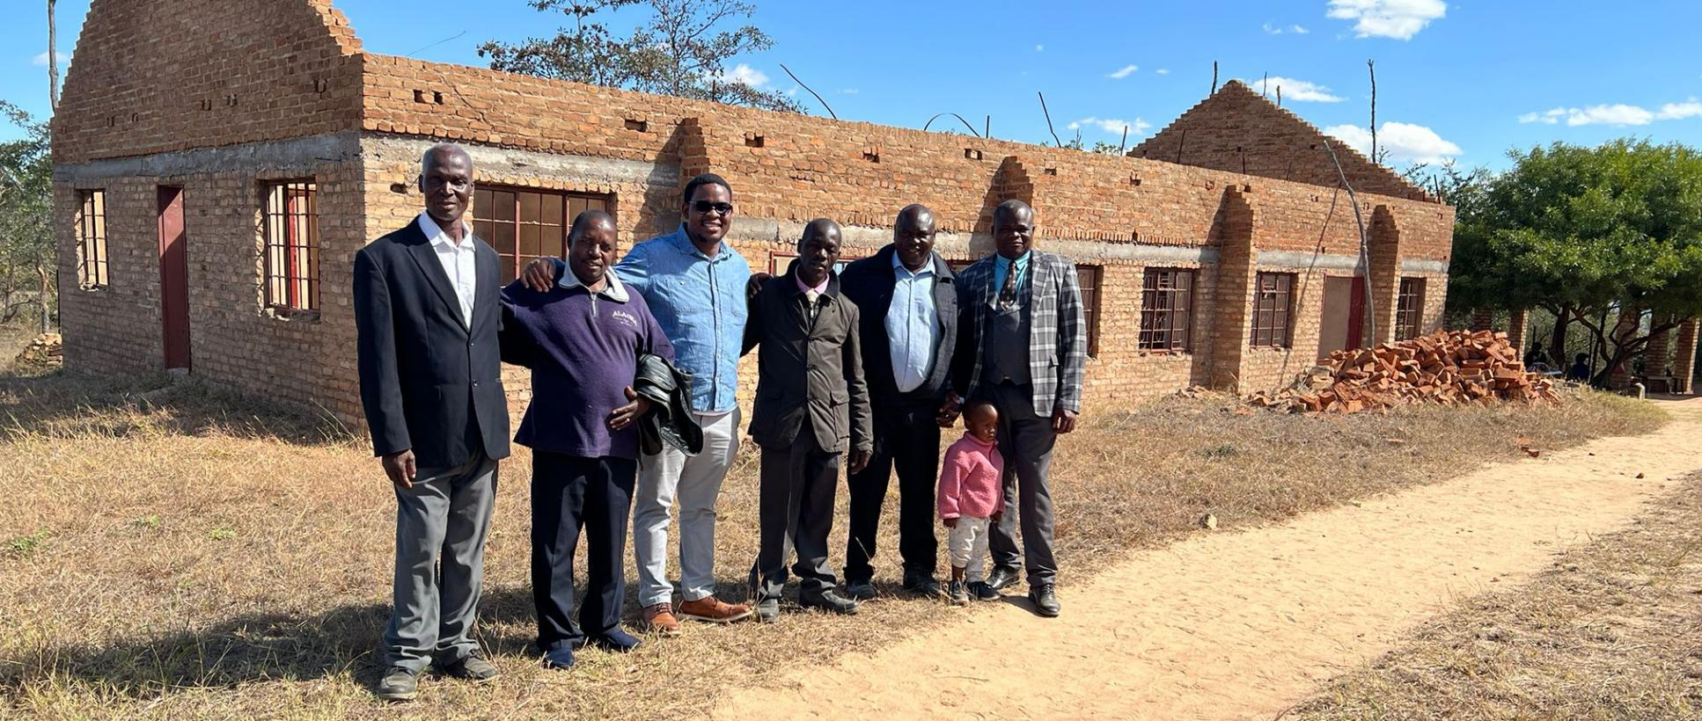
“A few of the believers came to meet me today in a place called Chimhenga. They say thank you for all your help with books and bibles.”

Slide 4
I PETER 5:6-7
Humble yourselves therefore under the mighty hand of God, that he may exalt you in due time: 7 Casting all your care [anxiety] upon him; for he careth for you.

Slide 5
THE.PRINCIPLES.OF.DIVINE.HEALING
33 Many has been the trials, heartaches, hardships; but tonight we're more than conquerors in Christ Jesus. When Christ died at the cross, He was wounded for our transgressions… Every Christian believer has a right to any of those redemptive blessings that Christ Jesus died for. But it's out of practice. People's afraid to take God at His Word. Do not be afraid. God's under obligation to make it so. 51-0923

Slide 6
But in our Natural State, we can Feel separated and far from God.
• From our life experiences;
• In our perceptions, and understanding;
• Through our complexes.

Slide 7
I.WAS.NOT.DISOBEDIENT.TO.THE.
HEAVENLY.VISION
10 There's a real power of the Holy Spirit that delivers the sufferer from his suffering.
And I do not see how that clergy could say and could preach the Gospel without including Divine healing in the atonement, because "He was wounded for our transgressions; and with His stripes we are healed.”
49-0718

Slide 8
2 Corinthians 10:4-6
⁴ (For the weapons of our warfare are not carnal, but mighty through God to the pulling down of strong holds;) ⁵ Casting down imaginations, and every high thing that exalteth itself against the knowledge of God, and bringing into captivity every thought to the obedience of Christ; ⁶ And having in a readiness to revenge all disobedience, when your obedience is fulfilled.

Slide 9
The Uniting Time And Sign
One of my main things that’s always hurt me through my life, has been a nervous condition. That when I get so worn, then I get real weary, kind of feel like nobody cares for you…You have it, too.
And I just happen to have a real overdose of it, you know, and it gets real bad sometime… It’s tension, and that’s what does it.
63-0818

Slide 10
Complexes: FLASHING.RED.LIGHT
25 This morning I had preached at length, way over my time, tired and worn. And there could be two things. He [Bro. Way] either got tired, or when I spoke of having a complex, not just to mess my brother up, as we'd say it... I was making my confession of having complex. And I guess if I'd ask tonight, in this audience of people, "How many in here knows you have complex?" practically every hand would go up.

Slide 11
And then it might have been this, that I've tried to think of it this afternoon. That, I had stood here and with all my heart told you exactly the Truth, and tell you of my complex, and make my open confession, and ask you to pray that my inside being would be changed towards the people, that I could do as the Lord did.
63-0623

Slide 12
But It Wasn’t So From the Beginning
Now, we find out, these well-trained ministers... And you know when I stand in front of men like this who are really trained and smart men to the ministry, and to the Gospel, and to the Bible and me stand here knowing with a grammar school education, I have a complex truly.
61-0411

Slide 13
The Indictment
388 Here recently I was going to just quit preaching. The people wouldn't hear me. They just kept on doing the same thing, and I got discouraged. I built a complex. O God!
63-0707

Slide 14
CONVINCED.THEN.CONCERNED
55 I'm so happy to be here. I think that God wants His children to be happy. I believe we can run it to extremes, and just get insincere about it. But I believe that God wants His people to be real happy, and sociable, friendly from our hearts. "Loving each other as God, for Christ's sake, or Christ loved us." I think that's why we ought to be happy Christians.
62-0118

Slide 15
THE.UNCHANGEABLE.GOD
34 And we notice, people change. It's got so that people today are not friendly like they used to be. I don't know whether you notice it out here or not, but we sure notice it back in the South and East. People are changing, year by year. They're too much of a hurry… It's change, in a hurry. 62-0120

Slide 16
FUNDAMENTAL.FOUNDATION.FOR.FAITH
11 Now, since He has restored man back to this place, man in the fall has lost his conscious of what Father put him here on earth to do. In other words, all of the plumbing, in our brain, the outlets, the faith, has been clogged up with business affair, with home life, domestic things. It's all become so clogged up with that until God can't operate through those channels that He made a man for.
55-0113

Slide 17
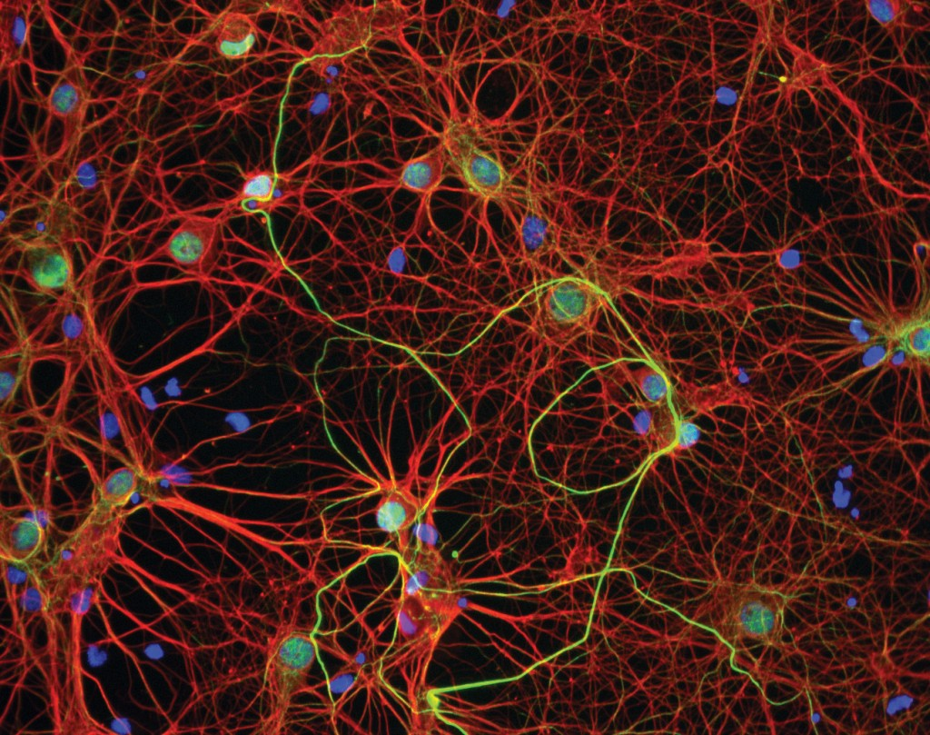

Slide 18
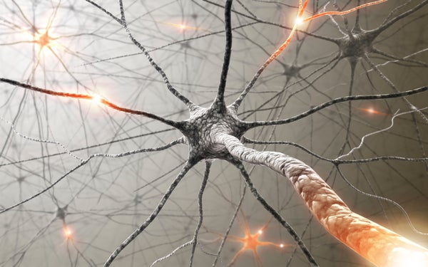
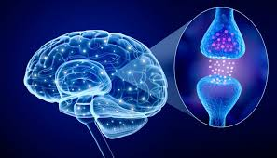

Slide 19
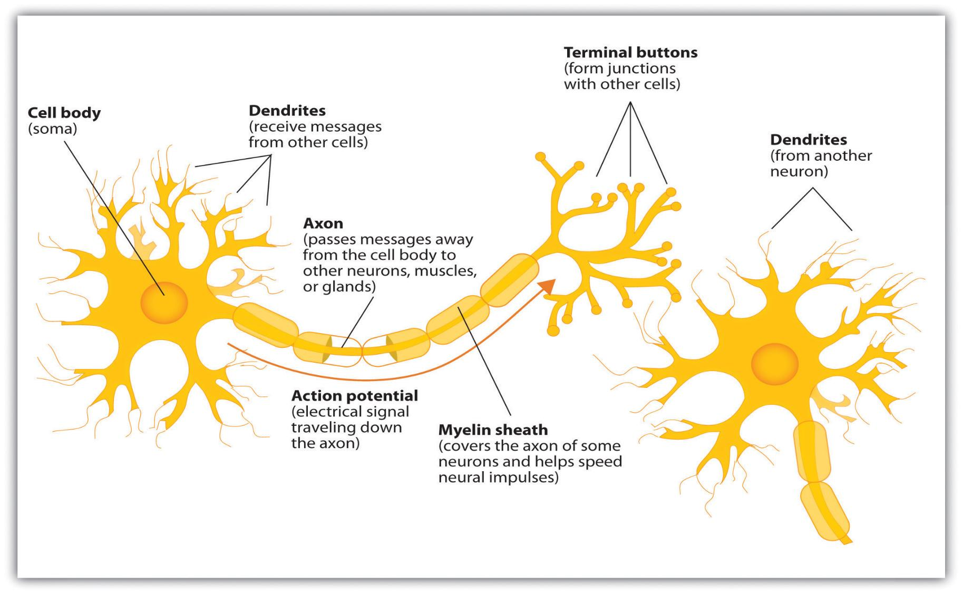

Slide 20
The Position Of A Believer In Christ
But do you know what it is? It’s hope instead of faith. Faith does the job right now. Hope hopes for it, but faith is the product. Faith really does it. See, we have lots of hope, but not much faith.
So we want to change from hope today to positive faith. And there’s only one way we can get positive faith: that’s by positive thinking of positive things. 55-0227

Slide 21
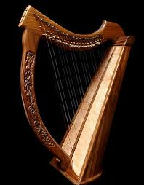
Philippians 4:8
Finally,brethren, whatsoever things are true, whatsoever things are honestwhatsoever things are just, what-soever things are pure, whatsoever things are lovely, whatsoever things are of good report; if there be any virtue, and if there be any praise, think on these things.

Slide 22
EVERLASTING.LIFE.AND.HOW.TO.RECEIVE.IT
45 You just imagine somebody hates you, once. And they don't hate you, but you imagine they do, and you just keep thinking, "They don't like me." And the first thing you'll be shunning that person, when they haven't done nothing to you. And after while, it become so a reality to you, till you'll actually believe that that person doesn't like you.
And you'll might bawl them out, for instance your wife, husband, some neighbor, when, the person is absolutely innocent of any ill thing. It's because that you just imagine it so, till it become a reality to you. 54-1231

Slide 23
NUMBERS 13:31-33
But the men that went up with him said, We be not able to go up against the people; for they are stronger than we. 32 And they brought up an evil report of the land which they had searched unto the children of Israel, saying, The land, through which we have gone to search it, is a land that eateth up the inhabitants thereof; and all the people that we saw in it are men of a great stature. 33 And there we saw the giants, the sons of Anak, which come of the giants: and we were in our own sight as grasshoppers, and so we were in their sight.

Slide 24
ROMANS 8:26-31
Likewise the Spirit also helpeth our infirmities [want of strength]: for we know not what we should pray for as we ought: but the Spirit itself maketh intercession for us with groanings which cannot be uttered.
27 And he that searcheth the hearts knoweth what is the mind of the Spirit, because he maketh intercession for the saints according to the will of God.

Slide 25
ROMANS 8:26-31
Likewise the Spirit also helpeth our infirmities: for we know not what we should pray for as we ought: but the Spirit itself maketh intercession for us with groanings which cannot be uttered. 27 And he that searcheth the hearts knoweth what is the mind of the Spirit, because he maketh intercession for the saints according to the will of God.
28 And we know that all things work together for good to them that love God, to them who are the called according to his purpose.
29 For whom he did foreknow, he also did predestinate to be conformed to the image of his Son, that he might be the firstborn among many brethren. 30 Moreover whom he did predestinate, them he also called: and whom he called, them he also justified: and whom he justified, them he also glorified. 31 What shall we then say to these things? If God be for us, who can be against us?

Slide 26
ROMANS 8:37-39
Nay, in all these things we are more than conquerors [incomparable, outstanding] through him that loved us. 38 For I am persuaded, that neither death, nor life, nor angels, nor principalities, nor powers, nor things present, nor things to come, 39 Nor height, nor depth, nor any other creature, shall be able to separate us from the love of God, which is in Christ Jesus our Lord.

Slide 27
I PETER 1:3-5
Blessed be the God and Father of our Lord Jesus Christ, which according to his abundant mercy hath begotten us again unto a lively hope by the resurrection of Jesus Christ from the dead, 4 To an inheritance incorruptible, and undefiled, and that fadeth not away, reserved in heaven for you, 5 Who are kept by the power of God through faith unto salvation ready to be revealed in the last time.

Slide 28
HEBREWS 2:16-18
For verily he took not on him the nature of angels; but he took on him the seed of Abraham. 17 Wherefore in all things it behoved him to be made like unto his brethren, that he might be a merciful and faithful high priest in things pertaining to God, to make reconciliation for the sins of the people. 18 For in that he himself hath suffered being tempted, he is able to succour them that are tempted.

Slide 29
The solutions to Complexes:
1. Being Renewed in Christ: (I Sam. 30:6)
• Finding your identity in Christ;
• Developing a RIGHT image of who Jesus Christ is (especially as an Advocate);
2. Using Scripture, understanding spiritual application to change your heart & mind.
3. Love (for Christ, for yourself, for each other)
a. Being able to receive the Love of God in all your weaknesses;

Slide 30
QUESTIONS.AND.ANSWERS.4
389. When a person realizes he has an inferior complex, or some sort of complex, how may he overcome this? Should it be if he was the only child caused this in his early youth?
Take exactly the opposite. If you're always wanting your way, and that one little brat that wants to always have everything your way, turn right back around and give everything you got the other way. If you're selfish and you want to hold everything, then start giving away what you got. Just go the vice versa. That's the way to overcome anything is an antidote. 64-0830

Slide 31
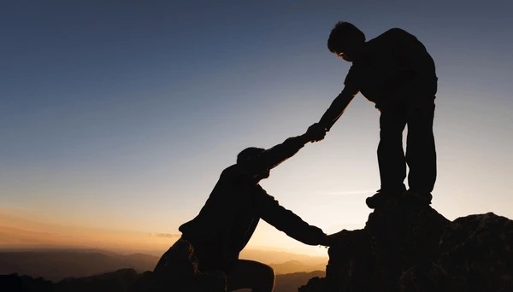
PROVERBS 27:10
Thine own friend, and thy father's friend, forsake not; neither go into thy brother's house in the day of thy calamity: for better is a neighbour that is near than a brother far off.

Slide 32
BLIND.BARTIMAEUS
2 It's been so nice, I met some of the people from the meeting here today, several of them on the street. And I tell you, it's going to be hard for us to leave this place. This is so nice. The people are nice and friendly. We certainly appreciate that. 59-1127

Slide 33
BELIEVEST.THOU.THIS
31 I tell you, that's what's a whole lot the matter with the people today. They're not friendly like they used to be. The people has got too selfish, got to a place where they think they live in a little world by themself. Why, you know it used to be out on the farm, when one of the neighbors would get sick, we'd go out and help do their work, and cut the wood and bring it in. And now, you don't know your neighbor's dead unless you're to read it in the paper.

Slide 34
32 And the people pass down the street, used to we'd grab a hold of one another's hands and shake their hands like that, "How are you, brother?" And today when they pass on the street, they give a little silly grin, throw their head up in the air. I despise that old somebody feel they're bigger than somebody else. 50-0115

Slide 35
PROVERBS 18:24
A man that hath friends must shew himself friendly: and there is a friend that sticketh closer than a brother.
Proverbs 18:24 (CJB)
²⁴ Some “friends” pretend to be friends,
but a true friend sticks closer than a brother.

Slide 36
WHAT.HEAREST.THOU.ELIJAH
4 I like friends to be friendly. I like to make everybody I meet Like I know them. I know sometimes they look at you very funny… One night this week, the Lord willing, I want to speak on that--what it means to be borned again. And we're happy to be here to join in this convention. And I'm grateful to these, my brethren, and to all you people of being so kind. 59-0609

Slide 37
EXPECTATIONS
23 If they'd only realize who you are. You're sons and daughters of God, heirs of the Kingdom. Right now we are kings. Claim your legal rights. Don't let Satan press anything on you. You're of God. He's has got no rights to hold it.
53-0507
PSALM 147:3
He healeth the broken in heart, and bindeth up their wounds.

