Slide 1
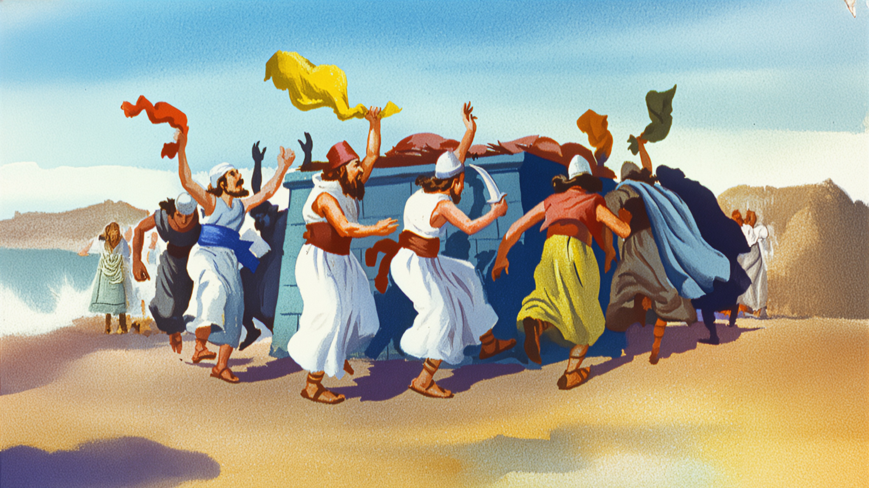
The Curse of Religion

Slide 2
What is religion?
A system of faith and worship; a pursuit or interest followed with devotion.
Religion can be seen as the outward expression of a belief system, in the form of rituals, customs or disciplines.
A system of worship, practices and beliefs.

Slide 3
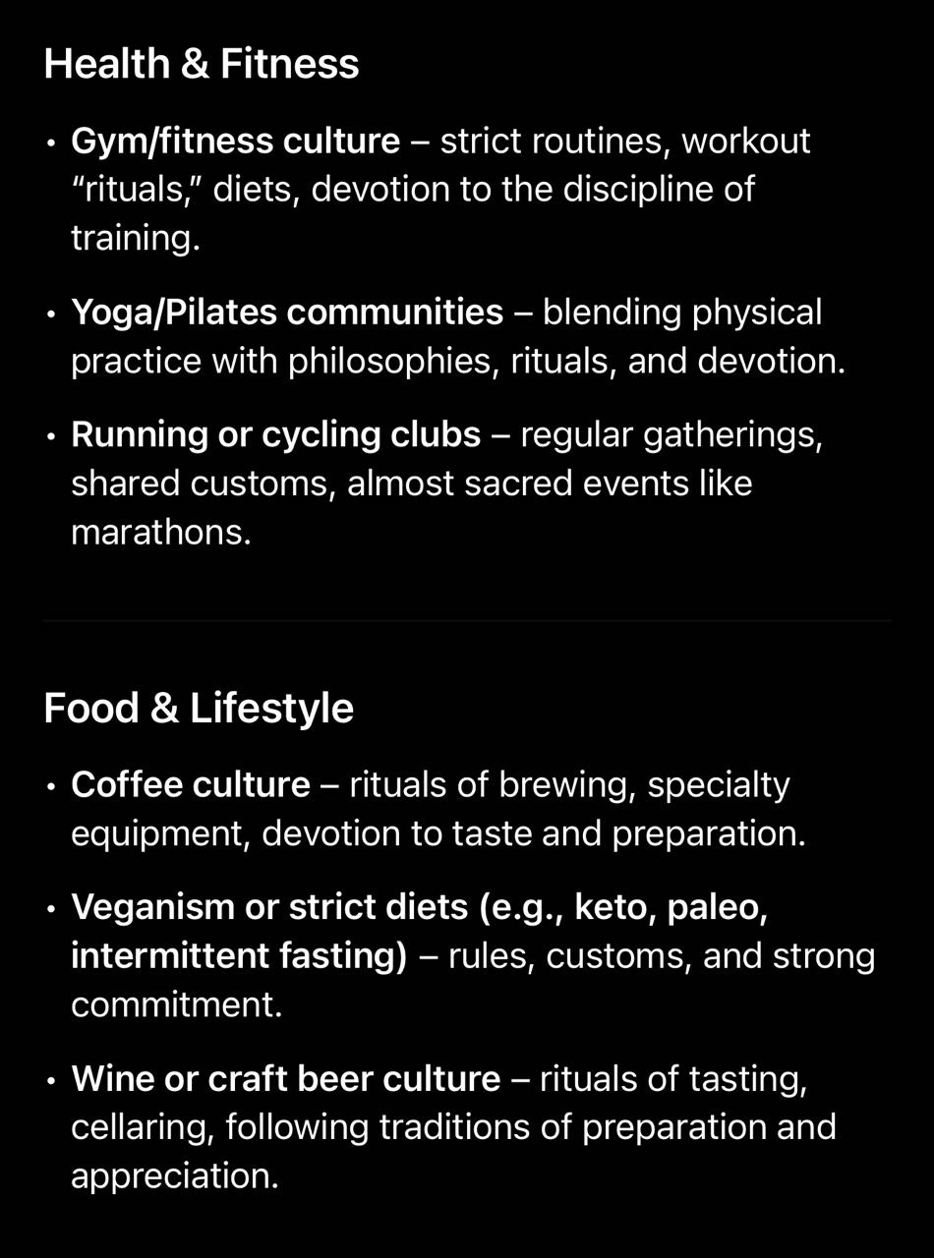

Slide 5
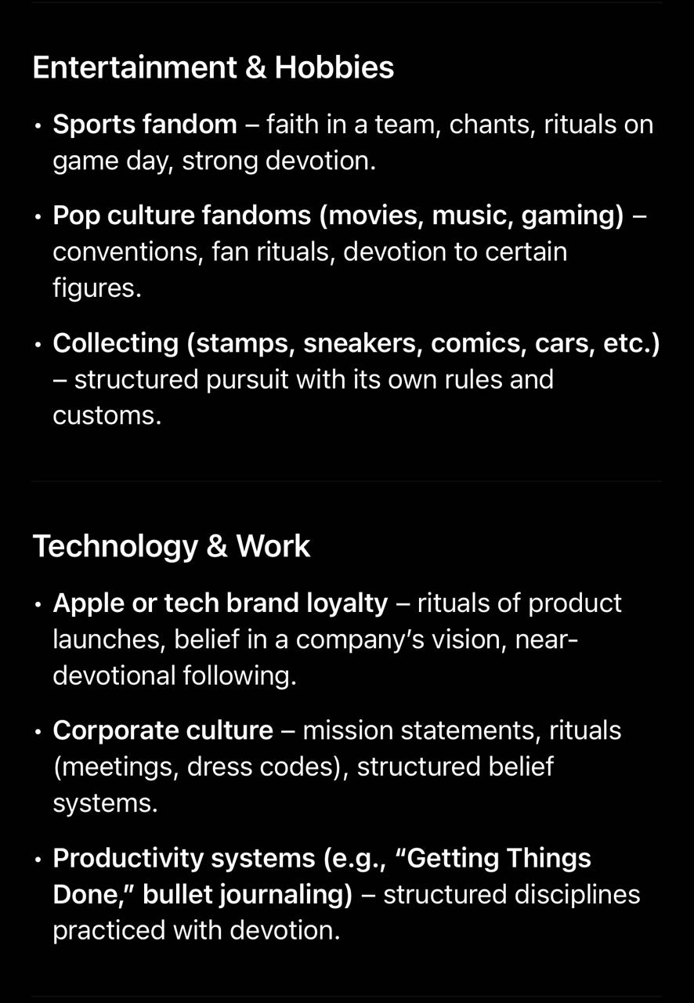

Slide 7
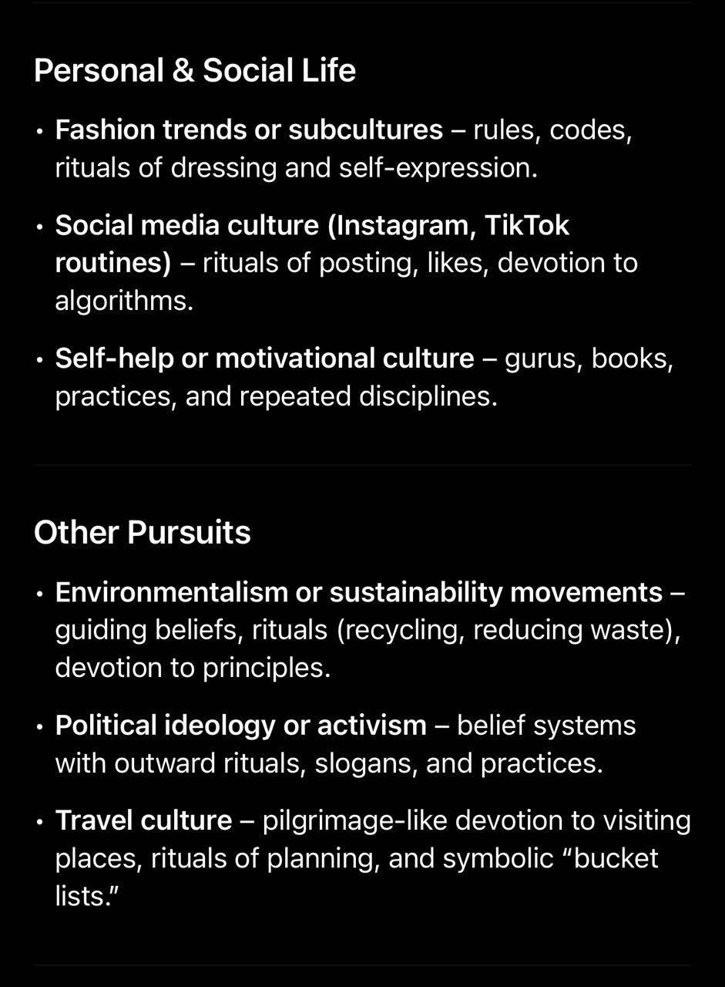

Slide 9
Amos 5:21 - 23
21 I hate, I despise your feast days, and I will not smell in your solemn assemblies.
22 Though ye offer me burnt offerings and your meat offerings, I will not accept them: neither will I regard the peace offerings of your fat beasts.
23 Take thou away from me the noise of thy songs; for I will not hear the melody of thy viols.

Slide 10
63-0825e Perfect Faith
79 If—if you had cancer, and the doctor told you yesterday that you'd be dead before Monday morning, (all your heart, your respiration's gone, the cancer's eat you up, your bloodstream's become completely cancer, whatever it is); and Something come with this substance of this genuine faith, Perfect Faith was made a substance in you, you'd laugh in that doctor's face.
80 You'd be like old Elijah, when he walked up-and-down before the idol, and said, "Won't you call a little louder? And maybe he's pursuing." He knowed what he was going to do, because God had told him what was going to happen. He said, "Let the god that answers by fire, be God." …

Slide 11
63-0825e Perfect Faith
…
82 Elijah was just as calm as he could be. He said, "Call a little louder," said—said, "maybe he's pursuing. Maybe—maybe he's on a fishing trip. Maybe he's doing something else, you see. He's out somewhere." They just… Just made fun of them, because he knew it's going to happen.

Slide 12
Genesis 3:8 - 10
8 And they heard the voice of the LORD God walking in the garden in the cool of the day: and Adam and his wife hid themselves from the presence of the LORD God amongst the trees of the garden.
9 And the LORD God called unto Adam, and said unto him, Where art thou?
10 And he said, I heard thy voice in the garden, and I was afraid, because I was naked; and I hid myself.

Slide 13
The Curse of Religion

Slide 14
How much of your Christian walk is just religion (fig leaves)?

Slide 15
63-1124E - Three Kinds Of Believers
143 They could take the miracles, and they performed them. They went out and cast out devils, preached the Word, and still unbelievers.

Slide 16
63-1124E - Three Kinds Of Believers
238 Jesus, we find out that He has warned us against these last days and these kind of people, that they be so much like the real thing, that they would absolutely would deceive the very Elected ones. What is that? That’s the Judases, the—the people that goes so far up. Look, they—they even can cry, shout, claim to cast out devils, everything, and then turn back around and deny the Word. Exactly. They have a form of godliness.

Slide 17
63-1124E - Three Kinds Of Believers
They would deceive the very Elected, so perfectly alike! Say, “They cry. They shout. They jump up-and-down. They claim healing services.” So did Judas, and so did all the rest of them. When they went out, come back rejoicing and everything, and even had their names written in the Lamb’s Book of Life.

Slide 18
Ruth 3:10 - 11
10 And he said, Blessed be thou of the LORD, my daughter: for thou hast shewed more kindness in the latter end than at the beginning, inasmuch as thou followedst not young men, whether poor or rich.
11 And now, my daughter, fear not; I will do to thee all that thou requirest: for all the city of my people doth know that thou art a virtuous woman.

Slide 19
Luke 8:48
48 And he said unto her, Daughter, be of good comfort: thy faith hath made thee whole; go in peace.

Slide 20
John 8:10 - 11
10 When Jesus had lifted up himself, and saw none but the woman, he said unto her, Woman, where are those thine accusers? hath no man condemned thee?
11 She said, No man, Lord. And Jesus said unto her, Neither do I condemn thee: go, and sin no more.

