Slide 1
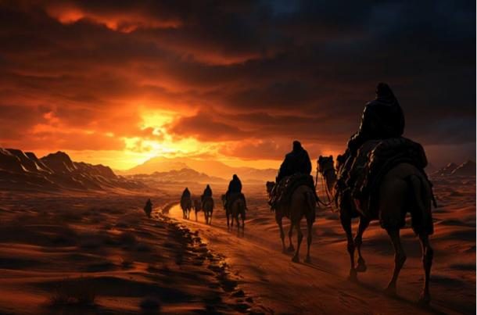
The Sacred Search 2
EZEKIEL 44:23-24
And they shall teach my people the difference between the holy and profane, and cause them to discern between the unclean and the clean.

Slide 2


Oct. 12th Tafara Nengomazha,
Tom Ward
Oct. 13th Samuel Pugh
Oct. 14th Tyler & Ashley Koplau
Oct. 15th Alora Clayville
Oct. 17th Dennis Sheppard
Oct. 18th Joseph Drum
Birthdays & Anniversaries

Slide 3
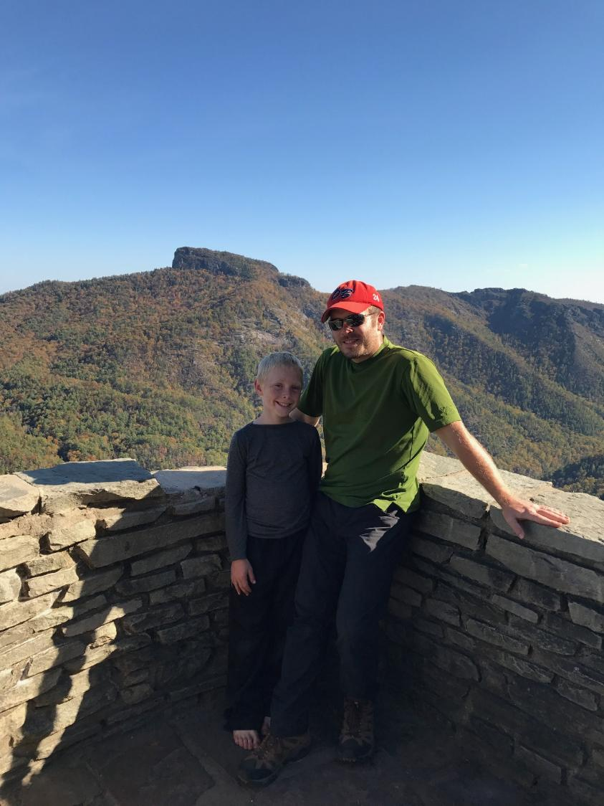
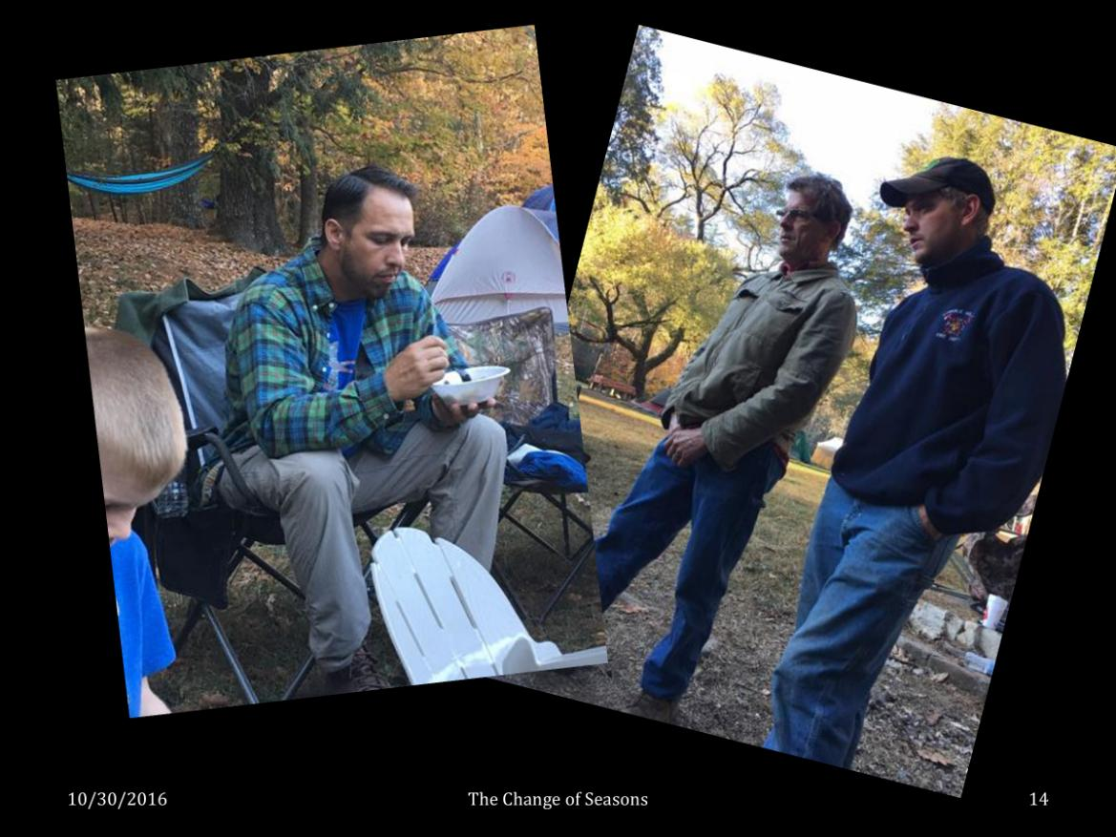
Men’s Campout

Slide 4
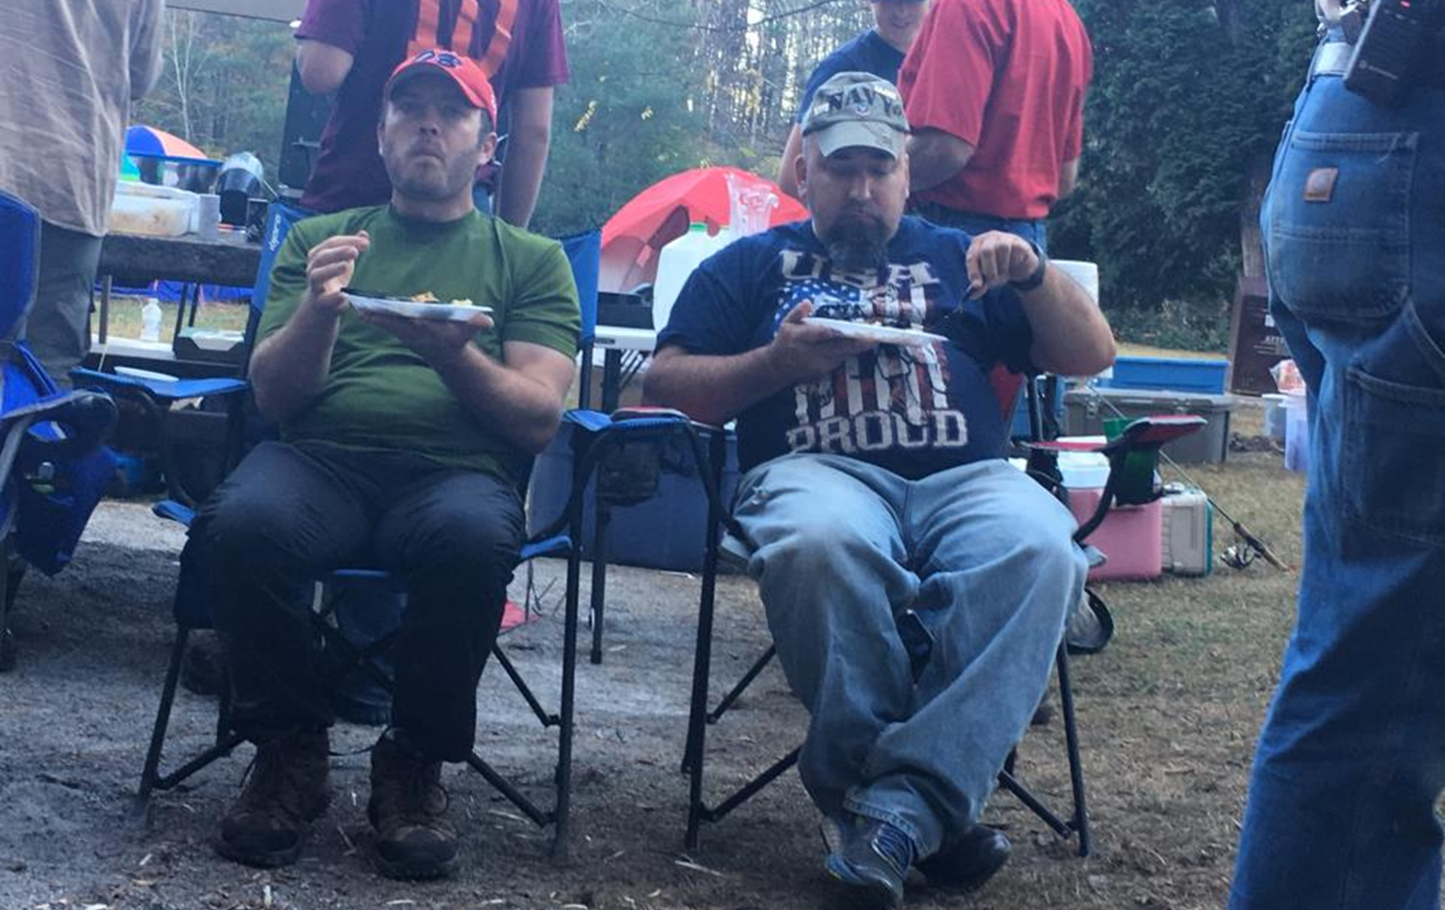

Slide 5
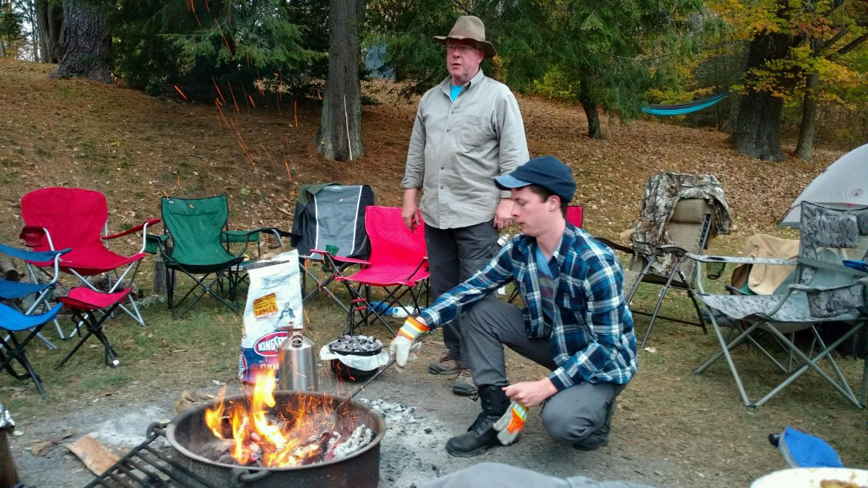

Slide 6
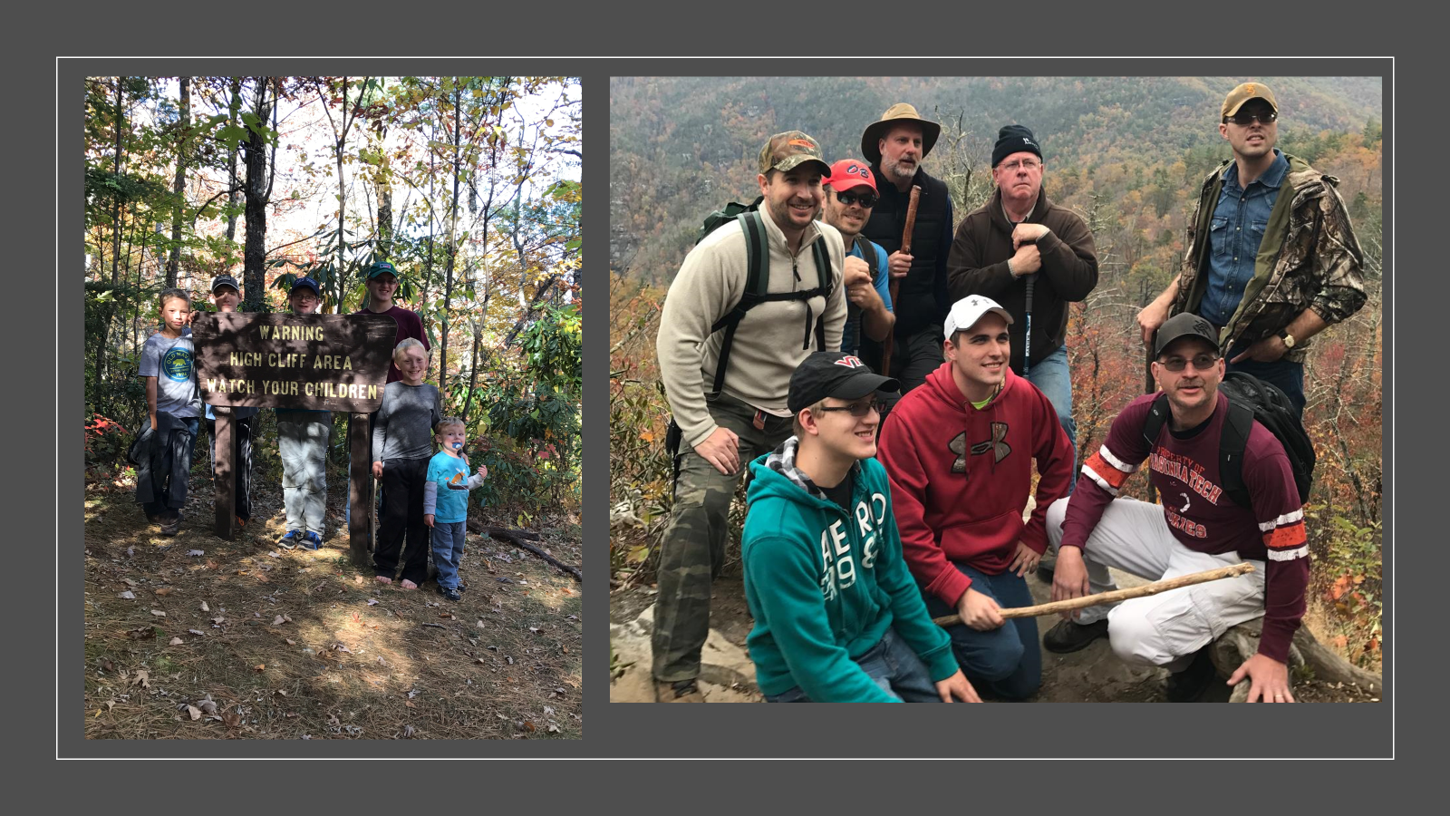

Slide 7
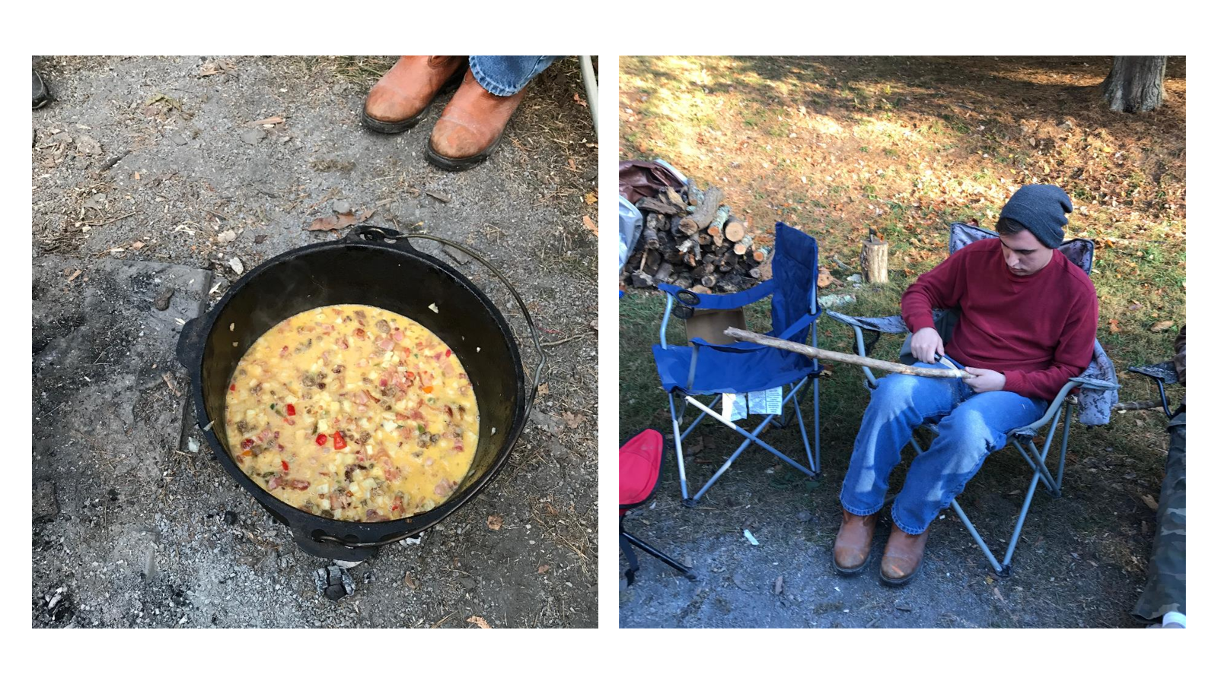

Slide 8
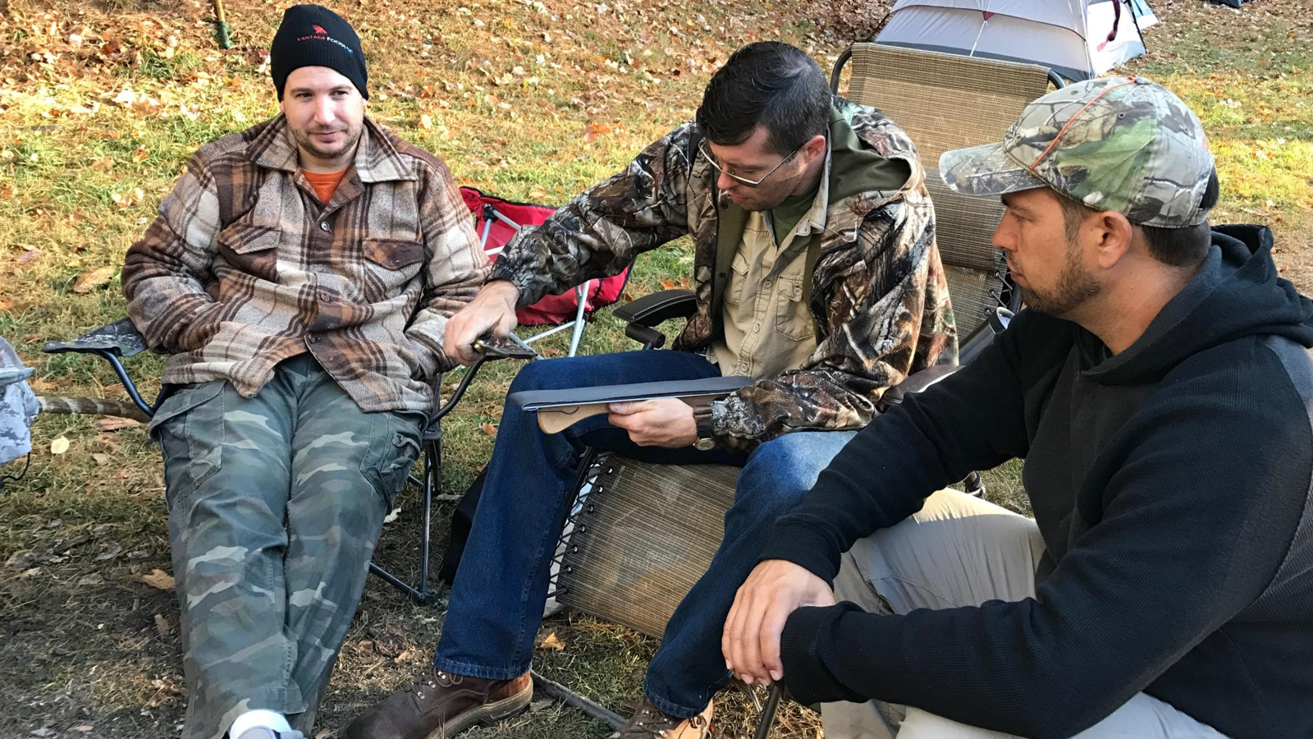

Slide 9
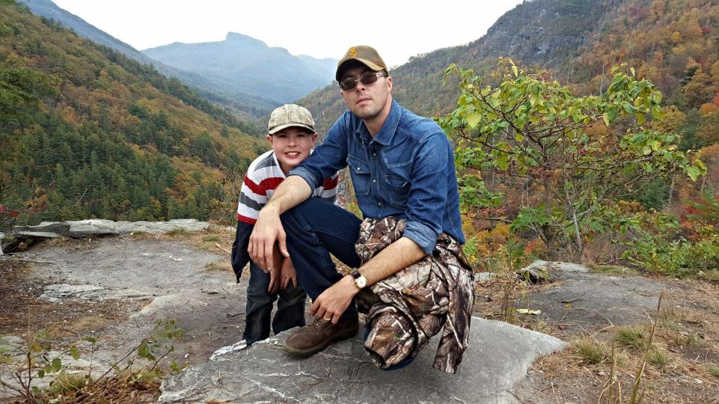

Slide 10
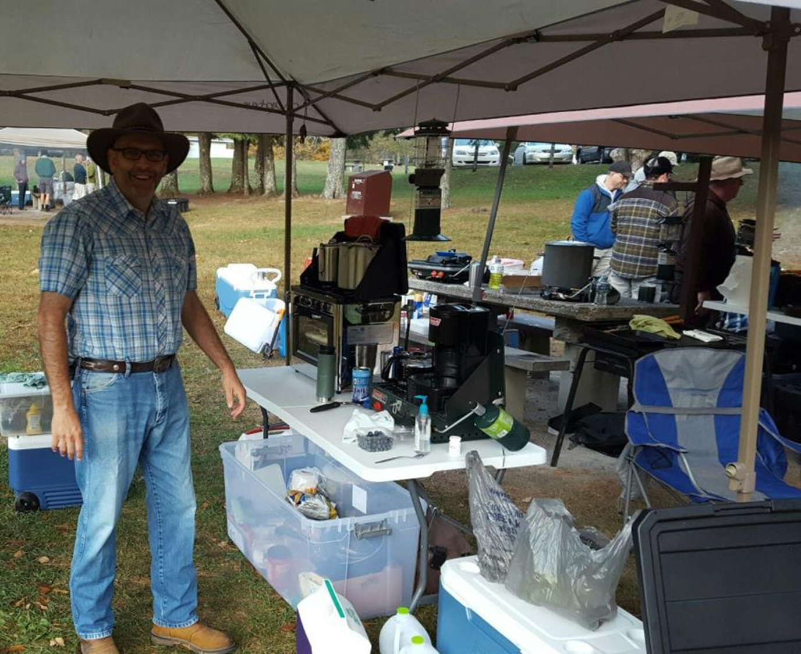

Slide 11
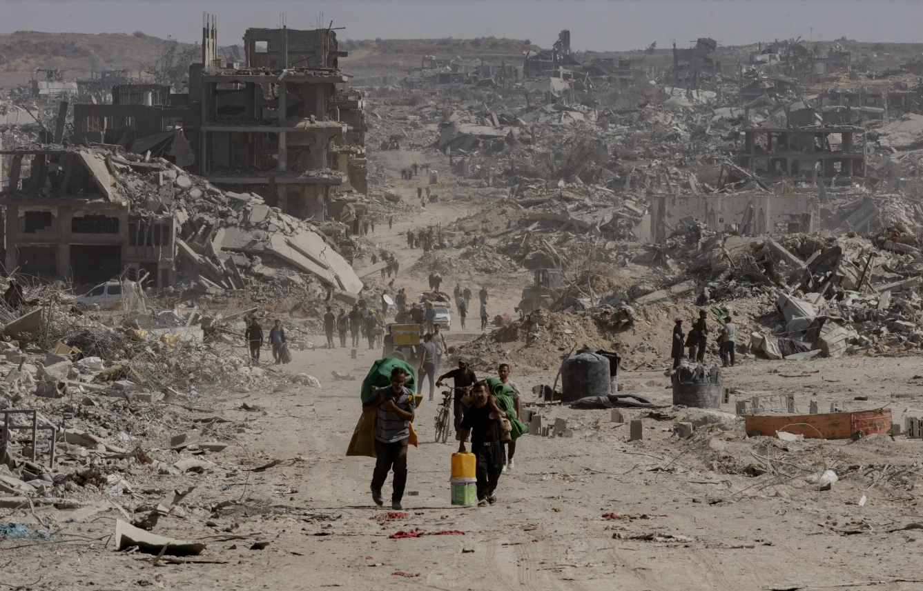
Gaza

Slide 12
The Sacred Search 2
EZEKIEL 44:23-24
And they shall teach my people the difference between the holy and profane, and cause them to discern between the unclean and the clean.

Slide 13
HE.CARETH.FOR.YOU
114 Remember these words, everything's at the end. Civilization's at the end. Democracy's at the end. We've got to come to this place. We're here. We're at the end....

Slide 14
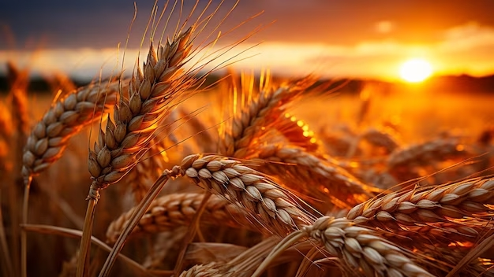
Harvest Time
The Time Has Come to Reap
Matt. 25:6-13

Slide 15
HE.CARES.DO.YOU.CARE? 63-0721
9 (Martin Luther King) "If those people were slaves, I'd take my church and go south to help them people out of slavery." I sure would, because man makes slaves, not God. We're all of one blood.
We all come from one tree, from Adam. God, by one blood has made all nations. And whether our colors are brown, black, yellow, red, or whatever we are all creatures of the Almighty, and there shouldn't be any differences in us.

Slide 16
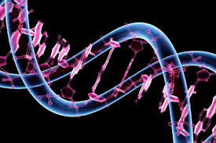
Bloodline:
The place where something begins, where it springs into being; properties attributeable to your ancestry; an event that is a beginning; a first of subsequent events;
The descendants of one individual; ancestry of a purebred animal.

Slide 17
MARK.OF.THE.BEAST 61-0217
28 …We find Israel; compared with Moab, stayed true, the blood line. Moab, illegitimate, fundamental, same as Israel was. But Israel, who had the true bloodline, had signs and wonders following them, a brass serpent, healing, the shout of the King in the camp, a heavenly Father feeding them from above. Having a glorious time… A perfect type of the true church today, headed for the homeland… And the great fundamentals like Moab was, come out with the perfect sacrifice, like Israel had: just as fundamental and everything as Israel was, but didn't have the Spirit*.

Slide 18
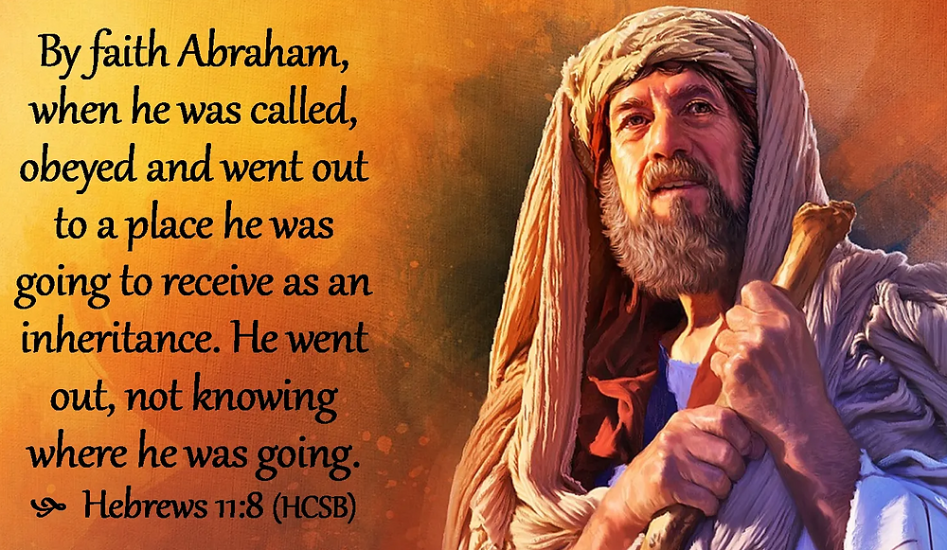

Slide 19
JEHOVAH.JIREH 59-0417
40 (Abimelech) If you don't take him back his wife and let him pray for you, you're as good as a dead man." That's God keeping His promise to Abraham’s. Healing is yours. Salvation is yours. Before the foundation of the world He chose you. You're His heir. He watches over you day and night, trying to get to you to do something for you.
"But, Bro. Branham, I made a mistake last week..." I don't care how many mistakes you make. We've all sinned…If you're a child of Abraham, you're ready to recognize that as sin, come back to God and God's mercy still hangs to you.

Slide 20
KINSMAN.REDEEMER 60-1002
52 Naomi, Elimelech was driven out because of a famine, went into Moab. ... The Moabites, originated from a illegitimate child, which was Lot's daughters. After they escaped the fires of Sodom, by the grace of God, then the daughters got the father drunk and lived with him as a wife. They brought forth a child and originated the nation of Moab… mixed in paganism. And leaving the promised land, (Naomi) no matter how bad it was, to sojourn over in another land, brought trouble.

Slide 21
DEUTERONOMY 23:2-4
A bastard shall not enter into the congregation of the LORD; even to his tenth generation shall he not enter into the congregation of the LORD. 3 An Ammonite or Moabite shall not enter into the congregation of the LORD; even to their tenth generation shall they not enter into the congregation of the LORD for ever: 4 Because they met you not with bread and with water in the way, when ye came forth out of Egypt; and because they hired against thee Balaam the son of Beor of Pethor of Mesopotamia, to curse thee.

Slide 22
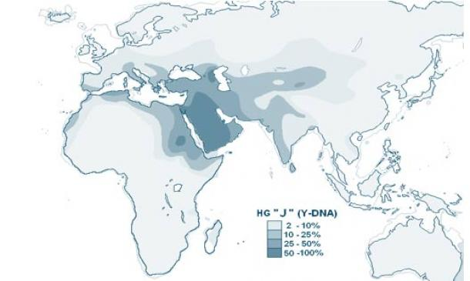
Genetic Distribution of Ashkenazi Jews

Slide 23
GENESIS 10:2-5
The sons of Japheth; Gomer, and Magog, and Madai, and Javan, and Tubal, and Meshech, and Tiras. 3 And the sons of Gomer; Ashkenaz, and Riphath, and Togarmah. 4 And the sons of Javan; Elishah, and Tarshish, Kittim, and Dodanim. 5 By these were the isles of the Gentiles divided in their lands; every one after his tongue, after their families, in their nations.

Slide 24
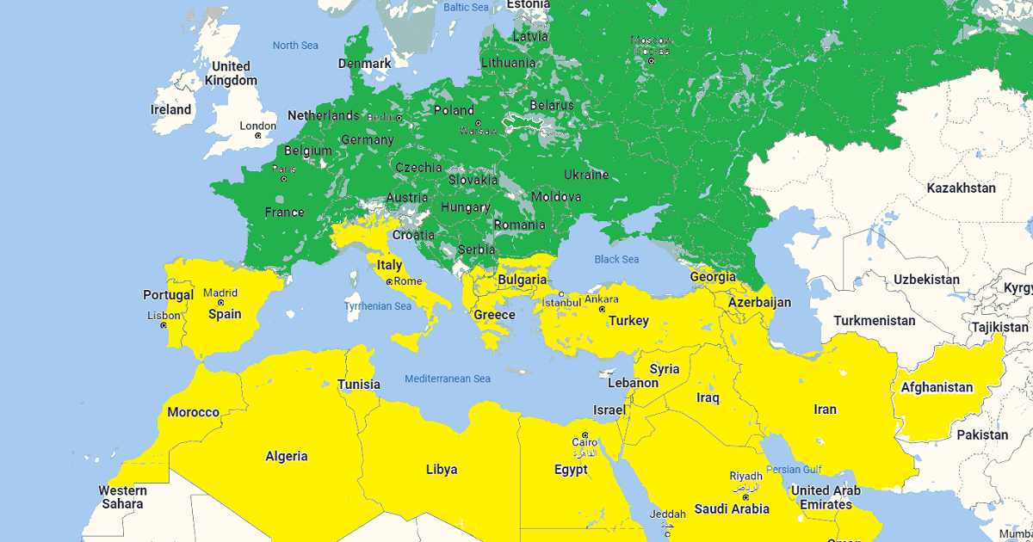
Sephardic Jews are the Jews of Spain, Portugal, North Africa and the Middle East and their descendants. The adjective "Sephardic" refers to Spain.

Slide 25
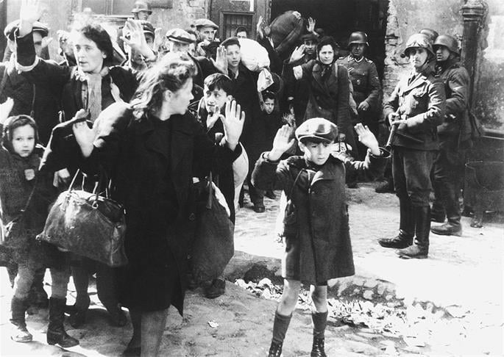
The first Jews in the US were Sephardim, who came during the colonial period. The mid-1800s saw an influx of German, French Ashkenazim, followed by an even larger migration of Eastern-European Ashkenazim from the 1880-1920. Thus, Yiddish-speaking Jews from Russia, Ukraine, and Poland became the dominant strand in the US, and continue to heavily influence public perception of Jewish culture in American life.
The Holocaust 1933-1945

Slide 26
THINGS.THAT.ARE.TO.BE
25 Your birth here was preplanned. Did you know that your being here never originated just at a myth or a thought? Everything was all preplanned by God, before the foundation of the world. The infinite God knowed. And to be infinite, He had to know every flea that ever would be in the earth... That's infinite. Our little minds cannot fathom what infinite means. Therefore, there's nothing out of cater. 65-1205

Slide 27
*CALLING.JESUS.ON.THE.SCENE
72 …Oh, if we tonight could only catch that vision: the very Jehovah that made the heavens and earth is right in this little vessel of ours, while we're sailing life's solemn main. For the Holy Ghost is Jehovah in Spirit form in you.
63-0804

Slide 28
LAW.HAVING.A.SHADOW 54-1203
42 …Every little germ has a life; that life come from somewhere. The life of the cancer come from the Devil. Your life come from God; that's the difference.
ANOINTED.ONES.AT.END.TIME 65-0725
134 That was Satan talking through Pharaoh. That was God talking through Moses.

Slide 29
IT.WASN'T.SO.FROM.THE.BEGINNING 60-1127
48 Hybriding was such a horrible thing in the Old Testament… Ten generations, 400 yrs. before a illegitimate child could ever come into the Kingdom of God. There was no serum to take care of him. He had to just breed it out through the family.
But today, since the Blood of the Jesus Christ has been shed and you've been interbred by all different kinds of ideas, the Holy Spirit is here this morning to breed you back to the original, bring you back to Pentecost, breed you back.

Slide 30
GOD.PERFECTING.HIS.CHURCH 54-1204
16 (God was manifested in His Son, Christ Jesus) God Himself came down into a blood cell and wrapped the Blood around Him.
Now by that, make you perfect and to bring you back into fellowship. He brings you through the Blood cell of the Lord Jesus that veiled the Life of Jehovah, and coming through the Blood cell, becomes a part of that Life. So, Deity itself lays in the man that's received the Holy Spirit.

Slide 31
What Was God watching? DESPERATIONS 21 And the Holy Ghost is the Token that the Blood has been applied, because It follows the Blood all the way from the Book of Redemption... That's what He followed in every age. Every age He has followed that, to see that It's brought forth, and they could not be made perfect without us. And now the entire Holy Spirit visits the Church, making God in human flesh; as He did before Sodom… which was a type. 63-0901

Slide 32
THE.MANIFESTATION.OF.THY.RESURRECTION.
TO.THE.PEOPLE.OF.THIS.DAY
44 The Holy Spirit still hangs in that corner. The Angel of God, the Light that followed the children of Israel, stands right there and looks to me.
You can see It now, as It's moving there. It's hanging over a lady; she's setting here. She's got low blood pressure. Your faith has healed you, lady. Christ has made you well. Amen. 54-0809

Slide 33
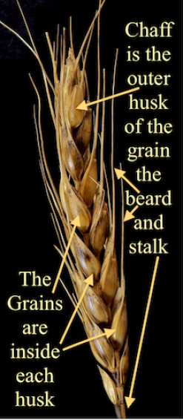
It's coming more like the grain all the time - the one that went in the ground. And when it comes forth the stalk, it's got life in it, but it sure isn't the grain.
And it's just in the shape of the wheat, exactly like the grain of wheat; but yet it isn't the wheat.

Slide 34
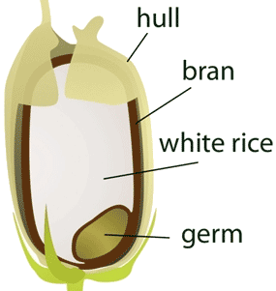
Grain of Wheat
MODERN.EVENTS 65-1206
God does His Own choosing by His predestinated choosing. He done it in every age, He set forth the man for each age. Fixes his nature, style of preaching, to honor His gift, all that He does is to meet the challenge of that day. God creates that man and sent him. In His Own mind, we are a germ of the gene of God.

Slide 35
CALLING.JESUS.ON.THE.SCENE 63-0804
72 …Oh, if we tonight could only catch that vision: the very Jehovah that made the heavens and earth is right in this little vessel of ours, while we're sailing life's solemn main. For the Holy Ghost is Jehovah in Spirit form in you.

Slide 36
Separation
Separation of Time (Ex. 20:8)
Separation of People (Lev. 20:26)
Separation of Places (Ex. 29:44)

Slide 37
EZRA 9:1-4
Now when these things were done, the princes came to me, saying, The people of Israel, and the priests, and the Levites, have not separated themselves from the people of the lands, doing according to their abominations, even of the Canaanites, the Hittites, the Perizzites, the Jebusites, the Ammonites, the Moabites, the Egyptians, and the Amorites. 2 For they have taken of their daughters for themselves, and for their sons: so that the holy seed have mingled themselves with the

Slide 38
people of those lands: yea, the hand of the princes and rulers hath been chief in this trespass. 3 And when I heard this thing, I rent my garment and my mantle, and plucked off the hair of my head and of my beard, and sat down astonied. 4 Then were assembled unto me every one that trembled at the words of the God of Israel, because of the transgression of those that had been carried away; and I sat astonied until the evening sacrifice.

Slide 39
CONDEMNATION.BY.REPRESENTATION
184 Jesus died that He might breed back. Oh, hallelujah. Only the Blood can do that. Only through the chemistry of the Blood of Jesus Christ can breed back again a person that won't vary one word from what God said.
60-1113

Slide 41
THE.WORLD.IS.FALLING.APART
177 There's a true Church, that's waiting for the Coming of the Lord… There's a predestinated Seed. When that Light strikes, they'll catch it like that. She'll bloom. Others will just go right over the top of it.
179 Those who were predestinated to Eternal Life, they got It. "No man can come to Me, except My Father draws him. And all the Father hath given Me will come." We just got to scatter the Seed, throw the Light.
63-0412

Slide 42
The Masterpiece 64-0705
78 Now, stalk don't look nothing like a seed; neither the tassel… The first thing comes forth you'd almost think it was a seed, but it's the husk… a little outside thing, to hold the seed. But the husk is not the seed; it's a carrier of the life, corn of wheat (Jn. 12). After Wesley, puts forth the husk, which is most like the grain…

Slide 43
BELIEVER'S.POSITION.IN.CHRIST 55-0116
27 …Outside of Christ, without God, without hope, in the world condemned to die, God by grace, elects us, calls us to Christ…And we come, confess our sins, are baptized for the remission of our sins.
...We come through the spray of Blood; and we have fellowship one with another, while the Blood of Jesus Christ the Son of God cleanses from all unrighteousness. (I John 1:17)

