Slide 1
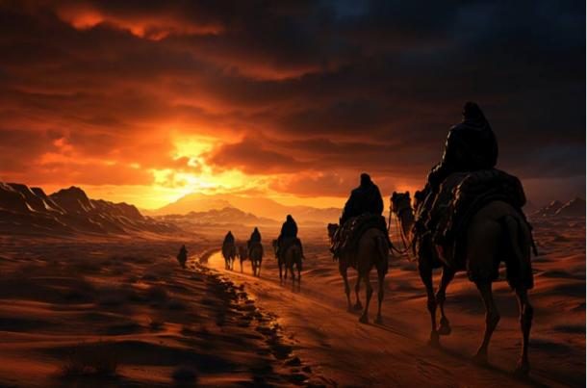
The Sacred Search 3
LEVITICUS 20:26
And ye shall be holy unto me: for I the LORD am holy, and have severed you from other people, that ye should be mine.

Slide 2


Birthdays & Anniversaries
Oct. 18th Joseph Drum,
Daniel Cockman
Oct. 23rd Ethan McCafferty
Oct. 25th Fall Festival (Noon)

Slide 3


Slide 4
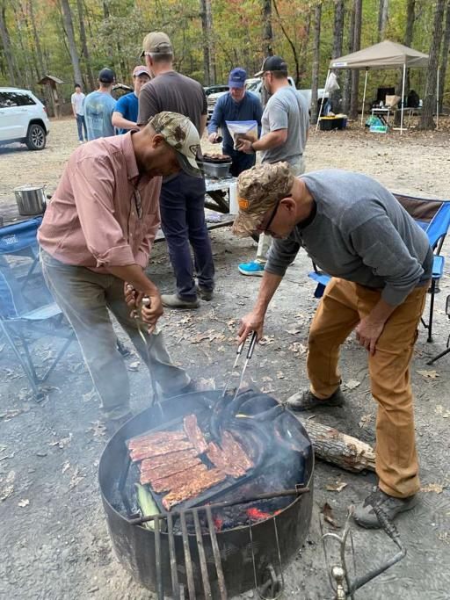

Men’s Campout 2025

Slide 5
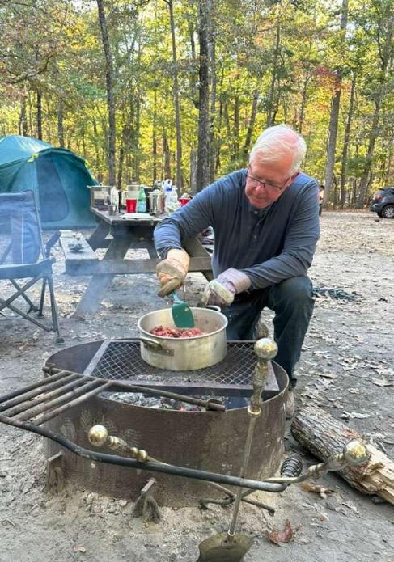
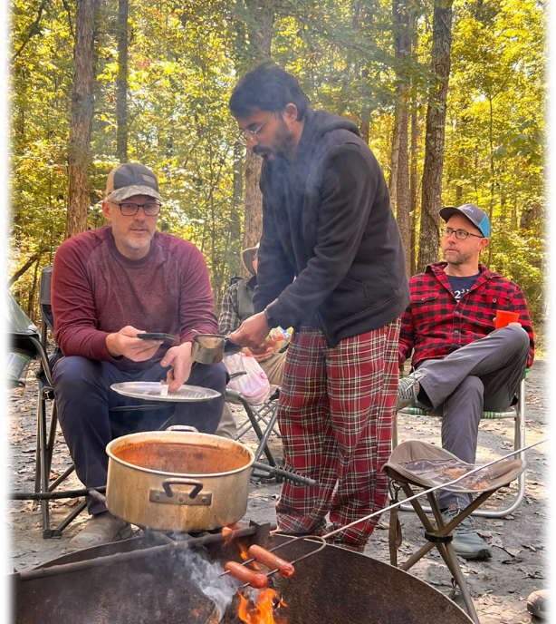

Slide 6
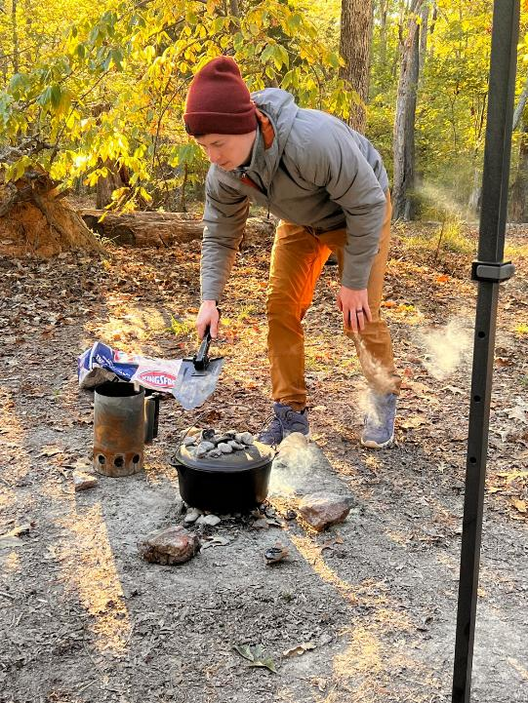
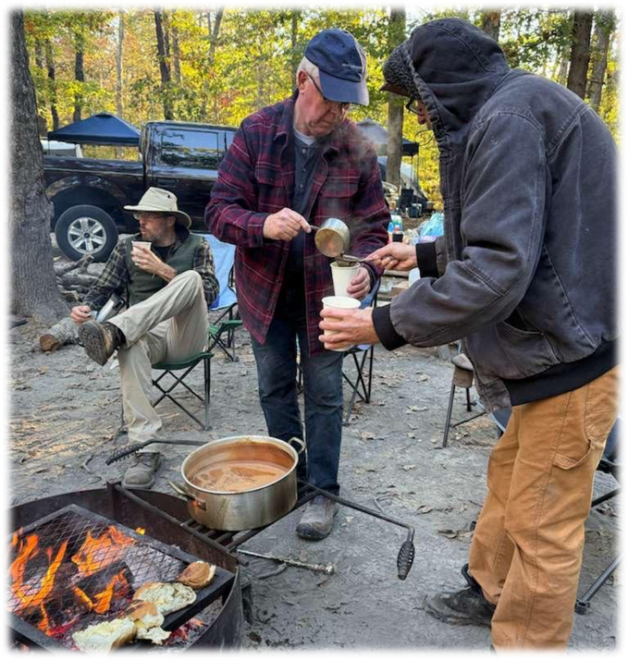

Slide 7



Slide 8
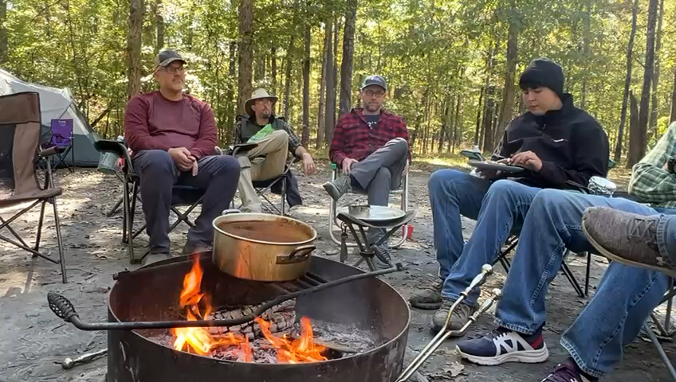

Slide 9
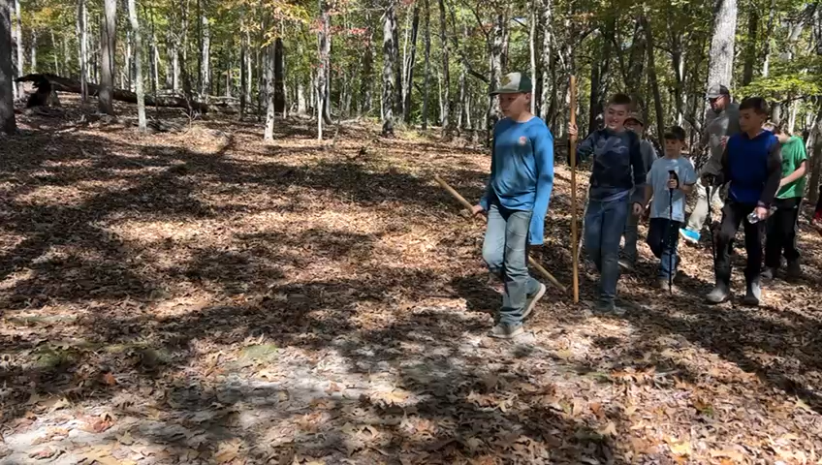

Slide 10
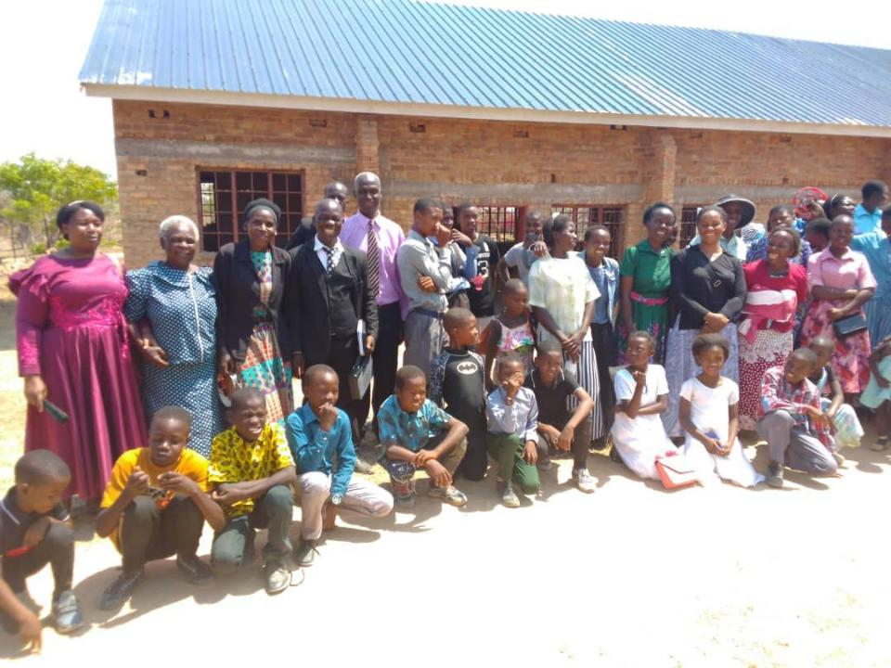
Zimbabwe
The saints in Chimhenga would like to express their gratitude for the love and support provided on their church roof. May God bless bro Barry and the saints

Slide 11
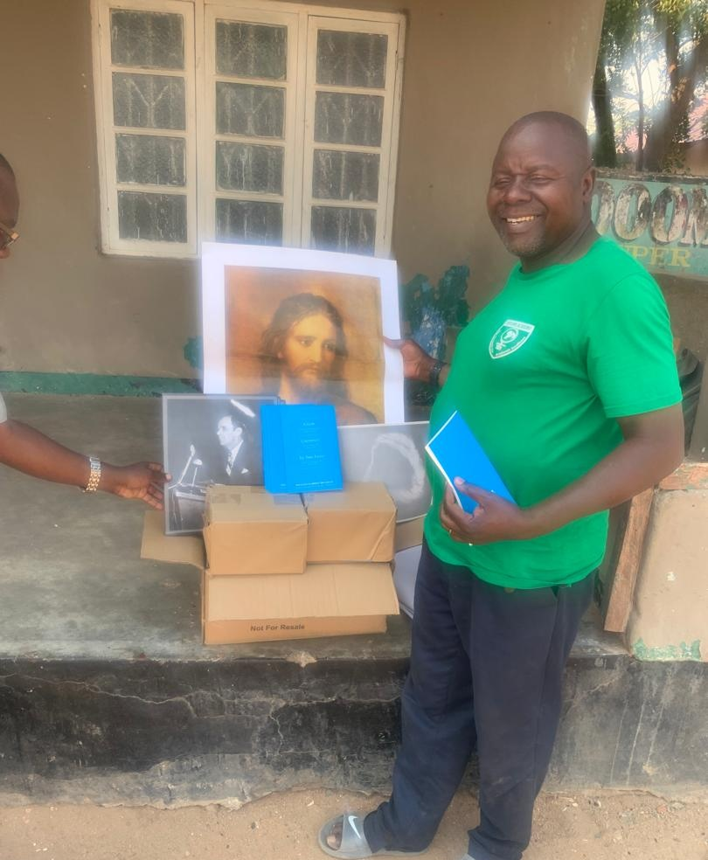
Vision Books
Malawi
Book Distribution
April 16, 2025

Slide 12
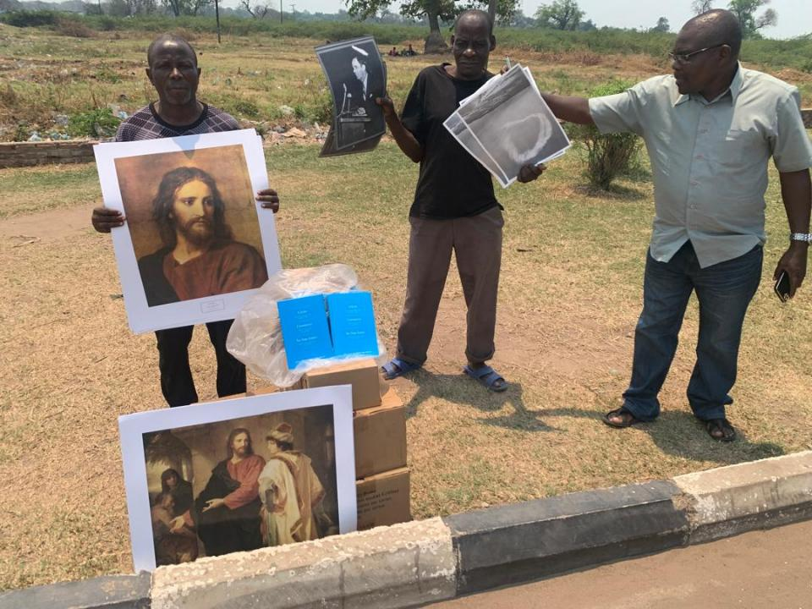

Slide 13
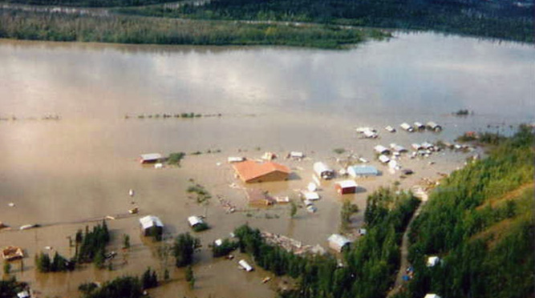
Alaska

Slide 14
The Sacred Search 3
LEVITICUS 20:26
And ye shall be holy unto me: for I the LORD am holy, and have severed you from other people, that ye should be mine.

Slide 15
Separation
Separation of Time (Ex. 20:8)
Separation of People (Lev. 20:26)
Separation of Places (Ex. 29:44)

Slide 16
THE.CALLING.OF.ABRAHAM
21 Many people say, "Oh, I believe," and try to reform. Our business is not to reform; it's to preach the Gospel. We're not reformers. We should be Gospel preachers. As soon as God called Abraham, He called him to separate himself. As soon as He calls a man, He calls for a complete separation. "Abraham, separate yourself from your kindred." That's a big thing to do, wasn't it? You've never walked this way before, but I want you to separate yourself so you can walk with Me, among a strange people, speaking a strange language... a pilgrim, a sojourner."

Slide 17
22 Every man that's borned of Christ separates himself from sin immediately. Here's the lamb feeding in alfalfa. Here's a pig feeding in the pen on slop. Take the nature out of a lamb and put it in the pig, he will never eat no more slop, but go to eating alfalfa. But you can reform him and polish him up, he will run right back to the pig pen again. It's got to be something God does for a man, not what man does… We got too much man-made reforming today. "Sign your name.

Slide 18
Put your name on the church book. Join a church. Bring your letter in." I ain't got nothing again' it, if the other has already took place. If you've been born again, all right. You don't care where your letter is at anyhow, it's in heaven, not written on a piece of paper, but on a Lamb's skin by Lamb's Blood…
When God called you, He calls you to separate from that kind of a life and walk a different life.
55-1116

Slide 19

JOHN 15:19
If ye were of the world, the world would love his own: but because ye are not of the world, but I have chosen you out of the world, therefore the world hateth you.

Slide 20
HE.THAT.IS.IN.YOU
18 And if Christ is in you, the works of Christ you will do... (John 14:12) But if you're still living your own life, then your own works you'll do. If Christ is in you, "He that's in you is greater than he that's in the world." If your doubts, flusterations about God's promise is in you, then Christ isn't there; you're only worked up. But if the Life, if Christ is living in you, His Word He will recognize and His promise He'll do. 63-1110

Slide 21
*CALLING.JESUS.ON.THE.SCENE
72 …Oh, if we tonight could only catch that vision: the very Jehovah that made the heavens and earth is right in this little vessel of ours, while we're sailing life's solemn main. For the Holy Ghost is Jehovah in Spirit form in you.
63-0804

Slide 22

Separation vs. Isolation
Jesus prayed that his followers would be in the world but not of it (John 17:15). Christians are called to be salt and light in the world, (interaction) not isolation from it.
Paul clarified that he wasn't telling believers to "have nothing to do with people of this world who are immoral" but specifically to avoid associating with those in the church who are unrepentant. Rom. 16:17

Slide 23
Example: ACTS 17:26-28
And hath made of one blood all nations of men for to dwell on all the face of the earth, and hath deter-mined the times before appointed, and the bounds of their habitation; 27 That they should seek the Lord, if haply they might feel after him, and find him, though he be not far from every one of us: 28 For in him we live, and move, and have our being; as certain also of your own poets have said, For we are also his offspring.

Slide 24
ROMANS 1:18-20
For the wrath of God is revealed from heaven against all ungodliness and unrighteousness of men, who hold the truth in unrighteousness; 19 Because that which may be known of God is manifest in them; for God hath shewed it unto them. 20 For the invisible things of him from the creation of the world are clearly seen, being understood by the things that are made, even his eternal power and Godhead; so that they are without excuse:

Slide 25
THINGS.THAT.ARE.TO.BE
25 Your birth here was preplanned. Did you know that your being here never originated just at a myth or a thought? Everything was all preplanned by God, before the foundation of the world. The infinite God knowed. And to be infinite, He had to know every flea that ever would be in the earth... That's infinite. Our little minds cannot fathom what infinite means. Therefore, there's nothing out of cater. 65-1205

Slide 26
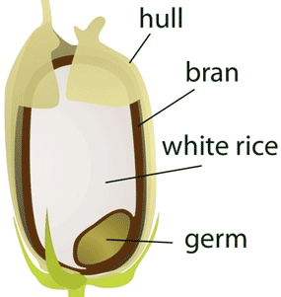
Grain of Wheat
MODERN.EVENTS 65-1206
God does His Own choosing by His predestinated choosing. He done it in every age, He set forth the man for each age. Fixes his nature, style of preaching, to honor His gift, all that He does is to meet the challenge of that day. God creates that man and sent him. In His Own mind, we are a germ of the gene of God.

Slide 27
Separation of People (Lev. 20:22-26)
Lev. 20:12 “Confusion”
Apart from Divine order.
LEVITICUS 20:7 Sanctify yourselves therefore, and be ye holy: for I am the LORD your God. 8 And ye shall keep my statutes, and do them: I am the LORD which sanctify you.

Slide 28
Deuteronomy 23
An Ammonite or Moabite shall not enter into the congregation of the Lord; even to their tenth generation shall they not enter into the congregation of the Lord for ever: ⁴ Because they met you not with bread and with water in the way, when ye came forth out of Egypt; and because they hired against thee Balaam the son of Beor of Pethor of Mesopotamia, to curse thee.

Slide 29
DEUTERONOMY 7:1-8
When the LORD thy God shall bring thee into the land whither thou goest to possess it, and hath cast out many nations before thee, the Hittites, and the Girgashites, and the Amorites, and the Canaanites, and the Perizzites, and the Hivites, and the Jebusites, seven nations greater and mightier than thou; 2 And when the LORD thy God shall deliver them before thee; thou shalt smite them, and utterly destroy them; thou shalt make no covenant with them, nor shew mercy unto them: 3 shalt thou make marriages with them; thy daughter thou shalt not give unto his son, nor his daughter shalt thou take unto thy son.

Slide 30

Nehemiah:
A. Restoring Sanctity in the Temple (13:1-14) B. Restoring Sacredness to the Sabbath (13:15-22) C. Restoring Purity to God's People (13:23-29) D. Restoring All Things to Their Design (13:30-31)

Slide 31
NEHEMIAH 2:9
Then I came to the governors beyond the river, and gave them the king's letters. Now the king had sent captains of the army and horsemen with me.
10 When Sanballat the Horonite, and Tobiah the servant, the Ammonite, heard of it, it grieved them exceedingly that there was come a man to seek the welfare of the children of Israel.

Slide 32
NEHEMIAH 4:1-3
But it came to pass, that when Sanballat heard that we builded the wall, he was wroth, and took great indignation, and mocked the Jews. 2 And he spake before his brethren and the army of Samaria, and said, What do these feeble Jews? will they fortify themselves? will they sacrifice? will they make an end in a day? will they revive the stones out of the heaps of the rubbish which are burned? 3 Now Tobiah the Ammonite was by him, and he said, Even that which they build, if a fox go up, he shall even break down their stone wall.

Slide 33
NEHEMIAH 6:12
And, lo, I perceived that God had not sent him; but that he pronounced this prophecy against me: for Tobiah and Sanballat had hired him. 13 Therefore was he hired, that I should be afraid, and do so, and sin, and that they might have matter for an evil report, that they might reproach me. 14 My God, think thou upon Tobiah and Sanballat according to these their works, and on the prophetess Noadiah, and the rest of the prophets, that would have put me in fear.

Slide 34
NEHEMIAH 13:1-3
On that day they read in the book of Moses in the audience of the people; and therein was found written, that the Ammonite and the Moabite should not come into the congregation of God for ever; 2 Because they met not the children of Israel with bread and with water, but hired Balaam against them, that he should curse them: howbeit our God turned the curse into a blessing. 3 Now it came to pass, when they had heard the law, that they separated from Israel all the mixed multitude.

Slide 35
CONDEMNATION.BY.REPRESENTATION
184 Jesus died that He might breed back. Oh, hallelujah. Only the Blood can do that. Only through the chemistry of the Blood of Jesus Christ can breed back again a person that won't vary one word from what God said.
60-1113

Slide 36
II CORINTHIANS 6:14-18
Be ye not unequally yoked together with unbelievers: for what fellowship hath righteousness with unrighteousness? and what communion hath light with darkness? 15 And what concord hath Christ with Belial? or what part hath he that believeth with an infidel? 16 And what agreement hath the temple of God with idols? for ye are the temple of the living God; as God hath said, I will dwell in them, and walk in them; and I will be their God and they shall be my

Slide 37
people. 17 Wherefore come out from among them, and be ye separate, saith the Lord, and touch not the unclean thing; and I will receive you, 18 And will be a Father unto you, and ye shall be my sons and daughters, saith the Lord Almighty.

