Slide 1
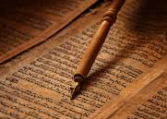
Teaching Adoption Part 3
ROMANS 3:19-23
Now we know that what things soever the law saith, it saith to them who are under the law: that every mouth may be stopped, and all the world may become guilty before God.

Slide 2

PSALM 56:3-4 What time I am afraid, I will trust in thee. 4 In God I will praise his word, in God I have put my trust; I will not fear what flesh can do unto me.

Slide 3
Abraham And His Seed After Him
126 What happened when that son, in the Old Testament what if that son was a good boy, stayed exactly like the father ordained? If the Bible said one thing, he stayed right with it. Regardless of what it is, no matter what the rest of them believe, he stays with the main Boss, he stays with what God said: “Let every man’s word be a lie, and Mine be the Truth.” The Bible predicts the Pentecostal age will become a lukewarm, spued out of God’s mouth. 61-0423

Slide 4
I saw the angel in the marble and carved until I set him free.
Michelangelo

Slide 5
(Holiness) Isaiah 6:6-8
Then flew one of the seraphims unto me, having a live coal in his hand, which he had taken with the tongs from off the altar: 7 And he laid it upon my mouth, and said, Lo, this hath touched thy lips; and thine iniquity is taken away, and thy sin purged. 8 Also I heard the voice of the Lord, saying, Whom shall I send, and who will go for us? Then said I, Here am I; send me.

Slide 6
THINGS.THAT.ARE.TO.BE
64 Now, when this Millennium is over, God is going to give the world a baptism of fire, renovation of the whole thing. And then there'll be a new heavens and a new earth. That’s where dwelleth righteousness.
That's where we are. We have become from mortal beings, time beings, to Eternal beings. When the Word of God lit our souls, and we become sons and daughters of God, with the gene of God in us, to be sons and daughters of the Father, crying, "Abba, Father! My God, my God, in my Father's House." 65-1205

Slide 7
LUKE 3:16
He answered, saying unto them all, I indeed baptize you with water; but one mightier than I cometh, the latchet of whose shoes I am not worthy to unloose: he shall baptize you with the Holy Ghost and with fire…
MATTHEW 3:11
I indeed baptize you with water unto repentance: but he that cometh after me is mightier than I, whose shoes I am not worthy to bear: he shall baptize you with the Holy Ghost, and with fire:

Slide 8
2a Numbers 5:1-3 Command the children of Israel, that they put out of the camp every leper, and every one that hath an issue, and whosoever is defiled by the dead:
2b Matthew 8:1-3 And, behold, there came a leper and worshipped him, saying, Lord, if thou wilt, thou canst make me clean. 3 And Jesus put forth his hand, and touched him, saying, I will; be thou clean. And immediately his leprosy was cleansed.

Slide 9
3. Numbers 5:11-14, 24
24 And he shall cause the woman to drink the bitter water that causeth the curse: and the water that causeth the curse shall enter into her, and become bitter.
John 7:38
He that believeth on me, as the scripture hath said, out of his belly shall flow rivers of living water.

Slide 10
BIRTH.PAINS
170 We're in the Laodicea church age. Her messenger is promised, in Malachi 4. He's promised to do it. And the Message is to bring the people back to the Word. Birth is to be.
She's to be delivered, of a new Birth, from according to Malachi 4.
65-0124

Slide 11
DESPERATIONS
79 Pentecost, there is where you failed! You thought because you were born of the Spirit, born of the Spirit of God, the Birthright, that settled it.
But it only starts it. You remember in the message of Hear Ye Him, how that the child, after it was born in the family, become a son. It had rights to the birthright, but it had to be proven, child-trained.

Slide 12
80 When the Holy Ghost fell upon the Pentecostal people and they begin to restore back the gifts that was in the church; they thought, because they were born of the Spirit, that settled it. But, there is a placing of a son. And after this son proved to be a real son, then he was taken in a public place, was set up, changed robes; then there was a placing of the son, had heir of everything the father had.
81 God did the same thing by His Son on Mt. Transfigu-ration. He was overshadowed, transfigured, and a voice said, "This is My Beloved Son in Whom I'm well pleased." Moses and the law had failed. He was placed.

Slide 13
82 Now Jacob thought, because that he had the birthright, that everything was made. So did Pentecostals, they begin to organize, fussing and pulling at one another, proved that the Token wasn't showing. Malice, envy, strife, see, but that's where it got to.
83 Jacob thought the same thing. But in fear, one night, of his own life, desperation took a hold of him, when he thought that, "Just across that river yonder, my brother is waiting to kill me. He is going to.“ 63-0901

Slide 14
GALATIANS 3:23 But before faith came, we were kept under the law, shut up unto the faith which should afterwards be revealed.
GALATIANS 4:4 But when the fulness of the time was come, God sent forth his Son, made of a woman, made under the law, 5 To redeem them that were under the law, that we might receive the adoption of sons.
21 Tell me, ye that desire to be under the law, do ye not hear the law?
GALATIANS 5:18 But if ye be led of the Spirit, ye are not under the law.

Slide 15
MARK 14:36 And he said, Abba, Father, all things are possible unto thee; take away this cup from me: nevertheless not what I will, but what thou wilt.
ROMANS 8:15 For ye have not received the spirit of bondage again to fear; but ye have received the Spirit of adoption, whereby we cry, Abba, Father.
GALATIANS 4:6 And because ye are sons, God hath sent forth the Spirit of his Son into your hearts, crying, Abba, Father.

Slide 16
LEADERSHIP
162 The choice of your conduct. You can't mix it now. You're either for God or against God, and the outward expressions shows exactly what's on the inside. Many of you think, "I got the baptism of the Holy Ghost, I'm going to Heaven." That don't mean one thing that you're going to Heaven. No, sir. You can have the baptism of the Holy Ghost every hour in your life, and still be lost and go to hell…
65-1207

Slide 17
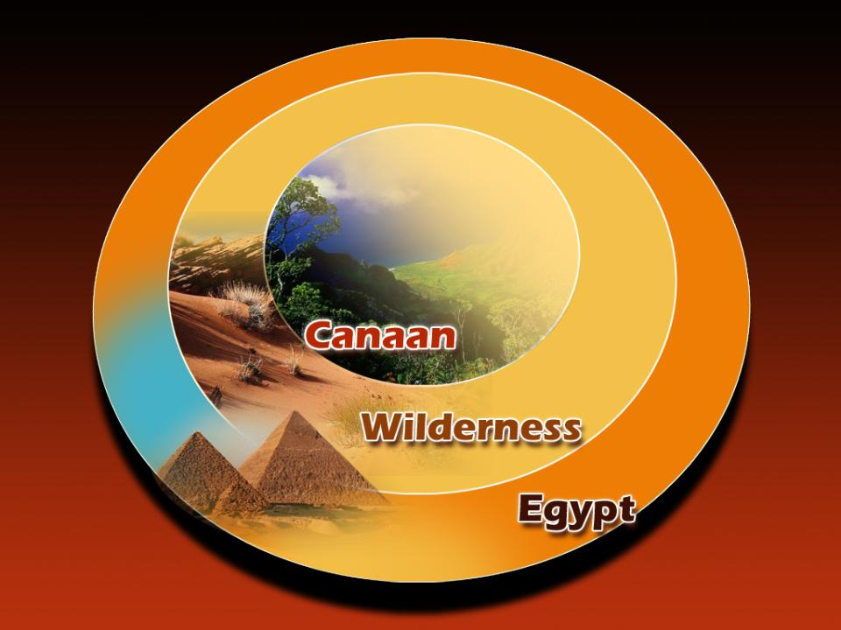

Slide 18
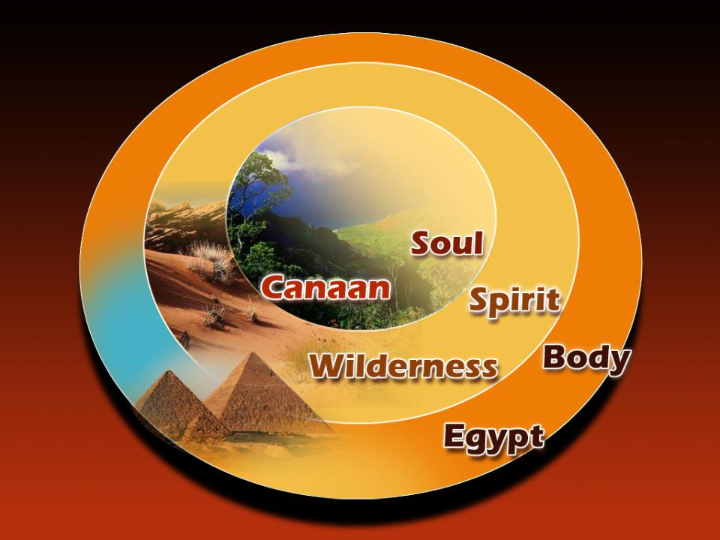

Slide 19
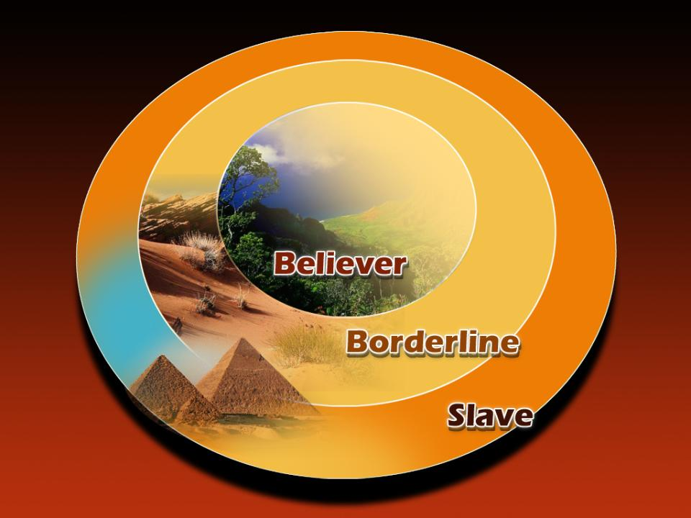

Slide 20
ROMANS 8:1,4 (Key)
There is therefore now no condemnation to them which are in Christ Jesus, who walk not after the flesh, but after the Spirit.
4 That the righteousness of the law might be fulfilled in us, who walk not after the flesh, but after the Spirit.

Slide 21
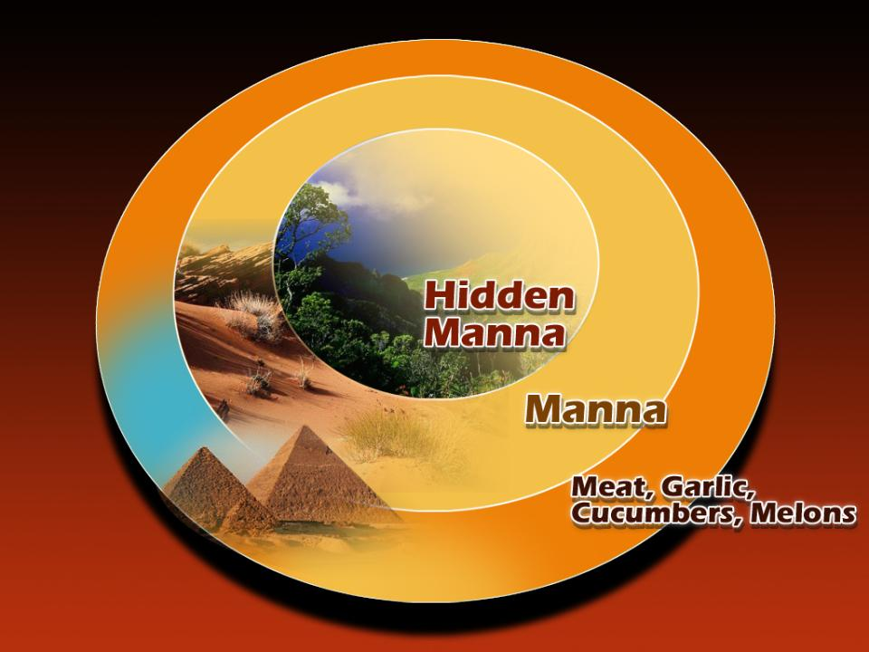

Slide 22
Romans 8:14-16
For as many as are led by the Spirit of God, they are the sons of God. 15 For ye have not received the spirit of bondage again to fear; but ye have received the Spirit of adoption, whereby we cry, Abba, Father. 16 The Spirit itself beareth witness with our spirit, that we are the children of God:

Slide 23
PHIL. 4:7 And the peace of God, which passeth all understanding, shall keep your hearts and minds through Christ Jesus.
2 Things to Remember:
God’s mercy has purchased for you a place in His family.
God’s power controls all things for your good until your eternal inheritance is to be received.

