Slide 1

The Better Knowledge Knowledge Shall Increase
COLOSSIANS 1:10
That ye might walk worthy of the Lord unto all pleasing, being fruitful in every good work, and increasing in the knowledge of God;

Slide 2
Birthdays & Anniversaries
Oct. 28th Suzanne Doucette, Cynthia Cockman,
Matt & Melody Cross
Oct. 29th Titus Clayville
Oct. 30th David Stevens
Dec. 13th Church Dinner

Slide 3
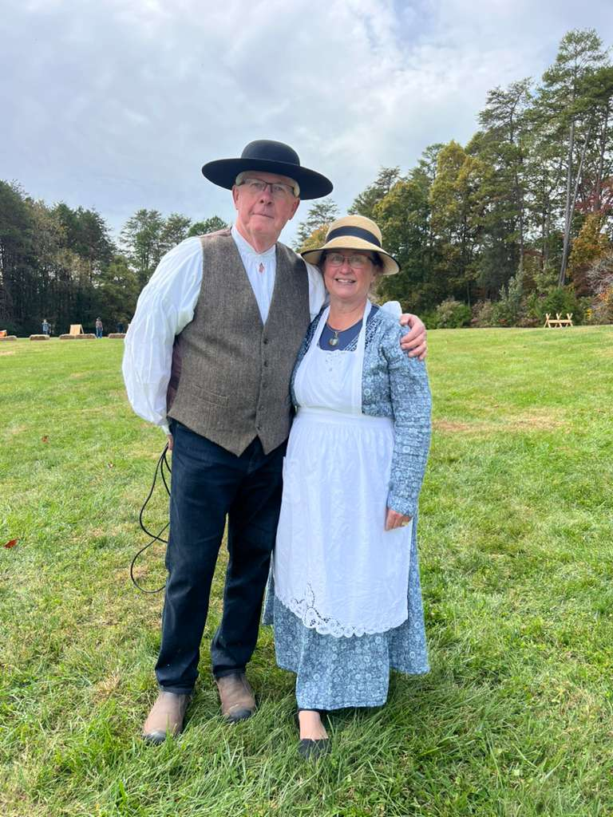
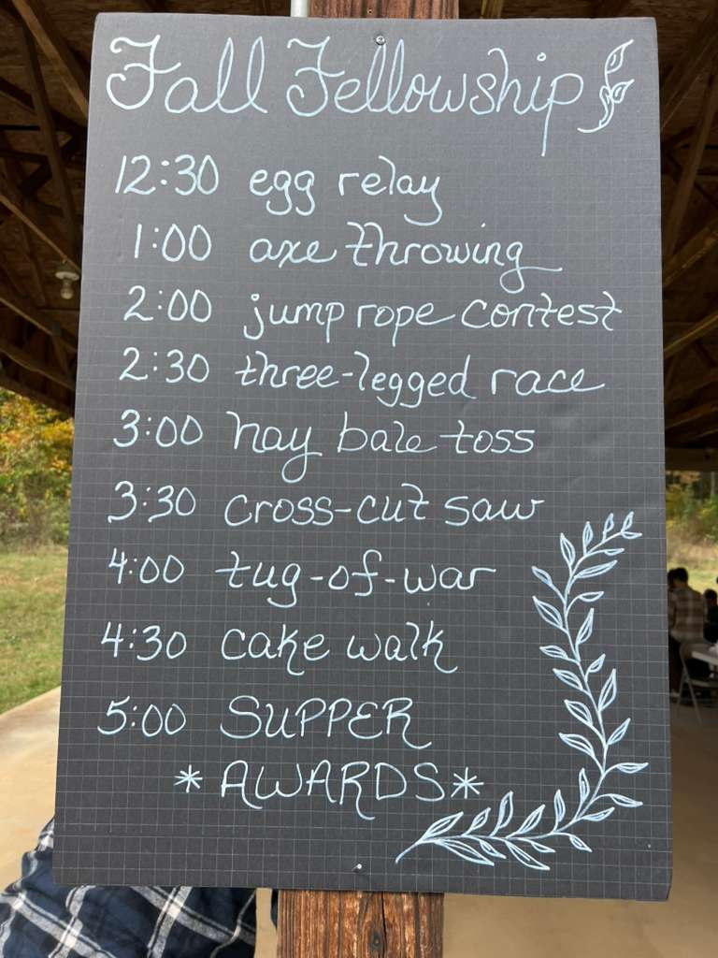
Fall Fellowship
2025

Slide 4
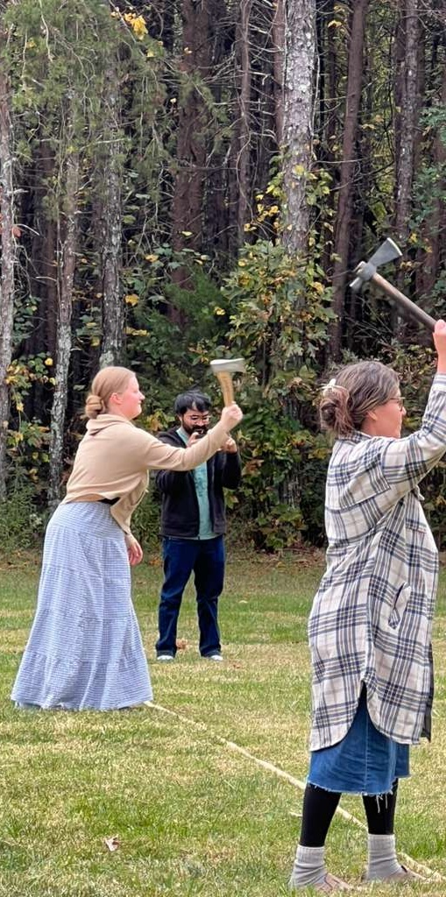
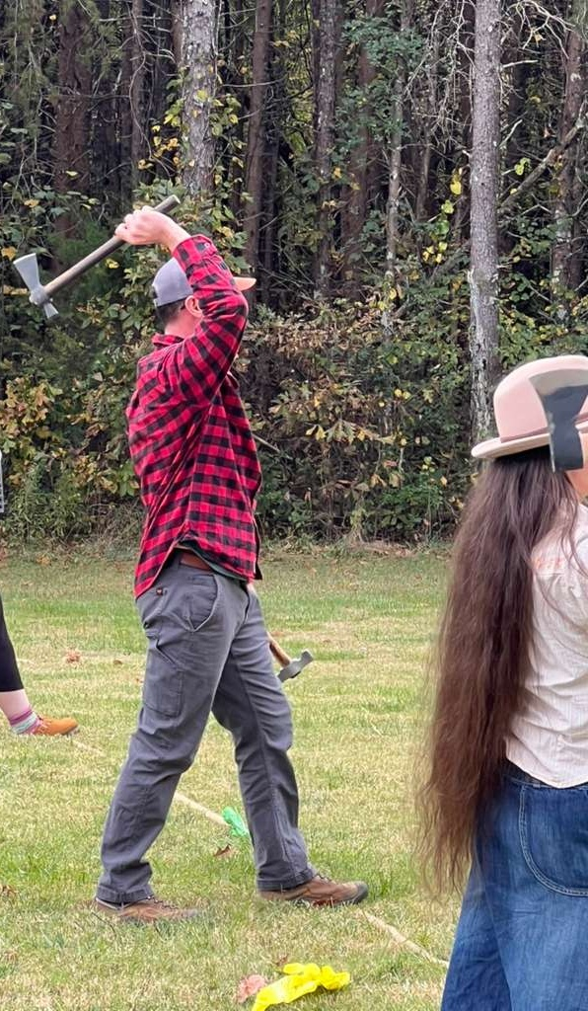
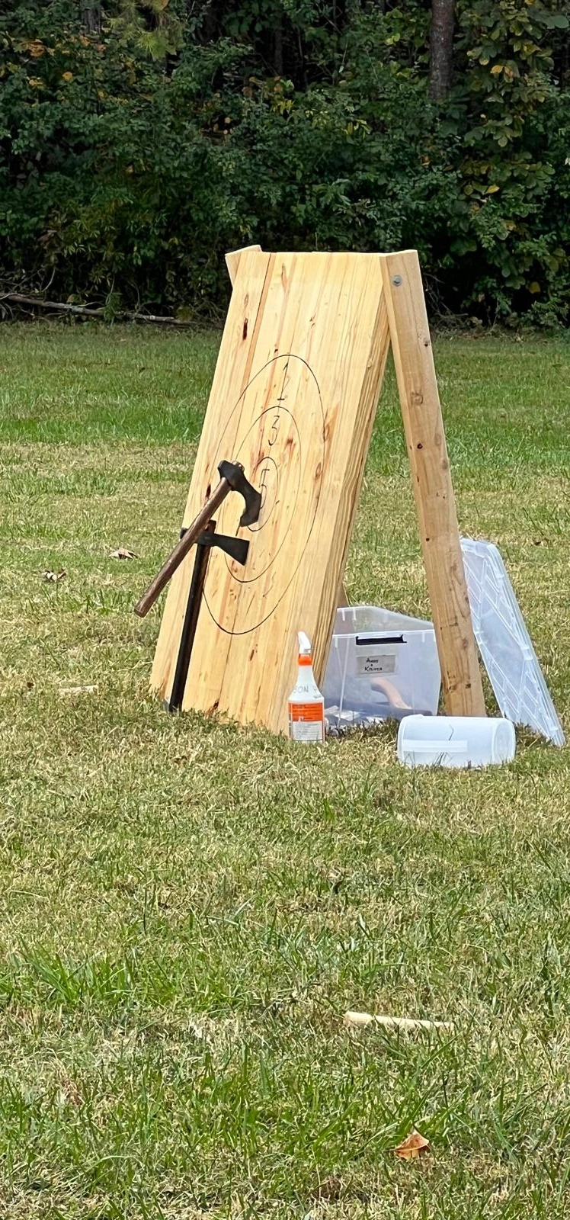

Slide 5
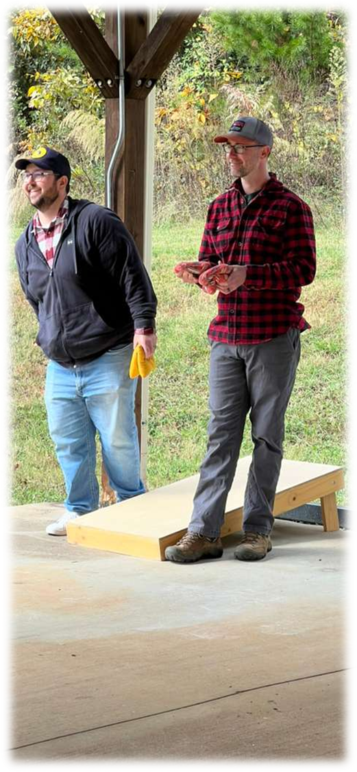
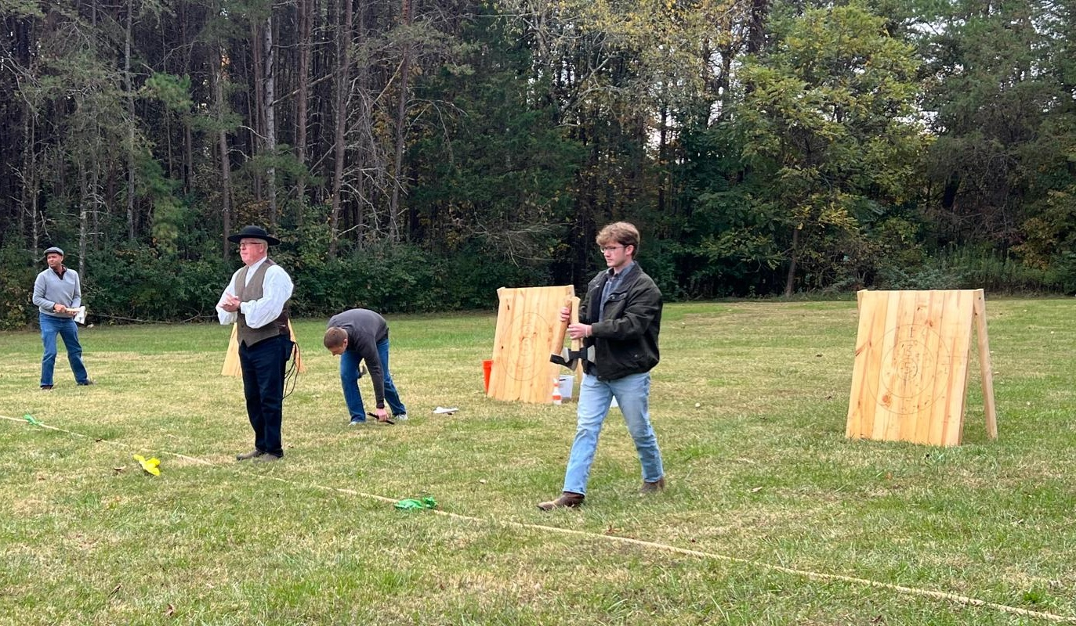

Slide 6
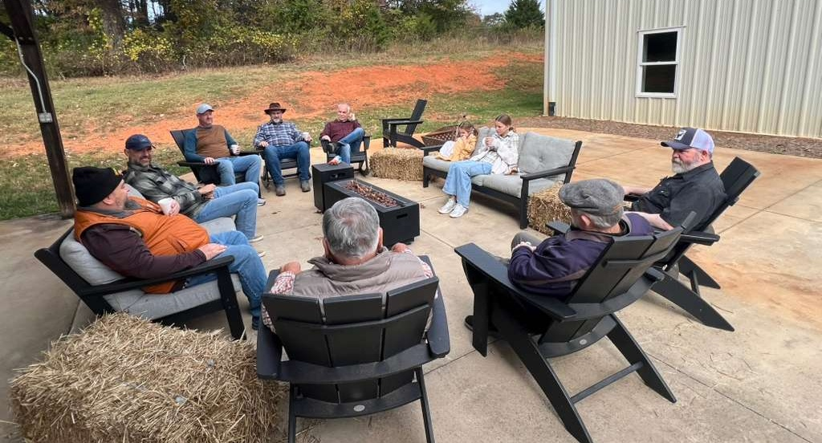

Slide 7
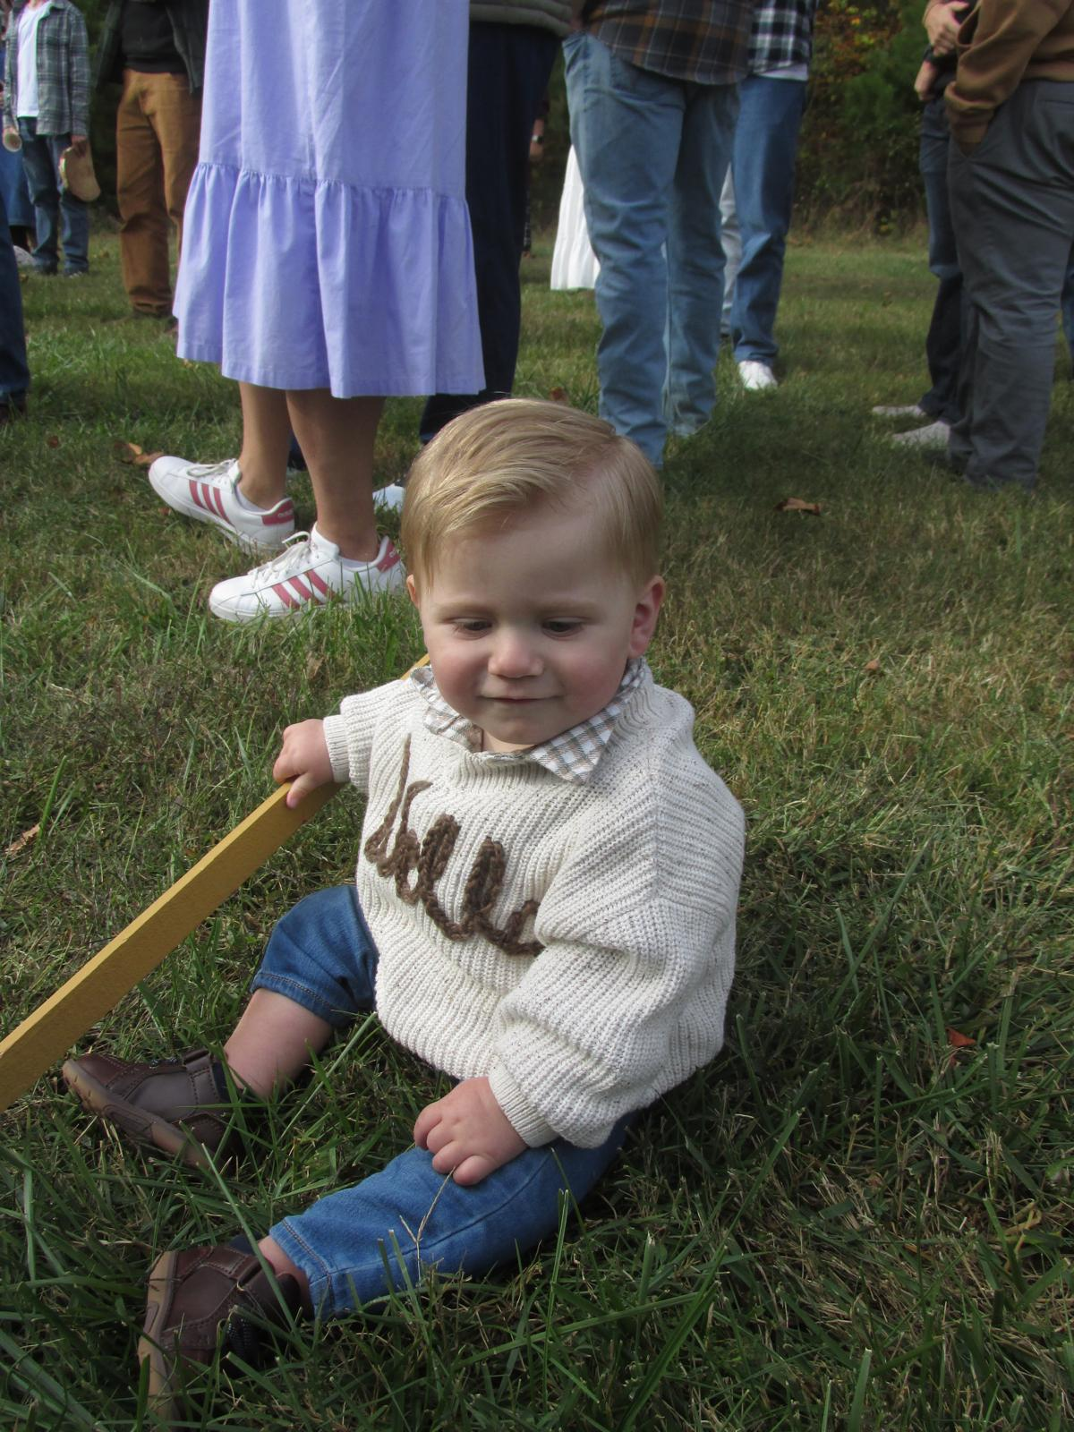
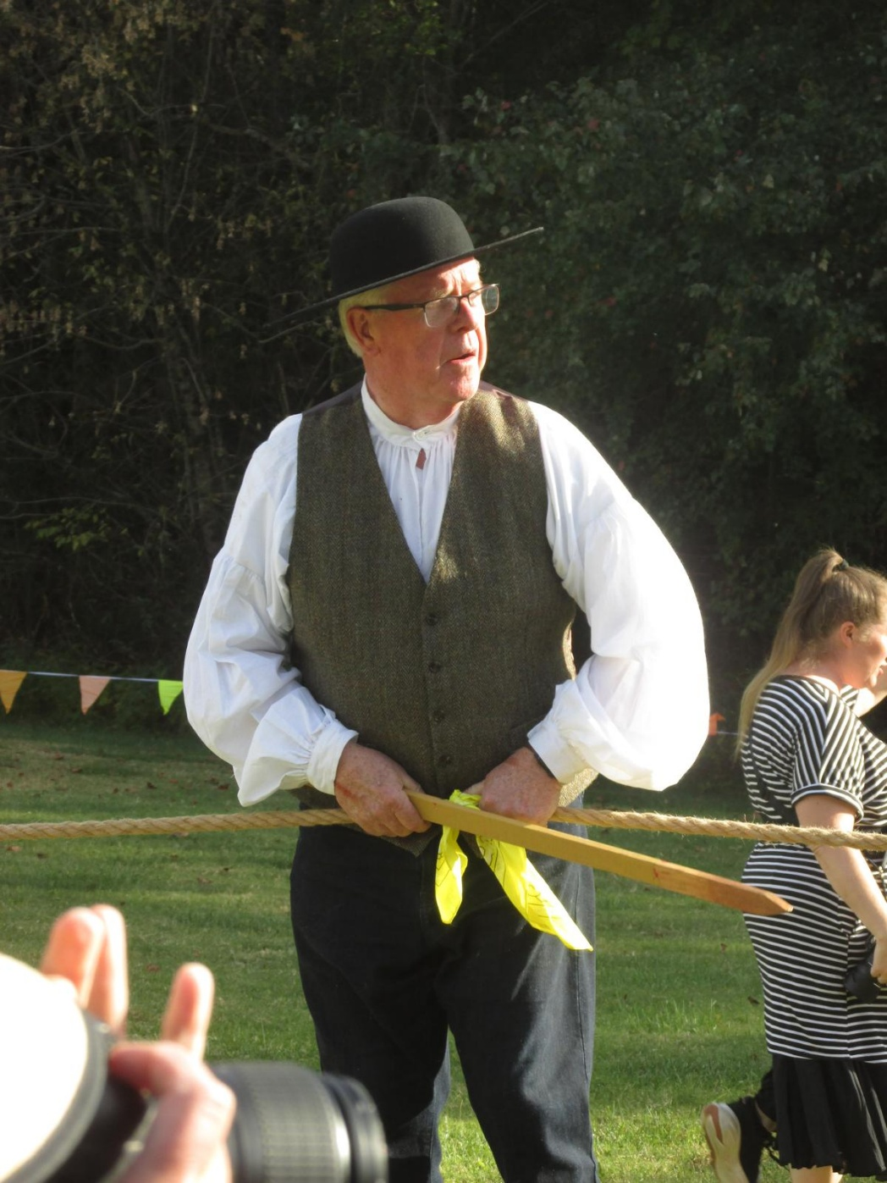

Slide 8
The Better Knowledge Knowledge Shall Increase
COLOSSIANS 1:10
That ye might walk worthy of the Lord unto all pleasing, being fruitful in every good work, and increasing in the knowledge of God;

Slide 9
THE.WORLD.IS.FALLING.APART
61 Every so often the world gets in such a chaotic condition until there is nothing can help it. We've had this several times, these preludes. And we find that each time when it meets this condition, it causes people to start praying. And they feel that everything has played itself out, as all of our systems, everything we have, play itself to the end. It did that in the antediluvian world... Politics and other things just comes to its end... I think all that's done by God, for a purpose, to kind of rejuvenate... And I think it's just a law of God, that these things comes to that place.

Slide 10
INFALLIBLE.PROOF.OF.THE.RESURRECTION
32 The sin question's settled when the Holy Spirit comes into the human heart, casts down reasoning. It goes above our intellectual affair.
Today the reason so many ups-and-downs, there's an intellectual conception of Christ, it's in their mind and not in their heart. They just mentally believe it. And your mental will reason, "Could Divine healing be so?

Slide 11
Could the baptism of the Spirit be so?" Now, that's intellectual reasonings.
But when that comes into the heart, it's a faith. It's a positive. There's no question at all about it. It's all settled forever. It's in your heart. And your heart doesn't reason, because it's the throne, the dwelling place of the Almighty in the heart.
57-0114

Slide 12

Knowledge: (Heb.) da'ath
Perception, skill, discernment,
understanding, and wisdom.
HOSEA 4:6-7
My people are destroyed for lack of knowledge: (discernment, understanding) because thou hast rejected knowledge, I will also reject thee, that thou shalt be no priest to me: seeing thou hast forgotten the law of thy God, I will also forget thy children. 7 As they were increased, so they sinned against me: therefore will I change their glory into shame.

Slide 13
Knowledge (Gr.) epignosis
Acknowledgement of precise and correct knowledge; used of the knowledge of things ethical and divine.
EPHESIANS 1:17
That the God of our Lord Jesus Christ, the Father of glory, may give unto you the spirit of wisdom and revelation in the knowledge of him:
4:13 Till we all come in the unity of the faith, and of the knowledge of the Son of God, unto a perfect man, unto the measure of the stature of the fulness of Christ:

Slide 14
Knowledge vs. Wisdom:
Knowledge is the accumulation of information and facts, while wisdom is the ability to apply that knowledge with good judgment, insight, and experience.
You can have knowledge without wisdom, but wisdom is impossible without some form of knowledge.

Slide 15
II CHRONICLES 1:11
And God said to Solomon, Because this was in thine heart, and thou hast not asked riches, wealth, or honour, nor the life of thine enemies, neither yet hast asked long life; but hast asked wisdom and knowledge for thyself, that thou mayest judge my people, over whom I have made thee king:
Wisdom: chokmah (Heb.)
Skill (in war, in administeration)
Shrewdness, prudence (in religious and ethical affairs).

Slide 16
Knowledge: madda’ (Heb.) 6x
Thought, mind, place of knowledge.
DANIEL 1:17 As for these four children, God gave them knowledge and skill in all learning and wisdom: and Daniel had understanding in all visions and dreams.
ECCLESIASTES 10:20 Curse not the king, no not in thy thought; and curse not the rich in thy bedchamber: for a bird of the air shall carry the voice, and that which hath wings shall tell the matter.

Slide 17
Revelation: (w)
God's disclosure of his own nature and his purpose for mankind, esp. through the words of human spokesmen, prophets.
Something in which such a divine disclosure is contained, such as the Bible.

Slide 18
Prophecy: (Gr.) propheteia
A discourse emanating from divine inspiration declaring the purposes of God, whether:
Reproving and admonishing the wicked, or
Comforting the afflicted, or
Revealing things hidden: foretelling future events. Used in the utterance of future events: prediction of events relating to Christ's kingdom;
An expression of the Divine mind.

Slide 19
THE.REVELATION.OF.JESUS.CHRIST
311 Zechariah, 487 yrs. before Christ: And it shall come to pass in that day, that I will seek to destroy all... nations that come against Jerusalem.... When is the Gospel returning to the Jews? When the day of the Gentile is finished. If I could just foretell you a little something that's fixing to happen here… We're ready for it. Everything is setting in order. This Gentile Message, as the Jews brought it to the Gentiles, the Gentiles will take it right back to the Jews again. And the Rapture will come.
60-1204

Slide 20
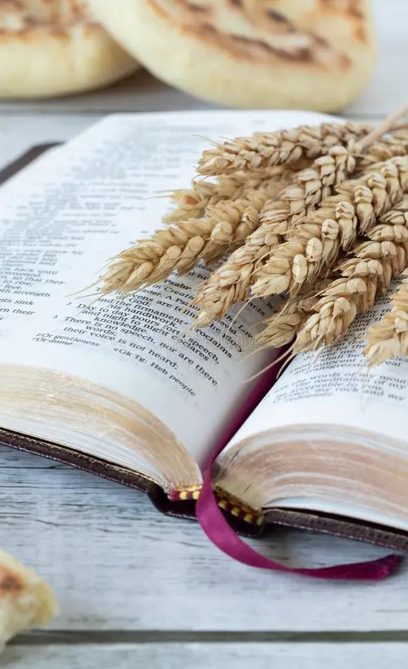
FAITH.IS.THE.SUBSTANCE
15 This day that we're living in, it's such a day of unsettled peace and unrest everywhere. People are running to-and-fro... And it's a day that the prophets spoke of.
…I think real true ministers of the Gospel ought to be up and going, ought to be giving the people the right things: meat in due season. 47-0412

Slide 21
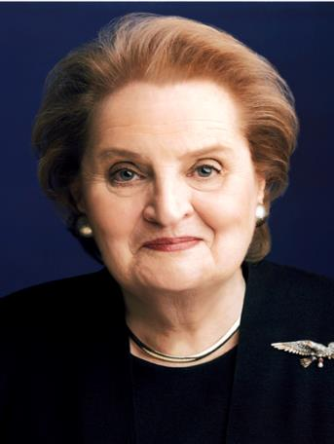
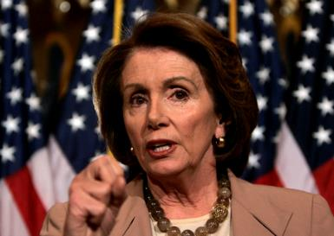
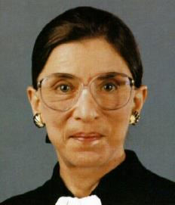
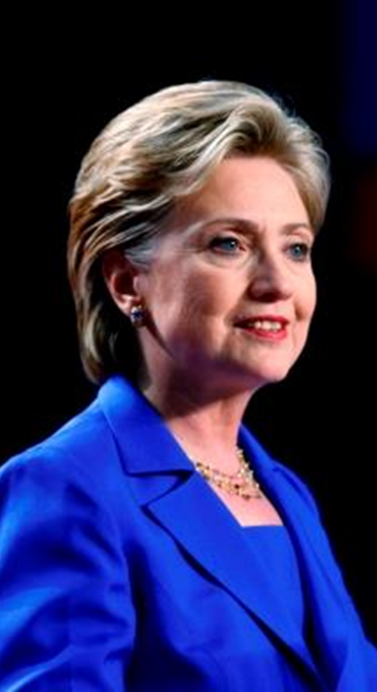
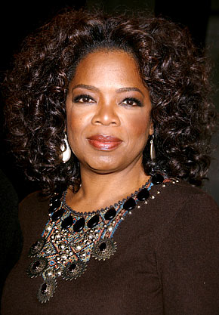
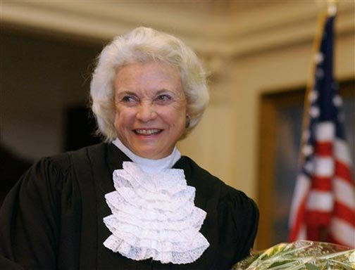
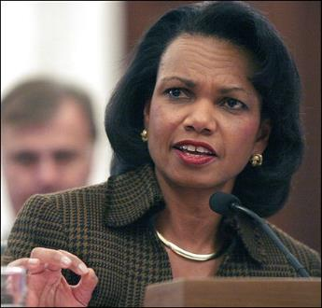
ONCE MORE
….And in this would be a woman stand up that would govern the United States; not actually a woman, but a church….
New York, 1963

Slide 22
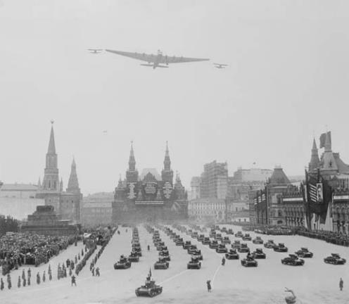
TIME.TESTED.FAITH
I believe we got sputniks in the sky, handwriting on the wall, men's hearts failing for fear, perplexed of times, distress between nations. One extra drink of Vodka, and we could all go to ashes before morning… Not a thing to keep them from doing it.
58-0530

Slide 23
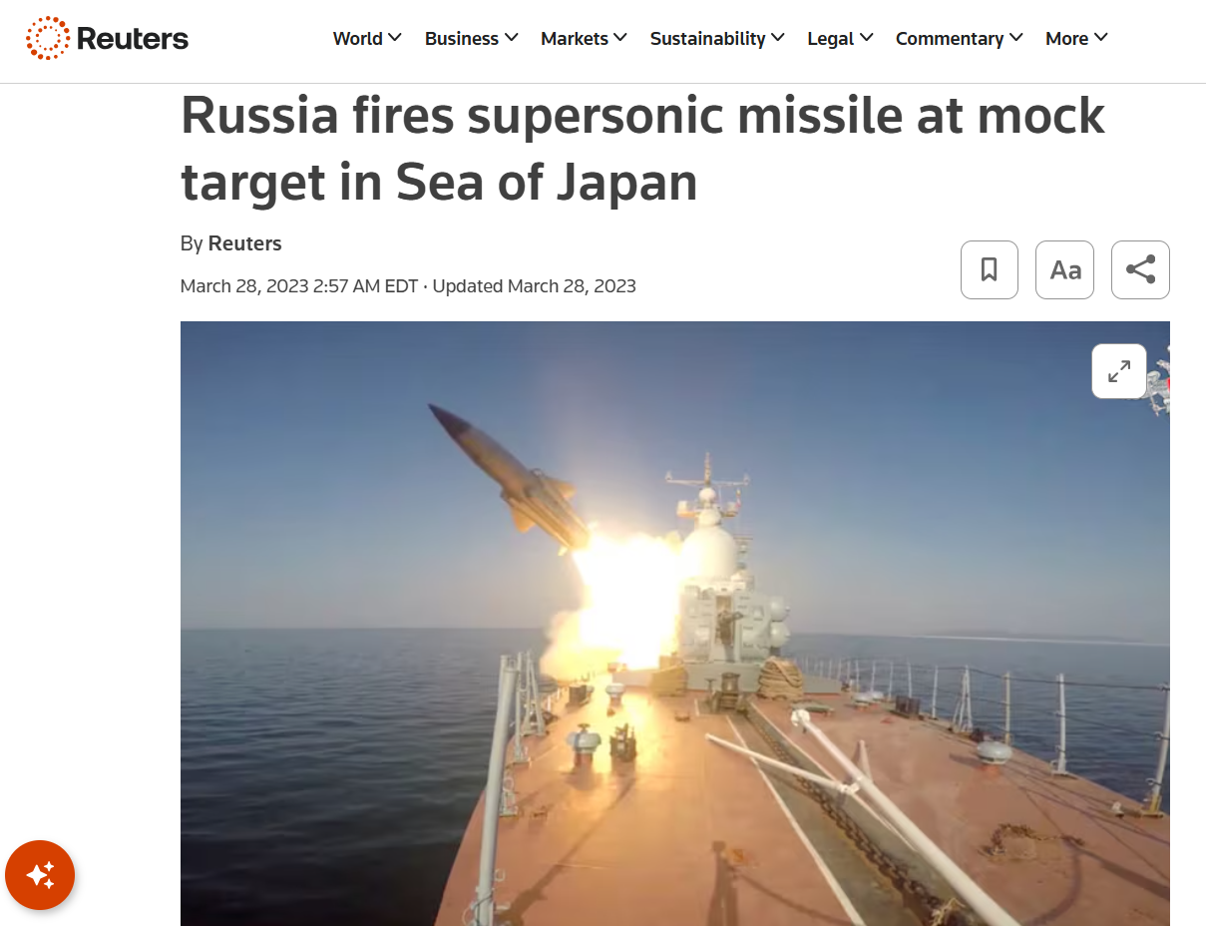

Slide 24
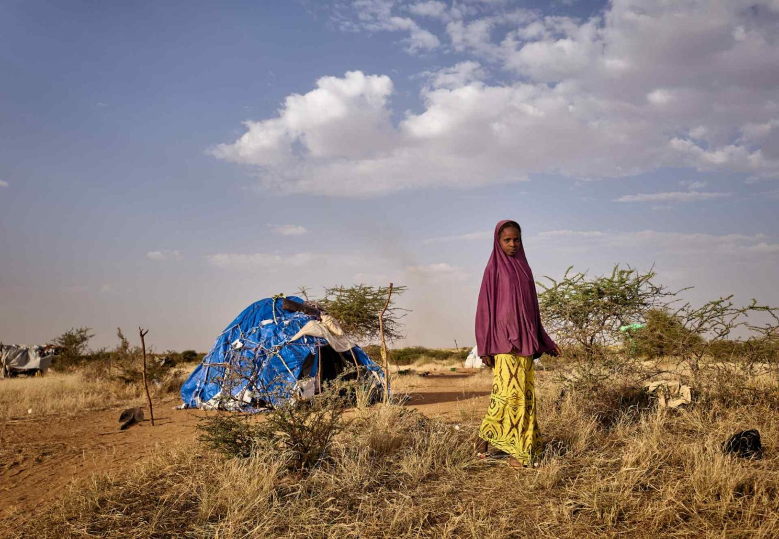
Mali

Slide 25
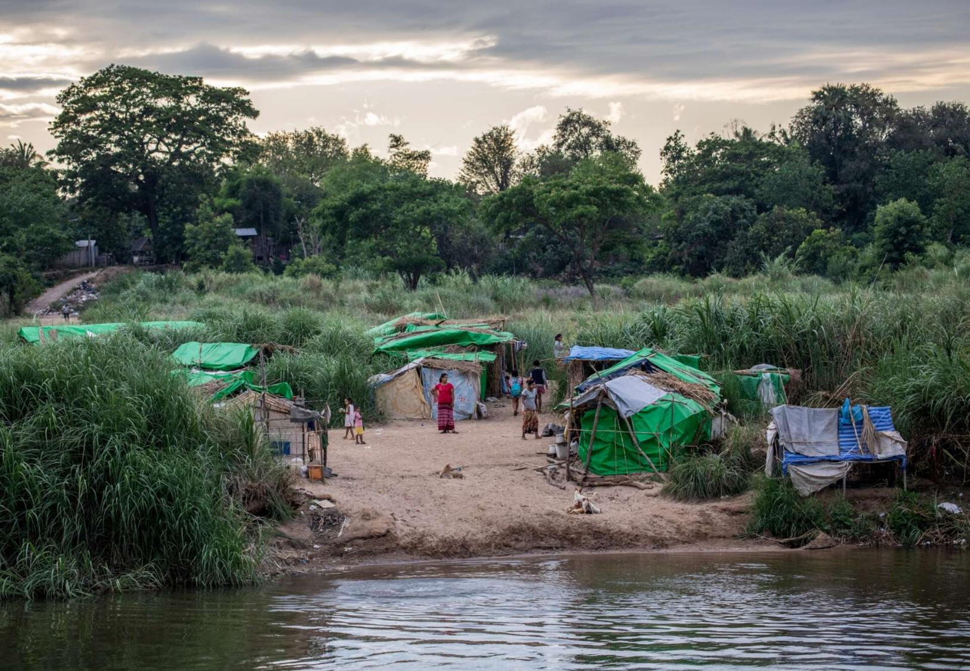
Myanmar

Slide 26
62 …Christ's first advent, we could say the world was falling apart. It was a corruptible time in politics, in religion. The whole systems had become corrupted. They had mingled, injecting man-made theories, religions... And the world was falling apart… God gave them a Messiah, they didn't want it the way He sent it.
64 And I wonder today, in our chaotic time, we find the world about in the same condition; morally decayed, politics, religious life, denominationalism, everything corrupted. All of us are looking for something to help us out of it, expecting a messiah. I wonder, if God sent us the Messiah, if we wouldn't just about do the same thing they done in the past. We wouldn't know Him, Who He was. 63-1115

Slide 27
In the Lifetime of a Prophet
Israel at the UN
WCC- Amsterdam
NATO Formed
1930
1940
1950
1960
7 Seals
7 Ages
Pillar of Fire Appears
Angel in Cave
America Spurns Mercy
Millennium

Slide 28
“So likewise ye, when ye see these things come to pass, know ye that the kingdom of God is at hand.” Luke 21:31
3/63
“Seals Revealed”
7 Thunders Sound
2nd Pull Ends
3rd Pull Begins
Rapture Cycle Begins
Church age Ceases
Laodicea into Chaos
Translation (Bride)
Tribulation Begins
144,000 Sealed
Armageddon
7th Trumpet:Israel
3.5 Years End
Millennium
Gog & Magog
White Throne
New Heaven & Earth
12/62
“Sirs?”
01/63
“Sword”
2/63
“Angels & Cloud”
1963
7th Trumpet to Israel

Slide 29
Time Line
“So likewise ye, when ye see these things come to pass, know ye that the kingdom of God is at hand.”
Luke 21:31
New Heavens
Flood
Calvary
Millennium
Creation
2,000
2,000
2,000
1,000

Slide 30
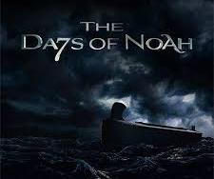
1. Immorality THE.FLASHING.RED.LIGHT
191 The infallible Voice of Jesus Christ warned us to watch the days of Noah and compare it with the day we live. When we seen those things happen, women becoming fair, and sons of God taking them, then we know that generation would see the Coming of the Lord. Then, we know the flashing light, His coming is near.
63-0623

Slide 31
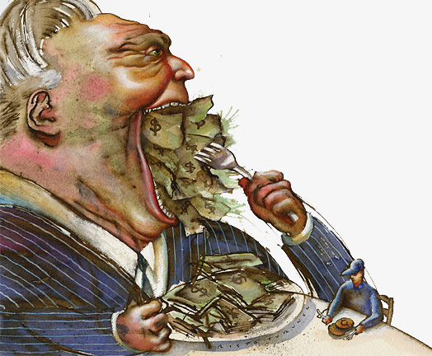
2. Greed
Financial Realities In a Declining America
“An imbalance between rich and poor is the oldest and most fatal ailments of all republics.”
Plutarch

Slide 32
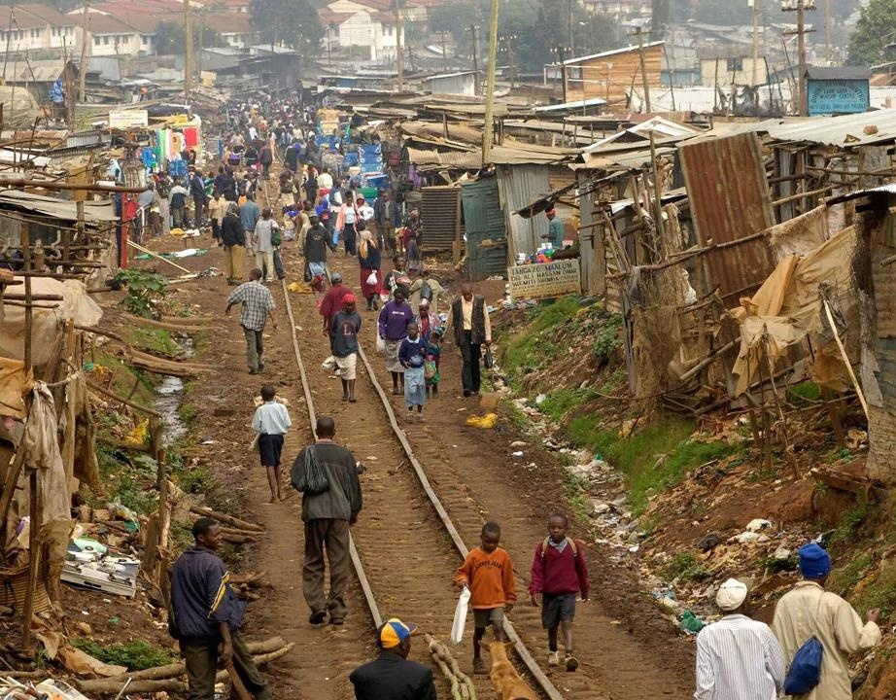
THE.TRUE.EASTER.SEAL
84 We find greed in church, politics, and national affairs… Because of greed, look what's happened down there in Africa; not only there, but all over the world... this is all they have on earth. If this was all I had, I'd be a miser-able person. I'm looking for a City whose Builder and Maker is God. There's where we lay our treasures up, for that purpose.
61-0402

Slide 33
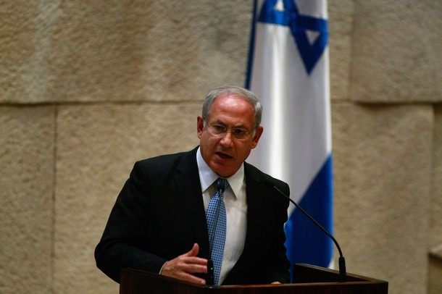
“We are not susceptible to pressure. We will do what is right….
“….a peace in which Israel is brought under attack is not a true peace.”
“Jerusalem belongs to the Jewish people and will remain under Israeli sovereignty for eternity.”
Likud Chairman
Benjamin Netanyahu

Slide 34
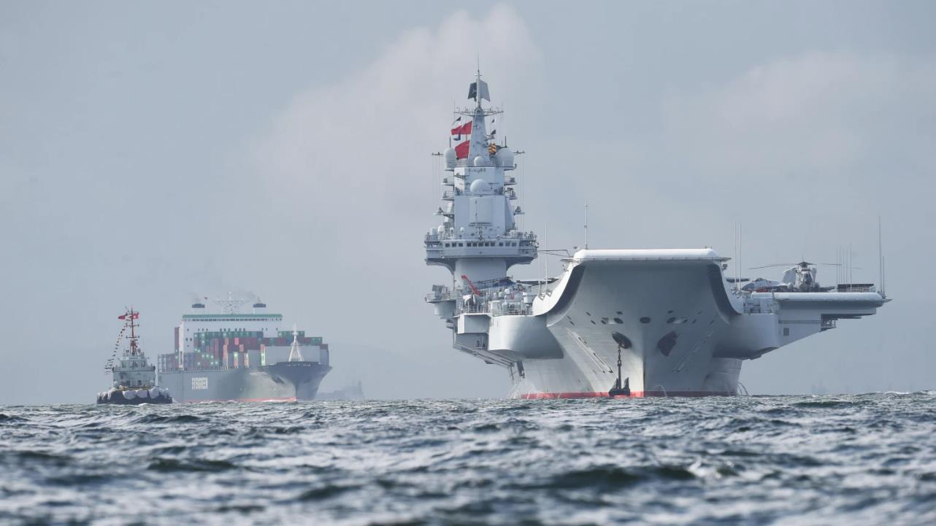
Is China
A Real Threat?

Slide 35
A Pentagon report said: “The PRC has the largest navy in the world, with an overall battle force of approx. 350 ships and submarines… China is increasingly looking to expand its naval operations ‘beyond China’s immediate region’, a move the US says… furthers the PRC’s growing global military posture’.
https://www.naval-technology.com/features/china-boasts-worlds-largest-navy-us-dod-report/

Slide 36
THE.JUNCTION.TIME
31 Now, the prophets prophesied of things. They didn't know what they were talking about. They just said them. They didn't understand. Daniel said he couldn't understand, but he just wrote it out, because it wasn't for his day. The Angel told him to close up the book until the end time. Many would run to and fro, and knowledge increase… He didn't understand it.
56-0122

Slide 37

DANIEL 12:1-13
And at that time shall Michael stand up, the great prince which standeth for the children of thy people: and there shall be a time of trouble, such as never was since there was a nation even to that same time: and at that time thy people shall be delivered, every one that shall be found written in the book.
4 But thou, O Daniel, shut up the words, and seal the book, even to the time of the end: many shall run to and fro, and knowledge shall be increased.

Slide 38
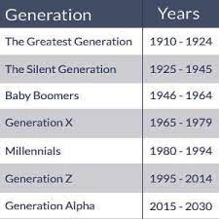
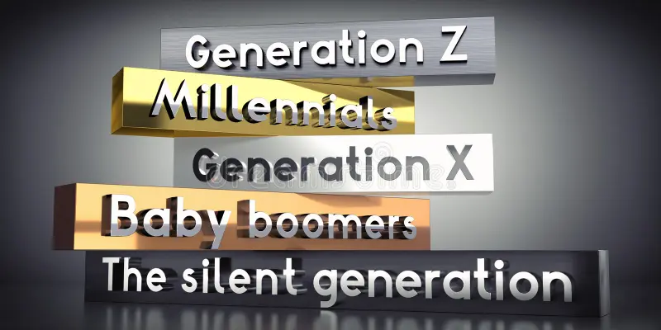

Slide 39
*GIFTS &CALLINGS.ARE.WITHOUT.REPENTANCE
Now, the Spirit of Christ is in the Church. It has never left the Church... And the days are growing evil, because that knowledge, man's knowledge, that he received in the garden of Eden... When he left the Tree of Life to eat from the tree of knowledge, that knowledge is increasing constantly.
And as knowledge increases, they get away from the Bible and get into a theory. 50-0300

Slide 40
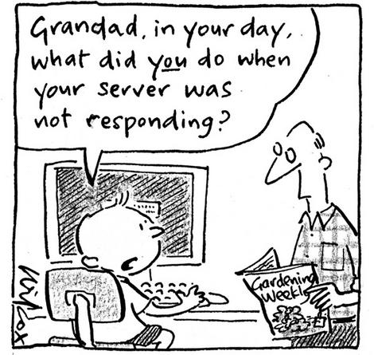

Slide 41

Gen Y Approach to Car Buying

Slide 42
Gen Y Approach to Everything Else

Slide 43
I.WAS.NOT.DISOBEDIENT.TO.THE
HEAVENLY.VISION 49-0718
… Father, Who brought again the Lord Jesus to Life, though all the world seems to be so modernistic, they're going to knowledge instead of just a simple faith in God. We realize in Eden when they tasted the tree of knowledge, they broke off relationship with the Tree of Life. Since then man has went after knowledge and destroys himself every time he bites from the tree: gun powder, cars, and an atomic bomb. Knowledge, knowledge... Truly the prophet Daniel said, "They'll run to and fro, and knowledge shall increase."

Slide 44
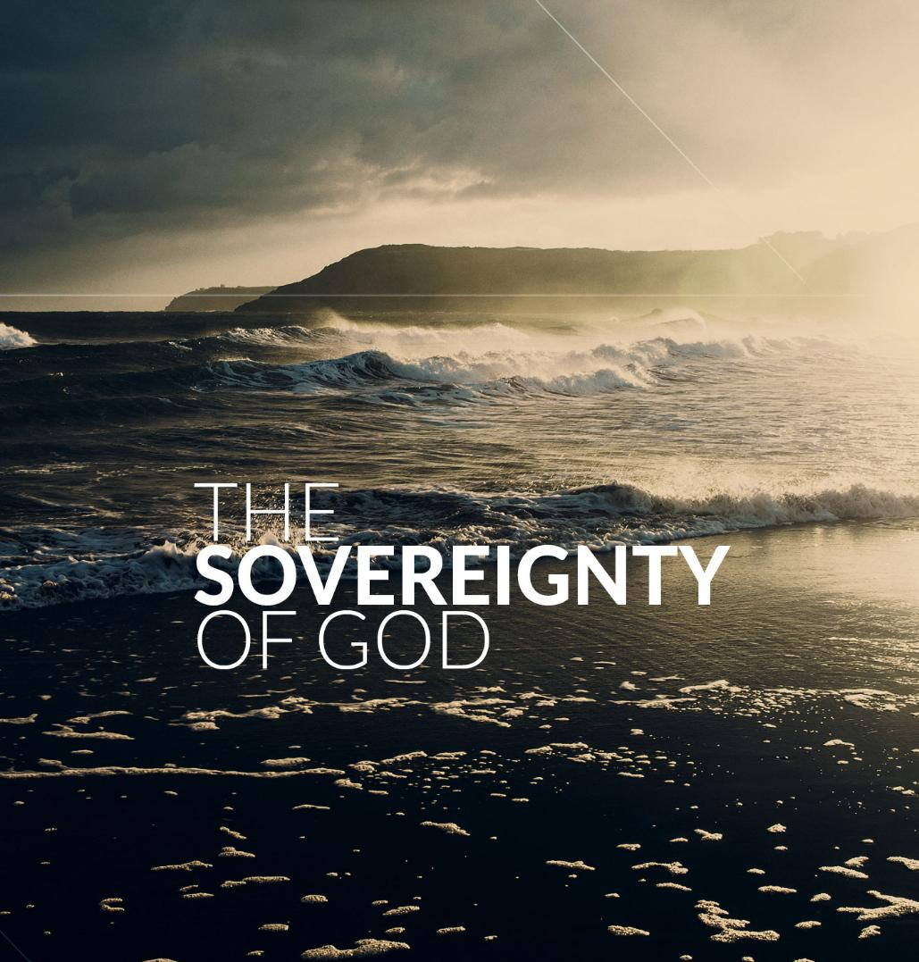
JOB 23:13-14
But he is in one mind, and who can turn him? and what his soul desireth, even that he doeth. 14 For he performeth the thing that is appointed for me: and many such things are with him.

Slide 45
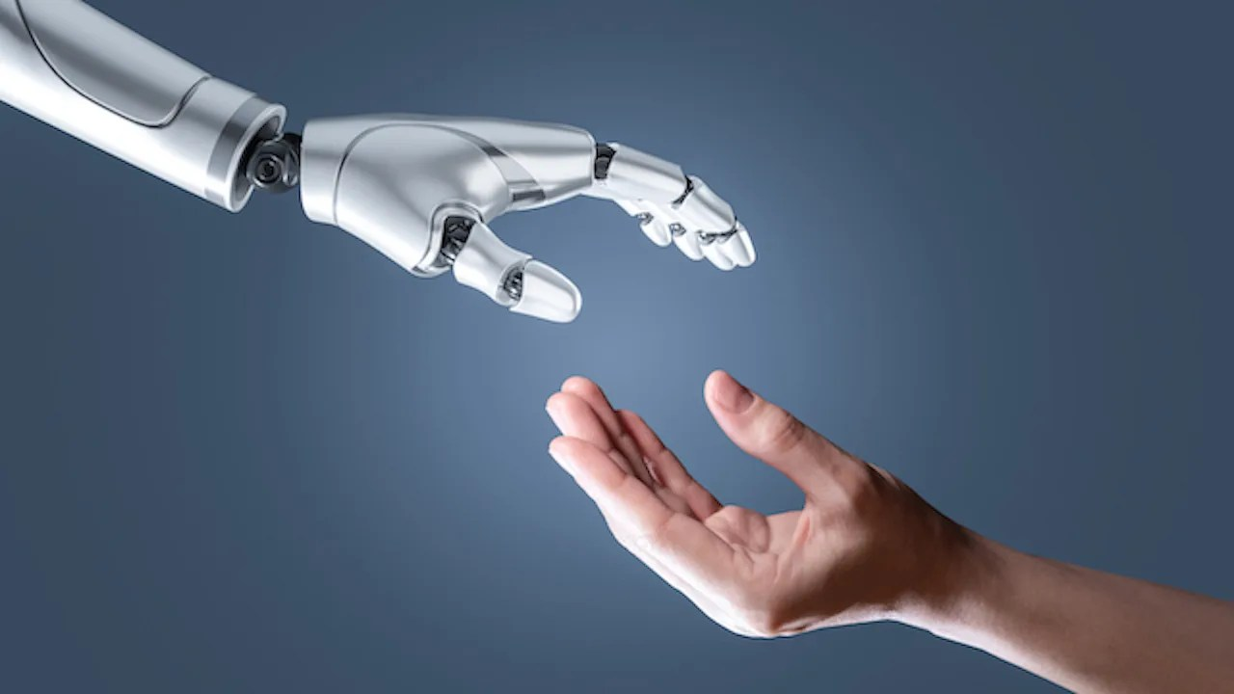
As AI Spreads, Experts Predict the Best and Worst Changes in Digital Life by 2035
“They have deep
concerns about people’s and society’s overall well-being. But they also expect great benefits in health care, scientific advances and education.”

Slide 46
The Future Harms To Human Knowledge
They fear that the best of knowledge will be lost or neglected in a sea of mis- and disinformation, that the institutions previously dedicated to informing the public will be further decimated, that basic facts will be drowned out in a sea of entertaining distractions, bald-faced lies and targeted manipulation. In addition, they argued that “reality itself is under siege” as emerging digital tools convincingly create deceptive or alternate realities.

Slide 47
“Superintelligence and godhood are not the end products of the History of human ingenuity. If there is a God who created and Upholds the universe and who made us in His image, then a superintelligence, God himself, has always existed. He is not an end Product. He is the producer.
John Lennox “2084”

Slide 48
THE.FALLING.APART.OF.THE.WORLD
196 “…We receive a Kingdom that cannot be moved." The world is falling apart. Every politician, denomination and church will fall to pieces, but we receive a Kingdom that cannot be moved… God made it fragile so it would break. We got a Kingdom that's solid now… Not a political system, church system, denominational system; it all becomes Pharisees and doctors of the Devil.
62-1216

Slide 49
THE.GOD.OF.THIS.EVIL.AGE
54 And the world seems to be in the more evil age that ever was. Never in any age did women ever act like that, but just before the destruction of the antediluvian world.
55 Has God lost control, or is He just permitting another agency to control? I wonder. The true answer to this question is, to my opinion, there is two opposing spirits in the world today, at work. Now, there can't be no more than two... And One of them is the Holy Spirit at work; the other is the spirit of the devil in deception. 65-0801

Slide 50
AN.ABSOLUTE
80 There's got to be somewhere that some-body's word is final. There's got to be something that's final… somebody who can say, "It's sin," or, "It's not sin." I'm glad for an absolute. No arguing, no need of arguing. The umpire said, "strike," that's what it is; mark it up in your mind, "it's a strike," and go on. When God says anything, that's the way it is!
63-1201

Slide 51
IS.THIS.THE.SIGN.OF.THE.END.SIR
53-2 Every one of you, cleanse your heart. Lay aside every weight. Don't let nothing bother you. Don't be scared. There's nothing to be scared about. If Jesus is coming, it's a moment the whole world has groaned and cried for. If it's something breaking forth now, a new gift or something, it'll be wonderful. If it's coming time that the revelation of the seven thunders will be revealed to the church, how to go, I don't know.
62-1230

Slide 52
DEUTERONOMY 5:32
Ye shall observe to do therefore as the LORD your God hath commanded you: ye shall not turn aside to the right hand or to the left. 33 Ye shall walk in all the ways which the LORD your God hath commanded you, that ye may live, and that it may be well with you, and that ye may prolong your days in the land which ye shall possess.
32 So Moses told the people, “You must be careful to obey all the commands of the Lord your God, following his instructions in every detail. 33 Stay on the path that the Lord your God has commanded you to follow. Then you will live long and prosperous lives in the land you are about to enter and occupy. (NLT)

Slide 53
REDEMPTION.BY.JUDGMENT
33 We're on the road. If this earthly tabernacle is gone, we got one already waiting yonder. There's nothing to be scared about. Yes sir, everything belongs to us, because Christ has redeemed it all to us through Him…
There's nothing to worry about, nothing to be scared about. Say, "Who's going to be President?" We'll have a depression. That doesn't matter to me. Only thing I know, God has spoke and said He's going to take me through, so I just took His hand, took His Word. When we get to Kadesh-barnea, we just believe God's Word and move on.
54-1114

Slide 54
“…let us watch and be sober”
1 Thessalonians 5:6

