Slide 1

Knowledge Shall Increase 3 The Golden Age
James 1:17-25
Every good gift and every perfect gift is from above, and cometh down from the Father of lights, with whom is no variableness, neither shadow of turning. 18 Of his own will begat he us with the word of truth, that we should be a kind of firstfruits of his creatures.

Slide 2
Birthdays & Anniversaries
Nov. 10th Chris and Cassia Clayville
Nov. 11th Ayden Stevens
Nov. 12th Kingston Kiser, Bill Walters
Nov. 13th Julia Clayville, Jeremy Botha
Nov. 14th Josiah Mayl
Dec. 13th Church Dinner

Slide 3
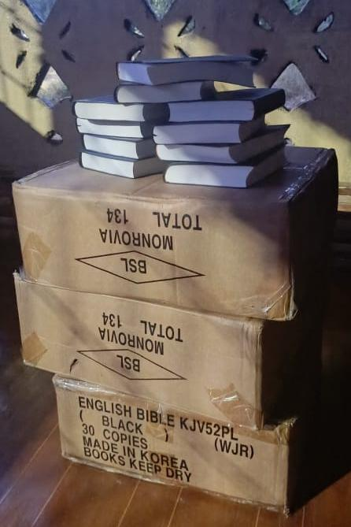
Monrovia, Liberia

Slide 4
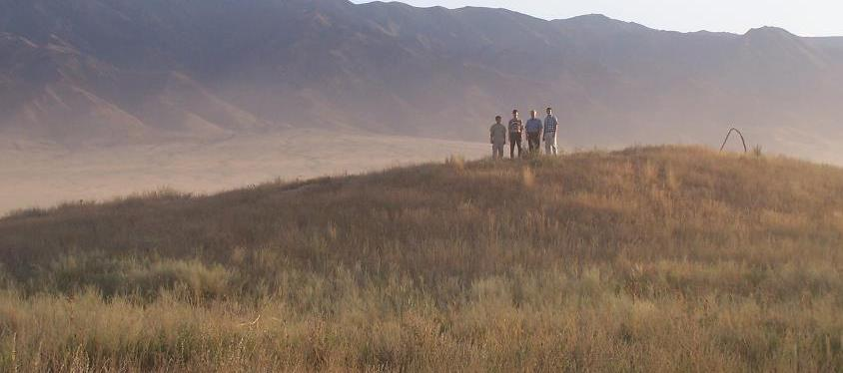
Kazakhstan
July 2005

Slide 5
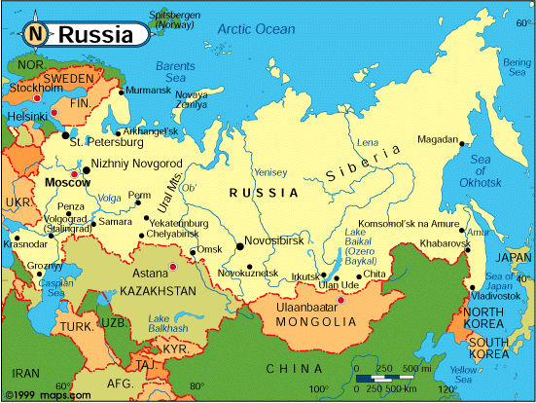

Slide 6
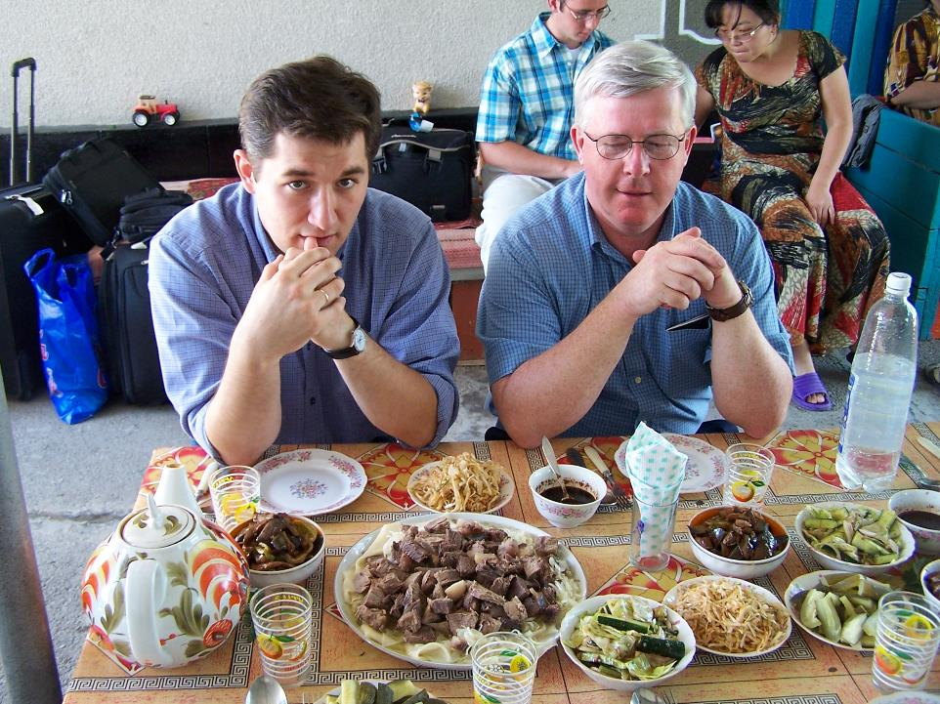

Slide 7
I TIMOTHY 4:12-16
Let no man despise thy youth; but be thou an example of the believers, in word, in conversation, in charity, in spirit, in faith, in purity. 13 Till I come, give attendance to reading, to exhortation, to doctrine. 14 Neglect not the gift that is in thee, which was given thee by prophecy, with the laying on of the hands of the presbytery. 15 Meditate upon these things; give thyself wholly to them; that thy profiting may appear to all. 16 Take heed unto thyself, and unto the doctrine; continue in them: for in doing this thou shalt both save thyself, and them that hear thee.

Slide 8
Knowledge Shall Increase 3 The Golden Age
James 1:17-25
Every good gift and every perfect gift is from above, and cometh down from the Father of lights, with whom is no variableness, neither shadow of turning. 18 Of his own will begat he us with the word of truth, that we should be a kind of firstfruits of his creatures.

Slide 9
HEALING.AND.WHAT.SICKNESS.IS 50-0808
3 And it does not yet appear what we shall be… for we shall see Him as He is, free from sickness, free from pain. God, that glorious day of redemption is coming; for all nature is groaning for that day.
Now, we're on the very threshold of the door to break forth into that great golden age that all the prophets has spoke of. Signs and wonders has been wrought by Thy servants throughout the land to turn the people back to a knowledge of the Presence of Jehovah God in our midst.

Slide 10
THE.THIRD.EXODUS
44 Heavenly Father, we by faith look towards the future. As it was in Germany, Russia, Italy, the people raised up Hitler and Stalin, Mussolini, who hated the Jew. God, You got ways of doing things, that we don't understand…
They were sent back to their homeland to fulfill the Word. Oh, the loving hand of God! Sometimes, it looks cruel, the way people suffer, still it's the tender hand of Jehovah, leading His little children… It's only the tender hand of Jehovah, leading them to the Tree of Life. 63-0630

Slide 11
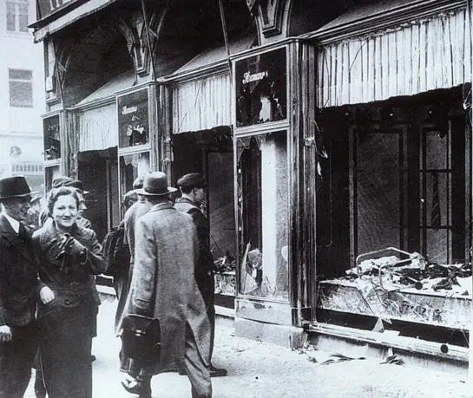
Kristallnacht, also known as the "Night of Broken Glass" was a series of organized, govern-ment-sanctioned violent attacks against Jewish people, homes, businesses, and synagogues throughout Nazi Germany on November 9-10, 1938. This event is considered a critical turning point and a prelude to the Holocaust.

Slide 12
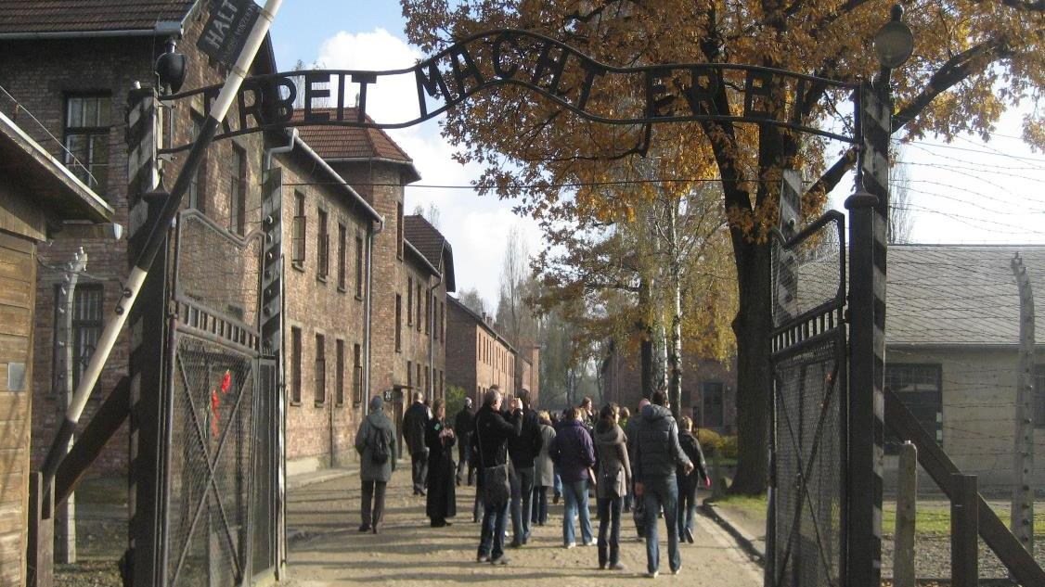
ISAIAH 56:5
Even unto them will I give in mine house and within my walls a place and a name better than of sons and of daughters: I will give them an everlasting name, that shall not be cut off.
Auschwitz, Poland 2012

Slide 13
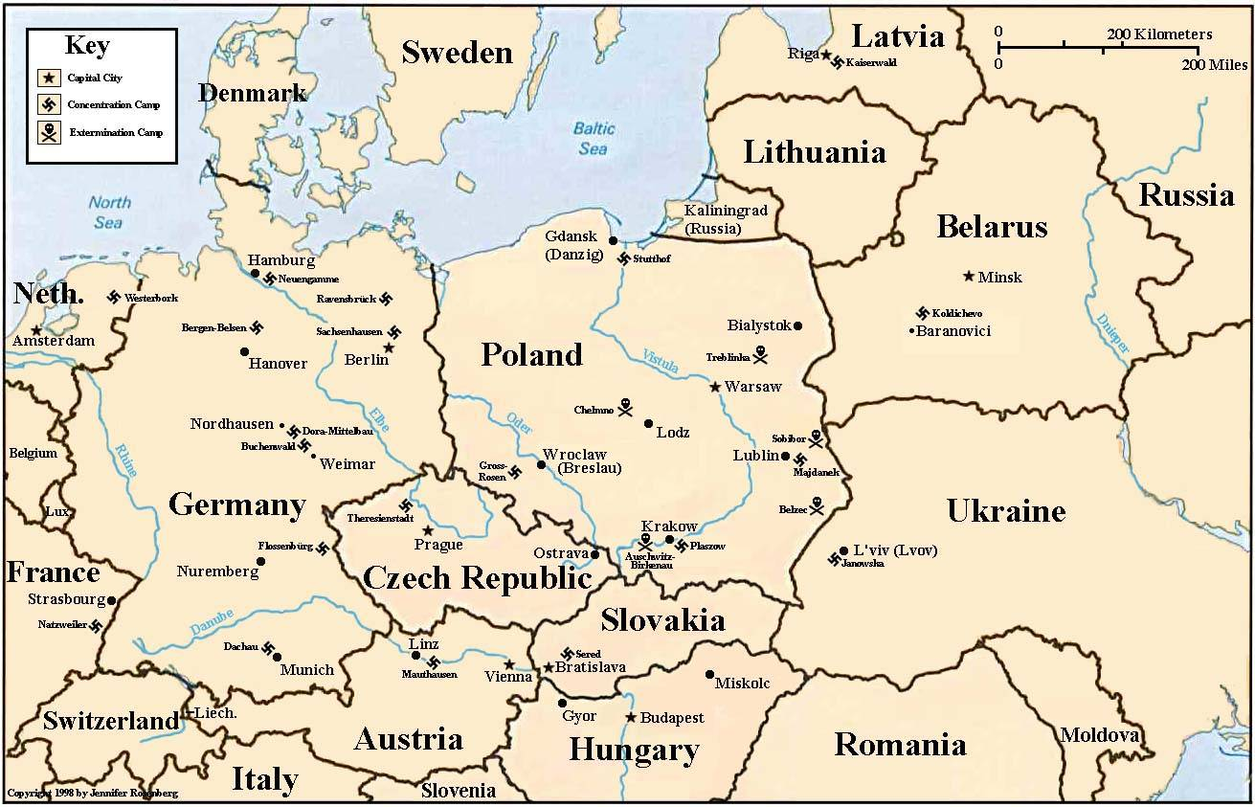

Slide 14
THE.QUEEN.OF.SHEBA
29 When God sends a gift to the people and they'll recognize it, it's always a golden age. But when they refuse it, there's nothing left but a chaos for that generation.
Now, listen closely. If God had sent the Holy Spirit in this age for a sign, and we reject It, there's nothing left but a destruction.
60-0110

Slide 15
THE.QUEEN.OF.THE.SOUTH
16 In the great, golden age of Israel, God had gifted a man by the name of Solomon… He prayed God to give him wisdom to lead the people. And when a gift is given to the church, and the church refuses to hear that gift, then the gift becomes of none effect. But when the gift is given to the church, and the church receives it, then it's a golden age for that church. Israel was living in its golden age under Solomon. All Israel glorified God because of this marvelous gift. It was perfectly operating… It was a real gift from God.
57-0614

Slide 16
THE.QUEEN.OF.THE.SOUTH
In all ages when God sends a gift to the people, and they refuse it, it only makes the people go into chaos. But when the people believes and accepts what God sent them, it is a golden age for that people. What He said in His own ministry, "How oft would I have hovered you... But you would not." They didn't know their day. And I'm just wondering if we as America know our day of visitation. 58-0208

Slide 17
INVISIBLE.UNION.OF.THE.BRIDE.OF.CHRIST
32 If I would have had a say-so before the foundation of the world, God laid out the whole program to me, "I want you to preach, what age do you desire?" I would have chose this age, I think this is the golden age.
33 I certainly would have loved to have been here during the time of His visit to earth. Still, I think this right now is a greater time, because… He's coming to take the people He's redeemed, near the resurrection when all the redeemed will come forth. What a glorious opportunity we have, to speak to a dying people, great time! 65-1125

Slide 18
Example: MAKE.THE.VALLEY.FULL.OF.DITCHES
3 A lady in my church... Mrs. Weber, dying with TB, in the sanatorium, last stages. They sent her home to die: said there's nothing could be done. She lived just beyond the Tabernacle, she had five or six children.
So the Angel of the Lord come to me that night and said, "Go, tell Mr. Webber to get things ready; for he's going to be left with those children on his hands; for his wife's going." Well, I went and told Mr. Webber.

Slide 19
4 Two days after that, some ladies from the govern-ment depot there, where she worked, come in. Mrs. Webber said, "If I could only have Bro. Bill to pray for me once more, I seen when my cousin Opal was healed with cancer, and the doctor just give her 'till morning to live.”
The girls from out at the government said, "There ain't nothing to that guy. He isn't nothing but a hypocrite."

Slide 20
And Miss Webber said, "Look, I'm a dying. And I know that, but I just won't stand still for that. I know better than that. I lived right here around this city, around that man all the time. I seen him from a child, growed up. You can call it fake if you want to, but I've seen it and seen God heal the people. I know the man's life and I know it's the truth.“
And it happened to be the Angel of the Lord heard that.

Slide 21
5 And that very night, setting on the side of my chair, I seen Him walking through the door. "Tomorrow (Sunday), they're going to pick Miss Webber up, bring her down. She'll be setting on the right hand side in the Tabernacle. I heard her, and tell her I heard her, what she said. And tell her, THUS SAITH THE LORD, she'll live and not die."
His Presence was there when she was taking up for what was right. His Presence was there, and He found her.

Slide 22
So, He come and told me what she had said to these women, and He had respect to her because she had respect unto what was representing God. So God will do the same thing for you. Not to respect to me, but to respect to Him, to Christ, the One Who died for your healing. If you'll just give respects to Him and His Word, God will do the work for you. Amen.
53-0609E

Slide 23
II Cor. 1:19-20
For the Son of God, Jesus Christ, who was preached among you by us, even by me and Silvanus and Timotheus, was not yea and nay, but in him was yea. 20 For all the promises of God in him are yea, and in him Amen, unto the glory of God by us.
“Not to respect to me, but to respect to Him, to Christ, the One Who died for your healing. If you'll just give respects to Him and His Word, God will do the work for you. Amen.”

Slide 24
(NLT) Do you think I make my plans carelessly? Do you think I am like people of the world who say “Yes” when they really mean “No”? ¹⁸ As surely as God is faithful, our word to you does not waver between “Yes” and “No.” ¹⁹ For Jesus Christ, the Son of God, does not waver between “Yes” and “No.”
He is the one whom Silas, Timothy, and I preached to you, and as God’s ultimate “Yes,” he always does what he says. ²⁰ For all of God’s promises have been fulfilled in Christ with a resounding “Yes!” And through Christ, our “Amen” (which means “Yes”) ascends to God for his glory.

Slide 25

12:1-13 …and there shall be a time of trouble, such as never was since there was a nation even to that same time: and at that time thy people shall be delivered, every one that shall be found written in the book.
4 But thou, O Daniel, shut up the words, and seal the book, even to the time of the end: many shall run to and fro, and knowledge shall be increased.

Slide 26
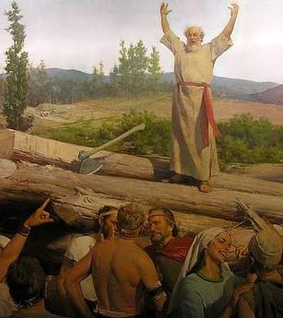
GENESIS 6:5
And GOD saw that the wickedness of man was great in the earth, and that every imagination of the thoughts of his heart was only evil continually…

Slide 27
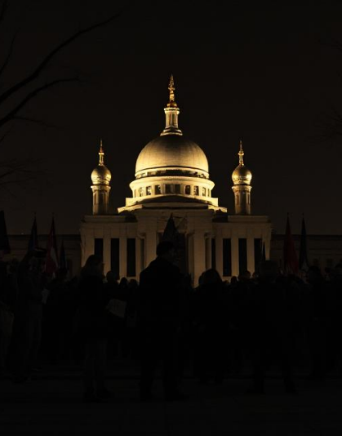
Secularism: A system of political or social philosophy that rejects all forms of religious faith and worship.
The view that public education and other matters of civil policy should be conducted without the introduction of a religious element.

Slide 28
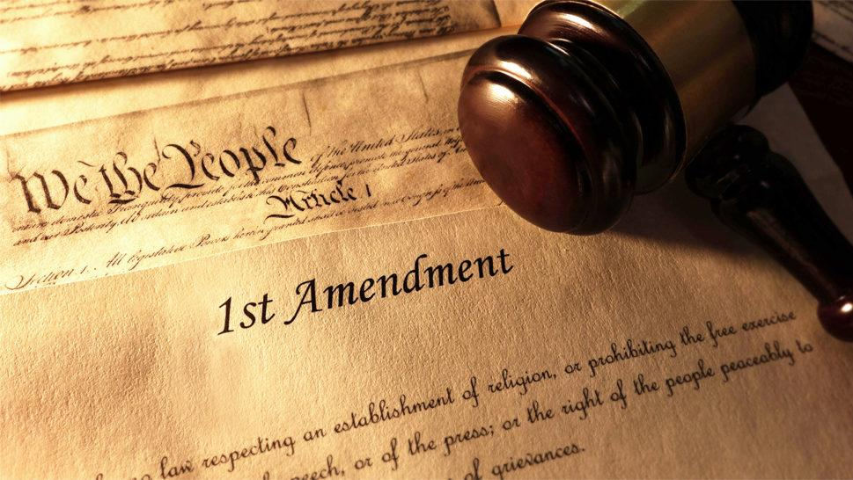
First Amendment
Congress shall make no law respecting an establishment of religion, or prohibiting the free exercise thereof; or abridging the freedom of speech, or of the press; or the right of the people peaceably to assemble, and to petition the Government for a redress of grievances.

Slide 29
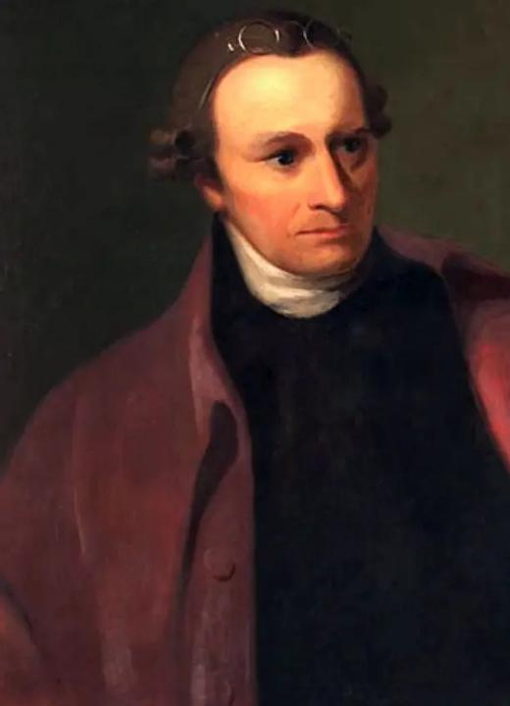
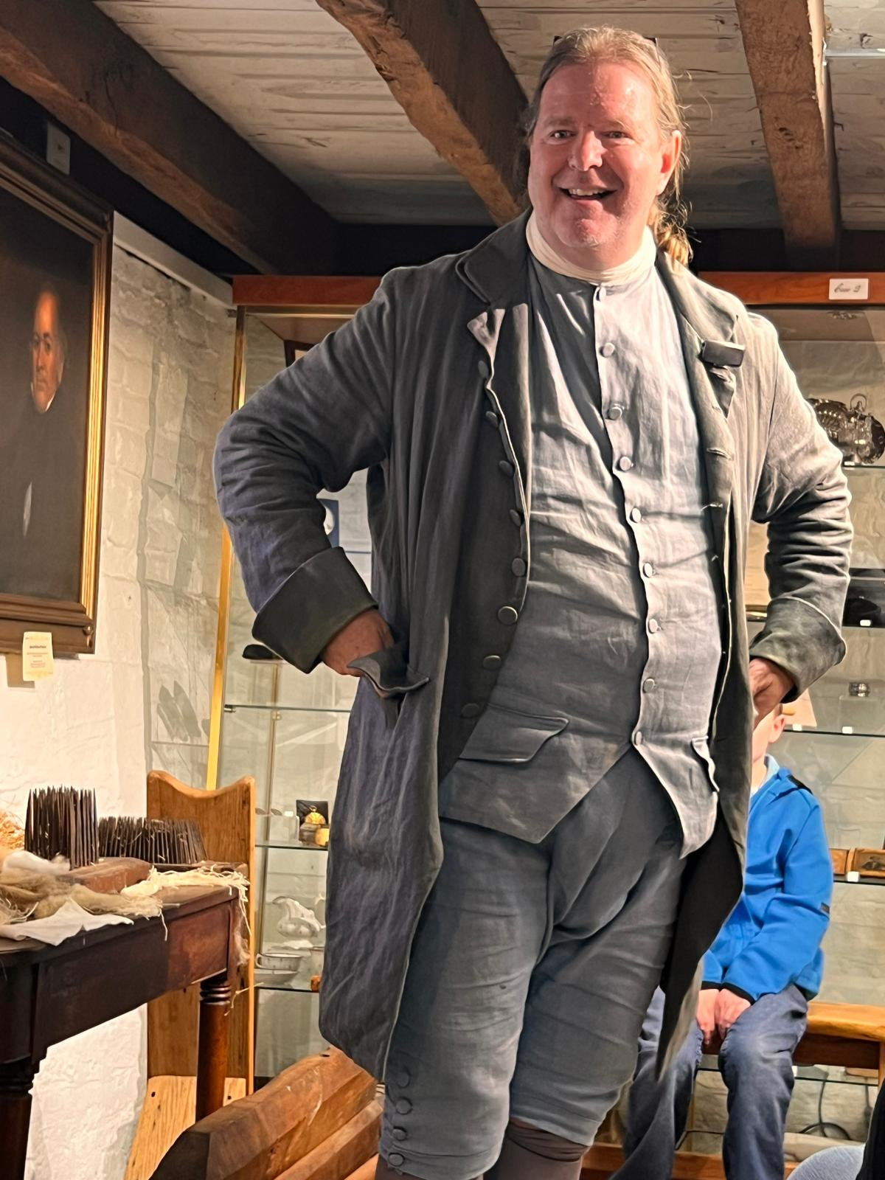
Ultimately, Henry wanted the Constitution to expressly limit the new government's power from the outset, not rely on later promises of amendments, which he felt might never be even passed. His persistent opposition was instrumental in forcing Federalists to agree to intro-duce a Bill of Rights in the 1st session of the new Congress, a promise that ensured Virginia's eventual ratification of the Constitution.
Patrick Henry
1736-1799

Slide 30
QUESTIONS.AND.ANSWERS.
292 Oh, how this world is contaminated. They have crossed the dividing line between reason and common sense, let alone between salvation.
Man can't even judge. We don't have men no more like we used to have. Where is Patrick Henry? Where is Abraham Lincoln? men that can stand for solid convictions. What's common sense? If she puts herself out there, let her go like a dog. If she’s [got] no more common decency than that... Where's the laws that could stop it? 64-0823

Slide 31
PSALM 27:5
For in the time of trouble he shall hide me in his pavilion: in the secret of his tabernacle shall he hide me; he shall set me up upon a rock.
Trouble: (Heb.) injury, evil, misery, distress, wrong,
Calamity, sadness, worry, fear, things that are bad, malignant.

Slide 32
Ps. 27:3-6
³ If an army encamps against me, my heart will not fear; if war breaks out against me, even then I will keep trusting. ⁴ Just one thing have I asked of Adonai; only this will I seek: to live in the house of Adonai all the days of my life, to see the beauty of Adonai and visit in his temple.
⁵ For he will conceal me in his shelter on the day of trouble, he will hide me in the folds of his tent, he will set me high on a rock. ⁶ Then my head will be lifted up above my surrounding foes, and I will offer in his tent sacrifices with shouts of joy; I will sing, sing praises to Adonai.

Slide 33
LEAN.NOT… UNDERATANDING
19 I got that little story about that eagle, walking with the hens and chickens because he was hatched out and born there, but he never did feel just like them chickens…
That's the way every believer is. You wasn't born for this world. You was created in the image of God, to be a son of God. And you don't belong in this chicken yard out here. You're a eagle.
65-0120

Slide 34
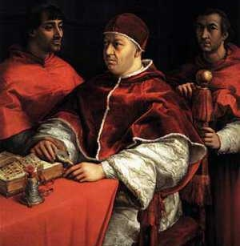
The Roman Catholic Church was the dominant religious power in Western Europe during the Dark Ages. Following the collapse of the Western Roman Empire in 476 CE, the Church was the only stable and unifying institution, effectively filling the power vacuum left by the absence of a centralized secular Roman government.
Political Power
Social & Cultural Authority
Economic Power
Religious Authority

Slide 35
Eg: FALLING.APART.OF.THE.WORLD
196 “…We receive a Kingdom that cannot be moved." The world is falling apart. Every politician, denomination and church will fall to pieces, but we receive a Kingdom that cannot be moved… God made it fragile so it would break. We got a Kingdom that's solid now… Not a political system, church system, denominational system...
62-1216
(Eg. Tower of Babel)

Slide 36
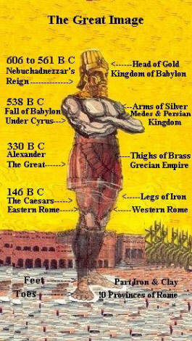

Slide 37
SCRIPTURAL.SIGNS.OF.THE.TIME
12 One of these days, that minority, "As it was in the days of Noah... In the days of Lot…"
13 They're looking for a great big universal something, when it's not even in the Scripture. One of these days, they'll say, "Well, I thought the Bible said that the church will escape all of this?" The Bride escapes this.
64-0410

Slide 38
GOD.HIDING.HIMSELF.IN.SIMPLICITY
113 Many miss Him by the way He reveals Himself. Man has their own ideas of what God ought to be and what God is going to do; and as I have made the old statement many times that man still remains man. Man is always giving God praise for what He did do, and always looking forward to what He will do, and ignoring what He's doing.

Slide 39
114 That's the way they miss it. They look back and see what a great thing He done, but they fail to see what a simple thing He used to do it with. Then they look forward, see a great thing coming, and nine times out of ten, it's already happening right around them, and it's so simple that they don't know it. Everything will move just as common as it can be.
379 And when they say the graves will open, how is the graves going to open when God just speaks

Slide 40
and the rapture will come. It ain't going out, Angels come down and shovel out the graves, get an old dead carcass here. It's born of sin to begin with, but a new one made in its likeness.
If we have this, we'll die again. Nobody will say, "The graves will open. The dead shall walk out." That may be true, but not open the way you say open. It won't be like that. It'll be a secret, because He said He'd come like a thief in the night. 63-0317

Slide 41
THE.FIFTH.SEAL
The martyrs down through the ages suffered terribly. But they were under the inspiration, the Spirit of God, the power. How could man do anything else besides the power of God that had been released to them?
If God sends a certain Spirit among them, that's the only thing that they can work by, is the Spirit that works among them. We'll prove to you by the history of the church, the opening of the Seals and the powers that let loose... And watch exactly the church responded to the anointing, and they couldn't do nothing else. 63-0322

Slide 42
SIRS.WE.WOULD.SEE.JESUS
3 There's many different gifts that God has to His Church. They're all for the perfecting of the Church to bring together in unity the great Body of the Lord Jesus Christ. All that God was, He poured into Christ. And Christ was God manifested on earth. All that Christ was, He poured into His Church. All the powers that God had rested in Christ, and the fulness of Christ rests in His Church. So what a people this should be. 57-0804

Slide 43
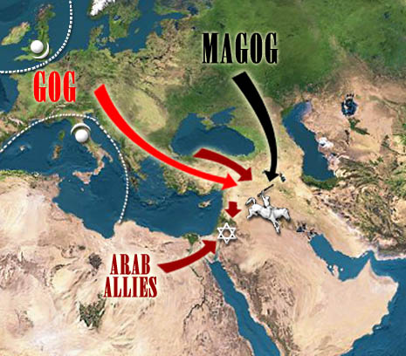
Gog & Magog

Slide 44
QUESTIONS & ANSWERS.ON.THE.SEALS
341 Please explain how Satan is bound a thousand years, being loosed again for the battle of Rev. 20:8?
That is not the battle of Armageddon. The battle of Armageddon takes place on this side when the tribulation period is ended.
Now, what relation does this have with the battle of Gog & Magog? None. One is this thousand years, and the other one is the end of the thousand years.
−

Slide 45
…as mentioned in the Fourth Seal, will Gog and Magog be gathered from peoples on the new earth?
Satan was loosed out of his prison and went to gather all the people, the wicked, to bring them to this place, and God rained fire and brimstone out of heaven, and they were consumed, two battles altogether.
63-0324

Slide 46
Wedding Supper
Moses & Elijah in Israel
Battle of Armageddon
Millennium
Battle of Gog & Magog
White Throne Judgment (Rev. 20:11)

Slide 47
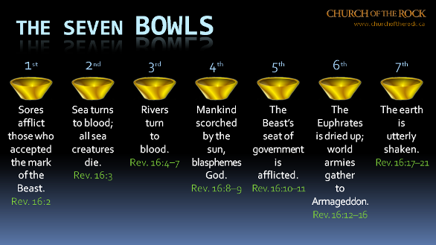

Slide 48
54-0515 QUESTIONS.AND.ANSWERS
312 Will the prophecy of Ezekiel 38 and 39 be fulfilled before the rapture? I think not. I think the next thing we look for is the rapture of the church.
61-0723 GOD.BEING.MISUNDERSTOOD
102 Will Ezekiel 38 and 39 come to pass before the rapture?
Now if you will notice, Ezekiel 38 and 39 deals with Gog and Magog, which is Russia, the north country. Now, to my way of teaching it comes to pass after the rapture, after the church is taken up. And God deals with Gog and Magog when they come down before Israel there. And I think that will come to pass after the rapture.

Slide 49
REVELATION 20:7-10
And when the thousand years are expired, Satan shall be loosed out of his prison, 8 And shall go out to deceive the nations which are in the four quarters of the earth, Gog and Magog, to gather them together to battle: the number of whom is as the sand of the sea.
9 And they went up on the breadth of the earth, and compassed the camp of the saints about, and the beloved city: and fire came down from God out of heaven, and devoured them. 10 And the devil that deceived them was cast into the lake of fire and brimstone, where the beast and the false prophet are, and shall be tormented day and night for ever and ever.

Slide 50
QUESTIONS & ANSWERS.ON.THE.SEALS
44. You have said many times that communism was raised up by God to serve His purpose, as King Nebuchadnezzar. Now where did communism fit into the picture? How does it wind up? Many scholars believe in the kingdom of the north, Gog and Magog in the Scriptures, goes down against Israel in… I believe you said it would finally that communism would finally destroy Catholicism or the Vatican by an explosion. Is this right? 63-0324

Slide 51
Yes. Rev. 16 - Rev. 18:8, 12… "Alas, alas, that great city... for in one hour she has come to her end.” It’ll be.
Just forget about communism. It's nothing in the world but a bunch of …barbarians that's ungodly. It's a system... Let me show you something--just to show you how simple it is. Why, there's only 1% of all Russia that's communism. They need a messenger. Then 99% of them are still on the Christian side. How can 1% control 99%? That ought to explain it to you right there. If God didn't permit it, why, they'd be thrown out long ago.

Slide 52
RESTORATION.OF.THE.BRIDE.TREE
346 That's the reason I say… many preachers are saying "Communism is going to take the world and throw it down." Don't you never try to fight communism. Fight Romanism. That's THUS SAITH THE LORD. Romanism is going to rule, not communism. It's just a puppet. The Lord told Micaiah, "I've got to send Ahab out there. Have them preachers to say that, to send Ahab out there, in order to make Elijah's words come to pass."
348 God had to let communism raise up. What did it do? They run all these “morgues” together, and made a

Slide 53
confederation of churches, to join, to make an image of the beast, just what His Word said would take place. Don't you worry about that. You watch the thing it's forming under.
351 Now, therefore, we find out that it was. It's communism is gathered together. God said, "Gog and Magog, will gather together, to bring about the battle." That's exactly true, 'cause it's going to bring these forces together. The Bible said it would.
62-0422

Slide 54
GABRIEL'S.INSTRUCTIONS.TO.DANIEL
32 This has been a week of tremendous study… been reading Dr. Larkin's book, Dr. Smith's book, Scofield's notes, different commentaries from men everywhere, yet I cannot put theirs together to make it come out right...
Been visiting the library in Kentucky on some of the ancient astronomy of calendars, times, and picking up all the ancient books that I can, what little I can do, and having my trust solemnly in Jesus Christ to reveal it to me, because I do not want it to say, "I know this, and I know that."

Slide 55
He knows my heart; He's listening at me. But I want it that I might enlighten His people. Therefore, I believe He will give it to me. I do not know as yet, but I'm trusting Him for next Sunday, 'cause that'll be the tremendous part to know and place those seventy weeks…
35 And that's why I'm asking God to let me know what these seventy of weeks mean, because I know it's the exact calendar for the age we're living in, therefore I want to know it, not for myself, 'course I want to know it. I want to know, because I want to know where we're living and what time we're living in.
61-0730

Slide 56
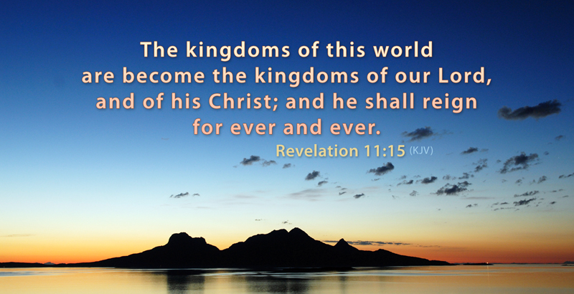

Slide 57
THE.ODDBALL
64 Satan, he has some bolts and nuts of the kingdoms of this world. Pharaoh was just as much nut to Moses, as Moses was to Pharaoh. Noah, by being a nut for God, pulled the church to the promised land. Depends on which way you're threaded. Moses pulled the church from Egypt, to God's promised land.
65 Now, be careful, 'cause these nuts and bolts look a whole lot a like. Just watch the thread. Matt. 24:24, "It would almost deceive the very Elected.” The American and the whole world denomination needs a nut. 64-0614

Slide 58
IS.THIS.THE.SIGN.OF.THE.END.SIR
53-2 Every one of you, cleanse your heart. Lay aside every weight. Don't let nothing bother you. Don't be scared. There's nothing to be scared about. If Jesus is coming, it's a moment the whole world has groaned and cried for. If it's breaking forth now, it'll be wonderful. If it's coming time that the revelation of the seven thunders will be revealed to the church, how to go, I don't know. 62-1230

Slide 60
Parent
YoReH
מורה
Yoreh
Rain is so special in Israel. This word refers to the annual debut of gentle rain on young seedlings, something noteworthy.

Slide 61
Present
Future
Husband
Instruct
Protector
Discipline
Provider
Counsel

Slide 62
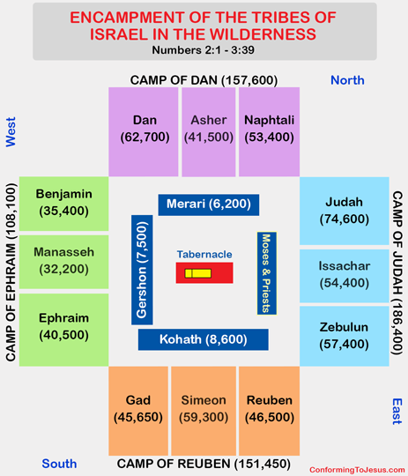
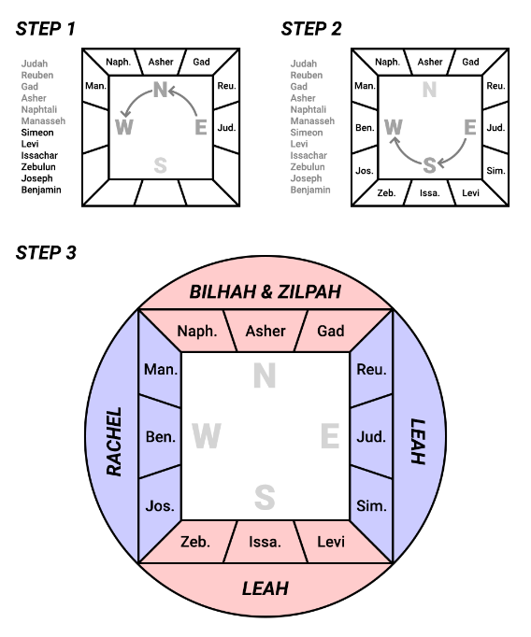

Slide 63
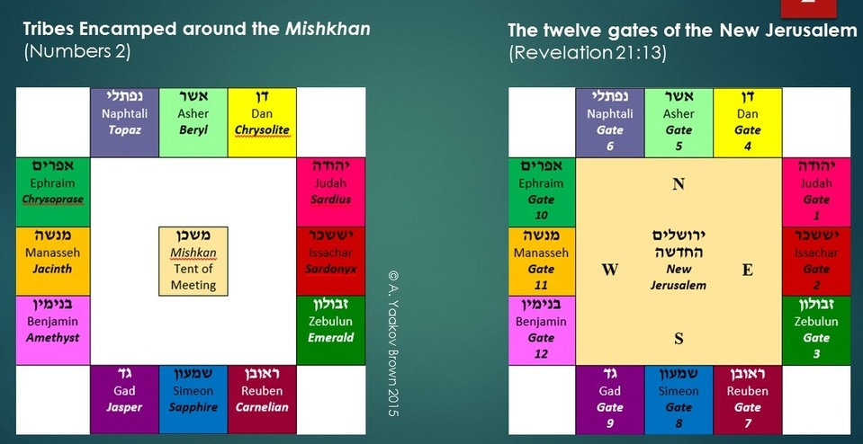

Slide 64
I CORINTHIANS 2:1-5
And I, brethren, when I came to you, came not with excellency of speech or of wisdom, declaring unto you the testimony of God. 2 For I determined not to know any thing among you, save Jesus Christ, and him crucified. 3 And I was with you in weakness, and in fear, and in much trembling.
4 And my speech and my preaching was not with enticing words of man's wisdom, but in demonstration of the Spirit and of power: 5 That your faith should not stand in the wisdom of men, but in the power of God.

Slide 65
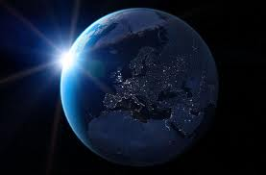
COD
273 I thought of that, God has helped me and let me know great men, let me go around the world. And people from around the world calling to come pray for them, sick people... And now, the businessmen prosper by the people that I bring into the city… And now, by the help of God, I believe that I'm directing the Bride of Jesus Christ. "Amazing grace, how sweet the sound!” 64-0823

Slide 66
ABRAHAM'S.COVENANT.CONFIRMED
13 …As soon as the sun rises, the moon goes down. The moon is a wife to the sun. Oh, I love that kind of Bible reading. See, the sun and the moon is a type of Christ and the church. When the sun goes down, out of sight, it's not down, it's just out of sight to the world. It reflects its light back to the moon to give light in its absence. 61-0318

Slide 67
REVELATION 11:15
And the seventh angel sounded; and there were great voices in heaven, saying, The kingdoms of this world are become the kingdoms of our Lord, and of his Christ; and he shall reign for ever and ever.
Kingdom: (Gr.) basileia Royal power, kingship, dominion, rule; not to be confused with an actual kingdom but rather the right or authority to rule over a kingdom;
MATTHEW 3:2 And saying, Repent ye: for the kingdom of heaven is at hand.

Slide 68
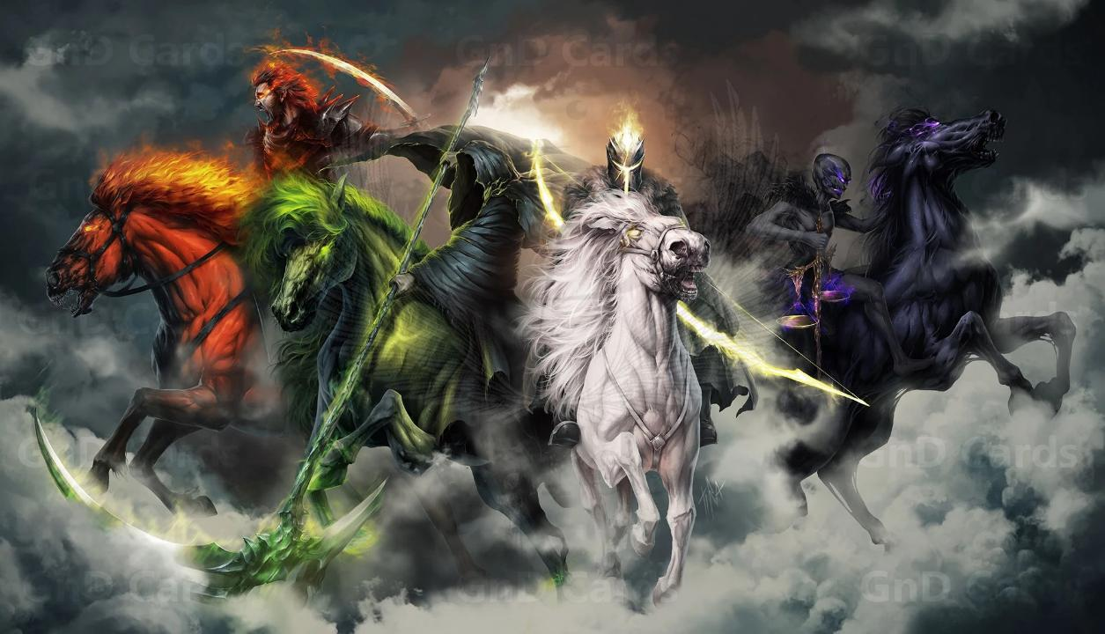

Slide 69
