Slide 1
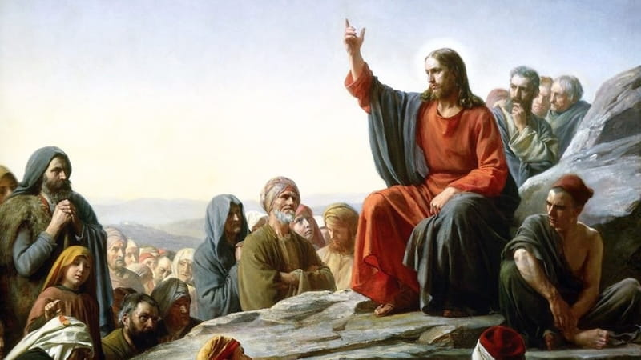
Enduring Sound Doctrine
Aaron Nengomazha : Hickory Bible Tabernacle

Slide 2


Slide 3
John 13:3-5 KJV
Jesus knowing that the Father had given all things into his hands, and that he was come from God, and went to God; [4] He riseth from supper, and laid aside his garments; and took a towel, and girded himself. [5] After that he poureth water into a bason, and began to wash the disciples' feet, and to wipe them with the towel wherewith he was girded.

Slide 4
2 Timothy 4:3 KJV
For the time will come when they will not endure sound doctrine; but after their own lusts shall they heap to themselves teachers, having itching ears;

Slide 5
Proverbs 3:11 KJV
My son, despise not the chastening of the LORD; neither be weary of his correction:

Slide 6


Slide 7
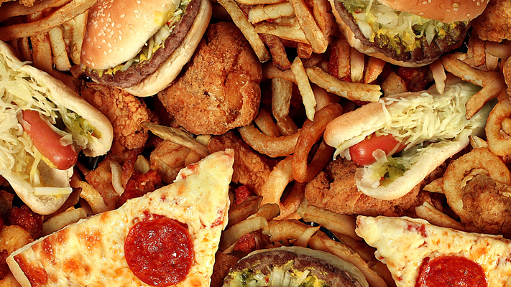

Slide 8


Slide 9
63-0728 - "Christ Is The Mystery Of God Revealed"
And may, as You gave the vision some two years ago, “to store up the Food,” fine, healthy-looking vegetables that I saw in the vision, being stored here in this tabernacle, may we today receive a whole barrel full of That (Grant it, Lord.), or, a tape load:

Slide 10
1 Peter 4:16-18 KJV
Yet if any man suffer as a Christian, let him not be ashamed; but let him glorify God on this behalf. [17] For the time is come that judgment must begin at the house of God: and if it first begin at us, what shall the end be of them that obey not the gospel of God? [18] And if the righteous scarcely be saved, where shall the ungodly and the sinner appear?

Slide 11
Isaiah 28:8-12 KJV
For all tables are full of vomit and filthiness, so that there is no place clean. [9] Whom shall he teach knowledge? and whom shall he make to understand doctrine? them that are weaned from the milk, and drawn from the breasts.

Slide 12
…[10] For precept must be upon precept, precept upon precept; line upon line, line upon line; here a little, and there a little: [11] For with stammering lips and another tongue will he speak to this people. [12] To whom he said, This is the rest wherewith ye may cause the weary to rest; and this is the refreshing: yet they would not hear.

Slide 13
54-0514 - "The Seal Of God"
209 There you are. That’s what He said. That wasn’t my word; that’s His Word. Change It, if you can. It can never be changed. He said, “Precept upon precept; line upon line; here a little and there a little.” The whole Gospel must be brought out.

Slide 14
62-0128M - "Unbelief Does Not Hinder God"
67 Isaiah 28:18 said, “And it shall come to pass in these last days, that the tables would be full of vomit,” and so forth, he said, but the Word would come, “Precept upon precept; line upon line upon line; here a little and there a little. And hold fast to that what is good. For with stammering lips and other tongues will I speak to this people. And this is the rest, this is the keeping of a sabbath that you should enter into. For all this, they wouldn’t understand it, walked away, wagging their heads,” and so forth.

Slide 15
61-0618 - "Revelation, Chapter Five Part II"
And any man that has not a doctrine has not a ministry.

Slide 16
60-0712 - "Hear Ye Him"
I don’t mean you’re mean, but I mean that the devil and some sissified pulpits, that ought to be out yonder as a hog caller instead of a preacher, ought to get out and tell the truth about it, so you’ll know what’s the truth. Is that right, brethren?

Slide 17
Malachi 4:4 KJV
Remember ye the law of Moses my servant, which I commanded unto him in Horeb for all Israel, with the statutes and judgments.

Slide 18
Hebrews 12:17-18 KJV
For ye know how that afterward, when he would have inherited the blessing, he was rejected: for he found no place of repentance, though he sought it carefully with tears. [18] For ye are not come unto the mount that might be touched, and that burned with fire, nor unto blackness, and darkness, and tempest,
Hebrews 12:22 KJV
But ye are come unto mount Sion, and unto the city of the living God, the heavenly Jerusalem, and to an innumerable company of angels,

Slide 19
Joshua 1:7 KJV
Only be thou strong and very courageous, that thou mayest observe to do according to all the law, which Moses my servant commanded thee: turn not from it to the right hand or to the left, that thou mayest prosper whithersoever thou goest.

Slide 20
63-0728 - "Christ Is The Mystery Of God Revealed"
5 And once, just a while ago, when You showed the vision, the little tabernacle here, about to store up the Food, that there would come a time when this would all be needed. When we seen Brother Sothmann and Brother Wood ready to cross over into another country, to…But You said, “Store up this Food here for the time.” Lord, reverently I’ve tried to do that.

Slide 21
Amos 8:11-13 KJV
Behold, the days come, saith the Lord God, that I will send a famine in the land, not a famine of bread, nor a thirst for water, but of hearing the words of the Lord : [12] And they shall wander from sea to sea, and from the north even to the east, they shall run to and fro to seek the word of the Lord, and shall not find it. [13] In that day shall the fair virgins and young men faint for thirst.

Slide 22
65-0718E - "Spiritual Food In Due Season"
And, you know, that was predicted by the prophets, just before the Second Coming of Christ would be? Said, “There will come a famine in the land, and it won’t be for bread alone, but for the hearing of the Word of God.” And that day is now, “hearing the true Word of God.” Now, this types the natural drought with the spiritual.

Slide 23
John 6:34-35 KJV
Then said they unto him, Lord, evermore give us this bread. [35] And Jesus said unto them, I am the bread of life: he that cometh to me shall never hunger; and he that believeth on me shall never thirst.

Slide 24
John 6:63 KJV
It is the spirit that quickeneth; the flesh profiteth nothing: the words that I speak unto you, they are spirit, and they are life.

Slide 25
Matthew 23:34 KJV
Wherefore, behold, I send unto you prophets, and wise men, and scribes: and some of them ye shall kill and crucify; and some of them shall ye scourge in your synagogues, and persecute them from city to city:

Slide 26
John 3:19-20 KJV
And this is the condemnation, that light is come into the world, and men loved darkness rather than light, because their deeds were evil. [20] For every one that doeth evil hateth the light, neither cometh to the light, lest his deeds should be reproved.

Slide 27
2 Thessalonians 2:11-12 KJV
And for this cause God shall send them strong delusion, that they should believe a lie: [12] That they all might be damned who believed not the truth, but had pleasure in unrighteousness.

Slide 28
60-1208 - "The Thyatirean Church Age"
51 And God said that the deeds of the Nicolaitanes (which was in the Ephesians), over in the—the little church of Pergamos became a “doctrine,” and said it was “a doctrine of Balaam.” And Balaam was the one who taught Israel to go over there and commit fornications, or they committed fornications with Moab (which was a lukewarm church member), or the common church, the great organization.

Slide 29
Galatians 5:19-20 KJV
Now the works of the flesh are manifest, which are these ; Adultery, fornication, uncleanness, lasciviousness, [20] Idolatry, witchcraft, hatred, variance, emulations, wrath, strife, seditions, heresies,

Slide 30
65-0718E - "Spiritual Food In Due Season"
9 And it gives me great pleasure to get to see, when you know that you have a Message from God and you give it to the people, and see the people respond to That. Then you look back and say, “Thank You, Father.” Oh, what a joy it is then to see the children eating the Bread that’s been sent to them! You realize that was a vision years ago, right here at this tabernacle? That’s right, “The Bread of Life.” Brother Neville, you remember it. Mighty—mighty time!

