Slide 2
PSALM 127:3 - 5
3 Lo, children are an heritage of the LORD: and the fruit of the womb is his reward.
Notes:
PSALM 127:3 - 5
3 Lo, children are an heritage of the LORD: and the fruit of the womb is his reward.
4 As arrows are in the hand of a mighty man; so are children of the youth.
5 Happy is the man that hath his quiver full of them: they shall not be ashamed, but they shall speak with the enemies in the gate.

Slide 3
4 As arrows are in the hand of a mighty man; so are children of the youth.
Notes:
PSALM 127:3 - 5
3 Lo, children are an heritage of the LORD: and the fruit of the womb is his reward.
4 As arrows are in the hand of a mighty man; so are children of the youth.
5 Happy is the man that hath his quiver full of them: they shall not be ashamed, but they shall speak with the enemies in the gate.

Slide 4
5 Happy is the man that hath his quiver full of them: they shall not be ashamed, but they shall speak with the enemies in the gate.
Notes:
PSALM 127:3 - 5
3 Lo, children are an heritage of the LORD: and the fruit of the womb is his reward.
4 As arrows are in the hand of a mighty man; so are children of the youth.
5 Happy is the man that hath his quiver full of them: they shall not be ashamed, but they shall speak with the enemies in the gate.

Slide 5
“Raising Children who are Unashamed”

Slide 6
“Raising Children who are Unashamed”
Teaching our children a posture of courage.

Slide 7
“Raising Children who are Unashamed”
Raising Courageous Christ-Like Children in a culture of Anxiety.

Slide 8
What does it mean to be Christ-Like?
Notes:
Many of our home grown youth are now 17. They have been sheltered well, raised in church. Worldliness is starting to creep in as they go through this phase:
"Every kid has to go through that. Practically everyone goes through that age. You did; I did. And we got to think their thoughts."
Youth. We see it. We desire better for you.
Parents: we gotta help them with this phase

Slide 9
Do you want to raise Christ Like Children?
Notes:
Many of our home grown youth are now 17. They have been sheltered well, raised in church. Worldliness is starting to creep in as they go through this phase:
"Every kid has to go through that. Practically everyone goes through that age. You did; I did. And we got to think their thoughts."
Youth. We see it. We desire better for you.
Parents: we gotta help them with this phase

Slide 10

The GRAY Zone
Notes:
Many of our home grown youth are now 17. They have been sheltered well, raised in church. Worldliness is starting to creep in as they go through this phase:
"Every kid has to go through that. Practically everyone goes through that age. You did; I did. And we got to think their thoughts."
Youth. We see it. We desire better for you.
Parents: we gotta help them with this phase

Slide 11
Why do we parent?

Slide 12
2025 Reasons for Parenting (Bad)
Makes me look good on the ‘gram
That’s what we’re supposed to do.
Natural Product of being married

Slide 13
How do we parent with those reasons?
Maximum impact of our image
Maximum impact of them doing what they are supposed to do.
Maximum impact of removing the inconvenience

Slide 14
The Final Parenting Stages
"She needs a buddy, and you’re the one to be her buddy, you and I. We’re her parents.”
64-0823M - "Q And A #1"
Notes:
The MCD Principle
What is the final goal of parenting? Your kids should one day be your brothers and sisters, and good friends in Christ. They will be independent of you in the millennium and heaven.
So the goal is to raise good friends. Be their buddy. Become their brother or sister in Christ.
"She needs a buddy, and you’re the one to be her buddy, you and I. We’re her parents.”

Slide 15
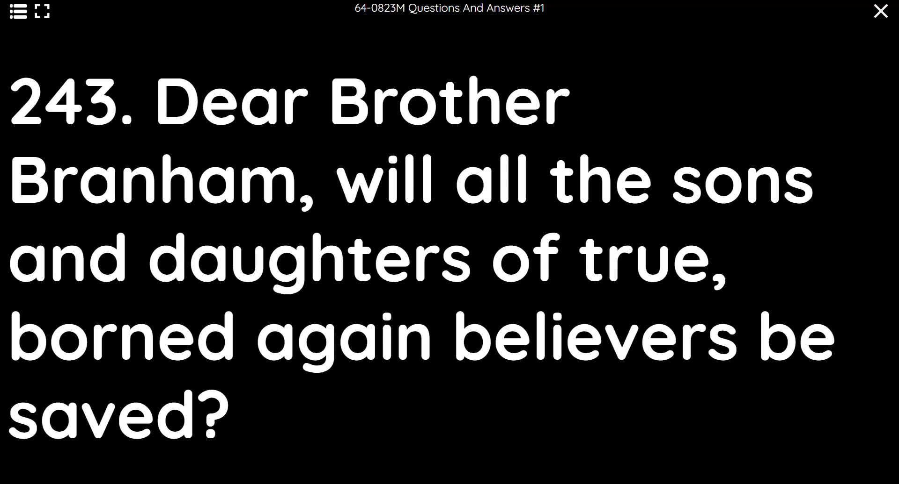
Notes:
The MCD Principle
What is the final goal of parenting? Your kids should one day be your brothers and sisters, and good friends in Christ. They will be independent of you in the millennium and heaven.
So the goal is to raise good friends. Be their buddy. Become their brother or sister in Christ.
"She needs a buddy, and you’re the one to be her buddy, you and I. We’re her parents.”

Slide 16
Reasons for Parenting (Godly)
To raise sons and daughters of God
To raise Godly friends.
To Glorify God

Slide 17
Friendly Caveat
If the goal of parenting is to produce brothers and sisters in Christ, and good friends.
Make sure your definition of Friends is Godly.
Notes:
Being friends with our kids needs some thoughts.
This is godly friendship. Less video game style. IOW, if you are an immature parent, the friendship you are drawing them into is not one of maturity, and not what we mean.

Slide 18
64-0830E Q and A #4
390. Brother Branham, what achievement should we let our preteenage children participate in? (I beg your pardon, it's)--what activities should our preteen children anticipate-- participate in.
Notes:
64-0830E Q and A #4
390. Brother Branham, what achievement should we let our preteenage children participate in? (I beg your pardon, it's)--what activities should our preteen children anticipate-- participate in. Also, how should we go about helping them select their associates?
Keep them in Christian company as long as you possibly can. Keep them with... If it's a girl, keep her with Christian girls; Christian boys, vice versa. If she's old enough to go with a boy, see that she keeps with the right kind of boy. Discourage her to any boy otherwise, or boy to a girl. If she's going with an unbeliever, try to encourage her to go with a believer, and vice versa. Make your home nice. Make your home a place where your daughter or son will not be ashamed to bring their company before their father and mother, and into their house; and make home so happy that they'll be pleased in their home to stay there.
Oooh, my, here's seven in a row. I won't go but just a few minutes longer.

Slide 19
Also, how should we go about helping them select their associates?
Notes:
64-0830E Q and A #4
390. Brother Branham, what achievement should we let our preteenage children participate in? (I beg your pardon, it's)--what activities should our preteen children anticipate-- participate in. Also, how should we go about helping them select their associates?
Keep them in Christian company as long as you possibly can. Keep them with... If it's a girl, keep her with Christian girls; Christian boys, vice versa. If she's old enough to go with a boy, see that she keeps with the right kind of boy. Discourage her to any boy otherwise, or boy to a girl. If she's going with an unbeliever, try to encourage her to go with a believer, and vice versa. Make your home nice. Make your home a place where your daughter or son will not be ashamed to bring their company before their father and mother, and into their house; and make home so happy that they'll be pleased in their home to stay there.
Oooh, my, here's seven in a row. I won't go but just a few minutes longer.

Slide 20
Keep them in Christian company as long as you possibly can. Keep them with... If it's a girl, keep her with Christian girls; Christian boys, vice versa. If she's old enough to go with a boy, see that she keeps with the right kind of boy.
Notes:
64-0830E Q and A #4
390. Brother Branham, what achievement should we let our preteenage children participate in? (I beg your pardon, it's)--what activities should our preteen children anticipate-- participate in. Also, how should we go about helping them select their associates?
Keep them in Christian company as long as you possibly can. Keep them with... If it's a girl, keep her with Christian girls; Christian boys, vice versa. If she's old enough to go with a boy, see that she keeps with the right kind of boy. Discourage her to any boy otherwise, or boy to a girl. If she's going with an unbeliever, try to encourage her to go with a believer, and vice versa. Make your home nice. Make your home a place where your daughter or son will not be ashamed to bring their company before their father and mother, and into their house; and make home so happy that they'll be pleased in their home to stay there.
Oooh, my, here's seven in a row. I won't go but just a few minutes longer.

Slide 21
Discourage her to any boy otherwise, or boy to a girl. If she's going with an unbeliever, try to encourage her to go with a believer, and vice versa.
Notes:
64-0830E Q and A #4
390. Brother Branham, what achievement should we let our preteenage children participate in? (I beg your pardon, it's)--what activities should our preteen children anticipate-- participate in. Also, how should we go about helping them select their associates?
Keep them in Christian company as long as you possibly can. Keep them with... If it's a girl, keep her with Christian girls; Christian boys, vice versa. If she's old enough to go with a boy, see that she keeps with the right kind of boy. Discourage her to any boy otherwise, or boy to a girl. If she's going with an unbeliever, try to encourage her to go with a believer, and vice versa. Make your home nice. Make your home a place where your daughter or son will not be ashamed to bring their company before their father and mother, and into their house; and make home so happy that they'll be pleased in their home to stay there.
Oooh, my, here's seven in a row. I won't go but just a few minutes longer.

Slide 22
Make your home nice. Make your home a place where your daughter or son will not be ashamed to bring their company before their father and mother,
Notes:
64-0830E Q and A #4
390. Brother Branham, what achievement should we let our preteenage children participate in? (I beg your pardon, it's)--what activities should our preteen children anticipate-- participate in. Also, how should we go about helping them select their associates?
Keep them in Christian company as long as you possibly can. Keep them with... If it's a girl, keep her with Christian girls; Christian boys, vice versa. If she's old enough to go with a boy, see that she keeps with the right kind of boy. Discourage her to any boy otherwise, or boy to a girl. If she's going with an unbeliever, try to encourage her to go with a believer, and vice versa. Make your home nice. Make your home a place where your daughter or son will not be ashamed to bring their company before their father and mother, and into their house; and make home so happy that they'll be pleased in their home to stay there.
Oooh, my, here's seven in a row. I won't go but just a few minutes longer.

Slide 23
and into their house; and make home so happy that they'll be pleased in their home to stay there.
Notes:
Why? Because they’ve become FRIENDS with their parents. They recognize they are NOT inconveniences!

Slide 24
Christ-Like means Choosing.
Notes:
Connecting with the idea of Christ like as choice and sacrifice, to mold our children into Christ like persons, they are going to progressively need to make choices, and see the results.
If we over protect from all choice, we hinder their ability to make the fundamental choice.
If a parent is over protective they are effectively undermining the child’s ability to be or become Christ like. We do not make everyone a slave to divine command, but we mold and encourage to the CHOICE to sacrifice.

Slide 25
Christ-Like means Choosing.
GALATIANS 5:1
Stand fast therefore in the liberty wherewith Christ hath made us free, and be not entangled again with the yoke of bondage.
Notes:
GALATIANS 5:1
Stand fast therefore in the liberty wherewith Christ hath made us free, and be not entangled again with the yoke of bondage.

Slide 26
Who saves and protects?
And I took Meda about a hour. I said, “Meda, take your hands off.”
“Me? That’s my kid!”
Notes:
And I took Meda about a hour. I said, “Meda, take your hands off.”
“Me? That’s my kid!”
126 I said, “Isn’t it mine too?” All right. I said, “If she was dying this morning, you’d have to commit her to God for her eternal destination. Why can’t we commit her to God now for her earthly journey?”

Slide 27
126 I said, “Isn’t it mine too?” All right. I said, “If she was dying this morning, you’d have to commit her to God for her eternal destination. Why can’t we commit her to God now for her earthly journey?”
Notes:
Here bro Branham presents a balance. This is not to say we do no protecting. But appropriate to their level. They MUST also have enough danger to learn a posture of overcoming.
What if you have protected your children so much they have never had anything to overcome before? - was this be helpful or harmful?
Now we can bring in over protecting as lack of faith and destructive to kids.
Kindness (wrong) can be over protection
God has not given us a spirit of fear.
If our children are fearful, where did they learn that spirit?

Slide 28
II Timothy 1:7
For God hath not given us the spirit of fear; but of power, and of love, and of a sound mind.
Notes:
II Timothy 1:7
For God hath not given us the spirit of fear; but of power, and of love, and of a sound mind.

Slide 29
ROMANS 8:14, 15
For as many as are led by the Spirit of God, they are the sons of God.
Notes:
ROMANS 8:14, 15
For as many as are led by the Spirit of God, they are the sons of God.
For ye have not received the spirit of bondage again to fear; but ye have received the Spirit of adoption, whereby we cry, Abba, Father.

Slide 30
For ye have not received the spirit of bondage again to fear; but ye have received the Spirit of adoption, whereby we cry, Abba, Father.
Notes:
ROMANS 8:14, 15
For as many as are led by the Spirit of God, they are the sons of God.
For ye have not received the spirit of bondage again to fear; but ye have received the Spirit of adoption, whereby we cry, Abba, Father.

Slide 31
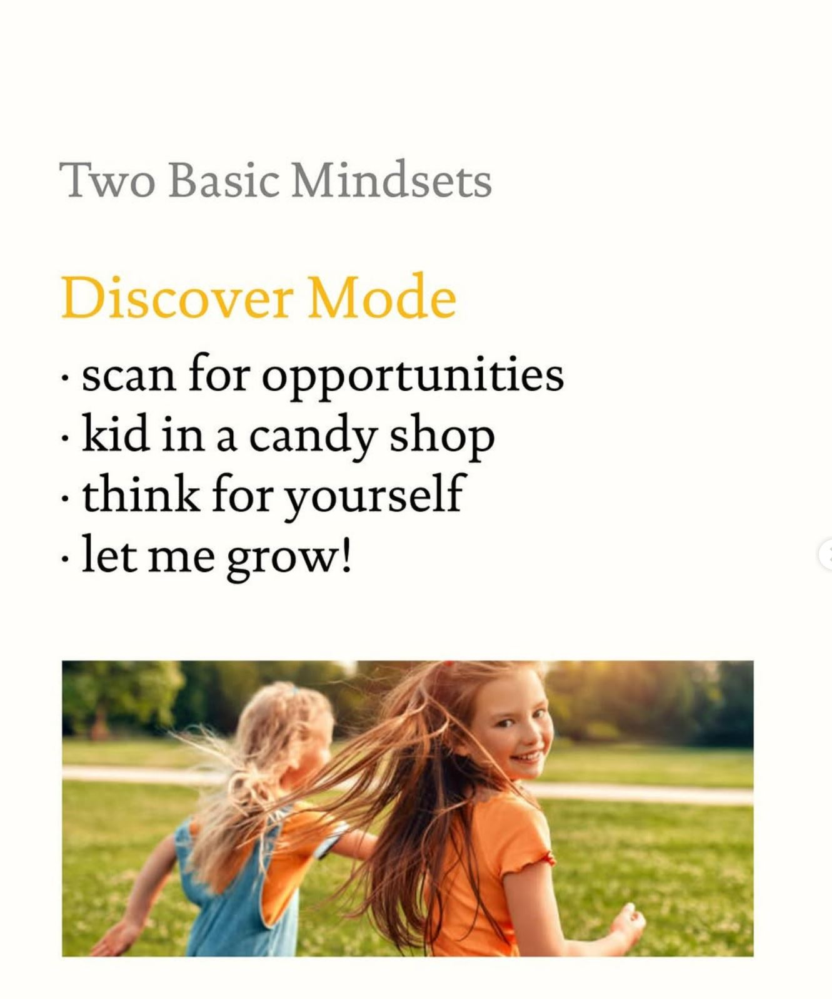
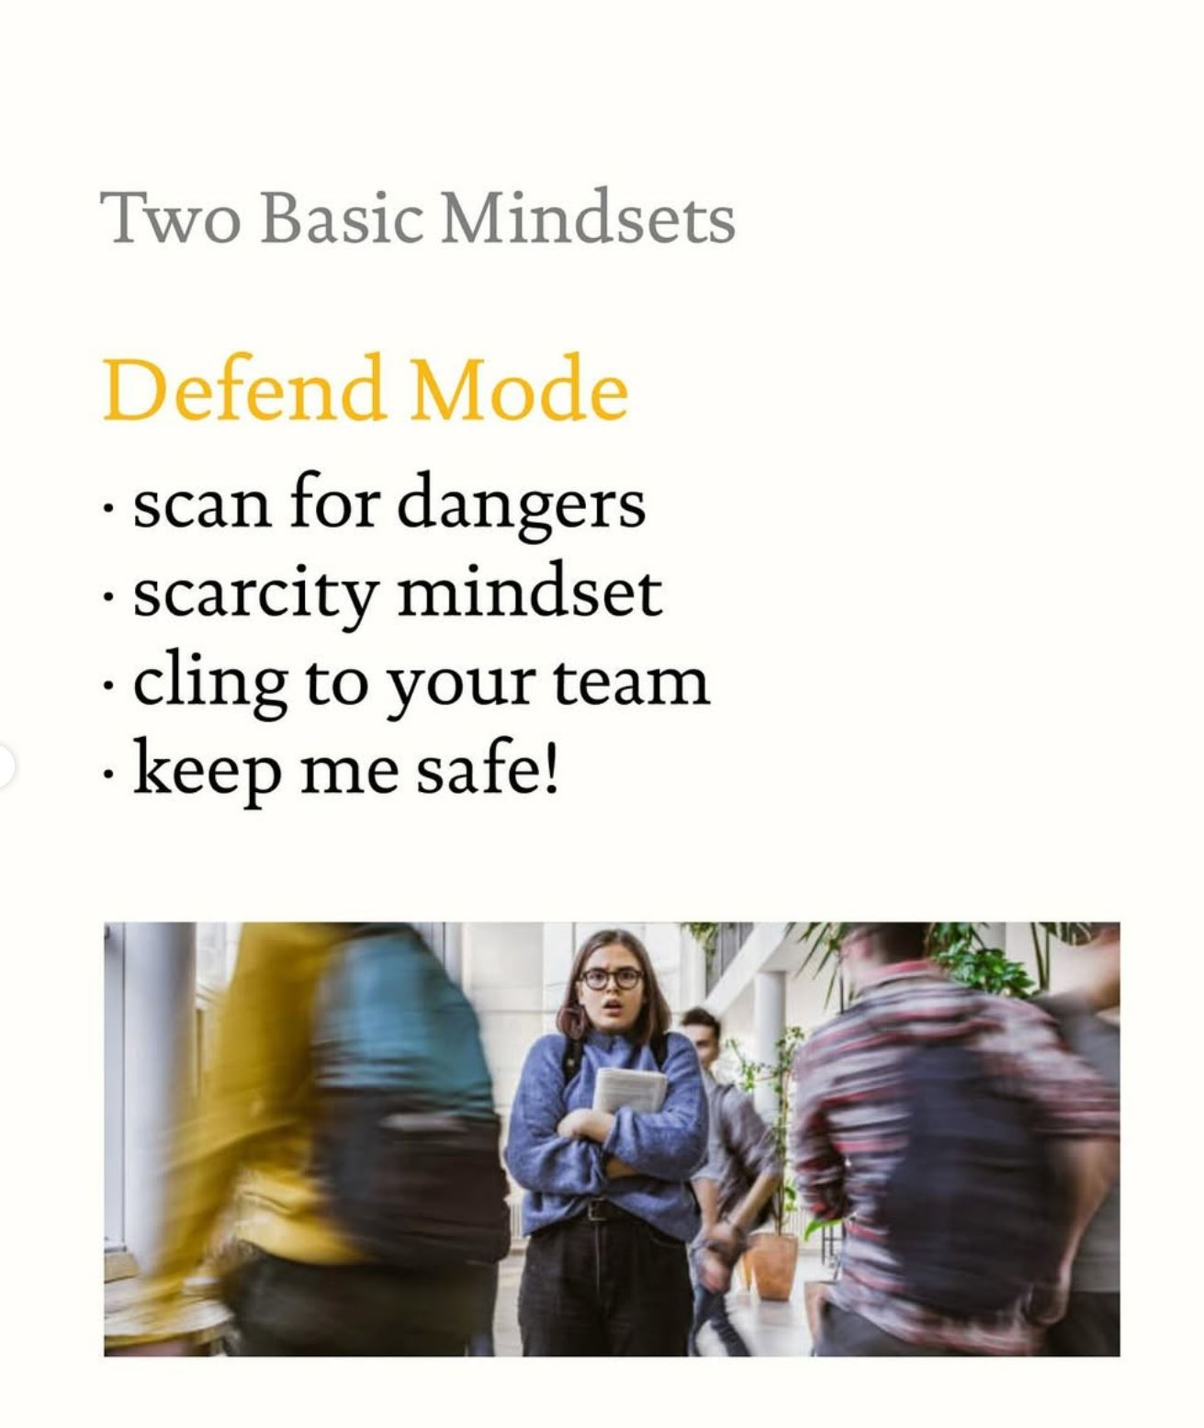
Notes:
What if you're in defend mode so much you're in defend mode from God?

Slide 32

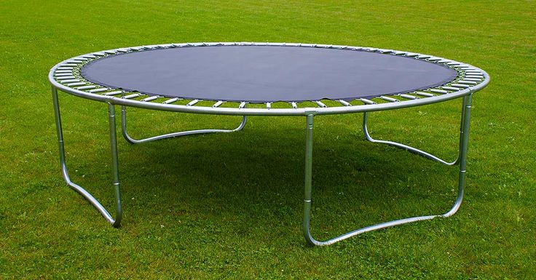
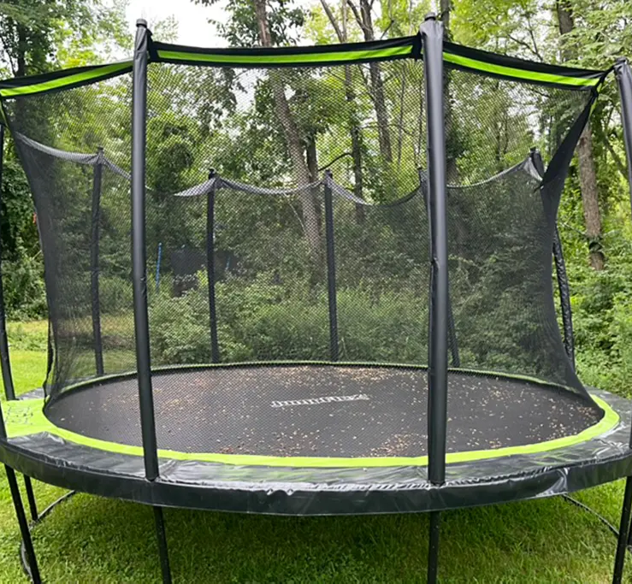
Which strengthens Children more?
Notes:
What if you're in defend mode so much you're in defend mode from God?

Slide 33
“My Children Speak to the Enemies”
“they shall not be ashamed, but they shall speak with the enemies in the gate”

Slide 34
54-0814 The Unconditional Covenant That God Made With The People
Don't give you permission to sin, now, remember that, but what I'm trying to get is the fear knocked out of you.
Notes:
54-0814 The Unconditional Covenant That God Made With The People
Don't give you permission to sin, now, remember that, but what I'm trying to get is the fear knocked out of you. You're always scared about something. Don't be scared. God has promised, God has got to do it, if you believe it, if you're the seed of Abraham. Someone said to me, like my Baptist friends used to say, "What difference does it make?" (The one that went off into eternal security.) They said, "Why--why, don't make any differen to me, I'm saved, Glory to God, I can do what I want to." That just shows you're not saved. That's right. That's right. If you're saved, you don't want to do those things. That's right.

Slide 35
You're always scared about something. Don't be scared. God has promised, God has got to do it, if you believe it, if you're the seed of Abraham.
Notes:
54-0814 The Unconditional Covenant That God Made With The People
Don't give you permission to sin, now, remember that, but what I'm trying to get is the fear knocked out of you. You're always scared about something. Don't be scared. God has promised, God has got to do it, if you believe it, if you're the seed of Abraham. Someone said to me, like my Baptist friends used to say, "What difference does it make?" (The one that went off into eternal security.) They said, "Why--why, don't make any differen to me, I'm saved, Glory to God, I can do what I want to." That just shows you're not saved. That's right. That's right. If you're saved, you don't want to do those things. That's right.

Slide 36
56-1208 Abraham
If you can ever get the scare out of the church and let them realize who they are and what they are positionally, healing will be the simplest message to be preached,
Notes:
56-1208 Abraham
If you can ever get the scare out of the church and let them realize who they are and what they are positionally, healing will be the simplest message to be preached, or anything else. But you're scared. You're afraid. You don't realize that you're sons and daughters of God; and now, not we will be. We are now sons and daughters of God, not way off in the future. And we won't sometime in the future set in heavenly places; now we're seated in heavenly places, right now. And now we are the sons and daughters of God. It does not yet appear what we shall be in the end, but we know we'll see Him, for we'll have a body like His. We'll see Him as He is.

Slide 37
or anything else. But you're scared. You're afraid. You don't realize that you're sons and daughters of God; and now, not we will be.
Notes:
56-1208 Abraham
If you can ever get the scare out of the church and let them realize who they are and what they are positionally, healing will be the simplest message to be preached, or anything else. But you're scared. You're afraid. You don't realize that you're sons and daughters of God; and now, not we will be. We are now sons and daughters of God, not way off in the future. And we won't sometime in the future set in heavenly places; now we're seated in heavenly places, right now. And now we are the sons and daughters of God. It does not yet appear what we shall be in the end, but we know we'll see Him, for we'll have a body like His. We'll see Him as He is.

Slide 38
We are now sons and daughters of God, not way off in the future. And we won't sometime in the future set in heavenly places; now we're seated in heavenly places, right now.
Notes:
56-1208 Abraham
If you can ever get the scare out of the church and let them realize who they are and what they are positionally, healing will be the simplest message to be preached, or anything else. But you're scared. You're afraid. You don't realize that you're sons and daughters of God; and now, not we will be. We are now sons and daughters of God, not way off in the future. And we won't sometime in the future set in heavenly places; now we're seated in heavenly places, right now. And now we are the sons and daughters of God. It does not yet appear what we shall be in the end, but we know we'll see Him, for we'll have a body like His. We'll see Him as He is.

Slide 39
And now we are the sons and daughters of God. It does not yet appear what we shall be in the end, but we know we'll see Him, for we'll have a body like His. We'll see Him as He is.
Notes:
Do we want this for our children? To get the scare out of them?
Then we should come along side them to see that God is powerful, our shield, our protector.

Slide 40
The Balance: Representing Christ, until Christ is embodied.
Notes:
We should be a “secure base” for our children. That they can COME TO and be SECURE.
We should not MANDATE security, we should PROVIDE security.

Slide 41
Book Of Trevor:
Tech and Parenting Chapter
No Phones Until 16
No Social Media Until 18
Notes:
Let them grow into strong young people. Screens will NOT help that.

