Slide 1

Principles to Live by
ACTS 7:17-21
But when the time of the promise drew nigh, which God had sworn to Abraham, the people grew and multiplied in Egypt, 18 Till another king arose, which knew not Joseph.
Notes:
MOVE YOUR MIC DOWN AN INCH

Slide 2
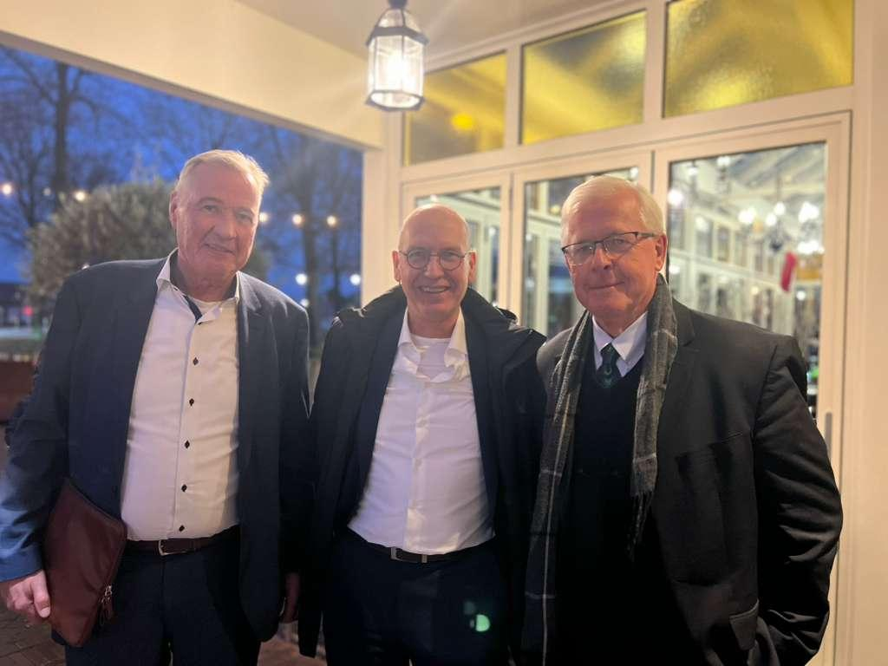
Bro. Gustav Panknin, Bro. Eric Peters, Bro. Barry

Slide 3
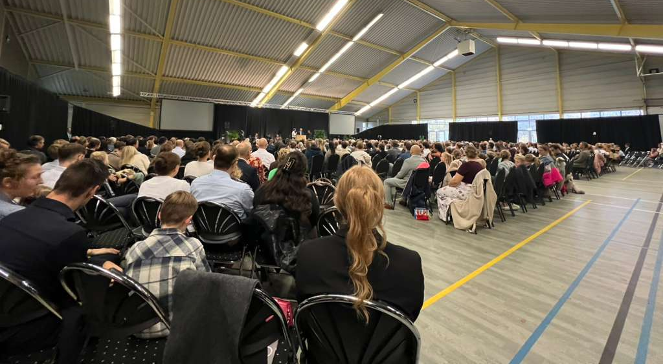

Slide 4
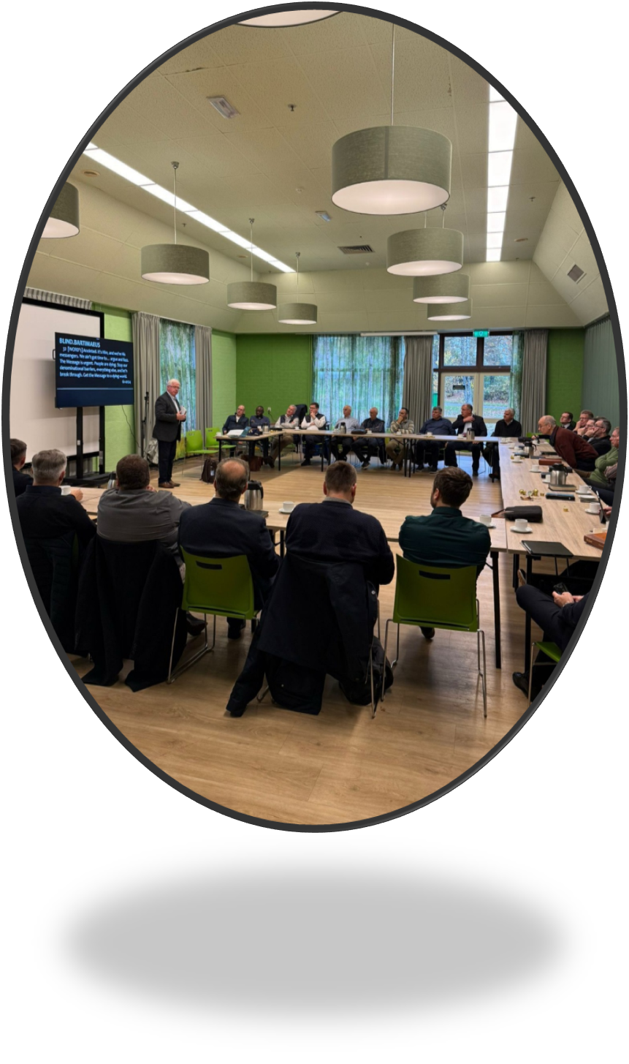
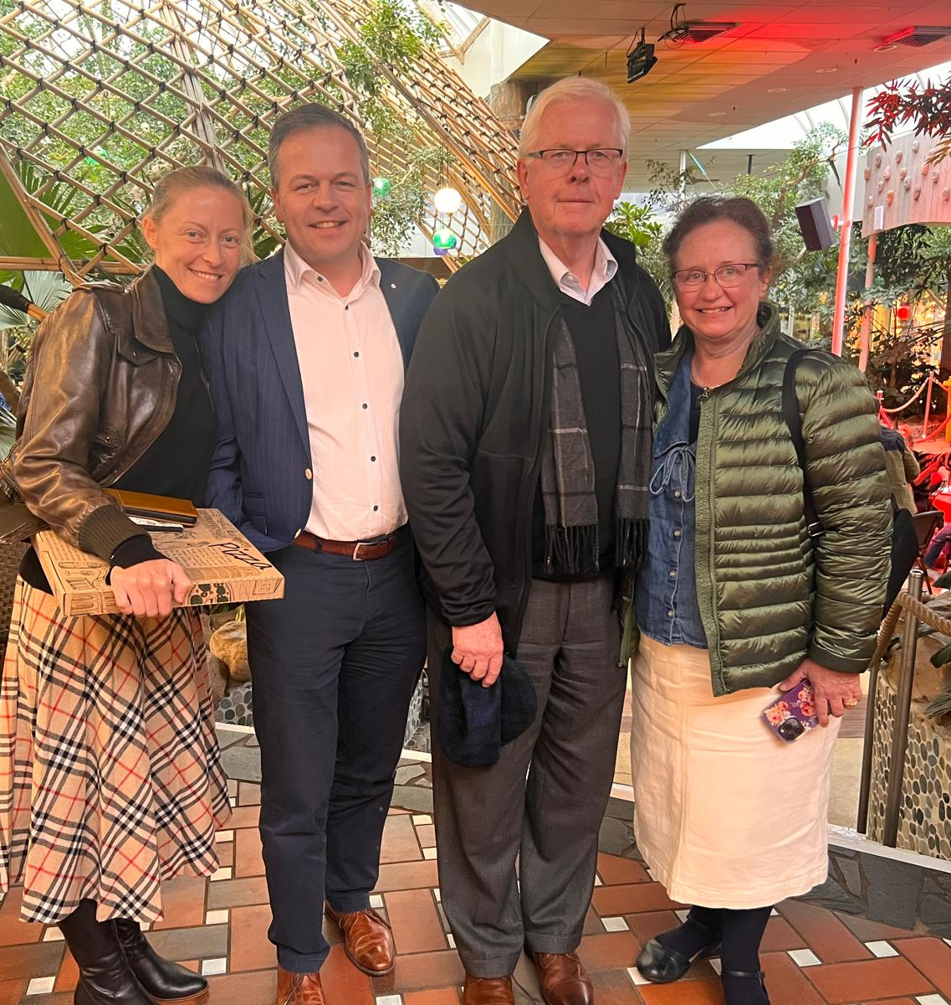

Slide 5
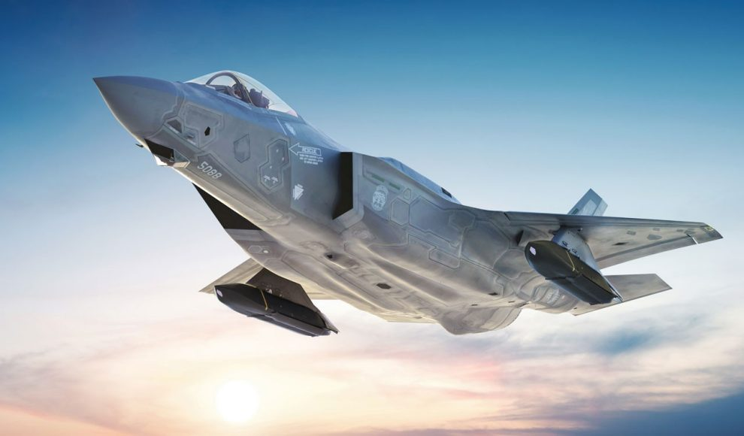

Slide 6
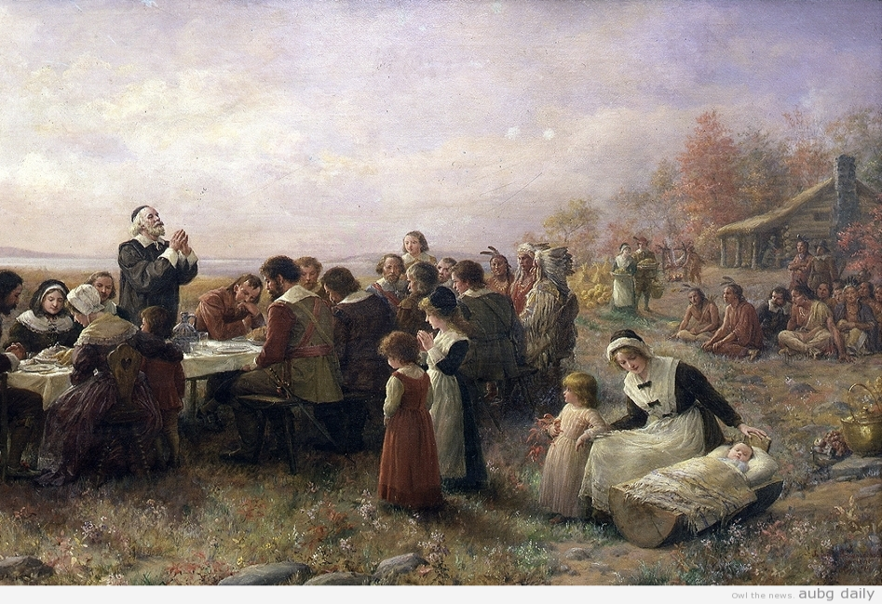
Thanksgiving
Psalm 95:1-3
O come, let us sing unto the LORD: let us make a joyful noise to the rock of our salvation. 2 let us come before his presence with thanksgiving, and make a joyful noise unto him with psalms. 3 for the LORD is a great god, and a great king above all gods.

Slide 7
This holiday is an opportunity to instill in our children virtues such as the triumph of good over evil, the value of truth, rewards of discipline, and importance of finding happiness in immaterial things, family closeness, and generosity. Let us be thankful for the bonds of family and the chance to build strong, supportive homes where children can grow into independent, compassionate individuals who impact the world for the better.

Slide 8
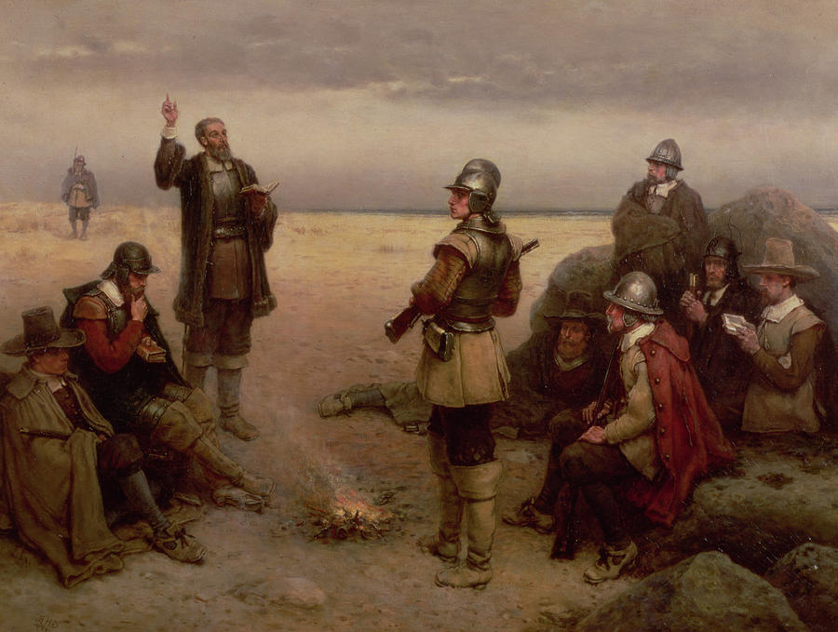
The Landing Of
The Pilgrim Fathers
COLOSSIANS 4:2
Continue in prayer, and watch in the same with thanksgiving;

Slide 9
THE.ANGEL.OF.THE.LORD
2 It's a pleasure to serve the Lord Jesus, to come into His courts with thanksgiving, to make known His blessings to the people.
And I don't think there's anything greater to talk about in the world today, than Jesus Christ.
53-0604

Slide 10
PSALM 100:1
A Psalm of praise. Make a joyful noise unto the LORD, all ye lands. 2 Serve the LORD with gladness: come before his presence with singing. 3 Know ye that the LORD he is God: it is he that hath made us, and not we ourselves; we are his people, and the sheep of his pasture. 4 Enter into his gates with thanksgiving, and into his courts with praise: be thankful unto him, and bless his name. 5 For the LORD is good; his mercy is everlasting; and his truth endureth to all generations.

Slide 11
THE.CALLING.OF.ABRAHAM
6 Heavenly Father, we come to Thee first tonight to offer thanksgiving for all that You've done for us, blessing us, and giving us blessings that we are not deserving. And Father, yes, we deserve nothing.
But it's through Thy righteousness of grace that Thou doest bless us. And we're so thankful.
55-1116

Slide 12
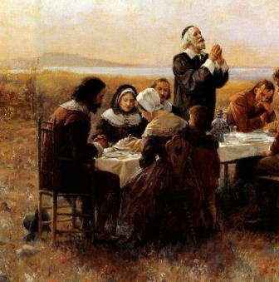

THE.CHILDREN.OF.ISRAEL
25 Father, someday, may we have Thanksgiving together when You're crowned the King of king and the Lord of lords. That great Thanksgiving day, when all the saints shall rally together, God, help us to work for that day while we're here on earth, and may You give us Divine strength. 47-1123

Slide 13
IT.IS.I.BE.NOT.AFRAID 54-0720
15 …Not long ago when we established this nation, we were a wonderful people. When this nation was established on Plymouth Rock, men got on their faces, prayed and thanked God for a nation of freedom of religion, they could worship God. We were young; in our infancy. After that, they declared a Thanksgiving Day, where God blessed their grounds… We were a great people when we were young… But I'm afraid, after we've got big, we went off without Jesus. When we were young, God could deal with us. I'm afraid that our nation is moving on in its own self, leaving God out. We're sure to hit troubles.

Slide 14
Principles & Promises to Live by
ACTS 7:17-21
But when the time of the promise drew nigh, which God had sworn to Abraham, the people grew and multiplied in Egypt, 18 Till another king arose, which knew not Joseph.
Notes:
MOVE YOUR MIC DOWN AN INCH

Slide 15
I CORINTHIANS 10:18-23
All things are lawful for me, but all things are not expedient: all things are lawful for me, but all things edify not.
Expedient: sumphero
To bear together or at the same time; to carry with others; to collect or contribute in order to help, be profitable.

Slide 16
GALATIANS 4:8-11
Howbeit then, when ye knew not God, ye did service unto them which by nature are no gods. 9 But now, after that ye have known God, or rather are known of God, how turn ye again to the weak and beggarly elements, whereunto ye desire again to be in bondage? 10 Ye observe days, and months, and times, and years. 11 I am afraid of you, lest I have bestowed upon you labour in vain.

Slide 17
THE.WORLD.IS.FALLING.APART
143 Now we find out that God promised to supply all of our needs we had need of, in this journey. But, remember, He only supplies it on conditions. We've got to meet His condition, first. If we do not meet His condition, He will not meet our condition. We've got to do the thing that's right, first, got to go down to the bottom and build up. We can't start at the top and come down. Now, He'll meet our condition. All of His promises are on condition. 63-1115

Slide 18
Holiness
To divide off, to mark off from other things and other people, making something different, distinct, not common.
WHY? 63-0626
126 The same God, lived one time, still lives today. His same doctrine of holiness just lives tonight the same as it ever lived, just the same thing. Notice, the people has got away from the doctrine of it, that's all.

Slide 19
WHY
5 Brother Williams, God ever be with you and your son in this great work, the missionaries and so forth... How I appreciate this. Never, never get away from it, friends. Don't never let that spirit of worship and that clean holiness ever die among you. Keep that light burning, for it's the lifeline of the church. It's Christ in His Church.
60-0401

Slide 20
MARK.OF.THE.BEAST.AND.THE.SEAL.OF.GOD.2
Here's a glass. I find it out there, it's full of mud out in the chicken yard somewhere. Would you woman go and put some water in that for your husband? Well, I wouldn't want to be your husband. What is the first thing you do? You pick it up out of the miry clay; that's justification.
Then what do you do? You take it in and put it through a process of boiling and sterilizing and cleaning. What does "sanctify" mean? It's a compound Greek word which means "to be cleaned and set aside for service." 61-0217

Slide 21
JOHN 13:10-11
Jesus saith to him, He that is washed needeth not save to wash his feet, but is clean every whit: and ye are clean, but not all. 11 For he knew who should betray him; therefore said he, Ye are not all clean.
PSALMS 141:4
Incline not my heart to any evil thing, to practise wicked works with men that work iniquity…

Slide 22
MATTHEW 23:25 (Clean on the Outside)
Woe unto you, scribes and Pharisees, hypocrites! for ye make clean the outside of the cup and of the platter, but within they are full of extortion and excess. 26 Thou blind Pharisee, cleanse first that which is within the cup and platter, that the outside of them may be clean also.
I CORINTHIANS 9:27
But I keep under my body, and bring it into subjection: lest that by any means, when I have preached to others, I myself should be a castaway.

Slide 23
I CORINTHIANS 6:9-11
Know ye not that the unrighteous shall not inherit the kingdom of God? Be not deceived: neither fornicators, nor idolaters, nor adulterers, nor effeminate, nor abusers of themselves with mankind, 10 Nor thieves, nor covetous, nor drunkards, nor revilers, nor extortioners, shall inherit the kingdom of God. 11 And such were some of you: but ye are washed, but ye are sanctified, but ye are justified in the name of the Lord Jesus, and by the Spirit of our God.

Slide 24

Holiness (or, Purity):
Internal and External Quality About it.

Slide 25
II CORINTHIANS 7:1
Having therefore these promises, dearly beloved, let us cleanse ourselves from all filthiness of the flesh and spirit, perfecting holiness in the fear of God.

Slide 26
I CORINTHIANS 6:9-11
Know ye not that the unrighteous shall not inherit the kingdom of God? Be not deceived: neither fornicators, nor idolaters, nor adulterers, nor effeminate, nor abusers of themselves with mankind, 10 Nor thieves, nor covetous, nor drunkards, nor revilers, nor extortioners, shall inherit the kingdom of God. 11 And such were some of you: but ye are washed, but ye are sanctified, but ye are justified in the name of the Lord Jesus, and by the Spirit of our God.

Slide 27
CHURCH.AGE.BOOK
292-1 …It is not joining a church that counts. The life is not in the church. The life is in Christ.
…Man is made holy by the Spirit. It is the Spirit of Holiness that raised Jesus from the dead that in-dwells us and makes us holy with His holiness.

Slide 28
THE.RAPTURE
27 And I want to speak on the subject of: The Rapture.
28 Now, we believe that there will be a Rapture. All Christians believe that, that's Bible readers, believes that there will be a Rapture.
65-1204

Slide 29
COLOSSIANS 2:4
And this I say, lest any man should beguile you with enticing words. 5 For though I be absent in the flesh, yet am I with you in the spirit, joying and beholding your order, and the stedfastness of your faith in Christ. 6 As ye have therefore received Christ Jesus the Lord, so walk ye in him: 7 Rooted and built up in him, and stablished in the faith, as ye have been taught, abounding therein with thanksgiving. 8 Beware lest any man spoil you through philosophy and vain deceit, after the tradition of men, after the rudiments of the world, and not after Christ.

Slide 30
Zechariah 1:18-21
¹⁸ Then lifted I up mine eyes, and saw, and behold four horns. ¹⁹ And I said unto the angel that talked with me, What be these? And he answered me, These are the horns which have scattered Judah, Israel, and Jerusalem.
²⁰ And the Lord shewed me four carpenters.
²¹ Then said I, What come these to do? And he spake, saying, These are the horns which have scattered Judah, so that no man did lift up his head: but these are come to fray them, to cast out the horns of the Gentiles, which lifted up their horn over the land of Judah to scatter it.

Slide 31
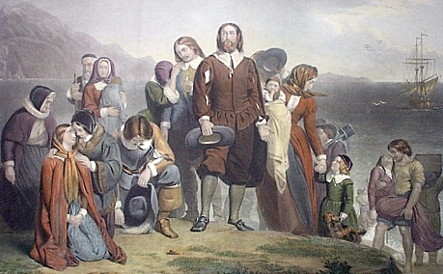
Have a Blessed Thanksgiving

Slide 32
HEBREWS.CHAPTER.SEVEN.1
75 Abraham said, "I'll not take from a thread to a shoelatch." He didn't fight the war, to make a lot of money. And real true battles are not made with selfish motives. Wars are not fought for money. Wars are fought for motives, for principles. Men fight war for principles. And when Abraham went out to get Lot, he didn't go out because he knowed he could whip the kings and take all their possession, he went out for the principle of "saving his brother."
76 And any minister that's sent out under the inspiration of the King of Heaven, will not go for money; neither will he go to make big churches, neither will he go to inspire denominations. He'll only go for one principle, and that is, "To bring back his fallen brother."
77 As I say, "Real wars are fought and waged for principles and not for money." And men and women who join church and come into church, to be popular, because the Joneses belong there, or they change their church from a little church to a big church, you're doing it for a selfish motive and the right principle is not behind it. You should be willing to stand at the battle front.

