Slide 1

Knowledge Shall Increase 4 The Open Book
II PETER 3:9-10
But the day of the Lord will come as a thief in the night; in the which the heavens shall pass away with a great noise, and the elements shall melt with fervent heat, the earth also and the works that are therein shall be burned up.

Slide 2
Birthdays & Anniversaries
Nov. 18th Autumn Pugh, M.E. Ashdown
Nov. 20th Joe Cockman, Hannah James
Nov. 28th Wellington Esau
Dec. 13th Church Dinner

Slide 3
WHY.CRY.SPEAK
215 God had honored everything he [Moses] said, and he was called for the job, so why did he have to say, "What must I do?" There was a need; it was just up to him to speak for it. God wanted Moses to put that gift of faith that He had given him, to work. God vindicated it. It was the Truth. And God wanted Moses, wanted the people to see that He was with Moses. 63-0714

Slide 4
HEALING.AND.WHAT.SICKNESS.IS
3 … Now, we're on the very threshold of the door to break forth into that great golden age that all the prophets has spoke of.
Signs and wonders been wrought by Thy servants through the land to turn people back to a knowledge of the Presence of Jehovah God in our midst. 50-0808
The Days of Solomon: Golden Age for Jews
Rev. 10:1-11 Golden Age for Gentiles

Slide 5
The Time Is At Hand!
DANIEL 12:4
But thou, O Daniel, shut up the words, and seal the book, even to the time of the end: many shall run to and fro, and knowledge shall be increased.
REVELATION 22:10
And he saith unto me, Seal not the sayings of the prophecy of this book: for the time is at hand.

Slide 6
*THE.BREACH
40 …At the sounding of the 7th church age, the last church age, all the loose ends through these church ages have been probed at, will be wound up together. When the Seals are broke, the mystery is revealed, down comes the Angel, the Messenger, Christ, setting His foot upon the land and sea with a rainbow over His head. Remember, this 7th angel is on earth at the time of this coming. 63-0317

Slide 7
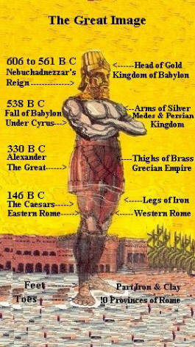
FALLING.APART.OF.THE.WORLD
196 “…We receive a Kingdom that cannot be moved." The world is falling apart. Every politician, denomination and church will fall to pieces… God made it fragile so it would break.
62-1216

Slide 8
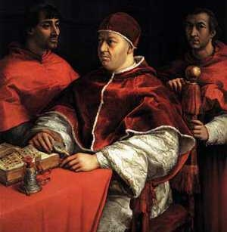
The Roman Catholic Church was the dominant religious power in Western Europe during the Dark Ages. Following the collapse of the Western Roman Empire in 476 CE, the Church was the only stable and unifying institution, effectively filling the power vacuum left by the absence of a centralized secular Roman government.
Political Power
Social & Cultural Authority
Economic Power
Religious Authority

Slide 9
Faith vs faith
אמונה
Faith is the connecting power to the spiritual realm, linking us with God and makes Him real. It is the basic ingredient to begin a relationship with God.
Faith is the assurance that the things revealed and promised in the Word are true, even though unseen, and gives the believer a conviction that what he expects in faith, will come to pass. Faith makes a promise so tangible that you can now rejoice in it before it comes to pass!

Slide 10
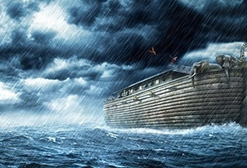
HEBREWS 11:7
By faith Noah, being warned of God of things not seen as yet, moved with fear, pre-pared an ark to the saving of his house; by the which he condemned the world, and became heir of the righteousness which is by faith.

Slide 11
EARNESTLY.CONTENDING.FOR.THE.FAITH
The people have to be in this kind of a spirit to bring the latter days. The people's in the spirit of the latter days. The nations are in the spirit of the end time.
They got atomic weapons, all kinds of things, because it's the spirit of the day, the spirit of the end time. The Church is moving together under the power and the impact of the Holy Spirit. And the world's running out yonder, and making fun, scoffing, laughing, and living like the devil every day. It's in the spirit of the thing. 53-0614

Slide 12
We’re In An Age Of ‘Apocalypse Anxiety’ And Will Never Stop Worrying About Doomsday
Not so long ago, most people in the West thought the world would end on Judgement Day after the dead rose from their graves. Now, of course, that seems unlikely because we are absolutely sure doomsday will come when climate change melts the ice caps and rising seas swallow our civilization. Or, a killer computer will wipe us off the planet – as long as we manage to survive the inevitable nuclear war, alien invasion or global pandemic.

Slide 13
Many predictions of the future have one common theme: we’re doomed and human civilization is going to end any day now. You might think that removing religion from society would stop us worrying about some disaster destroying our species. Yet modern secular society is as full of millennial fears about the end of the world as the societies our ancestors lived in, with science offering us a whole new set of doomsday scenarios. And we’re not about to shake off this dread, because we’re in an era of apocalypse anxiety where people are scared about the end of the world.

Slide 14
So what’s the best way to respond to all these rumours about the end of the world? Chances are, you’ll need to get used to hearing false apocalypse warnings because they are basically a feature of human society.
Various ‘prophets’ have predicted that the world will end in 2020, 2021 and 2026 – but we’re going to go out on a limb here and say that nothing will happen.
Read more: https://metro.co.uk/2019/06/07/age-apocalypse-anxiety-will-never-stop-worrying-doomsday-9853553/?ito=cbshare

Slide 15
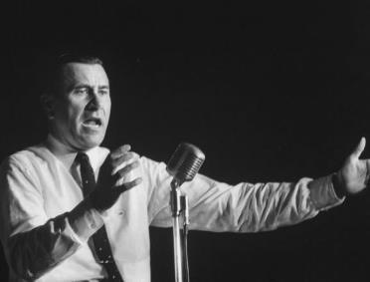
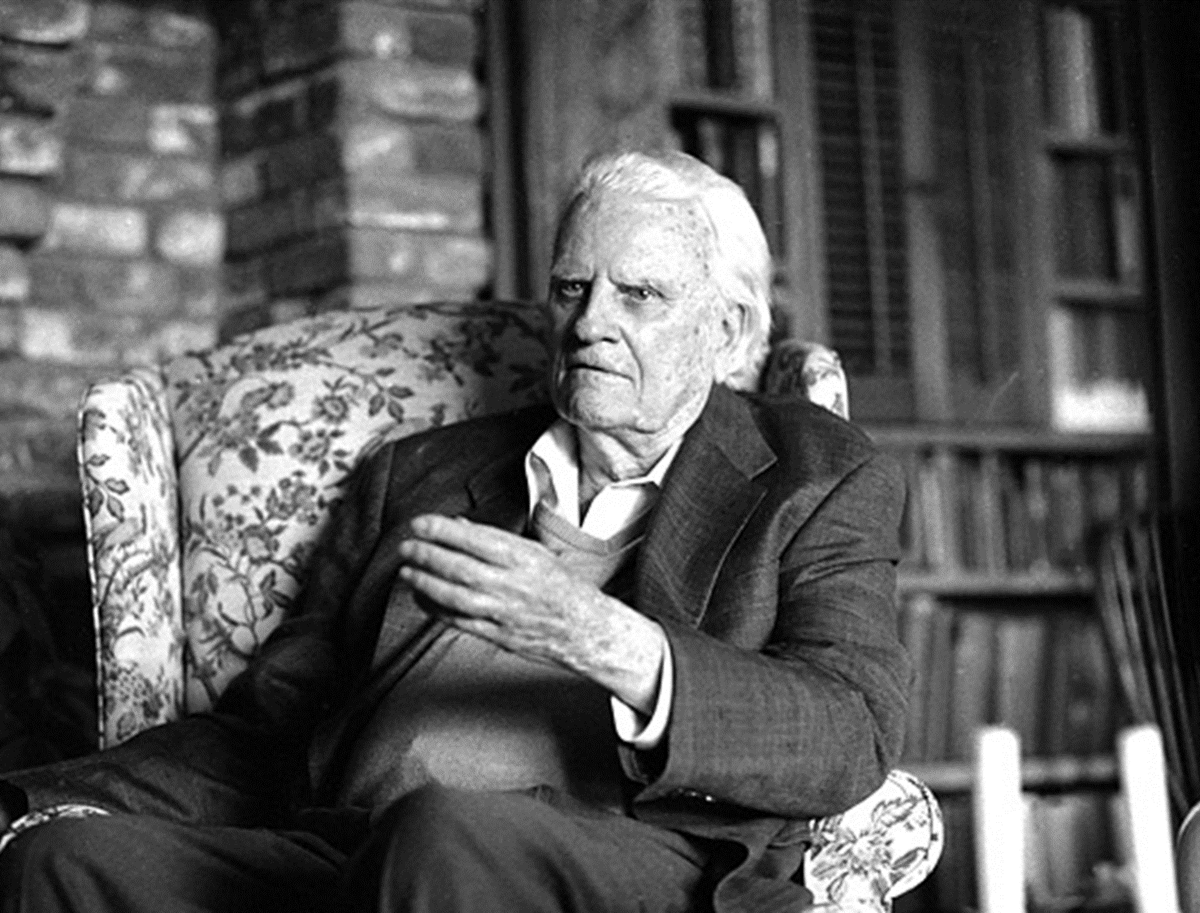
PUTTING ON THE WHOLE ARMOR OF GOD
Just before the end time, Abraham, elected church, was called out. It didn't go in Sodom…There was three Angels came to Abraham…..Two of them--a modern Billy Graham and an Oral Roberts, his messages went down into Sodom, preaching the Word, blinding them with the Word. To disbelieve the Word, you are blind. The preaching of the Gospel blinds the unbeliever. And that's what Billy Graham and those great evangelists are doing. Blinding. S. Pines, NC, 1962

Slide 16
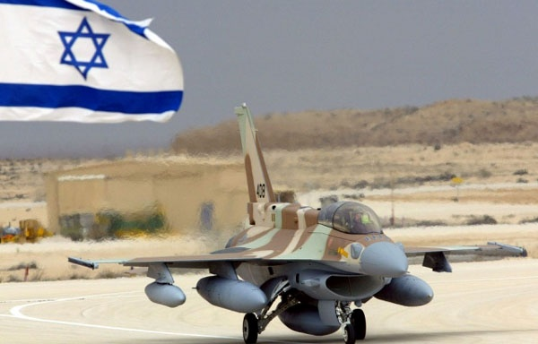
REVELATION 16:16
And he gathered them together into a place called in the Hebrew tongue Armageddon.

Slide 17
II PETER 3:9-10
The Lord is not slack concerning his promise, as some men count slackness; but is longsuffering to us-ward, not willing that any should perish, but that all should come to repentance. 10 But the day of the Lord will come as a thief in the night; in the which the heavens shall pass away with a great noise, and the elements shall melt with fervent heat, the earth also and the works that are therein shall be burned up.

Slide 18
Foundations for Biblical Faith
The Promises of God's Word
II COR. 1:20 For all the promises of God in him are yea, and in him Amen, unto the glory of God by us.
2. The Integrity of The Word
NUMBERS 23:19 God is not a man, that he should lie; neither the son of man, that he should repent: hath he said, and shall he not do it? or hath he spoken, and shall he not make it good?

Slide 19
3. The Ability of God to Endorse The Promise
ROMANS 4:20
He staggered not at the promise of God through unbelief; but was strong in faith, giving glory to God; 21 And being fully persuaded that, what he had promised, he was able also to perform. 22 And therefore it was imputed to him for righteousness.

Slide 20
Eg.: JEREMIAH 29:8-13
10 For thus saith the LORD, That after seventy years be accomplished at Babylon I will visit you, and perform my good word toward you, in causing you to return to this place. 11For I know the thoughts that I think toward you, saith the LORD, thoughts of peace, and not of evil, to give you an expected end. 12 Then shall ye call upon me, and ye shall go and pray unto me, and I will hearken unto you.13 And ye shall seek me, and find me, when ye shall search for me with all your heart.

Slide 21
4. The Confidence of the Believer in The Promises
HEBREWS 10:35
Cast not away therefore your confidence, which hath great recompence of reward. 36 For ye have need of patience, that, after ye have done the will of God, ye might receive the promise.

Slide 22
MATTHEW 17:20
And Jesus said unto them, Because of your unbelief: for verily I say unto you, If ye have faith as a grain of mustard seed, ye shall say unto this mountain, Remove hence to yonder place; and it shall remove; and nothing shall be impossible unto you.
POWER.OF.TRANSFORMATION 52 That's my Message, has been all along, is the Word of God. We must hold to That regardless of what other things take place. Always stay with that Word. 65-1031

Slide 23
LEAN.NOT.UNTO.THY.OWN.UNDERSTANDING
417 So, if you were in the foreknowledge of God, then you are becoming a part of God. And the only way you can be a son or daughter of God, you had to be a part of God, and God isn't complete without you… cause there is only one resource of Eternal Life, that is God, and Him alone has Eternal Life. Now, and you were a part of Him… in His thinking in the beginning. Because He thought of you in the beginning, it gives that little tug towards Him. That's what has to be quickened. 65-0120

Slide 24
HOW.CAN.I.OVERCOME
41 I was crossing an old log the other day. On the outside, it looked good. But a great chunk of it fell off. It was real rotten. I said, "That's the way the Christians are becoming." They been dead in sin and trespasses, so long, till become doty. They can hold no weight, at all. They don't know what the overcoming means. 63-0825
THERE.IS.ONLY.ONE.WAY.PROVIDED.BY.GOD.FOR.ANYTHING
163 The women are becoming so, they don't realize what they're doing; an evil spirit upon them. Why would a woman take her clothes off like that, to expose herself? She don't mean to be bad, they're just caught in that trap, and they don't know it. 63-0731

Slide 25
THERE.IS.ONLY.ONE.WAY.PROVIDED.BY.GOD.FOR.ANYTHING
34 They are breeding different things together, crossing over, and it makes a product that's no good... It's even perverting man and women, that man are becoming more like women, and women like man. Men are becoming a sissy, and women are becoming masculine. 63-0731
GOD.HIDING.HIMSELF.IN.SIMPLICITY
70 We are becoming a scientific age. Everything must be proven, scientifically… as predicted by the Bible, "weaker than wiser." And more we probe into science, further we get away from God. You'll never be able to scientifically prove God. 63-0412

Slide 26
WHY.I'M.AGAINST.ORGANIZED.RELIGION
4 …We are commissioned to pray for the sick, Who has already put on deposit the healing power. And we're only coming to write a check on that. "And whatever you ask the Father in My Name," that's the blank check… What a promise! Just can't fail. I have helped my brothers and sisters, around the world make these drawings on these notes in God's Bank, on the Blood of Jesus Christ. He's always paid off, and because the deposit's already there, you see. "He was wounded for our transgressions." It's all over. And we're happy tonight for your faith. 62-1111

Slide 27
(Blank Check) JOHN 15:14-16
Ye are my friends, if ye do whatsoever I command you. 15 Henceforth I call you not servants; for the servant knoweth not what his lord doeth: but I have called you friends; for all things that I have heard of my Father I have made known unto you. 16 Ye have not chosen me, but I have chosen you, and ordained you, that ye should go and bring forth fruit, and that your fruit should remain: that whatsoever ye shall ask of the Father in my name, he may give it you.

Slide 28
(Blank Check) MARK 11:22-24
And Jesus answering saith unto them, Have faith in God. 23 For verily I say unto you, That whosoever shall say unto this mountain, Be thou removed, and be thou cast into the sea; and shall not doubt in his heart, but shall believe that those things which he saith shall come to pass; he shall have whatsoever he saith. 24 Therefore I say unto you, What things soever ye desire, when ye pray, believe that ye receive them, and ye shall have them.

Slide 29
(Blank Check) JOHN 16:23-26
And in that day ye shall ask me nothing. Verily, verily, I say unto you, Whatsoever ye shall ask the Father in my name, he will give it you. 24 Hitherto have ye asked nothing in my name: ask, and ye shall receive, that your joy may be full. 25 These things have I spoken unto you in proverbs: but the time cometh, when I shall no more speak unto you in proverbs, but I shall shew you plainly of the Father. 26 At that day ye shall ask in my name: and I say not unto you, that I will pray the Father for you:

Slide 30
PSALM 107:40-43
He poureth contempt upon princes, and causeth them to wander in the wilderness, where there is no way. 41 Yet setteth he the poor on high from affliction, and maketh him families like a flock. 42 The righteous shall see it, and rejoice: and all iniquity shall stop her mouth. 43 Whoso is wise, and will observe these things, even they shall understand the lovingkindness of the LORD.

Slide 31
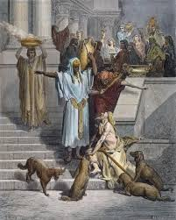
MATTHEW 5:3
Blessed are the poor in spirit: for theirs is the kingdom of heaven.

Slide 32
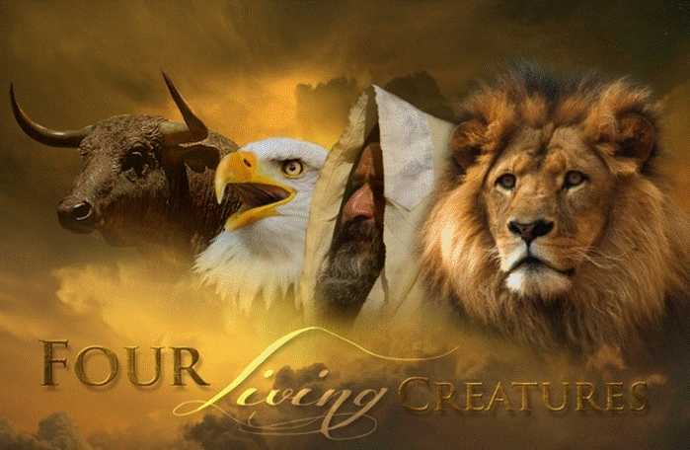
EZEKIEL 1:10
As for the likeness of their faces, they four had the face of a man, and the face of a lion, on the right side: and they four had the face of an ox on the left side; they four also had the face of an eagle.

Slide 33
QUESTIONS & ANSWERS.ON.HEB.3
683 Now, these four beasts, they had four faces: one had a face like a man; one had a face like an ox; the other face was like an eagle; and like a lion. And they never went backwards; they couldn't go backwards.
They could not go backwards, because every way they went they were going forward. If they went this a-way, they was going like a man; if they went this way, was going like a lion; this a-way, like an eagle; if they went this a-way, they was going like an ox. They couldn't go backwards; were going forward all the time. 57-1006

Slide 34
THE.FIFTH.SEAL
Martyrs down through the ages suffered terribly. But they were under the inspiration, the Spirit of God, the power. How could man do anything else besides the power of God that had been released to them?
If God sends a certain Spirit among them, that's the only thing that they can work by, is the Spirit that works among them. We'll prove to you by the history of the church, the opening of the Seals and the powers that let loose... And the church responded to the anointing, they couldn't do nothing else. 63-0322

Slide 35
THE.FIFTH.SEAL
188 So how in the world could the ox, a man be revealed until the eagle's come? They had their place. The lion, that was the original. There's where the antichrist come up in combat; then He raised up another power. He sent a power to meet it. Then He raised up another power, and He sent another power to meet it. And then at the last power, He brings down the eagle to restore the children back to the original faith again of the fathers - the eagle age. 63-0322

Slide 36
QUESTIONS & ANSWERS.ON.THE.SEALS
341 Please explain how Satan is bound a thousand years, being loosed again for the battle of Rev. 20:8?
That is not the battle of Armageddon. The battle of Armageddon takes place on this side when the tribulation period is ended.
Now, what relation does this have with the battle of Gog & Magog? None. One is this thousand years, and the other one is the end of the thousand years.
−

Slide 37
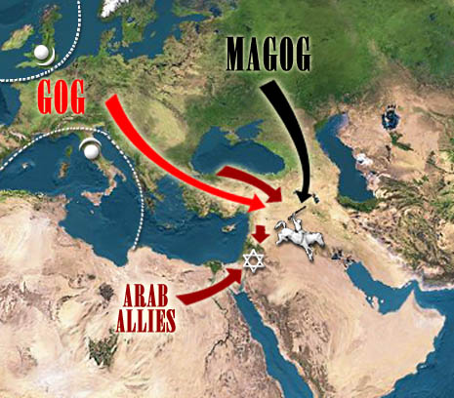
Gog & Magog

Slide 38
…as mentioned in the Fourth Seal, will Gog and Magog be gathered from peoples on the new earth?
Satan was loosed out of his prison and went to gather all the people, the wicked, to bring them to this place, and God rained fire and brimstone out of heaven, and they were consumed, two battles altogether.
63-0324

Slide 39
2. Moses & Elijah in Israel
3. Battle of Armageddon
4. Millennium
5. Battle of Gog & Magog
6. White Throne Judgment (Rev. 20:11)
1. Wedding Supper

Slide 40
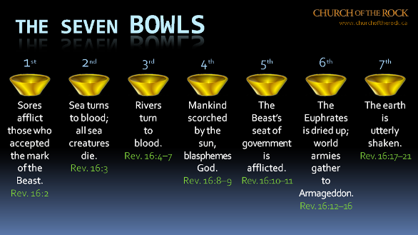

Slide 41
54-0515 QUESTIONS.AND.ANSWERS
312 Will the prophecy of Ezekiel 38 and 39 be fulfilled before the rapture? I think not. I think the next thing we look for is the rapture of the church.
61-0723 GOD.BEING.MISUNDERSTOOD
102 Will Ezekiel 38 and 39 come to pass before the rapture?
Now if you will notice, Ezekiel 38 and 39 deals with Gog and Magog, which is Russia, the north country. Now, to my way of teaching it comes to pass after the rapture, after the church is taken up. And God deals with Gog and Magog when they come down before Israel there. And I think that will come to pass after the rapture.

Slide 42
REVELATION 20:7-10
And when the thousand years are expired, Satan shall be loosed out of his prison, 8 And shall go out to deceive the nations which are in the four quarters of the earth, Gog and Magog, to gather them together to battle: the number of whom is as the sand of the sea.
9 And they went up on the breadth of the earth, and compassed the camp of the saints about, and the beloved city: and fire came down from God out of heaven, and devoured them. 10 And the devil that deceived them was cast into the lake of fire and brimstone, where the beast and the false prophet are, and shall be tormented day and night for ever and ever.

Slide 43
QUESTIONS & ANSWERS.ON.THE.SEALS
44. You have said many times that communism was raised up by God to serve His purpose, as King Nebuchadnezzar. Now where did communism fit into the picture? How does it wind up? Many scholars believe in the kingdom of the north, Gog and Magog in the Scriptures, goes down against Israel in… I believe you said it would finally that communism would finally destroy Catholicism or the Vatican by an explosion. Is this right? 63-0324

Slide 44
Yes. Rev. 16 - Rev. 18:8, 12… "Alas, alas, that great city... for in one hour she has come to her end.” It’ll be.
Just forget about communism. It's nothing in the world but a bunch of …barbarians that's ungodly. It's a system... Let me show you something--there's only 1% of all Russia that's communism. They need a messenger. Then 99% of them are still on the Christian side. How can 1% control 99%? That ought to explain it to you right there. If God didn't permit it, why, they'd be thrown out long ago.

Slide 45
RESTORATION.OF.THE.BRIDE.TREE
346 That's the reason I say… many preachers are saying "Communism is going to take the world and throw it down." Don't try to fight communism. Fight Romanism. That's THUS SAITH THE LORD. Romanism is going to rule, not communism. It's just a puppet. The Lord told Micaiah, "I've got to send Ahab out there. Have them preachers to say that, to send Ahab out there, in order to make Elijah's words come to pass."
348 God had to let communism raise up. What did it do? They run all these “morgues” together, and made a

Slide 46
confederation of churches join, to make an image of the beast, just what His Word said would take place. Don't you worry about that. You watch the thing it's forming under.
351 Therefore, we find out that it was. It's communism is gathered together. God said, "Gog and Magog, will gather together, to bring about the battle." That's exactly true, 'cause it's going to bring these forces together. The Bible said it would.
62-0422

Slide 47
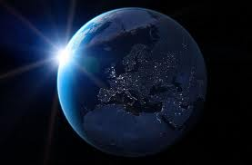
COD
273 I thought of that, God has helped me and let me know great men, let me go around the world. And people from around the world calling to come pray for them, sick people... And now, the businessmen prosper by the people that I bring into the city… And now, by the help of God, I believe that I'm directing the Bride of Jesus Christ. "Amazing grace, how sweet the sound!” 64-0823

Slide 48
I CORINTHIANS 2:1-5
And I, brethren, when I came to you, came not with excellency of speech or of wisdom, declaring unto you the testimony of God. 2 For I determined not to know any thing among you, save Jesus Christ, and him crucified. 3 And I was with you in weakness, and in fear, and in much trembling.
4 And my speech and my preaching was not with enticing words of man's wisdom, but in demonstration of the Spirit and of power: 5 That your faith should not stand in the wisdom of men, but in the power of God.

Slide 49
GABRIEL'S.INSTRUCTIONS.TO.DANIEL
32 This has been a week of tremendous study… been reading Dr. Larkin's book, Dr. Smith's book, Scofield's notes, different commentaries from men everywhere, yet I cannot put theirs together to make it come out right...
Been visiting the library in Kentucky on some of the ancient astronomy of calendars, times, and picking up all the ancient books that I can, what little I can do, and having my trust solemnly in Jesus Christ to reveal it to me, because I do not want it to say, "I know this, and I know that."

Slide 50
He knows my heart; He's listening at me. But I want it that I might enlighten His people. Therefore, I believe He will give it to me. I do not know as yet, but I'm trusting Him for next Sunday, 'cause that'll be the tremendous part to know and place those seventy weeks…
35 And that's why I'm asking God to let me know what these seventy of weeks mean, because I know it's the exact calendar for the age we're living in, therefore I want to know it, not for myself, 'course I want to know it. I want to know, because I want to know where we're living and what time we're living in.
61-0730

Slide 51
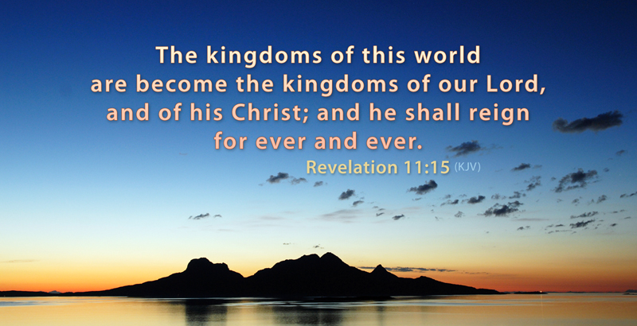

Slide 52
THE.ODDBALL
64 Satan, he has some bolts and nuts of the kingdoms of this world. Pharaoh was just as much nut to Moses, as Moses was to Pharaoh. Noah, by being a nut for God, pulled the church to the promised land. Depends on which way you're threaded. Moses pulled the church from Egypt, to God's promised land.
65 Now, be careful, 'cause these nuts and bolts look a whole lot a like. Just watch the thread. Matt. 24:24, "It would almost deceive the very Elected.” The American and the whole world denomination needs a nut. 64-0614

Slide 53
IS.THIS.THE.SIGN.OF.THE.END.SIR
53-2 Every one of you, cleanse your heart. Lay aside every weight. Don't let nothing bother you. Don't be scared. There's nothing to be scared about. If Jesus is coming, it's a moment the whole world has groaned and cried for. If it's breaking forth now, it'll be wonderful. If it's coming time that the revelation of the seven thunders will be revealed to the church, how to go, I don't know. 62-1230

Slide 54
Parent
YoReH
מורה
Yoreh
Rain is so special in Israel. This word refers to the annual debut of gentle rain on young seedlings, something noteworthy.

Slide 55
Present
Future
Husband
Instruct
Protector
Discipline
Provider
Counsel

Slide 56
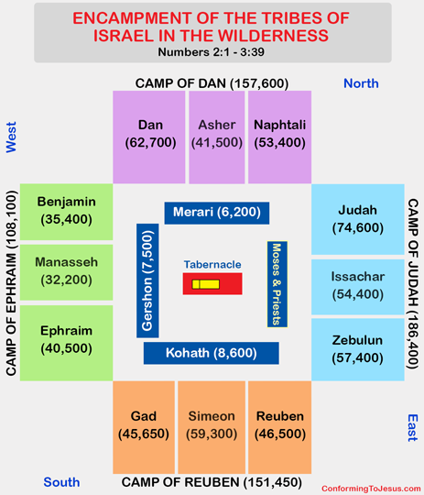
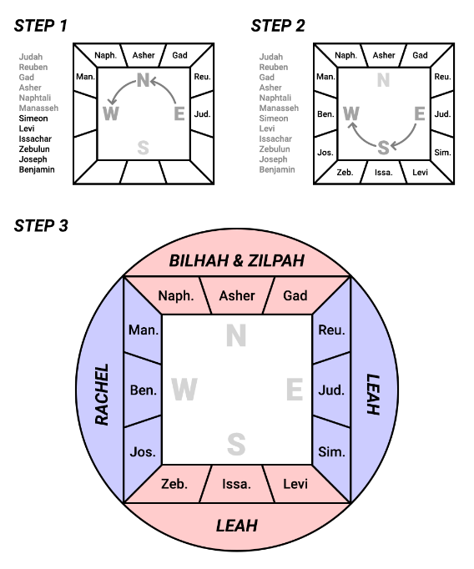

Slide 57
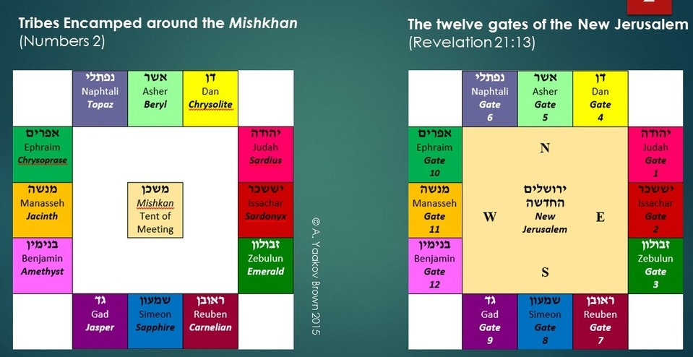

Slide 59
