Slide 1
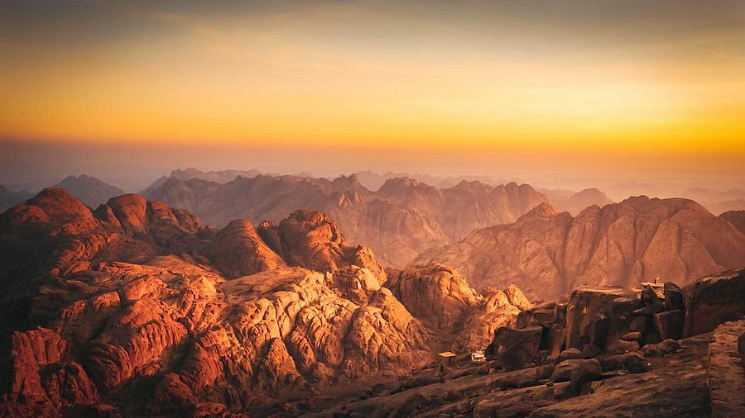
This I Know…
Knowledge Shall Increase
JOHN 9

Slide 2
Birthdays & Anniversaries
  Dec. 10th Hannah Harwell
  Josh & Kristen Godwin
  Dec. 11th Shame & Nomsa Chikoro
  Dec. 14th Hannah Whitlock
  Dec. 13th Church Dinner

Slide 3
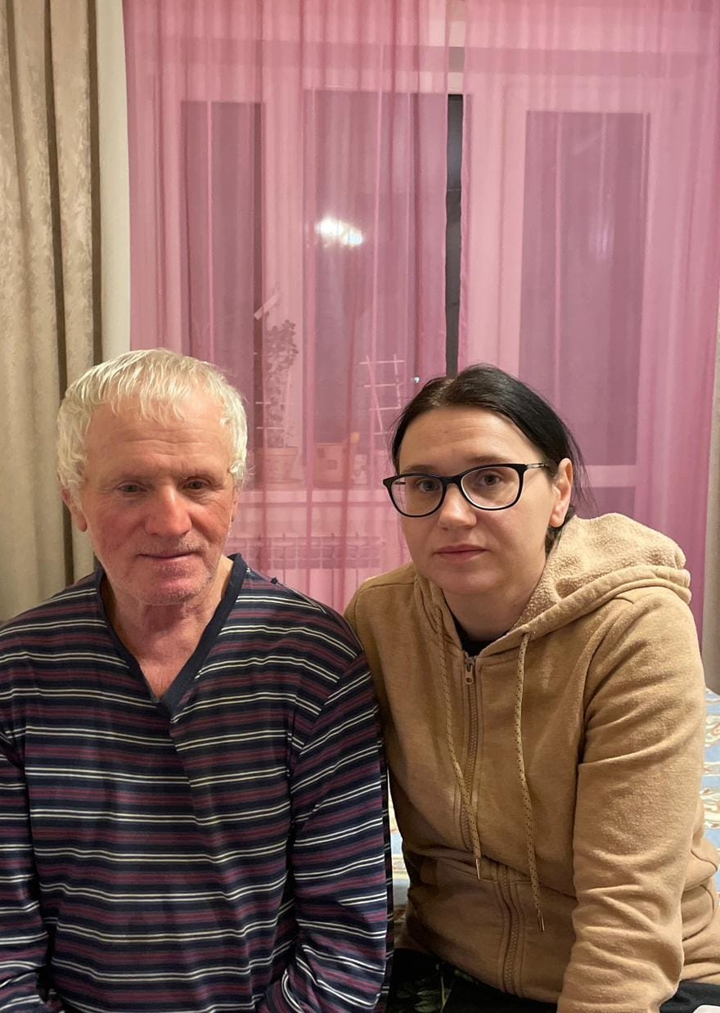
Kiev, Ukraine
Dear brothers and sisters from US and Bro. Coffey, from our heart, we thank you for the financial assistance. My family lives in Kiev, and our city has been under continuous strikes from drones and ballistic missiles. We always ask The Lord for His mercy, and He has kept us. We are often without electricity. My husband is still unable to work because it is unsafe for men to be outside on the street. Unfortunately, he has to stay home. I am the only one able to work. So, your assistance is always timely. Thank you very much. May The Lord bless you a hundredfold. With respect and gratitude,Your sister in Christ,Kira

Slide 4
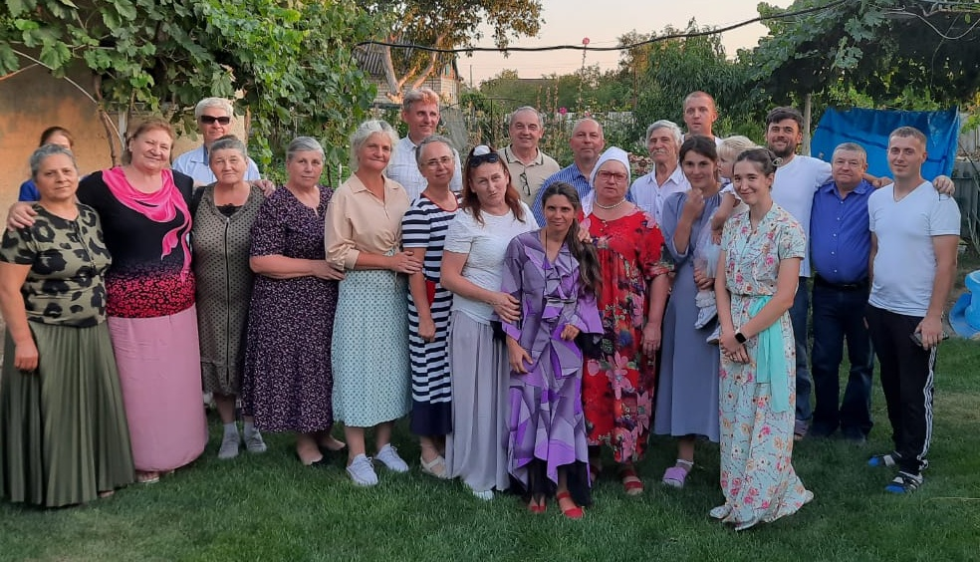
Vaznysansk, Ukraine

Slide 5
Greetings, brothers.I would like to thank you for your help during this difficult time. We lived in the city called Nikolaev where I had my device repair shop. Due to the war, we were forced to leave Nikolaev. We now live in the city called Vaznysansk. We are almost fully dependent on assistance because I am unable to work. I cannot even leave the house. I have not left the yard in over a year.
Men who are draft age are being caught by the draft police. We have our church services twice a week. Our family is very thankful for the help. We thank The Lord for the help through the brothers.

Slide 6


Slide 7
This I Know…
Knowledge Shall Increase
JOHN 9

Slide 8
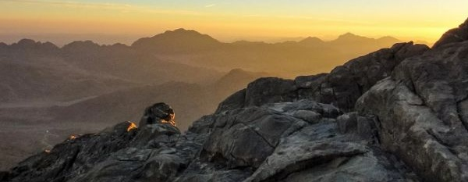
Exodus 19:1
In the third month, when the children of israel were gone forth out of the land of Egypt, the same day came they into the wilderness of Sinai...
Mt. Sinai

Slide 9
EXODUS 19:9
And the LORD said unto Moses, Lo, I come unto thee in a thick cloud, that the people may hear when I speak with thee, and believe thee for ever. And Moses told the words of the people unto the LORD.
And if thou wilt make me an altar of stone, thou shalt not build it of hewn stone: for if thou lift up thy tool upon it, thou hast polluted it.
Ex. 20:25

Slide 10
PSALM 56:8-9 Thou tellest my wanderings: put thou my tears into thy bottle: are they not in thy book? 9 When I cry unto thee, then shall mine enemies turn back: this I know; for God is for me.
I KINGS 17:23
And Elijah took the child, and brought him down out of the chamber into the house, and delivered him unto his mother: and Elijah said, See, thy son liveth. 24 And the woman said to Elijah, Now by this I know that thou art a man of God, and that the word of the LORD in thy mouth is truth.

Slide 11
HEAR.YE.HIM 57-0725
39 If the doctor said, "You're dying.“ Hear Him. He's the One Who brings life. "I'm the Lord Who heals thee." He's here tonight. His arms are open to receive you. I know I'm uneducated, a small pebble on the beach. But I know this one blessed thing: He lives! I know this: I know He lives. I can prove He lives. My heart knows He lives. His Spirit is here tonight, in a visible witness, to prove that Jesus Christ, God's Son, is here. You have no need of anything else but to hear Him.

Slide 12
SHALOM
144 Commit your ways to Him, He will bring the future out right, because we just see Him as He is in the Word.
145 You've seen Him vindicate the Word promised of today. You see it in the signs in the moon. You see it in the churches. "You said, 'in the church?” The moon represents the church. Jerusalem is the oldest known church city in the world. Melchisedec come from that city; And that was a moon, where the law was

Slide 13
established, and here come this wave of Gentile darkness coming over it. "The church would trod down the walls of Jerusalem till the Gentile dispensation was up." We're living right into it.
She is going right back, just as certain as my name is William Branham… we can see it. She is foreshadowed, calling the Elect out They grope right on in darkness, the rest of them... 64-0119

Slide 14
Daniel 2:17-23 [NLT]
Then Daniel went home and told his friends Hananiah, Mishael, and Azariah what had happened. ¹⁸ He urged them to ask the God of heaven to show them his mercy by telling them the secret, so they would not be executed along with the other wise men of Babylon. ¹⁹ That night the secret was revealed to Daniel in a vision. Then Daniel praised the God of heaven.
²⁰ He said, “Praise the name of God forever and ever, for he has all wisdom and power.

Slide 15
²¹ He controls the course of world events; he removes kings and sets up other kings. He gives wisdom to the wise and knowledge to the scholars. ²² He reveals deep and mysterious things and knows what lies hidden in darkness, though he is surrounded by light.
²³ I thank and praise you, God of my ancestors, for you have given me wisdom and strength. You have told me what we asked of you and revealed to us what the king demanded.”

Slide 16
I JOHN 3:2
Beloved, now are we the sons of God, and it doth not yet appear what we shall be: but we know that, when he shall appear, we shall be like him; for we shall see him as he is.
HEALING.AND.WHAT.SICKNESS.IS 50-0808
3. We're on the very threshold of the door to break forth into that great golden age that all the prophets has spoke of. Signs and wonders has been wrought by Thy servants throughout the land to turn the people back to a knowledge of the Presence of Jehovah God in our midst.

Slide 17
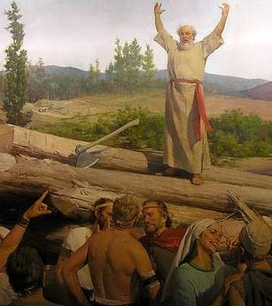
HEBREWS 11:7
By faith Noah, being warned of God of things not seen as yet, moved with fear, prepared an ark to the saving of his house; by the which he condemned the world, and became heir of the righteousness which is by faith.

Slide 18
SCRIPTURAL.SIGNS.OF.THE.TIME
12 One of these days, that minority, "As it was in the days of Noah... In the days of Lot…"
13 They're looking for a great big universal something, when it's not even in the Scripture. One of these days, they'll say, "Well, I thought the Bible said that the church will escape all of this?" The Bride escapes this.
64-0410

Slide 19
IS.THIS.THE.SIGN.OF.THE.END.SIR
53-2 Every one of you, cleanse your heart. Lay aside every weight. Don't let nothing bother you. Don't be scared. There's nothing to be scared about. If Jesus is coming, it's a moment the whole world has groaned and cried for. If it's breaking forth now, it'll be wonderful. If it's coming time that the revelation of the seven thunders will be revealed to the church, how to go, I don't know. 62-1230

Slide 20
Eg: FALLING.APART.OF.THE.WORLD
196 “…We receive a Kingdom that cannot be moved." The world is falling apart. Every politician, denomination and church will fall to pieces, but we receive a Kingdom that cannot be moved… God made it fragile so it would break. We got a Kingdom that's solid now… Not a political system, church system, denominational system...
62-1216
(Eg. Tower of Babel)

Slide 21
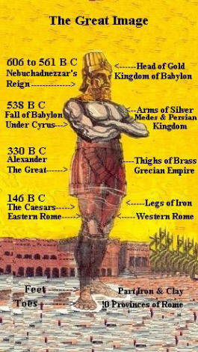
God’s people have always lived in the shadow of empires and their influence.
DANIEL 2:31
Thou, O king, sawest, and behold a great image. This great image, whose brightness was excellent, stood before thee; and the form thereof was terrible…
34 Thou sawest till that a stone was cut out without hands, which smote the image upon his feet that were of iron and clay, and brake them to pieces.

Slide 22
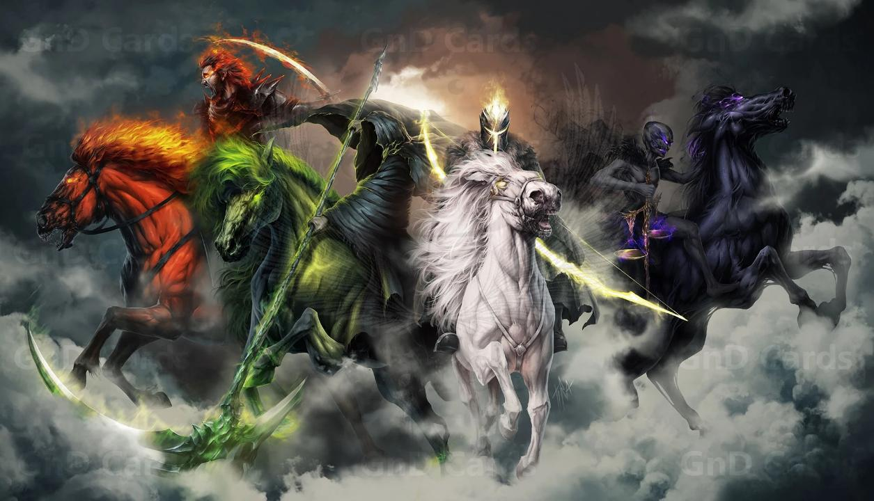

Slide 23
THE.FIFTH.SEAL
They [martyrs] were under inspiration, the Spirit of God... How could man do anything else besides the power of God that had been released to them?
If God sends a certain Spirit among them, that's the only thing that they can work by, is the Spirit that works among them. We'll prove to you by the history of the church, the opening of the Seals and the powers that let loose... And watch exactly the church responded to the anointing, and they couldn't do nothing else. 63-0322

Slide 24
LEAN.NOT… UNDERATANDING
19 I got that little story about that eagle…That's the way every believer is. You wasn't born for this world.
You was created in the image of God, to be a son of God. And you don't belong in this chicken yard out here. You're a eagle.
65-0120

Slide 25
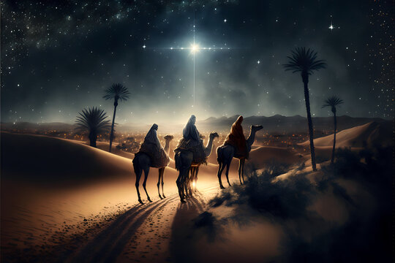
Emmanuel
“God with Us”
For unto you is born this day in the city of David
a Saviour, which is Christ the Lord. (LUKE 2:11-18)

Slide 26



Isaiah 7:14
Therefore the Lord himself shall give you a sign; Behold, a virgin shall conceive, and bear a son, and shall call his name Immanuel.

Slide 27
MATTHEW 1:22-25
22 Now all this was done, that it might be fulfilled which was spoken of the Lord by the prophet, saying, 23 Behold, a virgin shall be with child, and shall bring forth a son, and they shall call his name Emmanuel, which being interpreted is, God with us. 24 Then Joseph being raised from sleep did as the angel of the Lord had bidden him, and took unto him his wife: 25 And knew her not till she had brought forth her firstborn son: and he called his name JESUS.

Slide 28
GOD IN SIMPLICITY
20-3 Many miss Him by the way He reveals Himself. Now, man has their own ideas of what God ought to be and what God is going to do; and as I have made the old statement many times… Man is always giving God praise for what He did do, and always looking forward to what He will do, and ignoring what He's doing.
63-0317

Slide 29
SHOW.US.THE.FATHER & IT.SUFFICES
He was Emmanuel.
In other words, He was the expressed image of Jehovah here on earth, as Jehovah inveiled in flesh, living here on the earth, the only begotten of the Father, from His bosom.
50-0819

Slide 30
“The Messianic one coming out of Bethlehem
Has Existed for eternity. He is human by birth but
Supernatural in his origin.
“Although you are little Among the thousands
of Judah, out of you shall Come forth to me a
judge to be a ruler in Israel and This is the king
Messiah!”
Rabbi D. Kimchi

Slide 31
CHRIST.IS.THE.MYSTERY
291 Same as in the days of Christ, God holds the key to this revelation of Christ, Himself. You believe that? 63-0728
In that hour Jesus rejoiced in spirit, and said, I thank thee, O Father, Lord of heaven and earth, that thou hast hid these things from the wise and prudent, and hast revealed them unto babes: even so, Father; for so it seemed good in thy sight.
LUKE 10:21

Slide 32
THE.BREACH
136 So, you see, Jesus was God. He was not no third person, fourth person, second person; He was The Person. He was God. He was God Emmanuel. God come down from His glory, revealed Himself...
63-0317

Slide 33
MODERN.EVENTS
268 (Emaeus) Watch how He made Hisself known to these people, as their Messiah, promised Word of the age, as He has said to the prophets. "Fools, and slow of heart..."
269 He refers right back to the Word. He never come right out and told them, "Don't you know Me? I am the Messiah that's resurrected.“ He just give them the Scripture; like John did, and the rest of them. They have to pick that out themselves, judge for theirselves. Now, don't go to sleep, judge for yourself. 65-1206

Slide 34
JOHN 1:21-23
And they asked him, What then? Art thou Elias? And he saith, I am not. Art thou that prophet? And he answered, No. 22 Then said they unto him, Who art thou? that we may give an answer to them that sent us. What sayest thou of thyself? 23 He said, I am the voice of one crying in the wilderness, Make straight the way of the Lord, as said the prophet Esaias.

Slide 35
ISAIAH 40:3-5
The voice of him that crieth in the wilderness, Prepare ye the way of the LORD, make straight in the desert a highway for our God. 4 Every valley shall be exalted, and every mountain and hill shall be made low: and the crooked shall be made straight, and the rough places plain: 5 And the glory of the LORD shall be revealed, and all flesh shall see it together: for the mouth of the LORD hath spoken it.

Slide 36
GOD'S.PROVIDED.PLACE.OF.WORSHIP
72 Let's trace his name a little bit. The prophet said, "His Name would be called Emmanuel which is by interpretation, "God with us.” Matt. 1:23.
73 Emmanuel, and His Name was Jesus, God with us, with His Father's Name. There is where God placed His Name, in His Son. That's the only place that you can worship Him. The only place God will ever meet you, is in that Son which was typed by the sacrificial lamb.
1965

Slide 37
WHY.IT.HAD.TO.BE.SHEPHERDS
98 He had started a new creation. A creation of Himself. God was made flesh and dwelt among us. “…the beginning of the creation of God." God was created in human form; in Jesus Christ, His Son, God dwelt. He built His tabernacle of flesh and bones, and lived in that tabernacle; God, Emmanuel, "God with us." He built Himself a house, to live in it, so He could reflect His Word to His subjects through that. You know what God is, when you see Christ. 64-1221

Slide 38
TIME.TESTED.MEMORIALS.OF.GOD
21 …In April, the snow was melting in Judaea and coming down the mountains. Looked like he picked the worst time in all the year to cross Jordan. But God likes to take those kind of times to prove that He's God.
And men of God who believe God and know what God has promised, is not afraid to do it, because God will stick with His Word just as certain as He is God.
57-0818

Slide 39
EXODUS 25:8-9
And let them make me a sanctuary [temple, tabernacle]; that I may dwell among them. 9 According to all that I shew thee, after the pattern of the tabernacle, and the pattern of all the instruments thereof, even so shall ye make it.
MALACHI 3:1
Behold, I will send my messenger, and he shall prepare the way before me: and the Lord, whom ye seek, shall suddenly come to his temple, even the messenger of the covenant, whom ye delight in: behold, he shall come, saith the LORD of hosts.

Slide 40
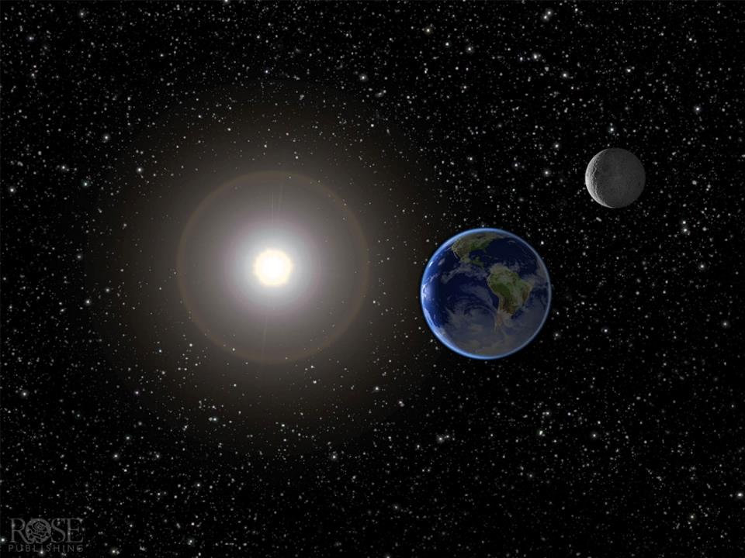
Everlasting
Father

Slide 41
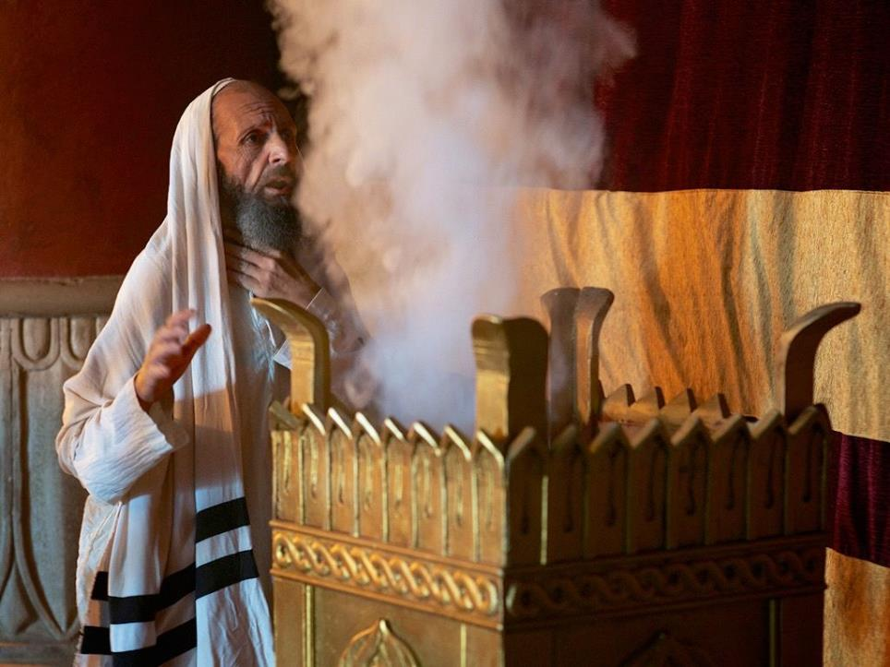
Zacharias
Luke 1:68-79

Slide 42
LUKE 1:67-79
And his father Zacharias was filled with the Holy Ghost, and prophesied, saying, 68 Blessed be the Lord God of Israel; for he hath visited and redeemed his people, 69 And hath raised up an horn of salvation for us in the house of his servant David;

Slide 43
PRESENCE.OF.GOD.UNRECOGNIZED 64-0618
60 (God has shook every promise in the Bible) Still we just sit and stare, looking. "Show me a sign, will you?" And it's going on all the time, right around us. Bringing the Presence of God, it ought to illuminate us…After Jesus had so proven that He was that Messiah… "Show us a sign." See, they didn't recognize, staring straight ahead of them. It wasn't in them to believe. They still didn't recognize Him, so blinded by their creeds… never knew the Scriptures of the promise, because the creeds had covered it up…”

Slide 44
WHY.LITTLE.BETHLEHEM
67 In this little town, stable down on the side of the bluff… and out of there came forth the Prince of Peace, born in straw, manure piled up in the barns, but out of there came that great Prince, the Seed of the woman, out of there came the Saviour of the world, out of there came Jehovah Himself, in a form of a man, came out of that little humble stable in Bethlehem.
63-1214

Slide 45
LUKE 2:1-4
And it came to pass in those days, that there went out a decree from Caesar Augustus, that all the world should be taxed. 2 (And this taxing was first made when Cyrenius was governor of Syria) And all went to be taxed, every one into his own city. 4 And Joseph also went up from Galilee, out of the city of Nazareth, into Judaea, unto the city of David, which is called Bethlehem; (because he was of the house and lineage of David:)

Slide 46
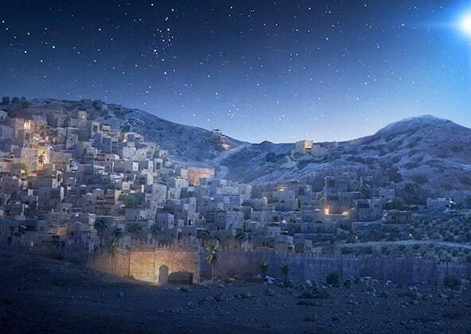
MICAH 5:2
But thou, Bethlehem Ephratah, though thou be little among the thousands of Judah, yet out of thee shall he come forth unto me that is to be ruler in Israel; whose goings forth have been from of old, from everlasting. 3 Therefore will he give them up, until the time that she which travaileth hath brought forth: then the remnant of his brethren shall return unto the children of Israel.

Slide 47
JOHN 7:40-42
Many of the people therefore, when they heard this saying, said, Of a truth this is the Prophet. 41 Others said, This is the Christ. But some said, Shall Christ come out of Galilee? 42 Hath not the scripture said, That Christ cometh of the seed of David, and out of the town of Bethlehem, where David was?

Slide 48
MATTHEW 2:17-18
Then was fulfilled that which was spoken by Jeremy the prophet, saying, In Rama was there a voice heard, lamen-tation, and weeping, and great mourning, Rachel weeping for her children, and would not be com-forted, because they are not.

Slide 49
JEREMIAH 31:15
Thus saith the LORD; A voice was heard in Ramah, lamentation, and bitter weeping; Rahel weeping for her children refused to be comforted for her children, because they were not.

Slide 50
REPROACH.FOR.THE.CAUSE.OF.THE.WORD
251 Angels… must have looked down and rejoiced, when they looked on the manger and seen God incarnate. No wonder they begin to scream, "Today, in the city of David, is born Christ the Saviour."
Angels rejoiced, swung their big wings together, over the hills of Judaea sang, "Glory to God in the highest, peace on earth, and good will to man." They seen God's Word, watched over It, to see It manifested. 62-1223

Slide 51
SHALOM
114 So, God took thousands of years to fulfill His promise of a coming Saviour. Four thousand years, but He knowed, from the beginning, just when it was going to happen; no one else did. And when it happened, people was in such a delusion, till they didn't know how to accept it. If that same thing hasn't repeated again!
64-0119

Slide 52
THE.MANIFESTATION.OF.THE.SPIRIT
42 I stand tonight as His servant to help you. It may not be according to your theological teachings. God usually does things contrary to [how] people have it figured out. Those priests couldn't believe Jesus come like that, born in a manger… In my opinion, brother clergymen, when Jesus appears the second time, it'll be altogether different than what we got it figured out. He hides it from the eyes of the wise and prudent, and will reveal it to babes such as will learn. It's spiritually understood.
51-0717

Slide 53
I JOHN 1:1-3
1 That which was from the beginning, which we have heard, which we have seen with our eyes, which we have looked upon, and our hands have handled, of the Word of life; 2 (For the life was manifested, and we have seen it, and bear witness, and shew unto you that eternal life, which was with the Father, and was manifested unto us;) 3 That which we have seen and heard declare we unto you, that ye also may have fellowship with us: and truly our fellowship is with the Father, and with his Son Jesus Christ.

Slide 54



JOHN 4:40-42
40 So when the Samaritans were come unto him, they besought him that he would tarry with them: and he abode there two days. 41 And many more believed because of his own word; 42 And said unto the woman, Now we believe, not because of thy saying: for we have heard him ourselves, and know that this is indeed the Christ, the Saviour of the world.

Slide 55
INVESTMENTS 63-0803
64 …Jesus was God. He was nothing short of God. God coming down to become man to die... God could not die as a Spirit, He's eternal… but God could make Himself in such a way that He could feel pain, and He could feel and suffer. God could not suffer, as the eternal Spirit, but when He become man, He could suffer, and feel the pain and the temptations that man went through like Adam and Eve in the garden of Eden, and everyone since.

Slide 56
THE.POWER.OF.DECISION 55-1007
21 So the devil… tries to cut off the move of God. Every time he will do that. And he's still the same devil, use the same techniques that he did in the old days, still uses them today. So he had power, and that power was death.
But he had no power beyond that. Just death ends his power. Then beyond death, faith sees the God of resurrection. After the devil's end of the power of death, then he's finished, the devil can do no more.

Slide 57
LUKE 2:36-38
And there was one Anna, a prophetess, the daughter of Phanuel, of the tribe of Aser: she was of a great age, and had lived with an husband seven years from her virginity; 37 And she was a widow of about fourscore and four years, which departed not from the temple, but served God with fastings and prayers night and day. 38 And she coming in that instant gave thanks likewise unto the Lord, and spake of him to all them that looked for redemption in Jerusalem.

Slide 58
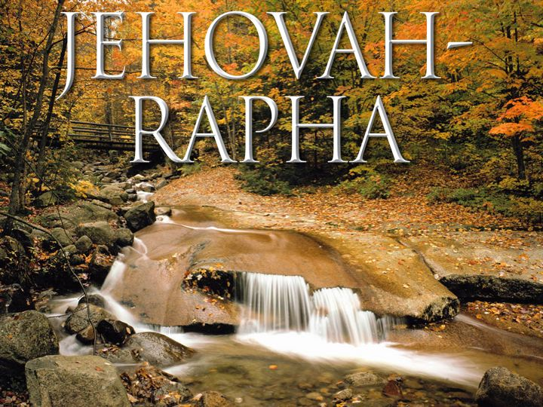
Jehovah is Our Healer

Slide 59
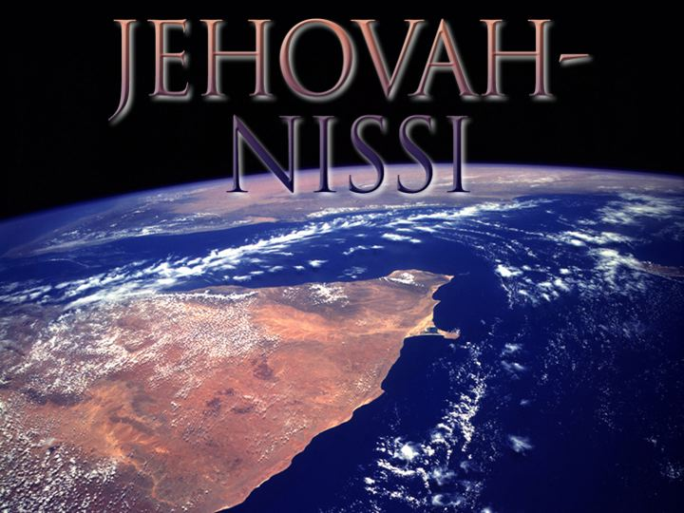
Jehovah is Our Banner

Slide 60

Jehovah is Our Provider

Slide 61
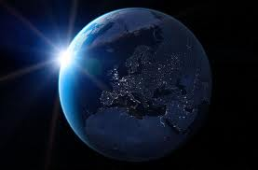
COD
273 I thought of that, God has helped me and let me know great men, let me go around the world. And people from around the world calling to come pray for them, sick people... And now, the businessmen prosper by the people that I bring into the city… And now, by the help of God, I believe that I'm directing the Bride of Jesus Christ. "Amazing grace, how sweet the sound!” 64-0823

Slide 62
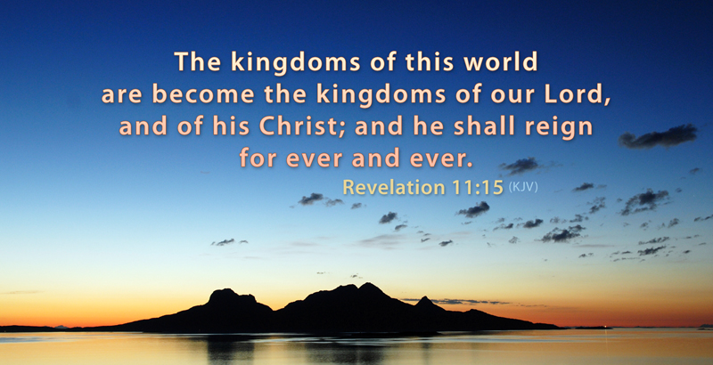

Slide 64
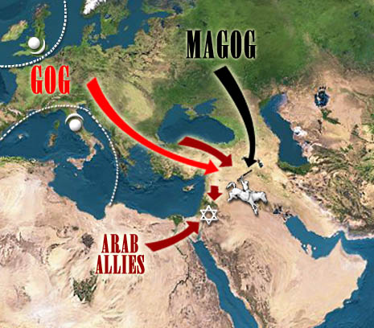
Gog & Magog

Slide 65
QUESTIONS & ANSWERS.ON.THE.SEALS
341 Please explain how Satan is bound a thousand years, being loosed again for the battle of Rev. 20:8?
That is not the battle of Armageddon. The battle of Armageddon takes place on this side when the tribulation period is ended.
Now, what relation does this have with the battle of Gog & Magog? None. One is this thousand years, and the other one is the end of the thousand years.
−

Slide 66
…as mentioned in the Fourth Seal, will Gog and Magog be gathered from peoples on the new earth?
Satan was loosed out of his prison and went to gather all the people, the wicked, to bring them to this place, and God rained fire and brimstone out of heaven, and they were consumed, two battles altogether.
63-0324

Slide 67
Wedding Supper
Moses & Elijah in Israel (3.5 years)
Battle of Armageddon
Millennium
Battle of Gog & Magog
White Throne Judgment (Rev. 20:11)

Slide 68
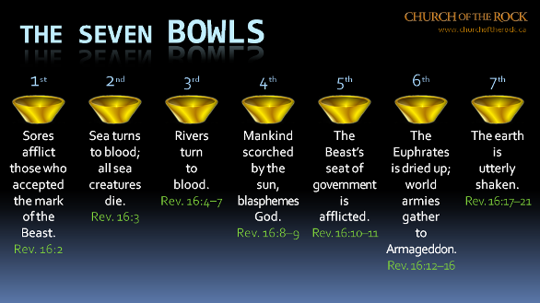

Slide 69
54-0515 QUESTIONS.AND.ANSWERS
312 Will the prophecy of Ezekiel 38 and 39 be fulfilled before the rapture? I think not. I think the next thing we look for is the rapture of the church.
61-0723 GOD.BEING.MISUNDERSTOOD
102 Will Ezekiel 38 and 39 come to pass before the rapture?
Now if you will notice, Ezekiel 38 and 39 deals with Gog and Magog, which is Russia, the north country. Now, to my way of teaching it comes to pass after the rapture, after the church is taken up. And God deals with Gog and Magog when they come down before Israel there. And I think that will come to pass after the rapture.

Slide 70
REVELATION 20:7-10
And when the thousand years are expired, Satan shall be loosed out of his prison, 8 And shall go out to deceive the nations which are in the four quarters of the earth, Gog and Magog, to gather them together to battle: the number of whom is as the sand of the sea.
9 And they went up on the breadth of the earth, and compassed the camp of the saints about, and the beloved city: and fire came down from God out of heaven, and devoured them. 10 And the devil that deceived them was cast into the lake of fire and brimstone, where the beast and the false prophet are, and shall be tormented day and night for ever and ever.

Slide 71
QUESTIONS & ANSWERS.ON.THE.SEALS
44. You have said many times that communism was raised up by God to serve His purpose, as King Nebuchadnezzar. Now where did communism fit into the picture? How does it wind up? Many scholars believe in the kingdom of the north, Gog and Magog in the Scriptures, goes down against Israel in… I believe you said it would finally that communism would finally destroy Catholicism or the Vatican by an explosion. Is this right? 63-0324

Slide 72
Yes. Rev. 16 - Rev. 18:8, 12… "Alas, alas, that great city... for in one hour she has come to her end.” It’ll be.
Just forget about communism. It's nothing in the world but a bunch of …barbarians that's ungodly. It's a system... Let me show you something--just to show you how simple it is. Why, there's only 1% of all Russia that's communism. They need a messenger. Then 99% of them are still on the Christian side. How can 1% control 99%? That ought to explain it to you right there. If God didn't permit it, why, they'd be thrown out long ago.

Slide 73
THE.ODDBALL
64 Satan, he has some bolts and nuts of the kingdoms of this world. Pharaoh was just as much nut to Moses, as Moses was to Pharaoh. Noah, by being a nut for God, pulled the church to the promised land. Depends on which way you're threaded. Moses pulled the church from Egypt, to God's promised land.
65 Now, be careful, 'cause these nuts and bolts look a whole lot a like. Just watch the thread. Matt. 24:24, "It would almost deceive the very Elected.” The American and the whole world denomination needs a nut. 64-0614

Slide 74
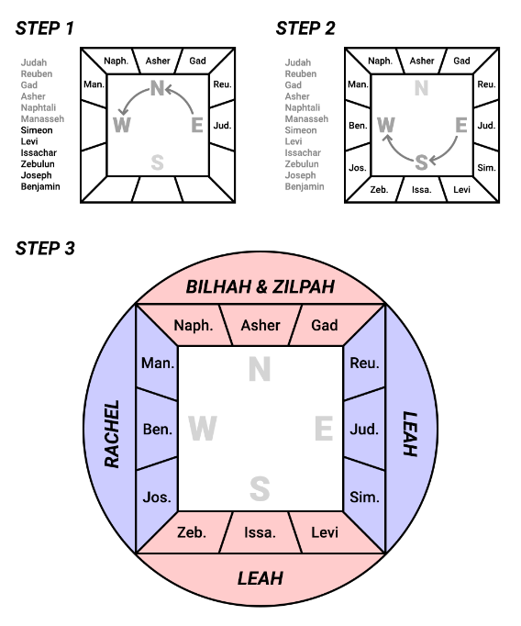
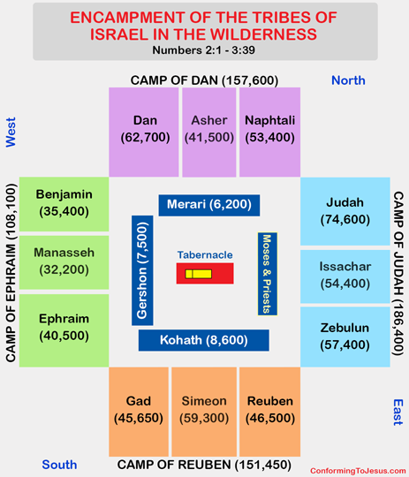

Slide 75
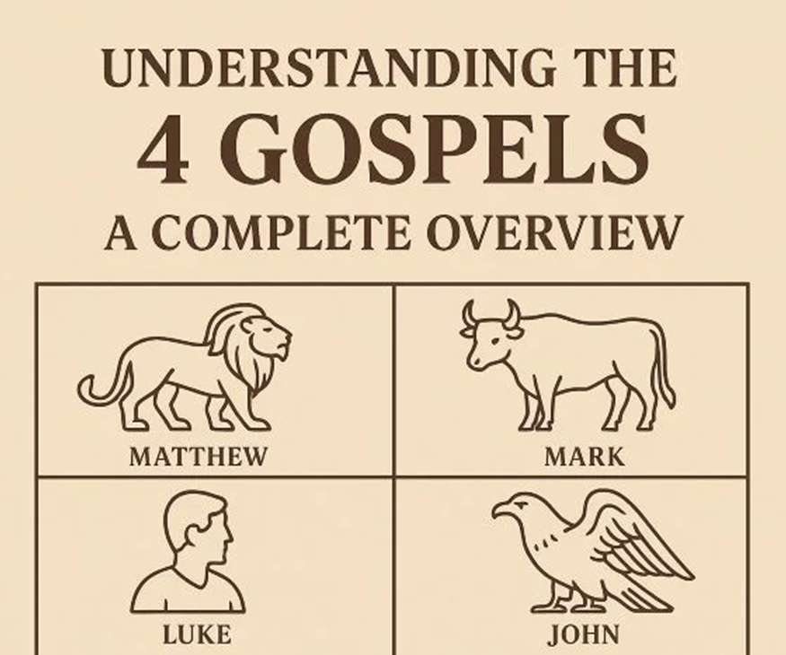
Q&A.HEBREWS.3
688 They seen everywhere they were going, the power of the Gospels as it goes out; the shrewdness of a man; the swiftness of an eagle; the burden-bearer like an ox; sternness, boldness of a lion: the four Gospels, which are the four powers of the Rev. 4. 57-1006

Slide 76
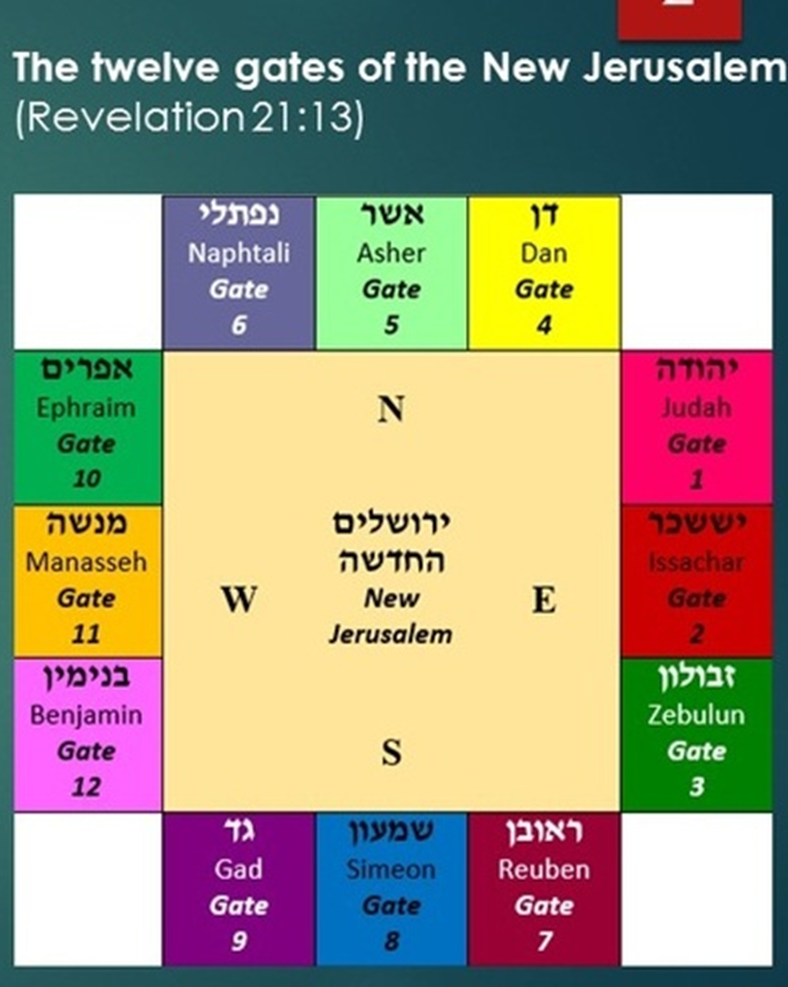
EZEKIEL 48:31-35
And the gates of the city shall be after the names of the tribes of Israel: three gates northward; one gate of Reuben, one gate of Judah, one gate of Levi. 32 And at the east side four thousand and five hundred: and three gates; and one gate of Joseph, one gate of Benjamin, one gate of Dan. 33 And at the south side four thousand and five hundred measures: and three gates; one gate of Simeon, one gate of Issachar, one gate of Zebulun. 34 At the west side four thousand and five hundred, with their three gates; one gate of Gad, one gate of Asher, one gate of Naphtali. 35 It was round about eighteen thousand measures: and the name of the city from that day shall be, The LORD is there.

Slide 77
I CORINTHIANS 2:1-5
And I, brethren, when I came to you, came not with excellency of speech or of wisdom, declaring unto you the testimony of God. 2 For I determined not to know any thing among you, save Jesus Christ, and him crucified. 3 And I was with you in weakness, and in fear, and in much trembling.
4 And my speech and my preaching was not with enticing words of man's wisdom, but in demonstration of the Spirit and of power: 5 That your faith should not stand in the wisdom of men, but in the power of God.

