Slide 1


Slide 2

“He came unto his own, and his own received him not. But as many as received him, to them gave he power to become the children of God, even to them that believe on His name; Who were born, not of blood, nor of the will of the flesh, nor of the will of man, but of God.”
John 1:11-13

Slide 3
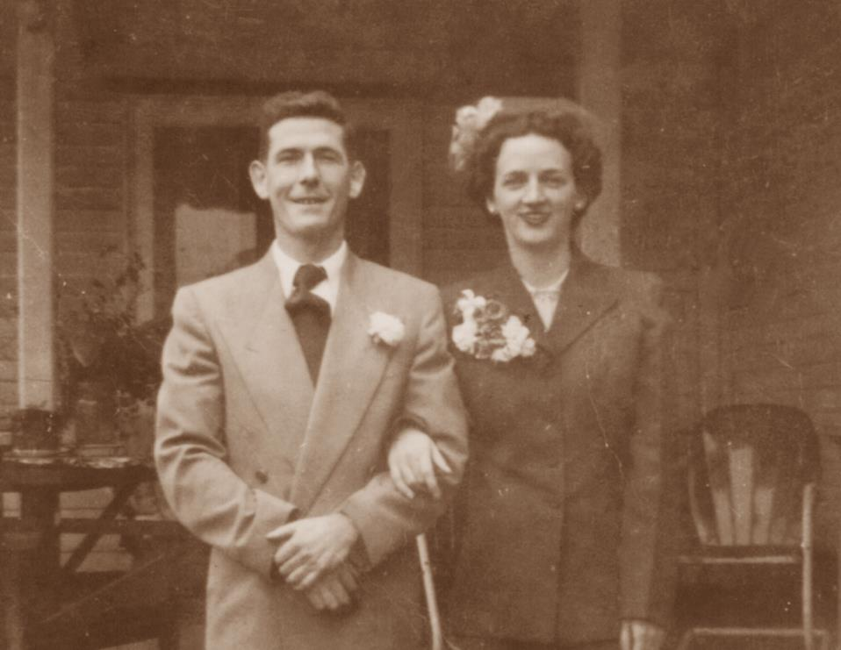
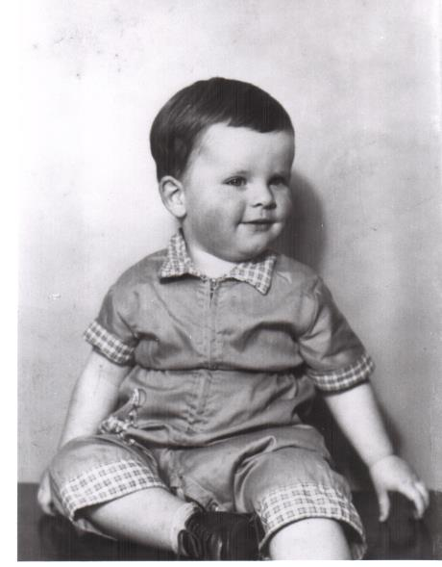
1951

Slide 4
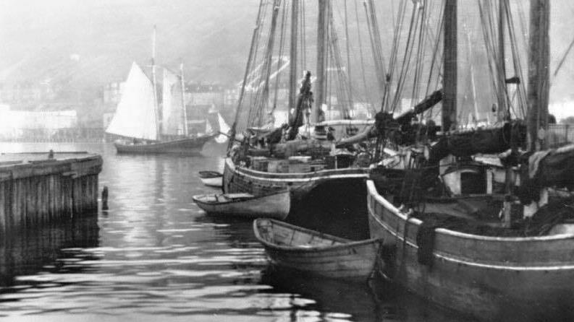
Old St. John’s (English Colony)

Slide 5
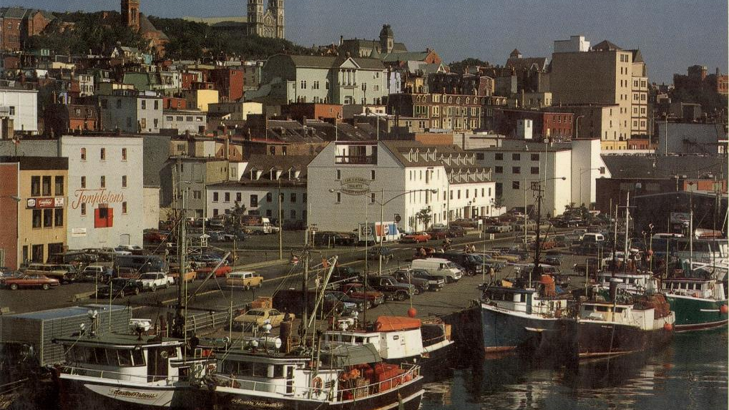
St. John’s
Newfoundland

Slide 7
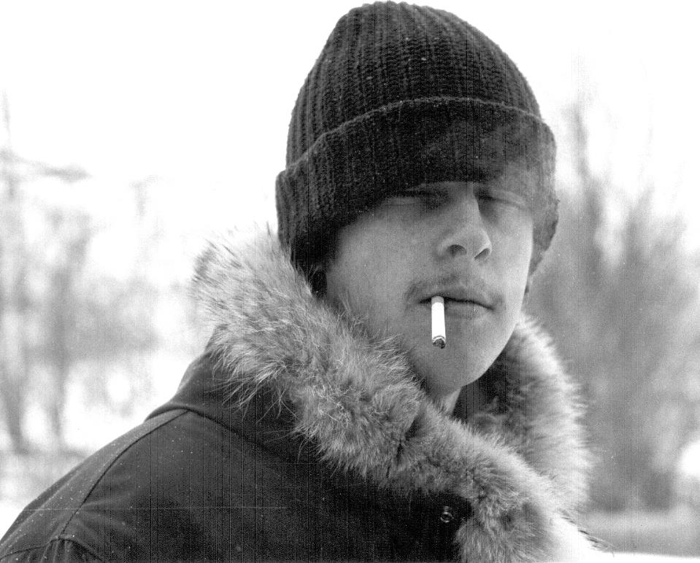
1975

Slide 8
AS.THE.EAGLE.STIRRETH.UP.HER.NEST
26 It's a pitiful sight, to see human being helpless, bound by sin… flopping around from beer parlor to beer parlor, place to place, from amusement to amusement, trying to find satisfaction, when God alone has the satisfaction that can satisfy them.
God made a man to thirst after Him. The reason man has something in him to thirst, God put that thirst in you. But you can't satisfy it with the things of the world. You'll never be satisfied till God takes that place.
59-0815

Slide 9
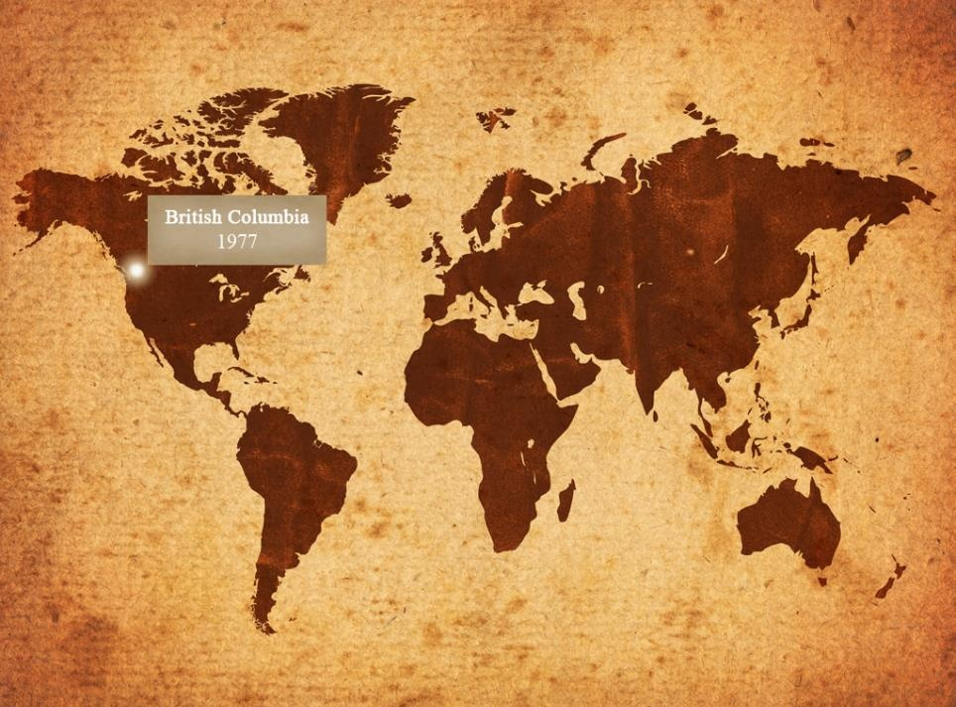
The Journey
November 1978

Slide 10
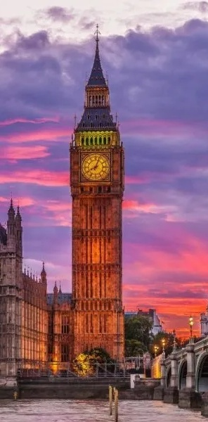
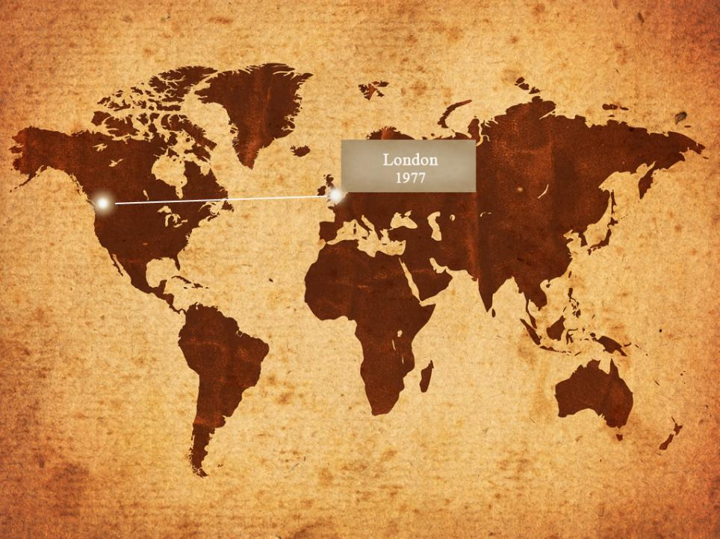

Slide 11
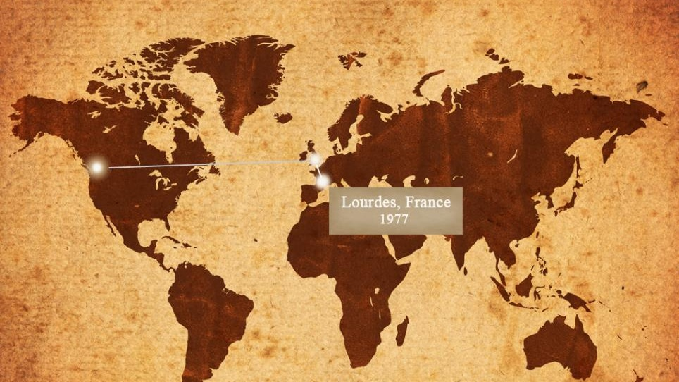

Slide 12
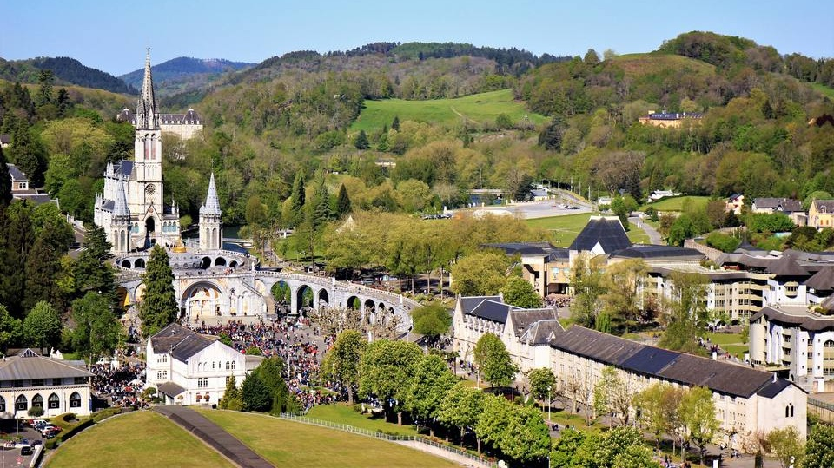

Slide 13
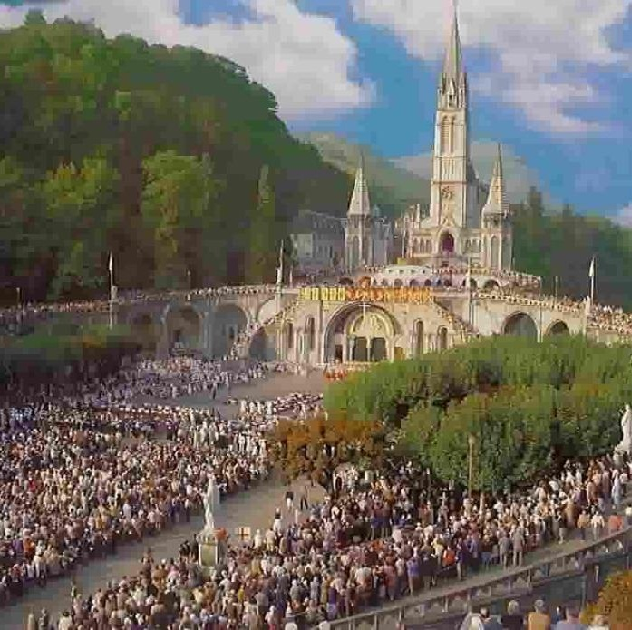
The Sanctuary of Our Lady of Lourdes Church
Lourdes
France

Slide 14
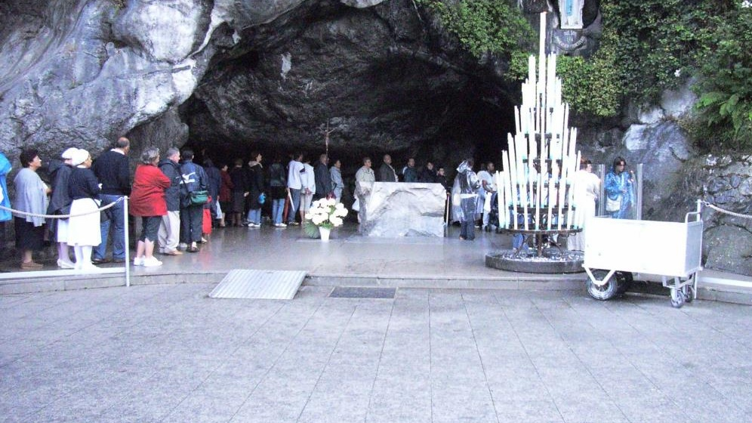
“Water From the Rock”
Lourdes, France

Slide 15
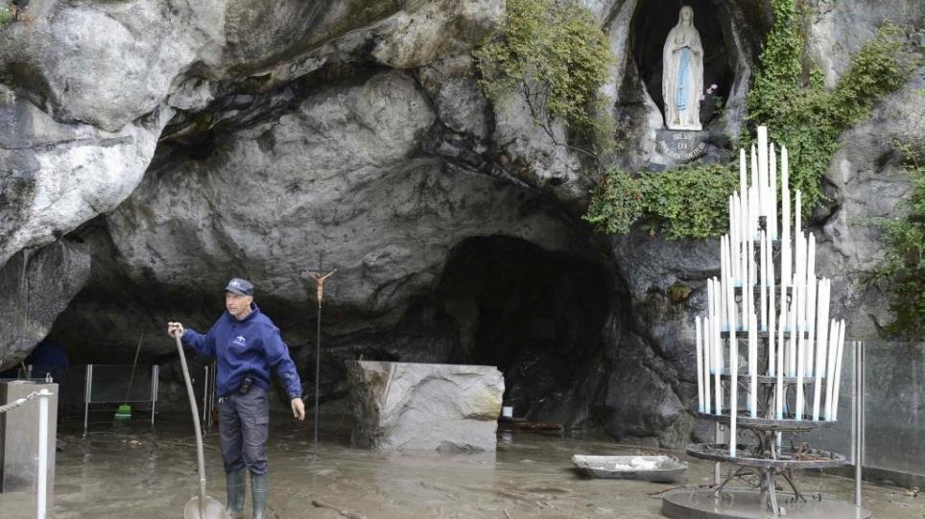

Slide 16
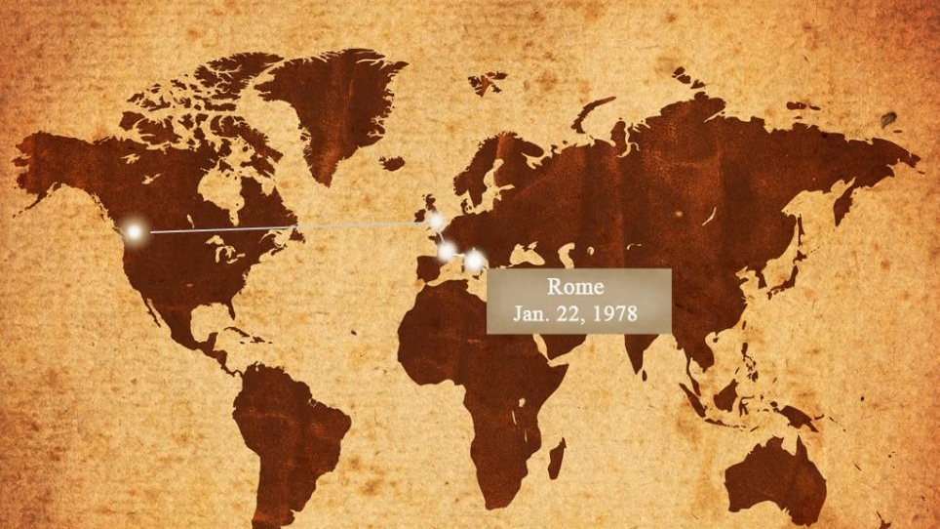

Slide 17
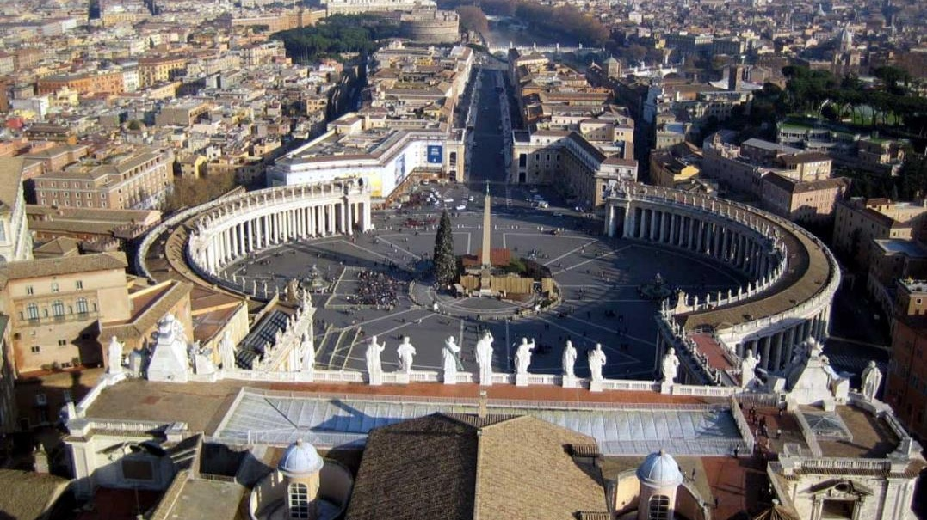
St. Peter’s Square
January 1978

Slide 18
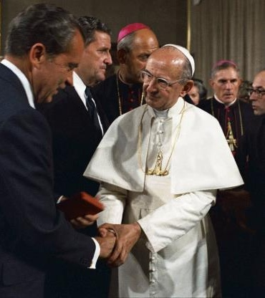
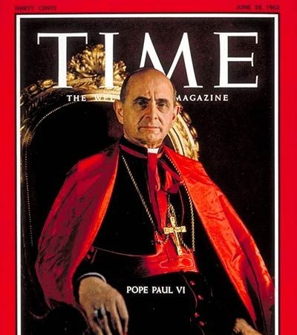
Pope Paul VI

Slide 19
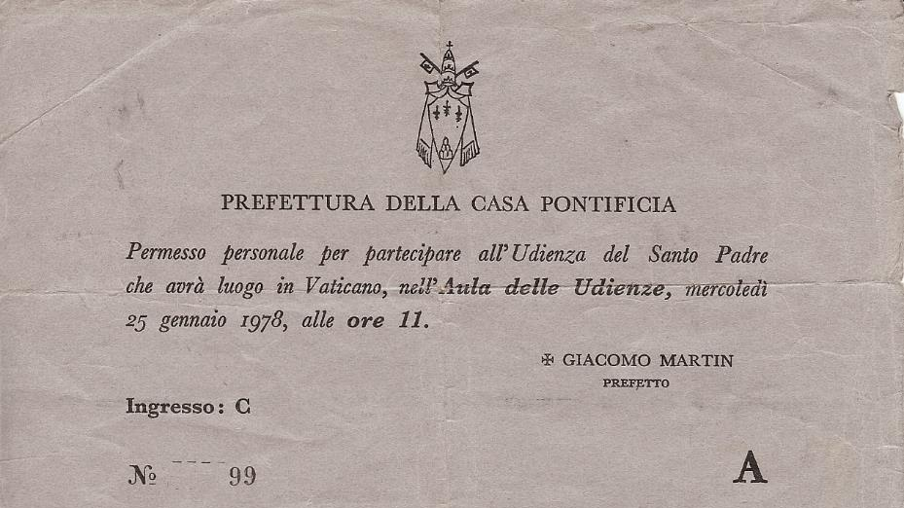

Slide 20
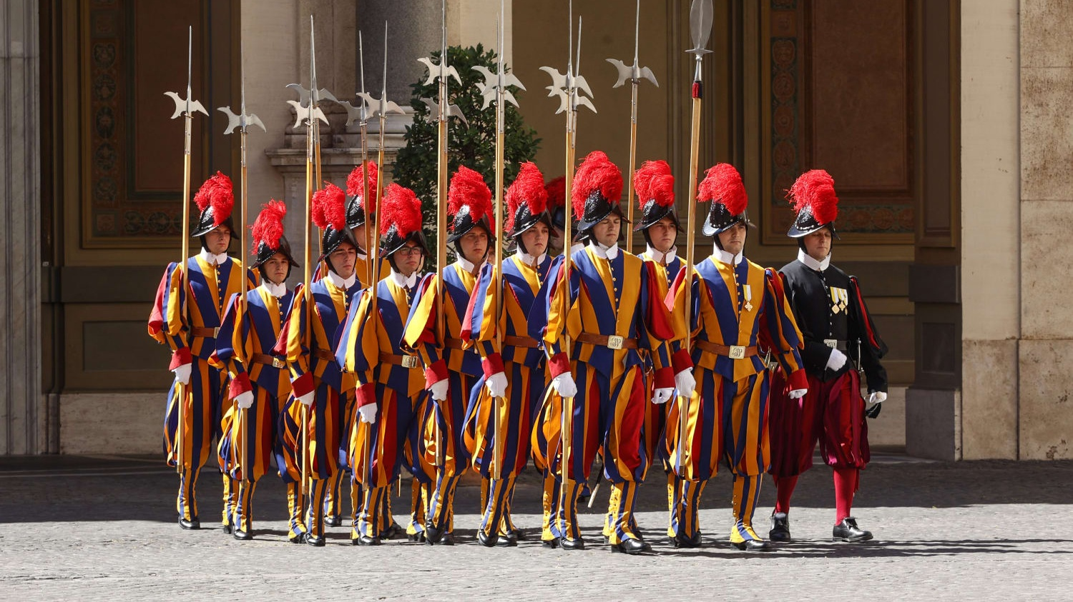

Slide 21
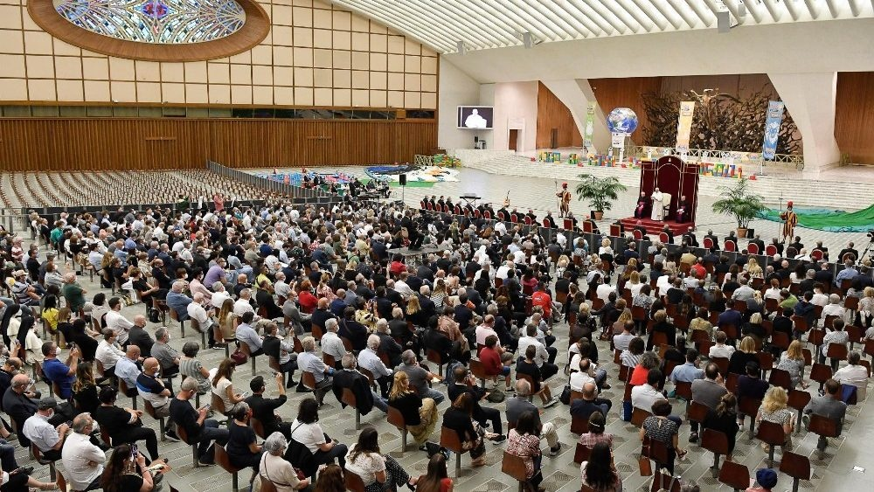

Slide 22
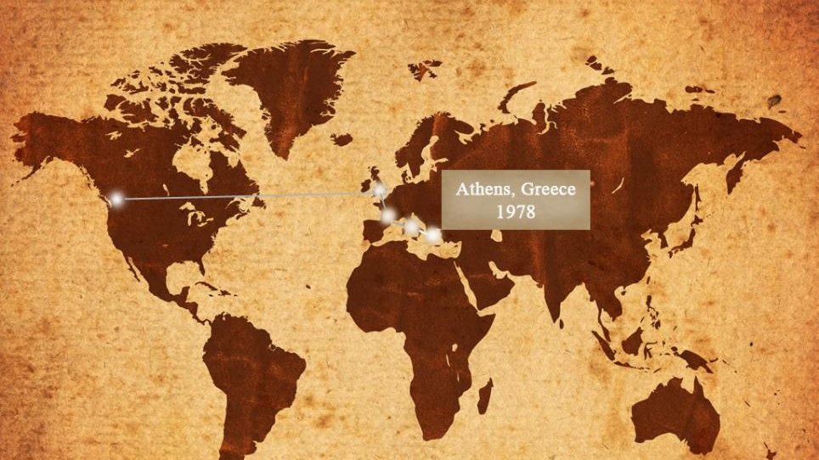

Slide 23


Slide 24
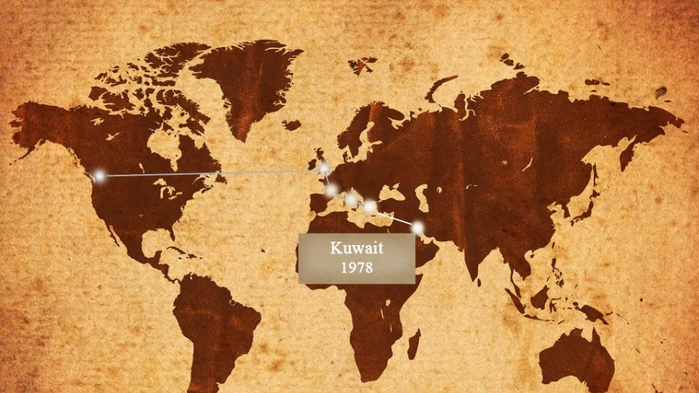

Slide 25


Slide 26
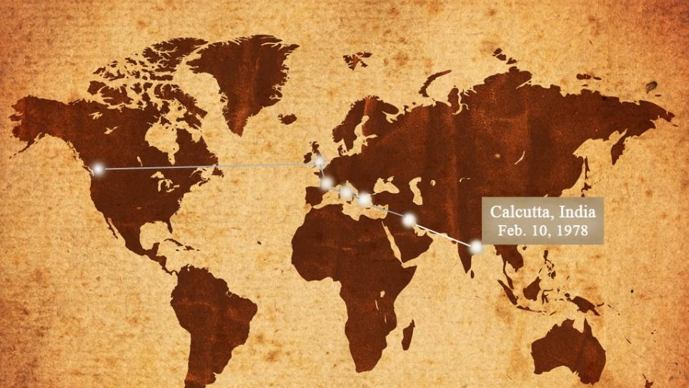

Slide 27
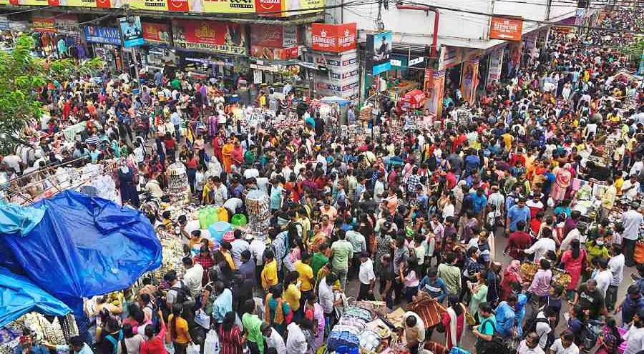
Calcutta, India

Slide 28
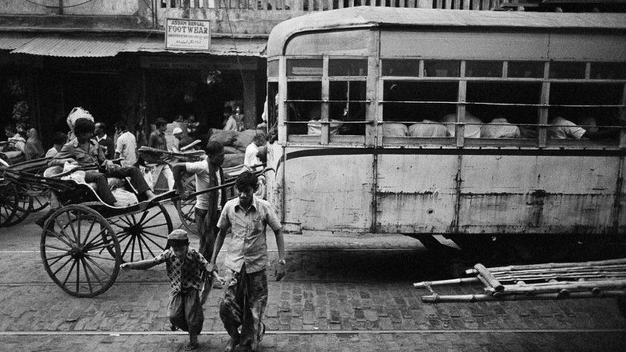

Slide 29
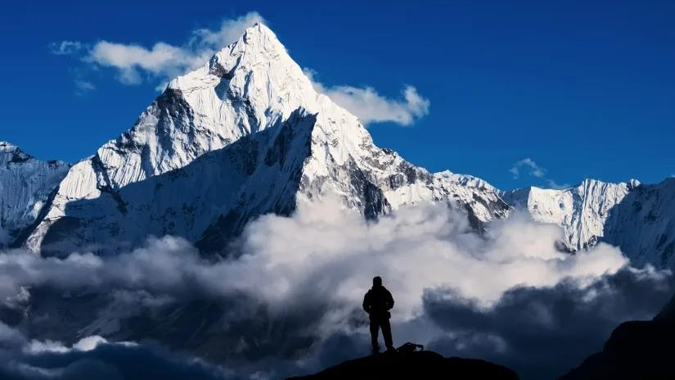
Mt. Everest

Slide 30
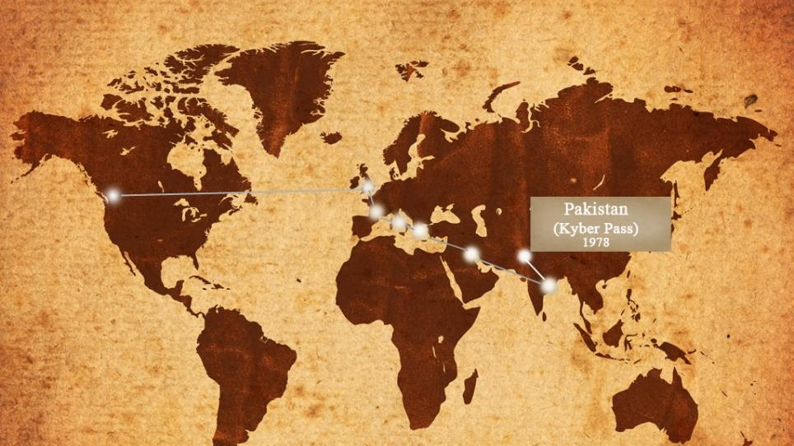

Slide 31
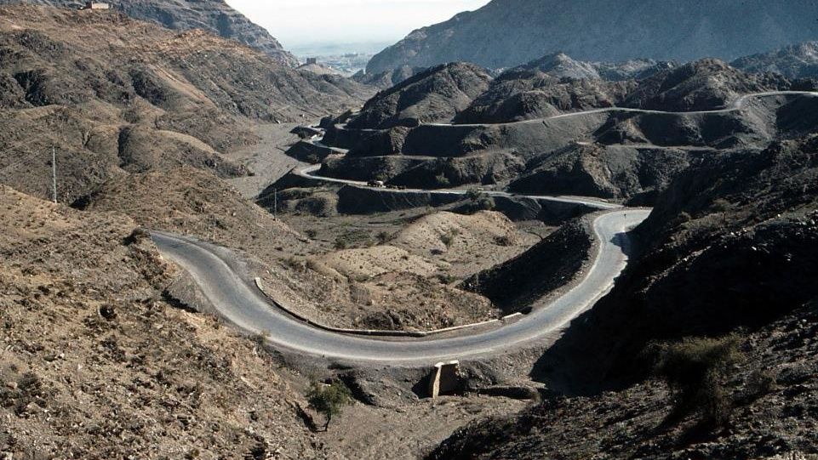
Khyber Pass 1978

Slide 32
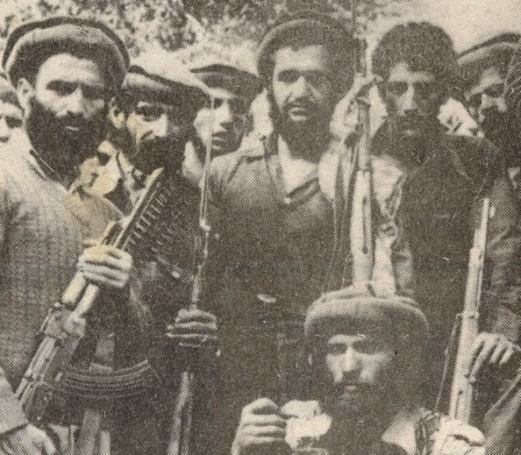
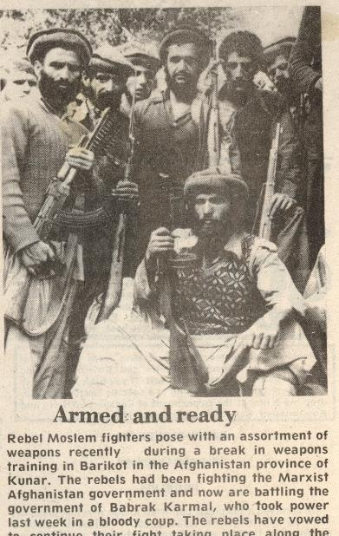

Slide 33
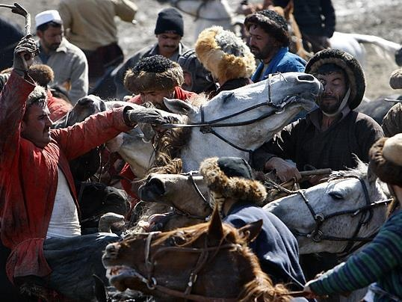
Bushkazzi, Afghanistan

Slide 34

The Desert of Shadows
Iran

Slide 35
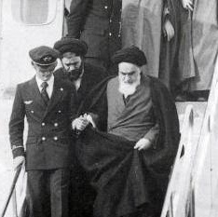
The Return of Ayatollah Khomeini from France

Slide 36
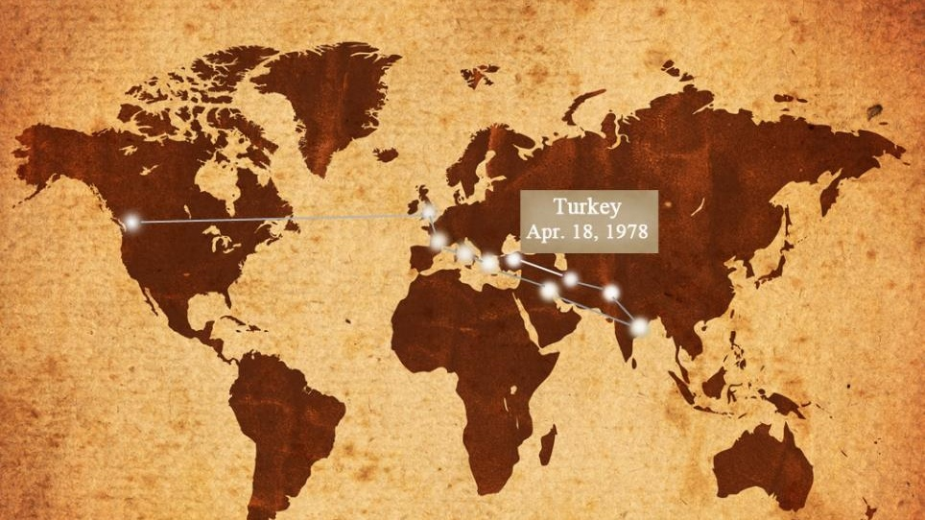

Slide 38
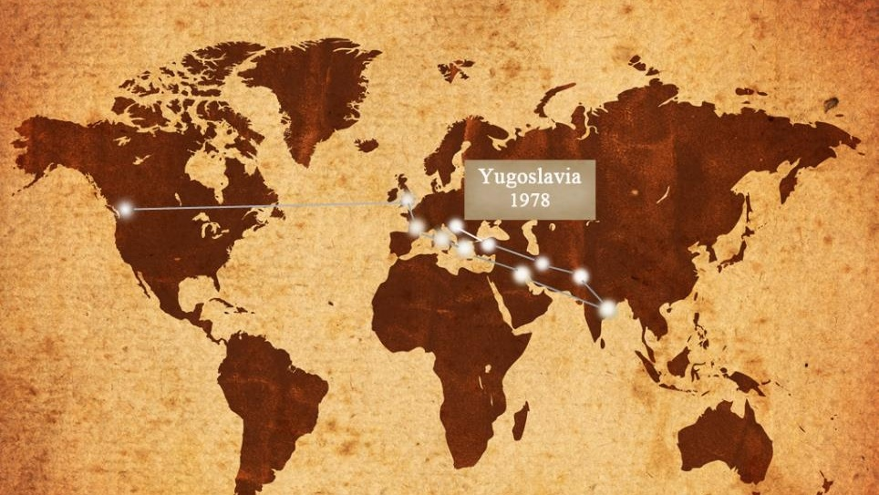

Slide 39
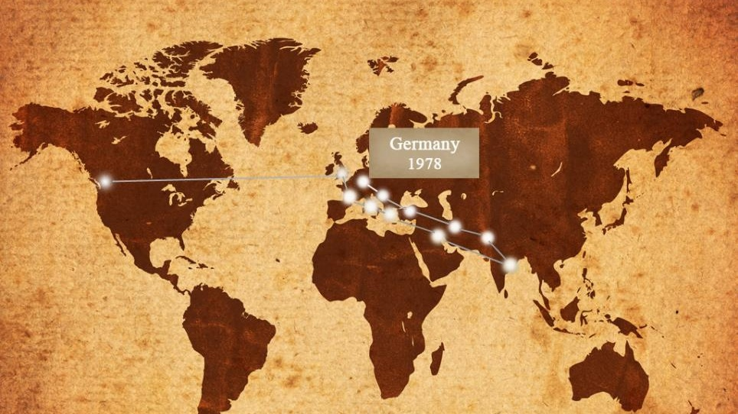

Slide 40
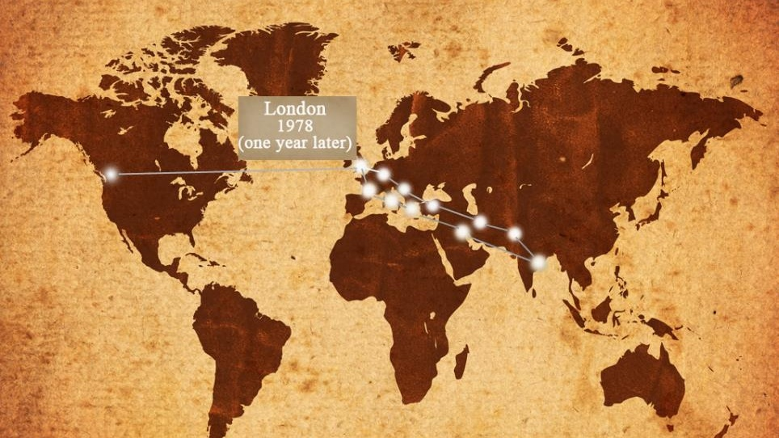

Slide 41
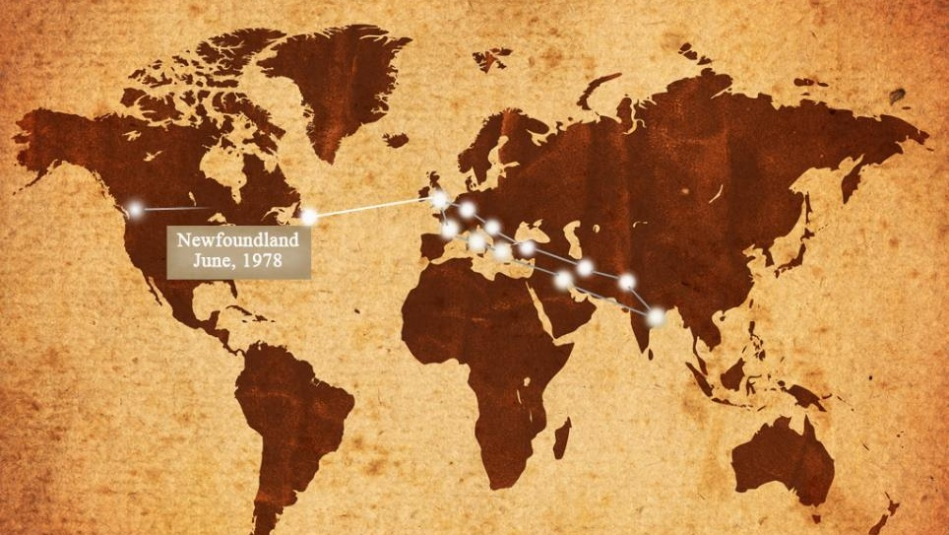

Slide 42
ROMANS 5:8
But God commendeth
his love toward
us, in that, while we were yet sinners,
Christ died for us.

Slide 43
AS.THE.EAGLE.STIRRETH.UP.HER.NEST
26 It's a pitiful sight, to see human being helpless, bound by sin… flopping around from beer parlor to beer parlor, place to place, from amusement to amusement, trying to find satisfaction, when God alone has the satisfaction that can satisfy them.
God made a man to thirst after Him. The reason man has something in him to thirst, God put that thirst in you. But you can't satisfy it with the things of the world. You'll never be satisfied till God takes that place.
59-0815

Slide 44
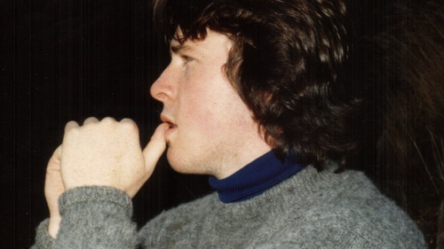
1979

Slide 45
RESTORATION.OF.THE.BRIDE.TREE
76 I'm just doing the best I can, going to this corner, sowing seeds; over here, sow a few seeds; over here, throw, sow a few seeds.
I know, the fowls of the air gather many of them up; some of them chokes, so forth.
But there might be a few, in there, come up on good ground. So let's just sow the seed, is the main thing.
62-0422

Slide 46
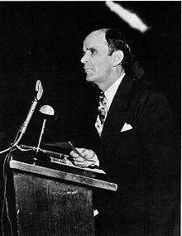
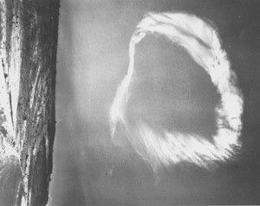
A Prophet to Our Generation
Behold, I will send you Elijah the prophet before the coming of the great and dreadful day of the LORD: 6 And he shall turn the heart of the fathers to the children, and the heart of the children to their fathers, lest I come and smite the earth with a curse. MALACHI 4:5-6
For more information please write to:
Grand Falls, Newfoundland

Slide 47
SATAN'S.EDEN
20 Also, It said, that, "Because you are lukewarm, neither hot or cold," the emotions of the outside, the mental conception of the Gospel; "because," He said, "you're that way, I'll spue you out of My mouth." In other words, it made Him sick to see the church in that condition.
65-0829

Slide 48
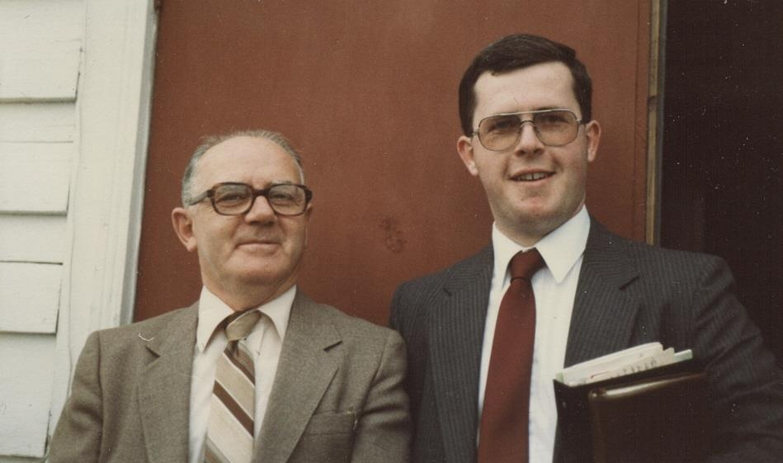
1981
Text goes here.

Slide 49
IT.IS.I
14 …I'd say, "I'd like to have a testimony of somebody who was saved by His grace.“ Everybody wants to say what they know about Him, if you've ever knowed Him. Oh, there's something about it that you want to tell everybody, because you know what you're talking about… it's something when you have received Christ as your Saviour, and the Holy Spirit's come into your life, you know something happened, for you was there, and it was you that it happened to…They could not explain it away, because that you know.
60-1124

Slide 50
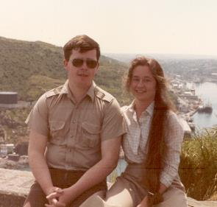

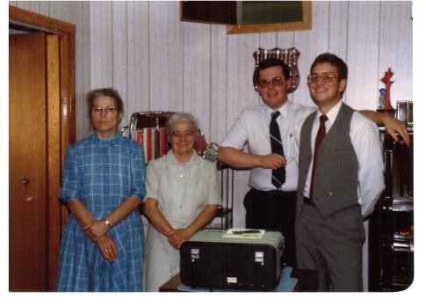
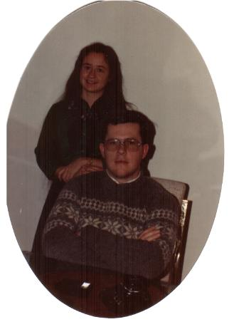
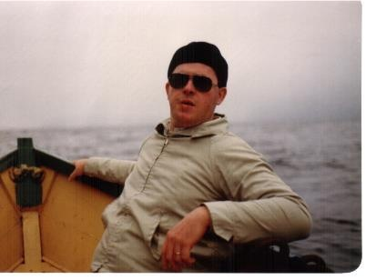

Slide 51

And a real Seed of God is absorbent for the Spirit. All denominationalism is took out. All unbelief. And when the Holy Spirit comes into that Germ of Life that's laying there, It produces another Seed, just exactly. Another son of God is born. Amen.
62-0318 THE.SPOKEN.WORD.IS.THE.ORIGINAL.SEED

